Slide 1
Unit V
CLUTCHES
Prepared by
VEERAPANDIAN.K
AP/MECH

Slide 2
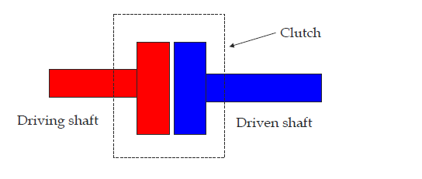
A Clutch is a machine member used to connect the driving shaft to a driven shaft, so that the driven shaft may be started or stopped without stopping the driving shaft. A clutch thus provides an interruptible connection between two rotating shafts.
A popularly known application of clutch is in automotive vehicles where it is used to connect the engine and the gear box.

Slide 3
Functions of the clutch
To connect and disconnect the shafts
To start or stop a machine (or a rotating element) without starting and stopping the prime mover.
To maintain constant speed, torque and power.
To reduce shocks transmitted between machine shafts.
For automatic disconnect, quick start and stop, gradual starts, and non-reversing and over running functions.

Slide 4
Principles of operation of clucth
When two friction surfaces are brought in connect with each other and pressed, they are united due to the friction between them.
The friction between the two surfaces depends upon the area of the surfaces, pressure applied upon them and coefficient of friction of the surface materials.
The two surfaces can be separated and brought into contact when required. One surface is considered as driving member and the other as driven member.
The driving member is kept rotating. When the driven member is brought in contact to the driving member, It is also starts rotating.

Slide 5
Required qualities of a good friction material
A high and uniform coefficient of friction.
The ability to withstand high temperatures, together with good heat conductivity.
Good resilience.
High resistance to wear, scoring.
Resistance against environmental conditions, such as moisture, salt water or fungi.
Adequate mechanical and thermal strengths.

Slide 6
Commonly used Friction Materials
Wood
Cork
Leather
Asbestos based friction materials – asbestos fibres, woven around brass, copper or zinc wires. Moulded or composite type.
Powdered ( or sintered) metal friction materials

Slide 7
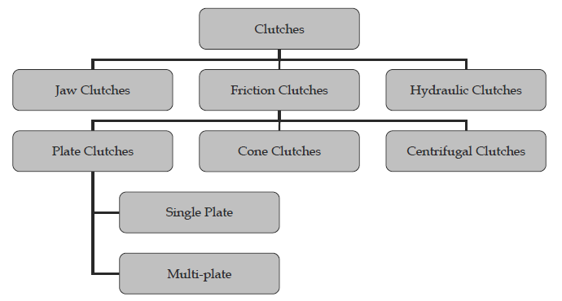
Classification of clutches

Slide 8
Friction Clutches
The friction clutches work on the fact that friction is caused when two rotating discs come into contact with each other

Slide 9
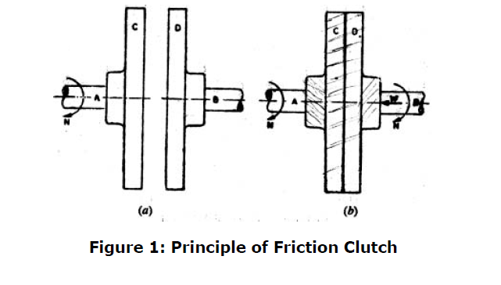
Principle of Friction Clutches

Slide 10
Let the shaft A and Disc C be revolving at some speed say N rpm. Shaft B and disc D keyed to it are stationary, initially when the clutch is not engaged.
Now apply some axial force W to disc D , so that it comes in contact with Disc C.
As soon as the contact is made the force of friction between C and D will come into play and consequently the disc D will also start revolving
The speed of D depends upon friction force present, which in turn is proportional to the force W applied.
If W is increased gradually , the speed of D will be increased correspondingly till the stage comes when speed of D becomes equal to speed of C. Then clutch is said to be fully engaged.

Slide 11
Continue…
Let
W = axial load applied.
= coefficient of friction
R = effective mean radius of friction surface.
Then ,
T = W R

Slide 12
DRY FRICTION CLUTCHES
Types:
Single Plate clutch
Multi plate clutch
Cone clutch
Semi-centrifugal clutch
Centrifugal clutch

Slide 13
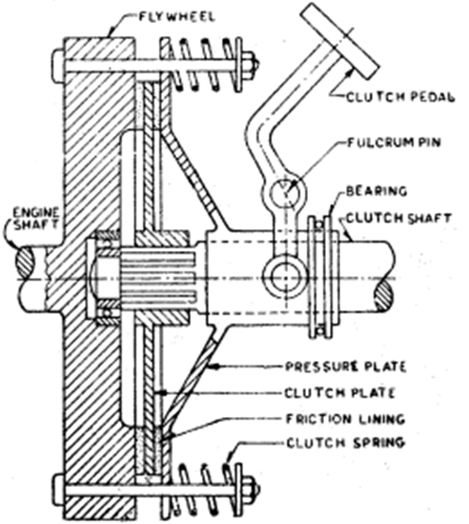
SINGLE PLATE CLUTCH

Slide 14
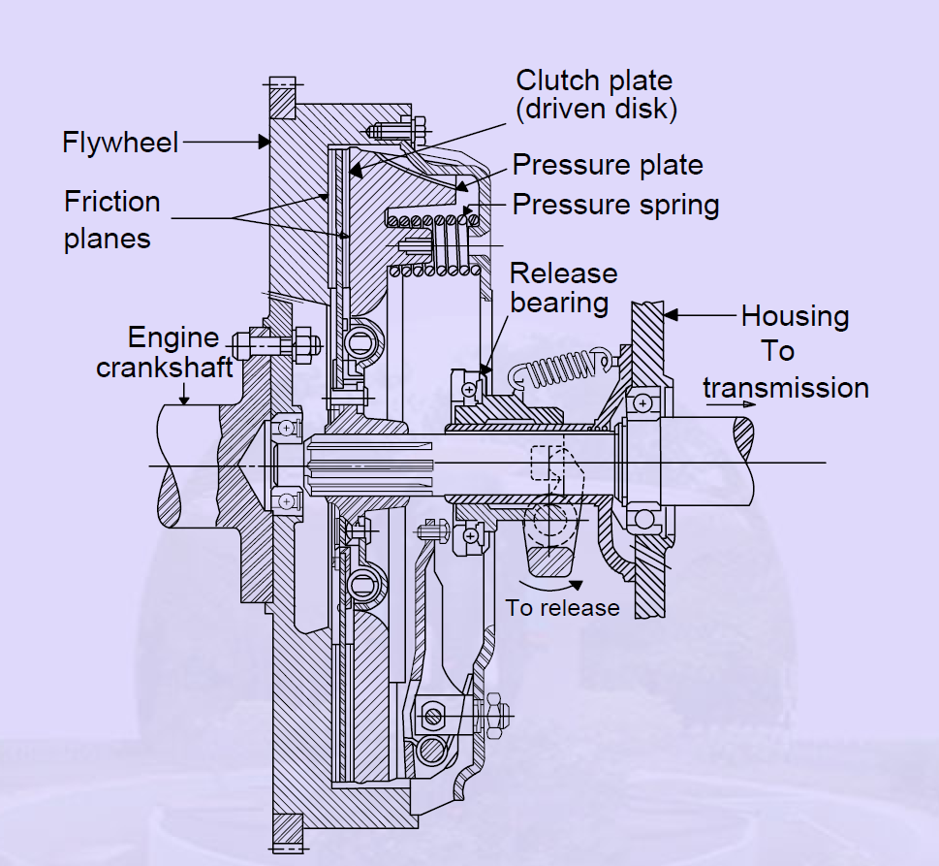
Single Plate clutch

Slide 15
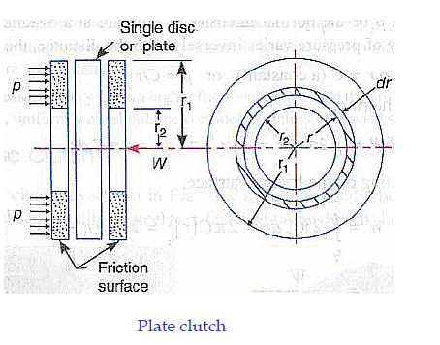
Design details of Single Plate Clutch

Slide 16
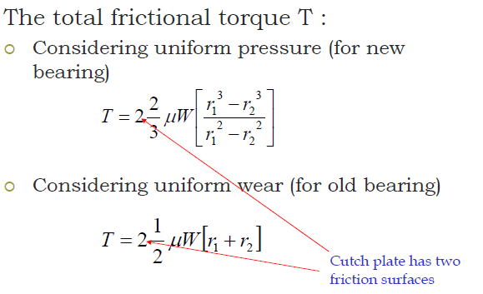

Slide 17
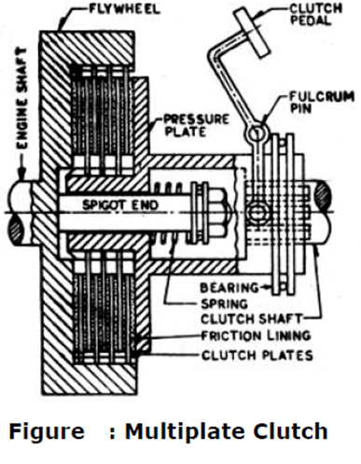
Multiplate Clutch

Slide 18
Multiple plate clutch
Pressure plates
1
2
3
4
5
6
driver
driven
Friction plates

Slide 19
Multiplate Clutch
The multiplate clutch is an extension of single plate type where the number of frictional and metal plates is increased.
Increase in number of friction surfaces obviously increases capacity of the clutch to transmit torque.
Alternatively, the overall diameter of the clutch is reduced for the same torque transmission as a single plate clutch
This type of clutch is therefore used in some heavy transport vehicles and racing cars where high torque is to be transmitted.
This finds application in case of scooters and motorcycles, where the space available is limited

Slide 20
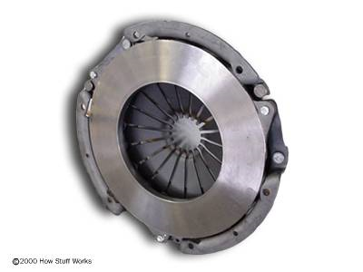
When your foot is off the pedal, the springs push the pressure plate against the clutch disc, which in turn presses against the flywheel. This locks the engine to the transmission input shaft, causing them to spin at the same speed.
The amount of force the clutch can hold depends on the friction between the clutch plate and the flywheel, and how much force the spring puts on the pressure plate

Slide 21
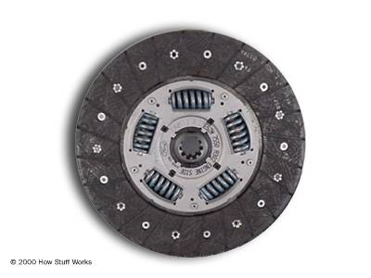
When the clutch pedal is pressed, piston pushes on the release fork, which presses the throw-out bearing against the middle of the diaphragm spring. As the middle of the diaphragm spring is pushed in, a series of pins near the outside of the spring causes the spring to pull the pressure plate away from the clutch disc This releases the clutch from the spinning engine.

Slide 22
Working of Single plate clutch
Basically, the clutch needs three parts. These are the engine flywheel, a friction disc called the clutch plate and a pressure plate.
There are springs which provide axial force to keep the clutch in engaged position.
When the engine is running and the flywheel is rotating, the pressure plate also rotates as the pressure plate is attached to the flywheel. The friction disc is located between the two .
When the driver has pushed down the clutch pedal the clutch is released. This action forces the pressure plate to move away from the friction disc against the force of springs.
With this movement of pressure plate , the friction plate is released and the clutch is disengaged.

Slide 23
Advantages
With single plate clutch , gear changing is easier than with the cone clutch , because the pedal movement is less in this case.
More reliable ( As it does not suffer from disadvantage of cone clutch , i.e. binding of cones)

Slide 24
Disadvantages
As compared to cone clutch , springs have to be more stiff and this means greater force required to be applied by driver while disengaging.

Slide 25
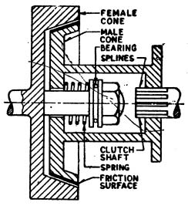
Cone Clutch

Slide 26
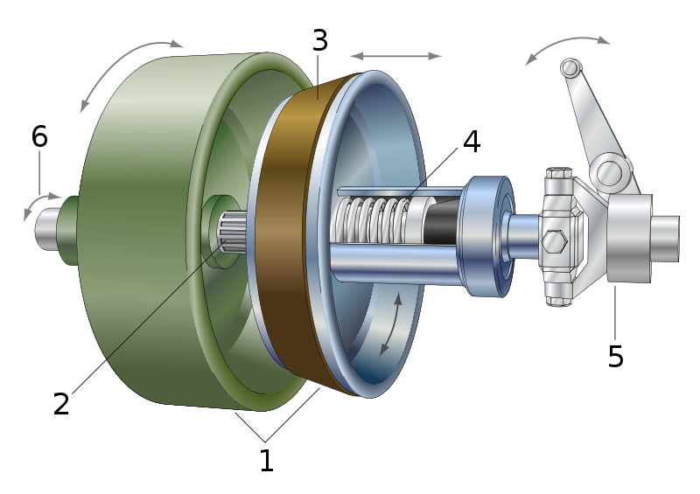
Cone Clutch

Slide 27
Cones: female= green, male= blue
Shaft: male cone is sliding on splines
Friction material
Spring: brings the male cone back after using the clutch control
Clutch control: separating both cones by pressing
Rotating direction: both direction of the axis are possible

Slide 28
In the engaged position the friction surface are in complete contact. This is done by means of spring which keep the male cone pressed all the time.
When the clutch is engaged the torque is transmitted from engine via the flywheel and the male cone to splined gear box shaft.
For disengaging the clutch , the male cone is pulled out by means of lever system operated through clutch pedal thereby separating the contact surfaces.

Slide 29
Cone-clutch
α = semi-apex angle of the cone
α
w
Driven shaft
Driving shaft
Friction lining

Slide 30
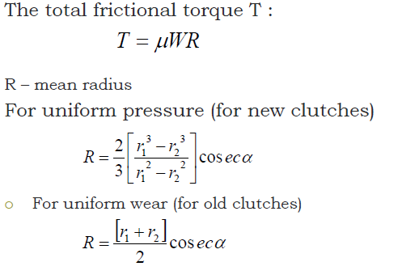

Slide 31
Advantage
The advantage of cone clutch is that the normal force acting on contact surface in this case is larger than axial force( as compared to single plate clutch in which the normal force acting on contact surfaces is equal to the axial force)

Slide 32
Disadvantages
This type of clutch is practically obsolete because of following reasons:
1) If the angle of cone is made less than about 20 degree, it will be difficult to disengage the clutch.
2) A small amount of wear on the cone surface results in considerable amount of axial movement of the male cone for which it will be difficult to allow.

Slide 33
Centrifugal clutch
In fully centrifugal type clutches ,the springs are eliminated altogether and only centrifugal force is used to apply the required pressure for keeping the clutch in engaged position

Slide 34
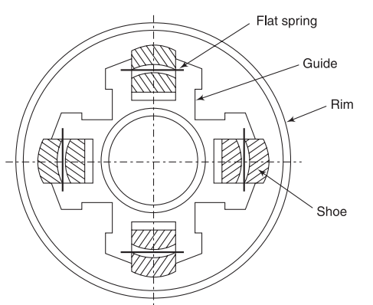

Slide 35
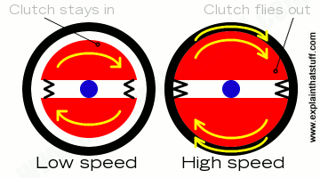

Slide 36
Advantages of centrifugal clutches
No separate clutch plate is required
Clutch is operated automatically depending upon engine speed

Slide 37
DESIGN OF A CENTRIFUGAL CLUTCH
MASS OF THE SHOES:
n= _{Number} of shoes
m= Mass of each shoe
R= Inside radius of the pulley rim
r= Distance of entre of gravity of the shoes from the centre of the spider
N= Running speed of the pulley
ω= Angular speed of the pulley = 2πN/ 60
ω₁= Angular speed at which the engagement begins to take place
μ= Coefficient of friction between the shoe and rim.

Slide 38
Contd…
Centrifugal force acting on each shoe, Fc = mω²r
Spring force exerted by each spring on the shoe, Fs = mω₁²r
Net outward force on the shoe = Fc-Fs= mω²r-mω₁²r
Frictional force acting on each shoe, F=μ(Fc-Fs)
Frictional torque acting on each shoe,Tr=F×R
= μ(Fc-Fs)
Frictional torque acting on each shoe, Tr = F×R
= μ(Fc-Fs)R
Total frictional torque transmitted T= n×μ(Fc-Fs)R = n.F.R

Slide 39
Contd…
Size of the shoes:
l= Contact length of the shoes
b= Width of the shoes
R= Contact radius of the shoes
θ= Angle subtended by the shoes at the centre of the spider,
p= Intensity of pressure exerted on the shoe
l=R.θ
Area of contact of the shoe A= l.b
Net force acting on the shoe = Fc-Fs =A×p = l.b.p

Slide 40
END

