Slide 1
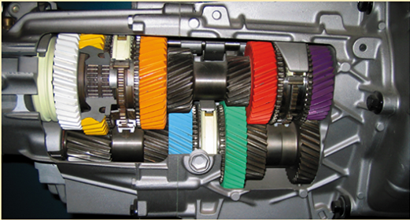
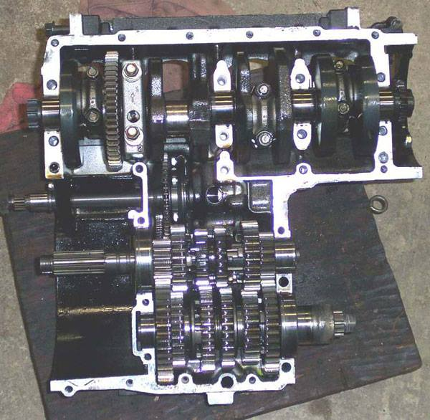
UNIT – IV GEAR BOX
Prepared by
VEERAPANDIAN.K
AP/MECH

Slide 2
INTRODUCTION
A transmission or gearbox provides speed and torque conversions from a rotating power source to another device using gear ratios.
gearboxes are used to reduce the load on the motor.
This reduces wear on the engine, allows more control, and allows greater speeds.

Slide 3
TYPES OF GEAR BOX
MANUAL TRANSMISSION
1. SLIDING MESH GEARBOX
2. CONSTANT MESH GEARBOX
3. SYNCHROMESH GEARBOX

Slide 4
EPICYCLIC GEARBOX
AUTOMATIC GEARBOX
1. HYDROMATIC GEARBOX
2. TORQUE CONVERTER GEARBOX

Slide 5
SLIDING MESH GEARBOX
Among the manual gear transmission, this sliding mesh type is simplest in construction.

Slide 6
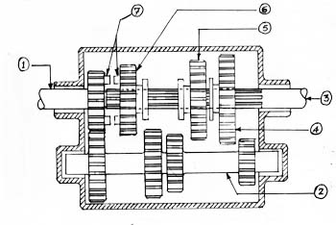

Slide 7
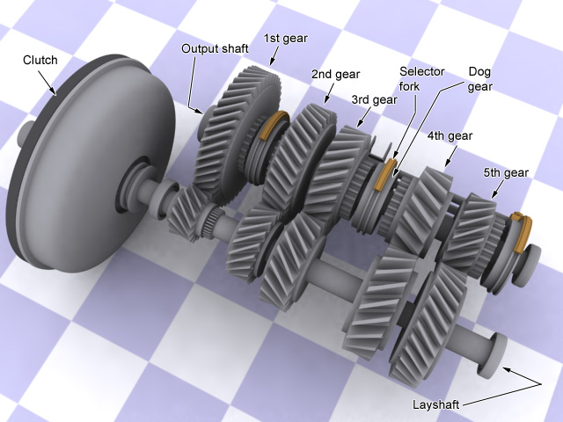
CONSTANT MESH GEARBOX

Slide 8
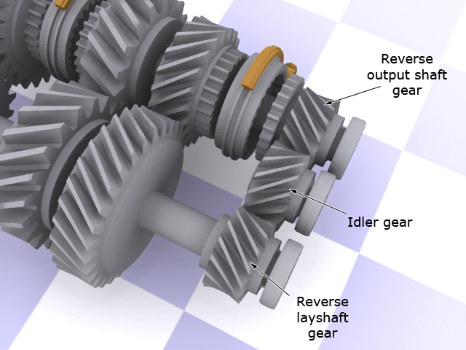

Slide 9
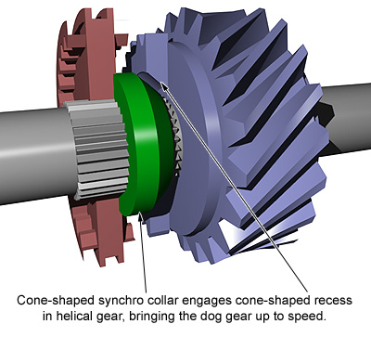
SYNCHROMESH GEARBOX

Slide 10
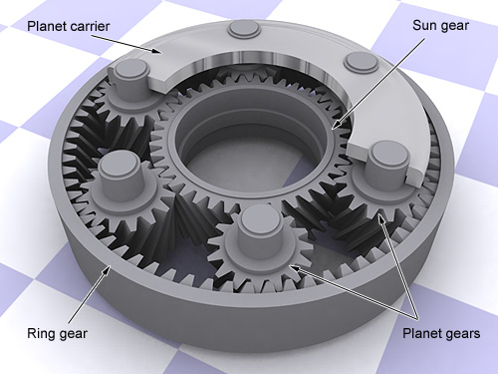
EPICYCLIC GEARS

Slide 11
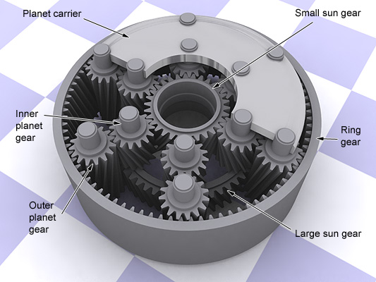

Slide 12
Requirements of a speed gear boxes
It should provide the designed series of spindle speeds
It should transmit the required amount of power to the spindle
It should provide smooth silent operation of the transmission
It should have simple construction
Mechanism of speed gear boxes should be easily accessible so that it is easier to carry out preventive maintenance

Slide 13
The speeds in machine tool gear boxes are in geometric progression
The speeds in gear boxes can be arranged in arithmetic progression (A.P.), geometric progression (G.P.), harmonic progression (H.P), and logarithmic progression (L.P.)

Slide 14
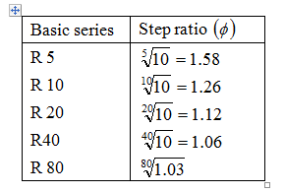
Preferred Numbers
Preferred numbers are the conventionally rounded off values derived from geometric series. There are five basic series, denoted as R 5, R 10, R 20, R 40 and R 80 series. Each series has its own step ratio i.e., series factor. The series factor for various series are given in table.
The series of preferred numbers is obtained by multiplying a step ratio with the first number to get the second number. The third number is obtained by multiplying a step ratio with the second number. Similarly the procedure is continued until the series is completed.

Slide 15
THANK YOU

