Slide 1

ME8793
PROCESS PLANNING AND COST ESTIMATION
UNIT IV - PRODUCTION COST ESTIMATION

Slide 2
UNIT IV
PRODUCTION COST ESTIMATION
Estimation of different types of jobs Estimation of forging shop
Estimation of welding shop
Estimation of foundry shop

Slide 3
Hand or Smith Forging
Drop Forging
Press Forging
Machine or Upset Forging

Slide 4

The iiietal is heated in a smithy and forged using
forging tools manually or using hand
It is used to produce small number of light foi’giHgs
It involves a lot of skill on the part of the operator and also is more tiiiie consuming

Slide 5

It utilizes a closed impression die to obtain the desired
shape of the component
The shaping is done by the repeated hammering given to the material in the die cavity
The equipment used for delivering the blows are called drop hammers
The drop forging die consists of two halves. The lower half of the die is fixed to the anvil of the machine, while the upper half is fixed to the ram. The heated stock is kept in the lower die while the ram delivers four to five blows on the metal.
crarik, crank shafi, connecting rod, wrench, crane hook, erc.

Slide 6

Press torgilig is similar to drop forging as also the forging dies.
The metal is shaped not by means of n sei'ies of blows as in drop forging, but by means of a single continuous squeezing action.
This squeezing is obtained by means of hydraulic prcsses.
This method is used for producing very heavy forgings.

Slide 7

Press forging where the iiiaterial is drawn out, in machine forging, the inatei'ial is only upset to get the desired shape.
The heated bar stock is held between two dies and the rOtruding end is hammered using another die
The cross section of the metal is increased with a
corresponding reduction in its length
This method is used for making geai blanks, shafts, axles and similar parts

Slide 8

Upsetting
Drawing Down (Fullcring)
Sctting Down
Bending
Punching
Drifting
Swaying

Slide 9
This is the process of increasing the thickness or the cross-sectiOnal area of the work piece by reducing its length.
Force is applied in a direction parallel to the length
axis
This is the process of inci'easiiig the length of the bar
and reducing its thickness or width
Force is applied ili a direction perpendicular to the
length axis

Slide 10

This operation can be pei formed with a haiiiiiier and
a flatter
This method is used for smoothing off a square or
rectangulai’ auicle
Metal rod or pipe can be bent to fOrln various shapes
without damaging its internal gain structure.
Bent shapes such as angles, ovals, circles. etc..

Slide 11


This is the process of producing holes in a WOfk
After a hole is punched, it iiiay be opened out to any size and shape by di‘iviiig a tapered drift thi'ough it.
This is the process of removing the irregularities on the sui face of the work piece produced by the process of drawing down

Slide 12

Shear Loss
Tonghold Loss
Scale Loss
Flash Loss
Sprite Loss

Slide 13
Shear I-oss
Shear loss is generally taken as 5% of the net weight.
Tonghold loss
Area of
Cross — secfion X
of bar
Length o tonghold
Tonghold loss =
Scale Loss
Generally scale loss is taken as 6% of the net weight.

Slide 14
_{Flash loss =} )Volumeof) (Density of the)
flash ? material
where
Circumference
of component x at parting time ^{I}
(Cross — sectional]
Volume of loss
area of flash ?
^{Cross — sectionalJ} = Flash thickness x Flash width
area of flash
Flash is generally taken as 20 min wide and 3 mm thick.
{›i”tic Lust
The spi uc loss is gcncrally taken as 7% of the net weight.

Slide 15



The cost of a forged component consists of
Material cost
Labour cost
Overhead cost
Total forging
COSt
Material
COSt
Overhead
COSt

Slide 16

(i) Calculation of Material Cost
Step 1: To rnfrufafr the net weight of forging .
Density o
X material used
olume o forging
Net weight —
Step 2 : To celculete the gross weight:
Material loss in the process
Gross weight = (Net weight} -F
In case of smith or hand forging, only scale loss and shear loss are to be added to net weight. But in case of die forging, all the losses are taken Tito account and added to net weight.

Slide 17
Step 3 : To find material cost.•
Material cost = {Gross weight) ^{Price of raw}
* material per kg
Step 4 : To select the diameter and fength ofstoch .
The diameter of the greatest section of the forging gives the diameter of the stock to be used
The length of the stock to be used is given by
Gross weight
Length of stock =
(Density oJg Cross — sectinnal)
material I area nf stock ?

Slide 18
Labour rate
(ii) Calculation of Labour Cost
Forging time per piece in hours
Labour cost =
x per hour in
rupees
Estimation of t'orging time
Though the estimation of forging time is very difficult, the past experiences have given us the approximate time required as shown in Table

Slide 19
"Time required for heating the job
Tiiae f‘e¢ uired f'or’ heating the j0b
^*
Klediu‹a C. High C. y
Upto t min. Upto t min
t to I.s min. i to 2 min.
I.5 to J min. 2 to 3min.
Tool or H.S.
M.S. or W.I.
y
30 soc
Upto I.S m›n
son
I.s ‹o 2.s min
200to400grn
2.5 min.
2to 3.ñ min.
3 to 3.S min.
3 to 4 min.
S to 4.1 min

Slide 20

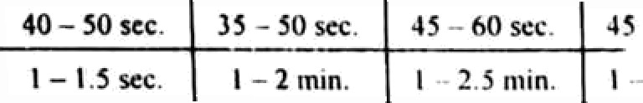
Time required for performing operations
 | Tlme required for p<rformicg operations
Upto 2 | Upto 20 sec. t Upio 25 scv. t Upto 30 sec. \!pto 32 c .
2 — 4 | 20 - 30 sec. 36 — 35 sec. 3S - 40 sec. 3S - 40 cc.
4— B 8 - l6 | 2.5 ruin
I6 — 32 | 3 — 6 min. J.S - 6 min. 4 — 7 min. } - 7 min.

Slide 21
(iii) Calculation of Overheads Cost
The overheads includes supervisory charges, depreciation of plant and machinery, consumables, power and lighting charges, office expenses, etc.
The overheads are generally expressed as percentage of the labour cost.

Slide 22
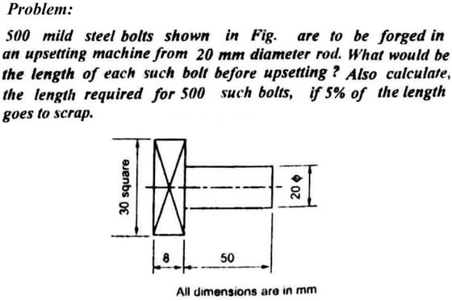

Slide 23
yafiad.• (ii I ength of each bolt before upsetting ; anJ liii I.vi›gth required for 500 such holts.
Volumeof square
\›olt head
VolumC OF
holt shaftk
Volume of ihe bolt
( 0 3 •#)(:i0 i0 2207.96mm'
Area o£cross-section oftke stock bar
i.cnth of tscb
th before upsetting
tz0£
3 I4. Ia min
4
2 79
314.16
72.92 mm

Slide 24



Length for 500 boils
Scrap
72.92 • JMS
5¥» of the leftglh
Net length required

Slide 25
Problem.•
Df bars required if mild steel bnzs un uv‹iilable in 4 m lengfh and 25 mcl diameter. date the denstt:f ofmild x/r•'f bar 7,6 gMcc. Consider all the pnmisfe/orgiag lossys.

Slide 26
iwn Dota :
n = 750
L — 4 m
D = 2§ mm
p= 7.6 x IN
kg/r«»i3
To fled: 1. Net weight and gross weight of 750 siepyd spindles, nnd
2. Number of bars required.
!. New irelghl ond gross weight required :
Net volume = Volume of(A + B + C + Dj
4
(42a 15 + (30a 30 + (25a 35
+ 4 ( IfiJ 70
4
= 73242.3 l mm*

Slide 27
Net volume x Den3¡ty
Nci iYeight / piece
73242.31 x 7.6 x l Q—4 = 0.5566 kg
0.5566 x 750 417.48 kg
Ncl weight of 710 spindlcs
^{In ord r Io calculae} the a oss weigh!/ piece, _{nm} inlo accc›unt the following lusses :
have ‹» take
100
0.5566
0.02783 kg or
6
100
0.5566
0.03339 kg or 33.3s ps

Slide 28
TaLing flash _{wid‹h -}
(i ii› Film.•h /f7,t.t :
20 mm and flashthi‹uess = j mm
Where
VUlume of flash =
Circumtcmnce of
CCimponent
at parking linc
( Fiash width x Flash thiclcnoss t
= [ 2 (IS * 30 * 35 + 70) + 16 * (25 — 16) +
^{(30 —} 25) + (42- 30) + 42 ] x [ 20 x 3 ]
* 27800 nim
Flash loss = ?.?.g00 x 7.6
10 = 0.) 733 kg or l73.3 g›‹i

Slide 29


Taking 20 o›m exos length req\jizsd to be held in long
Anna of
loss-section x
0#
^{Of}gh}old loss
0fth0
tonghold
x Density
= 4 (25/ x 2O x 7.6 z 1
= 0.0746 kg = 74.6 gms
(v) 6proz fun
7% of nei weight
⁷ x 0.556d
.tl3896 kg = 38.96 gms
l00

Slide 30
4’olal material
loss
27.83 + 33.39 + 1 73.3 * 74.6 * 18.96
- 348.08 gm ter 0.348 kg
= Nel weighi + Total material loss
= 0.5566 + 0.348 = 0.9046 kg
= 0.904d x 710 678.45 kg
Gross weight
Gross weight of 750 spindles

Slide 31

Gross volume of 750 spindles
2. Number of bars required :
Gross w‹•1ght Density
678.41
7.I› • lU^
89269736.g4 mm*
Let L =
Volume nf bar
L
Length ol” ihc *'i mm $ bar required.
4 (25) t. = 490.g7 L
mn or 18 I .BAB m
1’hen,
‹Jivcn that Lent;tli of one available bar 4 in
Number of bars
4 m length
181.858
4

Slide 32
Problem.•
¡z pqu red to prcpere a herogonol bolt of IS mm dia and
y¿ zp ¿gp#tjt /
of bee stock re
u bar stock of 1.8 cm dim C’oir«fnrr the fengfA
ired•
C•ho Dofn :
heragonol Sofr die -- IN
D — I. 8 cut
the tenth o/hot stock referred
ppj?nd: (i

Slide 33

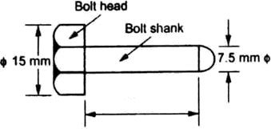

Since the dimensions or a‹ given he.xagunaI f»It is incomplete,
lel us consider the hexagonal bolt shown in Fiy.
g₅
mm
225 mm
Net volume of bolt
J Volume of
I bolt head J
Area or hexagonal head
t Volume uf t
[ ball shank )
Volume of t
hexagonal head J

Slide 34

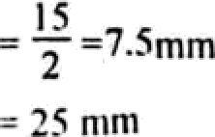
x I
"
= Hexagon side = Radius of bolt head
2
Here a
x (7.SQ x 25 ' 3,h53.5 mm3
t7.f›^ x 225 = 9,940.I V mm
Volume of bolt shank =
4
Nci volume ofa bolt = 3,6S3.ñ + 9,940.I9 — I J,593.69 mm’

Slide 35

*8!^*‹*^B the shear and scale losses,
¢iross volume of a bolt
1.crigth of’ 18 mm § bar stock
required for maktng
a hexagonal bolt
= Net volume = ]3,§93.69 mm’
I 3,593.h9
( 1C)
53.42 mm

Slide 36

Welding is the process ofjoining similar or dissimilar metals by the application of heat.
Welding can be done with or without application of pressure and with or without the addition of filler metal.
While welding. the edges of’ metal pieces are either
melted or brought tO plastic condition
The filler material has a similar composition and melting point as the base metal.

Slide 37
The tiller rod is used to make up Losses during welding, to fi11 rip any gap between the joint surfaces and to produce a fillct.
A flux is iequired in some welding processes, so as to remove the oxide layers, in the form of fusible slag which tloats on the molten metal
The fiiix also provides a shield preventing the re- formation of the oxide layer.

Slide 38

(i) Plastic or pressure welding
Ex: Spot welding, projection welding, and seam welding.
ii) Fusion or non-pressure welding.
Ex: Gas welding and electric arc welding.

Slide 39

Butt joint

Slide 40





Lap joint
(a) Single fillet lap joint
(b) Double fillet lap joint
(d) Single strap lap joint
(d) Double strap lap joint

Slide 41

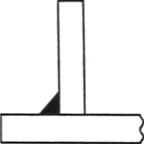
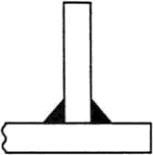
T-joint
(a) Single fillet Tee joint
(b) Double fillet Tee joint

Slide 42
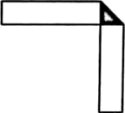
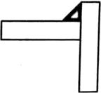

TYPES OF WELD JOI NTS
Corner joint
(b)

Slide 43
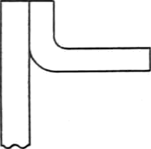

TYPES OF D E LD JOINTS
Edge joint
(a) Edge joint
(b) Flange joint

Slide 44

i. Direct material cost
Direct labour cost
Direct expenses
Overhead expenses

Slide 45
Cost of base materials to be welded
Cost of consumables such as electrodes, flux, O„ C,H₂, etc

Slide 46
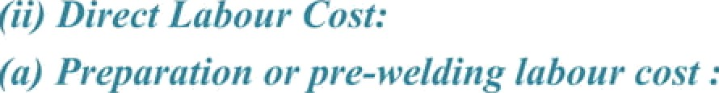
It is the cost of preparing the base material for
wclding.
lt includes the cost of edge preparation, the cost of machining of welded joints to shape. and the cost of cleaning of the foreign material front the surface be wcldcd.

Slide 47

It is the cost of lnbour in actual welding operation.
(‹) l’‹› f irrI‹Iiii ‹›i' /iiii›/iiii¿ ‹’‹›. r:
It is the cost of labour for finishing the welding joint after welding.
Post welding operations such as grinding, machining,
heat treatment. painting, etc., of welded joints.

Slide 48
It includes:
Cost of power consumcd, and
Cost of welding fixtures used.
The overheads consist of all other charges which include thc salaries of supcrvisors, indirect labour charges, depreciation of welding toOls and auxiliaries, administrative expenses, water and electricity charges, etc.

Slide 49
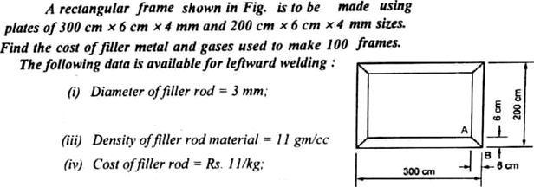
(viI (vii} fi'iiiJ (ixJ
Consumption of acetylene — iJ.2 m 8br. j el‹fin( sgeed = 4.6 m/Jir,
Cost of‹›xf pen -— Rs. I 2tm!,
€'o.st ufaceyletie -- Rs 4R/m!.
Welding 1s to bz dent on both sides of the Frome.

Slide 50

_{S}ylinian . From Fig. it is u›1dcrstood that
T'ofind : Cost of filler metal and gases used 1o make 100 framcs-
lhe rectangular
frame is
made from plates nt 300 cm x 6 cm x 4 mm (t o in i¹\tt0&+)
end *00 cm x 6 cm
4 fj\IT› (ta'o in number). The •ct‹Jin
is done
only on four ¢0m rS.
II” » c v‹›nsider one comer alone, it is clear tha\ u'eIding should be dane ‹ n four portions (i.c., top position + bottom portion + two side
pcs i‹1f ).
1 ¢ngth of weld
on one comer
Length of wrldiny on [top portion +
boxom portion * ten side portions]
₆2
I.cn¿ih of weld on top portion AB 6' 8.5 cm
Length of u'eId
I ¢I1 ih ‹›t"› 'eld on bottom portion =
=
8.5 cm

Slide 51
Thickness ofp)ate 4 mm = 0.4 cm
Length of weld on side ponion =
=
Lciigth of weld on one comer =
Total length of weld on all fuur comci
8.5 + 8.s + 2 0.4
= • 17.8
= 71.2 cm = O.712 m
I*“J Tu find ‹msg offlller mrial: Length of fill¢r rod used = Volume of filler rod used
2.{ x 0.7 12 = 1.495 in
(j I -J)° x t.Egg
 | = | i.057 x 10 * m3
weight of filler rod used | = | ().057 x 10-”) x (I I x 10³) 0.116 kg

Slide 52
Cosi of filler n›d used = 0.116 x I I - Ri.
1.28
(ii) To fiod Noel of gens used •
Time taken for wel'diR L 'h
1’'ve!d
Welding speed
₄!₆ x 0.712 = 0.155 hr.
Volume of 0₂ consumed " Cost of 0 consumed Volume ofC₂H consumed
= 0.2 x 0. I S5
= 0.03 I • I *
= 0.2 • 0. \55
= 0.03 I ni'
= Rs. 0.37°
0.03 I ni'
”. Cost ofC₂H consumed = Cosí of gases uscd =
0.03 I • 48 = Rs. ).49
0.372 + 1.49 = Rs. i.862

Slide 53
Cost of filler metøl
Total material cost =
+ Cost of gases used
= I.28 + ł.86ż = Rs. J. 142
Material cost to
make 100 frames
= 3.142 x 100
W 314.2

Slide 54
ELECTRIC ARC WELDING
Electric arc welding is defined as the process of joining two metal parts by melting their edges by an electric arc using filler rod without application of pressure. It is a type of fusion welding.

Slide 55
Principle of the process
Heat required for welding is obtained from the arc struck between a coated electrode and the workpiece.
When current is passed, an electric arc is produced between the electrode and the workpiece.
The arc temperature and the arc heat can be increased or decreased by employing higher or lower arc currents.

Slide 56
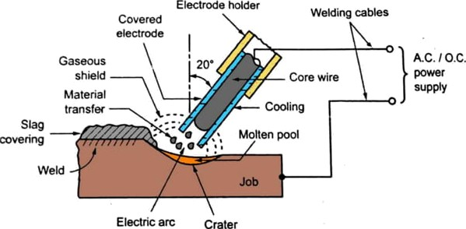
ELECTRIC ARC WELDING

Slide 57

WELDING COST
ESTIMATION OF ELECTRIC ARC
Cost of
Dircct material cost =
base + Cost of electrode
materials
Prepai ation
Post welding or finishing
COSt
Dir ect
laborit = cost
I
Welding cost
pre — welding labout cost

Slide 58

Cost of power
Power cost = ^{y x A}
V = Voltage in volts
t 1 1
A — Currcnt in amperes
T = Welding time in minutes
p = Efficiency of the welding machine
= 0.6 for welding transformer (or) 0.25 for welding generator,
r - Ratio pf operating time to connecting time taken by the
operator
C = Rate of electricity per kWhr in rupees
Overhead expenses

Slide 59


(¡g) Jprrent used ——250 amperes; (v Welding speed —— IO mnri
(via Elecvode used ——0. JS kg/m of iveIJing,- (via Labour rate ——Rs. 40 per how r,-
(uii Po»'er wait —— 8 per LWhr;
Electrode rate —‘ Rs. @ per hy,-
fxi,i Connecting ratio ——0.S;
@WPhead chafes = d0% ofdire‹'i charges.

Slide 60
Tofi‹od: Arc welding cost for making a lap joint.
(i} to find electrode cost:
Cost of electrodes per
metre of weld
Electrode used per metre
Electrode
rate
=
(ii) To find labour cost:
Time required for welding 1 m lengih
0.35 « S5 = Rs. I 9.25
I Welding speed
=
0.1 hr = 6 min

Slide 61



(iii) To find power cosr:
V • A | i | I | I
1000 • | 60
30 250 | @ | 1 | 1
1000 | 60 | 0.6 | 0.5
Power cost =
x 8 = Rs. 20
(yv} To /iii rf ‹i i‘‹'r/i‹'fi‹/x.’
Total direct cost per t metre of wcld J
cctrodc cosi
Labour
GOS1
Power cost
= 19.25 + 4 + 20 - Rs. 43.25
= 40% of direct charges
Overhead charges
40
100
43.25 Rs. 17.30

Slide 62
Totai charges for welding one
metre length of joint
Direc
+ Overheads
cost'
= 43.25 + 17.30 = Rs. 60.55
Since this is a double fillet Tap weld joinl, the welding should be done on both SideS.
’- Total welding cost = 60.55 x 2
= Rs. 121.10

Slide 63
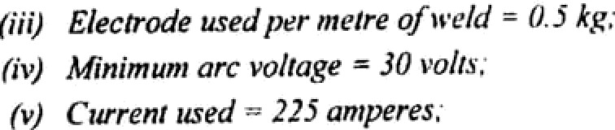
(i) /+’c/ding is done on bo(lfi xid«s.
(ii) Electrode diumeier —— S mttl.
(yf) (viii (vine (ix)
(x)
Labour charges -- . 2.50/t8 EUR ol *I'‹’lit,
Elecvode price — Rs 287kg.’ Efficiencv o)!w‹ldi'ng macliin‹• —- âll"a. fielding speeJ - 2 melres/lioiv.
p flip f pyt rating Io conned ti'ttff fflzt0 - /. I,
(xi) Power rate ——Rs, 0,60 per k trim

Slide 64


Solution .-
Arc welding cost for making a butt joini.
(ij Tv find eferirr4t• c«sf .
Cosi of elecirode @ Rs. 28fkg =
2fl x 0 J = Rs. 14
nd labuur cnsi :
Length of weld for one side
Cost of labour @ ks. 2.TO
per metre of weld
(ii) To
= 100 mm = 0. I in
= 2.50 x 0.1 = Rs. 0.*5
(iii) To fizi‹:I f:›o i•'‹’r ‹’ask .'
V x A | I | I
1000 | ” 60 * | q
/ = Welding time in minutes
0.5 hour 30 min

Slide 65

Power cosi
30 x 225 | 30 | 1 1
1000 | 60 | 0.6 ” I .5
0.60
Cost of Labour electrode ” cost +
Power charges
Total welding cost
= 14 * 0.25 + 2.25 = Rs. Id.50
Tota) cost of welding
for both sides

Slide 66
Foundry is the process of casting metals into objects of specified shapes.
The molten metals or alloys are pouied in the moulds and allowed to cool. The objcct after cooling is known as casting.
A mould is a cavity or a matrix formed in a heat resistant material, usually sand
FOundry consists of pattcrn making section, sand mixing section, core making section, mould waking section, iiielting and poui ing section, fettliiig section, heat treatment section and inspection section

Slide 67


By casting any size, shape and weight of components can be made .
Ayylications:
It is possible to cast practically any iiiaterial be it ferrous oi‘ non-ferrous
The necessary tools rcqiiired for casting moulds are very simple and inexpensive.
The dimensional accuracy and surtace finish obtained are comparatively lcss.

Slide 68
A pattcrii is a replica of the object to be made by the casting process.
Pattern Matei ials - wood, metal & plastics,
The most commonly used pattern material is wood - easy availability, low weight, easily shaped & relatively cheap.
Metal pattern —Aluminium, white metal, brass, etc., - used for large scale casting production & for closer dimensional tolerance
Plastic or Plastei’ tif Paris — low weight, easier
formability, smooth surface & durability

Slide 69

The dimensions of the patteni are different from tlic final dimensions of the castins required.
Therefoi'e the patterns are diven certain allowances for acquiring exact dimensions.
The various allowances provided to the pattern are as follows :
  Contraction or slirinkagc allowancc,
  Diafi allowance.
  Machining at lowance,
  Distortion allowance, and
  Shake allowance.

Slide 70
C.iiiiti ictitiii oi Sli i in kagc .Xllowaiicv
All inetals (except bisinuth) contrast diiriiig cooling at
different rates.
The slirinkage is volu1neti'ic which affects the
dÍfliensiOns all around the casting.

Slide 71
Hi aft A llt›waiicc
The pattern damages the vertical sides of the mould on its with-drawal.
A taper is provided to the patteni to facilitate the
withdi'awal without damaging thc vertical sides.

Slide 72
Machinilig allowance is the extra material is to be
provided Wli ÍC11 IS tO bc subscquently reiuoved by inachining Or“ cleaHing process.
This allowance depends upon ceuain factors like sliape, size, metal used for casting, method of niacliiiiing and the tiiiish reqiiired.
This allowance may rangc from 2 to 20 mm. But usually it is 2 mm.

Slide 73
The castings on cooling distort or undergo warpage,
particularly into irregular shapes
Thus the patterns are made with an opposite type of
distortion so as to obtain the correct shape on cooling

Slide 74

The pattern when pulled front the would distort the siide and shape of tlic mould even with utmost precaution.
To avoid this, the pattern are subjected to shake to create a small void between the mould and the pattern to facilitate its pulling.
To compensate this, pattcms are made slightly
siiiallei in size.
This negative allowance is known as shake allowance

Slide 75
Estini iitioii o1 Piittei n Cost
Direct material cost
Gross weight of the pattern material including
pattern allowance
Cost per unit weight
Direct material cost =
Estimated time
Direct labour cost = to manufacture
the pattern
x Labour rate
Direct
Total cost = material +
cost
Direct
labour + Overheads
cost

Slide 76

Estimation of foundry cost consists of the following elements:
Material cost,
  Direct inatei ial cost
  lndirect material cost.
Labour cost,
Diiect expenses, and
Overhead expenses.

Slide 77

Material Cost
Direi'i ilfatc•riul hrsf:
In Foundry process, the direct material cost means the cost of material required for casting.
Step 1• To t'al‹'iil)te the met weight vf the ca.sting•
From the component drawing, first calculate the volume of
material required for casting. Then,
Net weight _ of casting
Volumle of material required for casting
Density of j
material
5fey 2 . Add the weight of process scrap i.e., weight of runners, gates, risers. etc., consumed as a part of process in getting the casting . This is generally taken as 15 to 20% of the net weight of casting.

Slide 78
.Si yr 3: Add the weight of metal lost in oxidation in tiirnace and in cutting gates, spills, and ovcr arm ctc., which is nor recovei'able. This is usually taken as 8 to 10% of the net weight of casting.
.$i •/i 4: Find out the cost of material by multiplying the gross weight by cost per unii weight.
Gross weight
of casting
Cost per unit weight
cost of material
.¥r‹/i I: Subtract thc return value of scrap, if any, from the cost o1 material to get the direct iratei ial cost.
Cost of ) material
Return value of scrap
Direct material cost

Slide 79
Indircct Material Cost:
Material required in melting the metal such as coal,
limestone, other fluxes, etc.,
Material used in core shop for making the cores i.e., oils,
binders and refractories, etc.,
Generally the expenditure made on these indirect materials is expressed as per kg of casting weight and is covered in overhead costs.

Slide 80
Labour Cost
The cost of labour involved in making the cores and moulds. It is based on the time taken for making various moulds and cores.
The cost of labour involved in melting the metal, firing the furnace, baking of cores, cleaning of castings, fettling, painting of castings, etc. It is generally calculated on the basis of per kg of cast weight.
Direct Expenses
Direct expenses include the expenditure incurred on patterns, core boxes, cost of using machines and other items which can be directly identified with a particular product.

Slide 81

Overhead Expenses
It include the salaries of supervisors, indirect labour charges, depreciation of tools and machines, administrative expenses, water and electricity charges, etc.
The overheads are generally expressed as percentage of labour charges.
Toa!

Slide 82
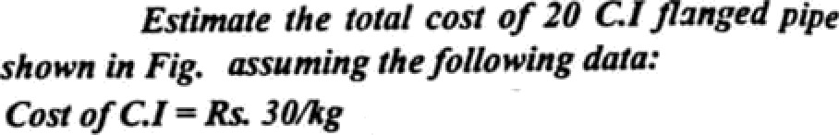
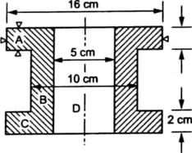
Process m = 2R o/url nieight of casting. Moulding and pour“ g chafes - s I Mpine,
Cnsting removal and clearing M piece
d»¿»tmwm « re «di = sK one c*<
2c/fi eg owrheads —— 70% adzninisaazive overhea s•

Slide 83


Net volume
Break up die flanged pipe into simple parts A, B. C and D.
of cast = Volume of(A 1 B + C - D) component
(160)* 20 + [ ₄ (I00/ 200 +
= 1,903,805.15 mm³
₄ (I60/ 20
— ₄ (50)² 240
Assume density of cast iron as 7.2 gn/cc.
1,903,805.15 x 7.2 x IN
i 3.71 kg

Slide 84
dli fin‹t nialerinl most:
Process scrap 2% of net weight of casting
100
Gross material required =
=
Cost of C.I = Costof 13.984 kgs of C. 1
Cost of process scrap
Cost of 0.274 kg sctap =
² x 13.71 0.274 kg
Net Weight + Process scmp
13.71 + 0.274 = 13.984 kg
Rs. 30/kg
30 « 13.984 = Rs.419.52
Rs. 7/kg
7 z 0.274 Rs. 1.918
Material cost/piece = Cost of C.1 — Cost of process scrap
= Rs. 419.52 — Rs. 1.918 = Rs. 417.60

Slide 85
(ii) To find labour cost:
Moulding and pouring charges | = | Rs. l5/piece
Casting removal and cleaning | = | Rs. 5/piece
Total labour cost per piece | = | 15 + 5 = Rs. 20
(iii) To find overheads:
Material
COSt
Labour
0OSt
Direct
+ expenses,
if any
Factory cost =
”.Factory cost
per piece
Rs. 417.60 + Rs. 20 + 0 = Rs. 437.60
5% of fSCtOJ Cost
J₀$J z Rs. 437.60 = Rs. 21.88
Administrative overheads =

Slide 86


fling overheads =
70% of administrative overheads
⁷⁰ x Rs. 21.88 = Rs. 15.31
)00
› ‹
Factory cost
A
dministrativet overheads J
Selling t
ovorhcadt t
Totaï costi•s t
cusT per piccc ]
_{Rs. 4}37.60 + Rs. 21.88 + Rs. 15.31
= Rs. 474.79
= Rs. 474.79 x 20 = Rs. 9495.80
Total cost of
20 pipes

