Slide 1
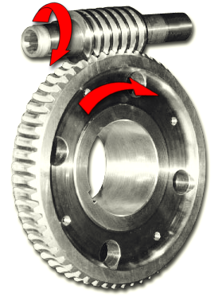
WORM GEAR
Presented by
PANDI.
GEAR
WORM

Slide 2
Introduction
The worm gears are used to transmit power between Non-intersecting, Non-parallel shafts.
The Non-intersecting not necessary to placed at right angles.
The crossed-helical and hypoid gears are also used to connect Non-intersecting and Non-parallel shafts. But it is suitable for low speed ratios (upto 8) and low power ratings.

Slide 3
Continue…
Worm gears can be used for high speed ratios (300:1)
The worm gear drive consists of a worm and a worm wheel.
If a tooth of a helical gear makes complete revolutions on the pitch cylinder, the resulting gear is known as a worm. The mating gear is called worm gear or worm wheel.
The worm in worm and worm gear drive is same as screw in screw and nut pair.

Slide 4
Application, Merits and Demerits
It is used as a in materials handling equipment, machine tools and automobiles.
Advantage:
The operation is smooth and silent.
It is used for speed ratios as high as 300:1
It is compact as well as spur & helical gear
The worm gear drives are irreversible. It means that the motion cannot be transmitted from worm wheel to the worm. This property of irreversible is advantageous in load hoisting application like cranes and lifts.

Slide 5
Continue…
Disadvantage:
The efficiency is low compared with other types of gear drives.
They are costly.
Since sliding occurs, the amount of heat generation is quite high.
The power transmitting capacity of worm gear drive is low (100 kW).

Slide 6
Types
1. Single-enveloping worm drive:
If the worm addendum forms a cylindrical surface, and if the worm-gear teeth are curved, then the drive is called single-enveloping.
2. Double-enveloping worm drive:
If the worm addendum has an hourglass form, and if the worm-gear teeth are also curved, then the drive is called double-enveloping.

Slide 8
THANK YOU

