Slide 1


III UNIT
DESIGN OF TEMPORARY AND PERMANENT JOINTS
Prepared by R.Sendil kumar

Slide 2
Syllabus
THREADED FASTNERS – DESIGN OF BOLTED JOINTS INCLUDING ECCENTRIC LOADING, KNUCKLE JOINTS, COTTER JOINTS – DESIGN OF WELDED JOINTS, RIVETED JOINTS FOR STRUCTURES – THEORY OF BONDED JOINTS.

Slide 3
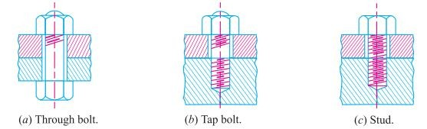
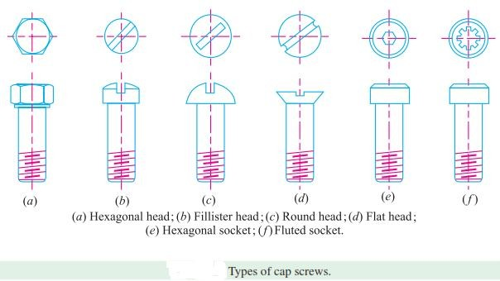
BOLTS:-

Slide 4
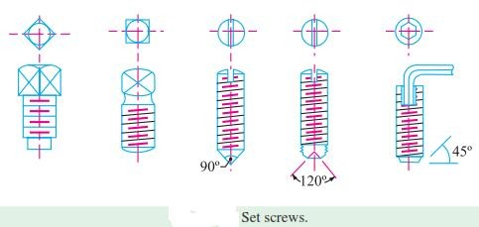

Slide 5
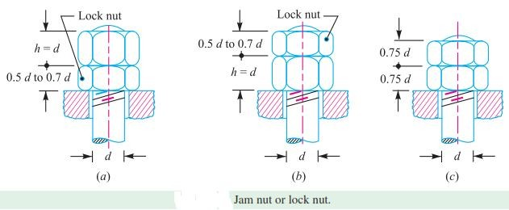
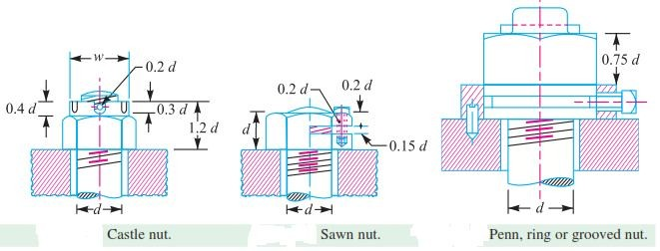
NUTS

Slide 6
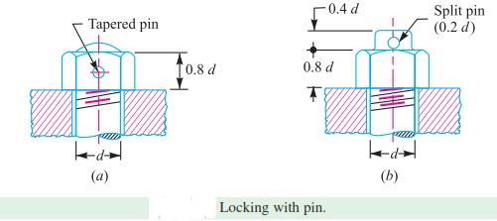
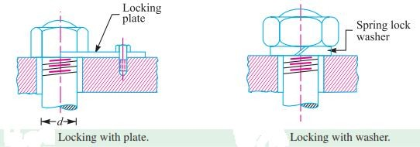

Slide 7
Problems
A steam engine cylinder has an effective diameter of 350 mm and the maximum steam pressure acting on the cylinder cover is 1.25 N/mm². Calculate the number and size of studs required to fix the cylinder cover. Assuming the permissible stress in the studs as 33 MPa.
The head of a steam engine cylinder 500 mm diameter is subjected to a pressure of 1 N/mm². The head is held in position by 16 numbers of M30 bolts. A copper gasket is used to make the joint steam tight. Determine the stress induced in the bolt. Assume k=0.5.

Slide 8
Continue…
Find the size of 14 bolts required for a C.I steam engine cylinder head. The diameter of the cylinder is 400 mm and the steam pressure is 1.5 N/mm². Take the permissible tensile stress as 35 N/mm².
The cylinder head of a steam engine with 250 mm bore is fastened by eight stud bolts made of 30C8 steel. Maximum pressure inside the cylinder is 1 MPa. Determine the bolt size and approximate tightening torque. Take 20% overhead. Assume σy
= 300 MPa for bolt material.

Slide 9
Eccentrically loaded bolted joints
1. A bracket as shown in figure. It is fitted to a wall with 5 bolts, three at the top and two at the bottom, with all the bolts equally spaced. A load of 20000 N is acting at an eccentricity of 200 mm vertical distances of first and second rows from the hinge point are 50 mm and 250 mm respectively. Select a suitable bolt size for this application

Slide 10
A bracket is fitted to a channel with 4 bolts as shown in figure. Distance between bolts 1 and 3 is equal to the distance between bolts 2 & 4 which is 150 mm, eccentricity is 300 mm. Find a suitable bolt.
A steel plate subjected to a force of 5 kN and fixed to a channel by means of three identical bolts is shown in figure. The bolts are made from plain carbon steel 45C8 and the factor of safety is 3. Specify the size of bolts. (N/D 2010)

Slide 11
3. A machine member has circular flange, which is connected to the frame by means of
8 bolts Assuming
and loaded as that the bolt
shown in fig. material has a
allowable shear stress of 30 Mpa, find the bolt size required.

Slide 12
Knuckle Joint
A knuckle joint is used to connect two rods which are under the action of tensile loads. However, if the Joint is guided, the rods may support a compressive load.
Application:
Link of a cycle chain
Tie rod Joint for roof truss
Valve rod joint with eccentric rod
Pump rod joint
Tension link in bridge structure

Slide 13
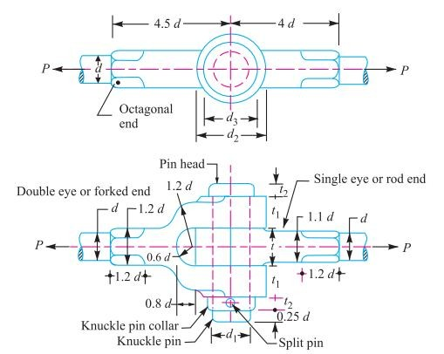
Design of Knuckle Joint

Slide 14
Let,
d- diameter of the rod d₁ – diameter of the pin
d₂ – outer diameter of the eye
d₃ – diameter of knuckle pin head and collar t – thickness of single eye
t₁ – thickness of fore
t₂ – thickness of pin head
(σ_{t}) – permissible tensile stress in the joint (τ) – permissible shear stress in the joint
(σ_{c}) – permissible crushing stress in the joint

Slide 15
Problem
Design a knuckle joint to connect two mild steel bars under a tensile load of 25 kN. The allowable stresses are 65 Mpa in tension, 50 Mpa in shear and 83 Mpa in crushing.

Slide 16
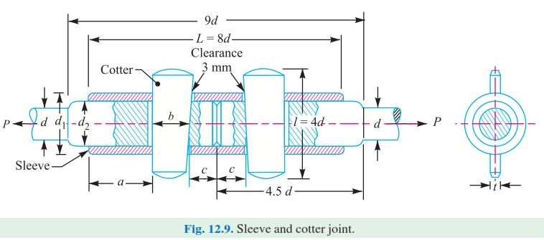
Sleeve and Cotter Joint

Slide 17
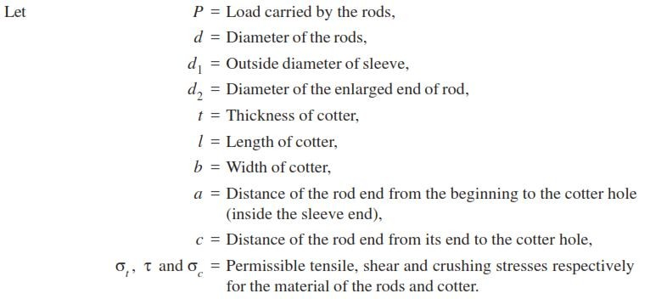
Design of sleeve and cotter Joint

Slide 18
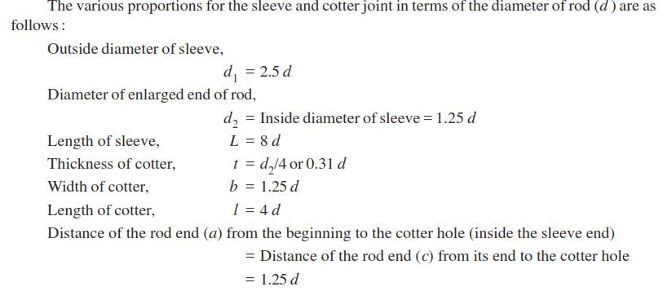
Continue…

Slide 19
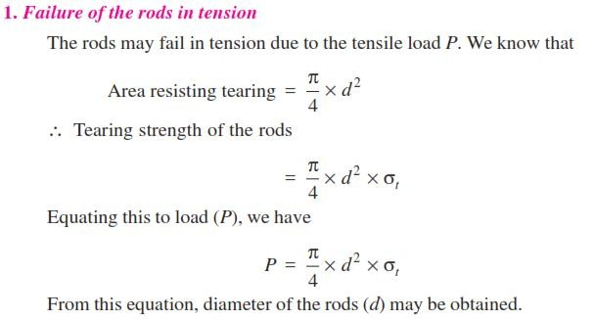

Slide 20
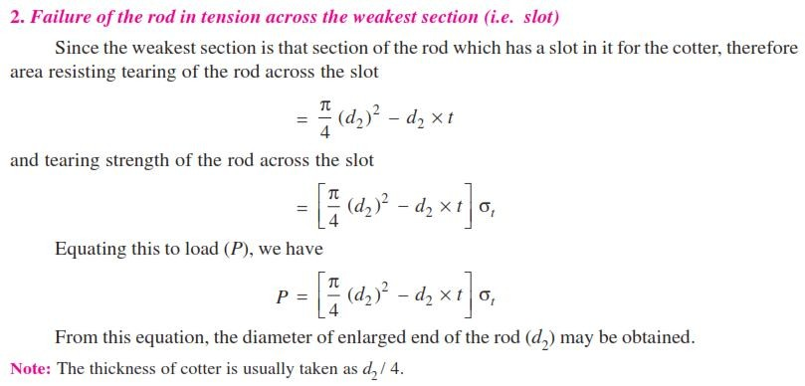

Slide 21
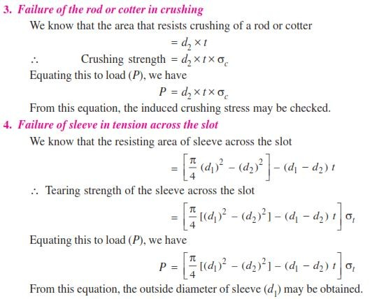

Slide 22
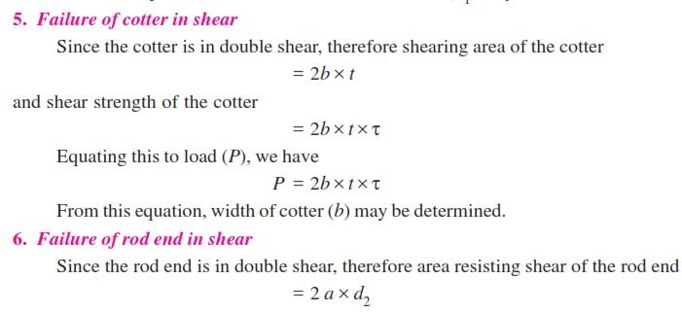
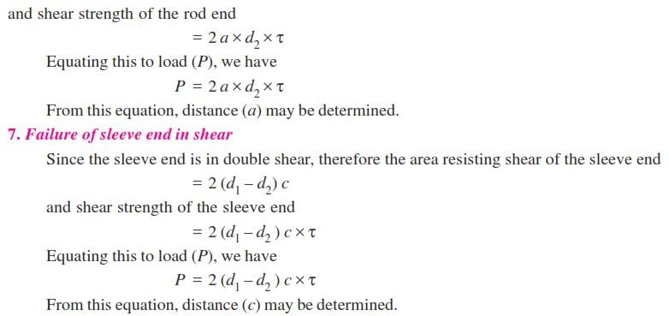

Slide 23
Problem
Design a sleeve and cotter joint to withstand a tensile load of 70 kN. All parts of the joint are made of saame material and the permissible stresses are (σ_{t}) = 60 N/mm², (σ_{c})= 120 N/mm², (τ) = 70 N/mm².

Slide 24
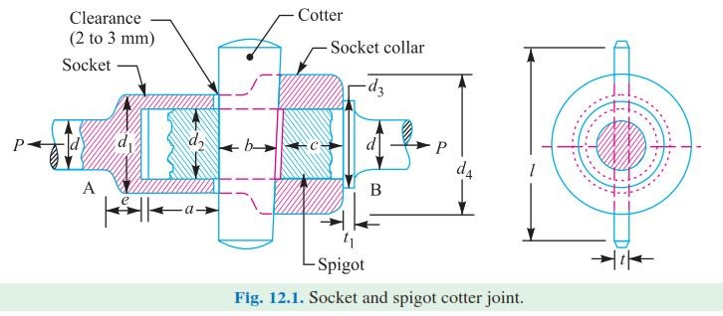
Socket and Spigot cotter Joint

Slide 25
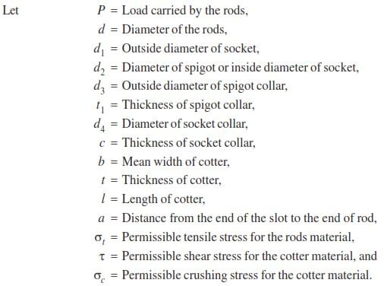

Slide 26
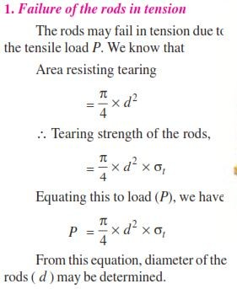

Slide 27
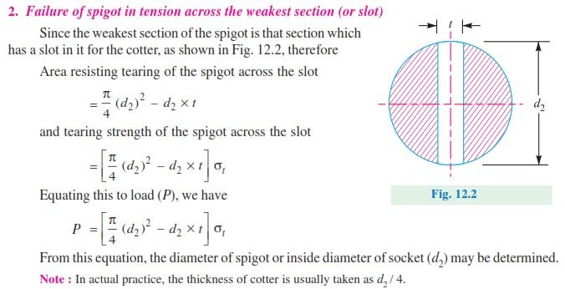

Slide 28
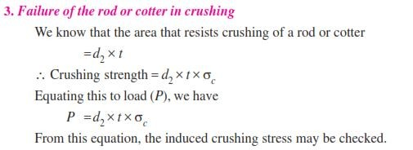
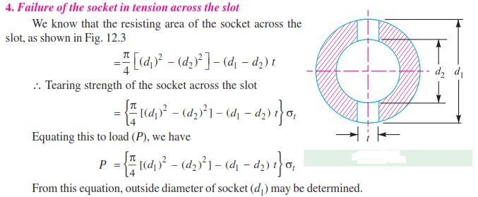

Slide 29
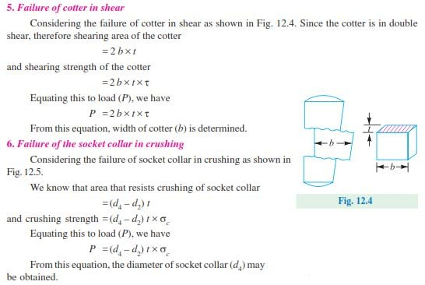

Slide 30
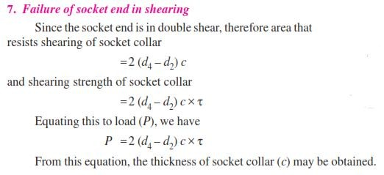
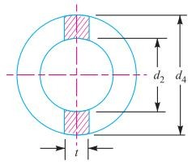
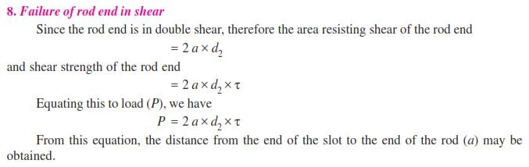

Slide 31
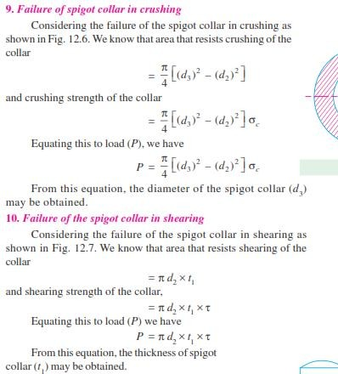
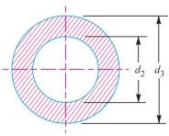
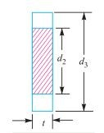


Slide 32
Problem
Design a socket and spigot cotter joint to transmit an axial load of 30 kN which alternately changes from tensile to compressive. The permissible stresses are 50 Mpa in tension, 35 Mpa in shear, and 90 Mpa in crushing.

Slide 33
Welded Joints
Welding:
Welding can be defined as a process of joining two similar or disimilar metals by
heating to a suitable diameter without the application of pressure.
Advantages:
with or
Lighter in weight
Leak proof Joint
Production time is less

Slide 34
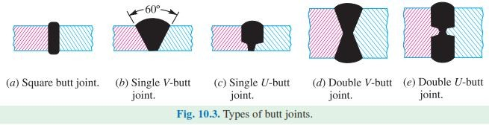
Continue…
Limitations:
Poor vibration damping charecteristics
Residual stresses introduced
Highly skilled welder required Types of welded Joints:
Butt Joint:
It is used to join the ends (or) edges of two plates. The surfaces of plates are located in the same plane.

Slide 35
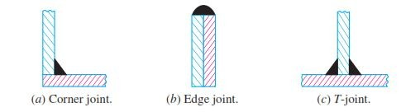
Lap Joint:
In a lap joint, two plates are over lapped each other for a certain distance.

Slide 36
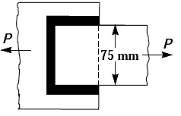
Problems
1. A plate 75 mm wide and 12.5 mm thick is joined
with another plate by a single transverse weld and a double parallel fillet weld as shown in Fig. the maximum tensile and shear stresses are 70 MPa and 56 MPa respectively. Find the length of each parallel fillet weld, if the joint is subjected to both static and fatigue loading. (N/D 2010)

Slide 37
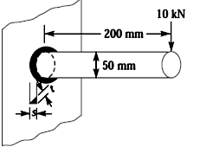
2. A 50 mm diameter solid shaft is welded to a flat plate as shown in Fig. If the size of the weld is 15 mm, find the maximum normal and shear stress in the weld. (NOV/ DEC 2006/ 2007)

Slide 38
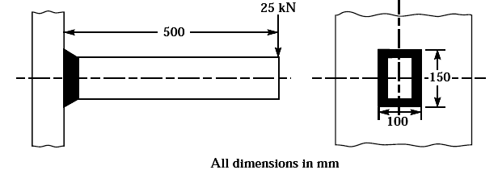
3. A rectangular cross-section bar is welded to a support by means of fillet welds as shown in Fig. Determine the size of the welds, if the permissible shear stress in the weld is limited to 75 MPa. (NOV/DEC 2011)

Slide 39
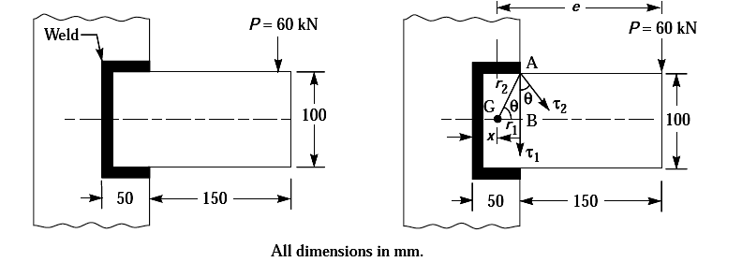
4. A rectangular steel plate is welded as a cantilever to a vertical column and supports a single concentrated load P, as shown in Fig. Determine the weld size if shear stress in the same is not to exceed 140 MPa. (NOV/DEC 2012, MAY/JUNE 2013)

Slide 40
A plate of 200 mm width and 600 mm long is welded to a vertical plate by placing it on the vertical plate to form a cantilever with projecting length of 480 mm and overlap between the plates as 120 mm. Fillet weld is done on all three sides. A vertical load 30 kN is applied at the free end of the cantilever plate parallel to its width of 200 mm. If the allowable weld stress is 95 Mpa. Determine the weld size.
A rectangular steel plate is welded as a cantilever to a vertical column and supports a single concentrated load P, as shown in fig. Determine the weld size if shear stress in the same is not to exceed 140 Mpa. (N/D 2012)

