Slide 1

UNIT I
STEADY STRESSES & VARIABLE STRESSES IN MACHINE MEMBERS
Prepared
by

Slide 2
Machine Design
The subject Machine Deisgn is the creation of new and better machines and improving the existing ones. A new or better machine is one which is more economical in the overall cost of production and operation.
The process of design is a long and time consuming one. From the study of existing ideas, a new idea has to be conceived. The idea is then studied keeping in mind its commercial success and given shape and form in the form of drawings.
In the preparation of these drawings, care must be taken of the availability of resources in money, in men and in materials required for the successful completion of the new idea into an actual reality.
In designing a machine component, it is necessary to have a good knowledge of many subjects such as Mathematics, Engineering mechanics, Strength of Materials, Theory of Machines, Workshop Processes and Engineering Drawing.

Slide 3
INTRODUCTION
Engineering Design:
Engineering design is a process of applying various scientific principles and techniques for purpose of defining in detail a product (or) a process (or) a system to its realisation.
In simpler words design is formulation of a plan, for execution towards satisfying a needs.
Machine Design is defined as to fix dimension for machine components.

Slide 4
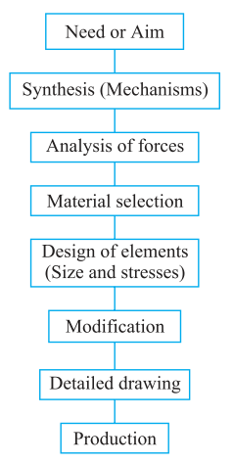
VARIOUS STEPS IN DESIGN PROCESS

Slide 5
VARIOUS STEPS IN DESIGN PROCESS
Recongnition of a need:
Identifying the customer needs through market research.
Definition of the problem:
Preparation of complete list of technical specifications.
Synthesis:
Collection of new ideas (or) modifying the existing Ideas.
Analysis:
  The forces acting on the component are determined.
  The material for the component is selected.
  The geometric dimensions of the component are determined.

Slide 6
CONTINUE…
Evaluation:
The possible success of the proposal should be verified from technical and economical stand points.
Detailed Design:
It’s the actual sizing and dimensioning all individual components in the part.
Proto-type & Testing:
Proto-type testing may lead to some modification.
Production:
Actual component manufactured at shop floor.

Slide 7
TYPES OF MACHINE DESIGN
Adaptive design:
The designer only makes minor alteration (or) modifications in the existing designs of the product.
Development design:
Modifying existing designs into a new idea by adopting a new material or different method of manufacture.
New design:
This type of design needs lot of research, technical ability and creative thinking.

Slide 8
Further classification of design
Rational design:
This type of design depends upon mathematical formulae of principle of mechanics.
Empirical design:
This type of design based on empirical formula based on practice and past experience.
Industrial design:
Depends upon the production aspects to manufacture.
Optimum design:
It’s the best design for the given objective function under the specified constraints.

Slide 9
Continue…
System design:
To develop a system that will meet expected needs within realistic constraints such as economical environmental, social, political, ethical, safety and sustainability
Element design:
Design of machine elements such as piston, crank shaft, gear,etc.
Computer aided design:
Use of computer systems to assist in the creation, modification, analysis and optimization of a design.

Slide 10
Factor influencing machine design
Safety
Reliability
Quality
Productivity
Cost
Ecological consideration
Availability of men, material & machines
Working environment
Energy conservation
Space constraints

Slide 11
General considerations in machine design
1. Type of load and stresses caused by the load
2. Motion of the parts or kinematics of the machine
3. Selection of materials
4. Form and size of the parts
5. Frictional resistance and lubrication
6. Convenient and economical features
7. Use of standard parts
8. Safety of operation
9. Workshop facilities
10. Number of machines to be manufactured
11. Cost of construction

Slide 12
Design rules
Design should aim at the best with the least expenditure
The component should have adequate strength, wear resistance and corrosion resistance
The assembly should be backlash free
Resonance is to be avoided
The design should be simple, fool proof, easy to operate and should reduce operator’s fatigue.
The design should need only a minimum maintenance
Whenever possible, dimensions of the components should be rounded off to standard values.

Slide 13
Engineering materials
Metals
Non-metals
Metals:
Ferrous – Which contains iron as the major constituent
Ex. Steel, Cast Iron
Non-ferrous – materials don't contains Iron.
Ex. Copper, Aluminium
Non-Metals:
Ceramic materials – oxides, carbides and nitrides of various metals. Ex. Glass, Brick, Concrete, Cement etc.
Organic materials – Polymeric materials composed of carbon compounds. Ex: Paper, fuel, rubber, paints, etc.

Slide 14
Factors to be considered for the selection of materials
Availability
Cost
Physical properties
Mechanical Properties
Manufacturing process
Physical properties:
Colour Electical conductivity
Shape Thermal conductivity
Size
Density

Slide 15
Material selection based on Mechanical properties
Strength → ability to resist external forces
Stiffness → ability to resist deformation under stress
Elasticity → property to regain its original shape
Plasticity → property which retains the deformation produced under load
Ductility → property of a material to be drawn into wire form with using tensile force
Brittleness → property of breaking a material without any deformation
Malleability → property of a material to be rolled or hammered into thin sheets
Toughness → property to resist fracture under impact load
Machinability→ property of a material to be cut
Resilience → property of a material to absorb energy
Creep → material undergoes slow and permanent deformation when subjected to constant stress with high temperature
Fatigue → failure of material due to cyclic loading
Hardness → resistant to indentation, scratch

Slide 16
Direct Stress
Load:
Any external force acting upon a machine member
Types of load:
Dead (or) Steady (or) Static load:
The load which does not change in magnitude and direction.
Ex. Self weight
(ii) Live (or) Varying load:
The load which is continuously changing.
Ex. Vehicle pass over a bridge

Slide 17
Continue…
(iii) Suddenly applied load (or) shock load:
The load which is applied suddenly
Ex: Blows of a hammer
(iv) Impact load:
The load which is applied with some initial velocity (or) The load which is dropped from certain height.
Ex: forging

Slide 18
Continue…
Stress:
The internal resistance of force per unit area is called stress.
σ =P/A
Where P = Load or force acting on the body
A = Cross- sectional area of the body
Strain:
The rate of change of deformation (or) It’s the ratio of change in dimension to the original dimension.
e =δl/l
Relationship between σ,e,E, δl
Deformation, ( δl ) =pl/AE

Slide 19
TYPES OF STRESSES AND STRAINS
Tensile Stress: The stress induced in a body, when subjected to two equal and opposite pulls as result of which there is an increase in length, is known as tensile stress. The ratio of increase in length to the original length is known as tensile strain.
Tensile stress σ = Resisting force =
^{Cross sectional area}
and tensile strain, ε = Increase length =
^{Original length}

Slide 20
Compressive Stress
The stress induced in a body, when subjected to two equal and opposite pushes as a result of which there is a decrease in length of the body, is known as compressive stress. The ratio of decrease in length to the original length is known as compressive strain.
Compressive stress, σ = Resisting force =
^{Cross sectional area}
Compressive strain, ε = Decrease in length =
^{Original length}

Slide 21
Shear Stress:
The stress induced in a body, when subjected to two equal and opposite forces which are acting tangentially across the resisting section as a result of which the body tends to shear off across the section, is known as shear stress. The corresponding strain is known as shear strain.
Shear stress, q = Shear resistance =
^{Shear area}
Shear strain Φ = Transverse displacement =
^{Distance}

Slide 22
FACTOR OF SAFETY AND LATERAL STRAIN
FACTOR OF SAFETY:
It is defined as the ratio of the ultimate stress to the working stress of the material.
Factor of Safety = Ultimate Stress
^{Working Stress}
LATERAL STRAIN:
The strain at right angles to the direction of applied load is known as lateral strain.
Lateral Strain = Increase or Decrease in Lateral Dimension
^{Original Lateral Dimension}

Slide 23
Modulus of Elasticity (Young’s Modulus (E):
According to Hooke’s law, the stress in a material is proportional to the strain upto the elastic limit. Therefore within the elastic limit, the ratio of the axial stress to the corresponding axial strain is found to be a constant. This constant is called Modulus of Elasticity or Young’s Modulus. It is denoted by E.
Modulus of Elasticity or Young’s Modulus = Axial Stress
Axial Strain
E =
Modulus of Rigidity or Shear Modulus (G):
The ratio of shear stress to the corresponding shear strain is found to be a constant upto the elastic limit of the material. This constant is called Modulus of Rigidity or Shear Modulus of the material. It is denoted by G.
Modulus of Rigidity or Shear Modulus = Shear Stress = G =
Shear Strain

Slide 24
Poisson’s Ratio (μ) or (1/m):
It has been experimentally found, that if a body is stressed within its elastic limit, the lateral strain bears a constant ratio to the linear strain. Mathematically,
Lateral strain = A constant
^{Linear strain}
This constant is known as poisson’s ratio and is denoted by 1/m or μ.
Strain Energy (or) Resilence:
When a body is loaded with in the elastic limit the work done on the body is stored in the form of energy . The strained body is now capable of doing some external work on removal of the load. The energy stored in the body due to internal strain is called strain energy or resilience.
Strain energy = (σ²/2E) ×A×l------------- N.mm

Slide 25
Hooke’s Law
It states that, “ Within elastic limit the stress induced in the material is directly proportional to strain”.
σ e
σ = E e.
E = σ
e
Where, σ – Stress; e – Strain; E – Young’s Modulus

Slide 26
Stress Strain Diagram
Ultimate Strength
Yield Point
STRESS/LOAD
Breaking Limit
Elastic Limit
Proportional Limit
EXTENSION/STRAIN

Slide 27
Stress Strain Diagram
Point P: Proportional Limit: Within Proportional Limit stress is directly proportional to strain. Hence the material will regain its original shape after unloading.
The stress corresponding to the load is known as Limit of Proportionality.
Point E represents the elastic limit. In the region PE, the stress is not proportional to strain. It means the stress strain diagram is not a straight line.
Any loading beyond point E, will cause permanent deformation. The stress corresponding to the load at E is called at Elastic Limit.
Yield Stress (Point Y) :The loading beyond E causes extension much larger than the extensions observed earlier. The material yields to a greater extent and the stress corresponding to the load at Y is termed as Yield Stress
Beyond Y, a much smaller increase in the load causes considerable extension and the materials is said to be semi plastic mode.

Slide 28
Stress Strain Diagram
At U, the material yields at a particular point and a neck is formed there. The stress corresponding to that load at U is called maximum stress (Ultimate stress)
Beyond U, the extension governed by the time of loading. The load required to cause extension is smaller than the load at M.
The area of cross section is considerable reduced.
The elongation continues till the material breaks at B.
The stress corresponding to the load at B is called Breaking stress.

Slide 29
Continue…
Percentage reduction in area:
% reduction in area = (A-A₁)/A ×100
A – Original area of cross-section.m²
A₁ – Cross- sectional area after fructure at the neck,m²
Percentage elongation:
% elongation in length= (l₁-l/l × 100
l₁ – Length of specimen after fracture, mm
l – original length, mm

Slide 30
Torsional shear stress
When a machine member is subjected to the action of two equal and opposite couples acting in parallel planes, then the machine member is said to be subjected to torsion.
The stress set up by torsion is known as torsional shear stress.
Consider a shaft fixed at one end and subjected to a torque (T) at the other end.
As a result of this torque every cross-section of the shaft is subjected to torsional shear stress.

Slide 31
Continue…
T/J = τ/R = Cθ/l
θ= angle of twist, radian
T=Torque = twisting moment = turning moment, N-mm
J= Polar movement of Inertia, mm⁴
τ= Torsional shear stress , N/mm²
C= Modulus of rigidity (or) shear modulus, N/mm²
l= Length of the shaft, mm

Slide 32
Continue…
Polar modulus z_{p}:
T/J = τ/R
T = τ× J/R
J/R is called the polar modulus (z_{p})
T= τ. z_{p}
For solid shaft of diameter (d)
J=πd⁴/32
R = d/2
_{Z p} = J/R = πd³/16
T = τ× (πd³ /16) ---- N-mm

Slide 33
Continue…
Torsional rigidity:
T/J =cθ/l
θ= T×l/c×J
The quantity c×J is called torsional rigidity
Power transmitted by shaft (p):
P = 2πNT/60 ---- Watts (or) N.m/s
T= torque-----N-m
N=speed------rpm

Slide 34
Impact and shock loading
The load acting on any machine component can be of either of these two types
1. Gradual load
2. Suddenly applied (or) Impact (or) Shock load.
Gradual load:
Gradual load is one which, goes on increasing over a period of time till the maximum value is reached.
Suddenly applied (or) Impact (or) Shock load:
Impact (or) shock load which is applied suddenly (or) with some initial velocity.
Ex: Punching presses, Hammer

Slide 35
Principal Stress
Principal plane is a plane in which the shear stress is zero, and the direct stresses acting along these planes are known as principal stress.
When shear stress is also acting in addition we have to find out maximum and minimum principal stresses.

Slide 36
Eccentric loading
An external load, whose line of action is parallel but does not coinside with the centroidal axis of the machine component, is known as an eccentric load (P).
The distance between the centroidal axis of the machine component and the eccentric load is called eccentricity.
It is generally denoted by e.

Slide 37
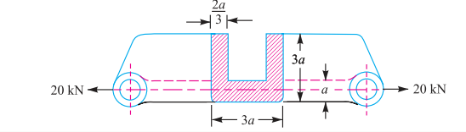
Problems
A cast-iron link, as shown in fig., is to carry a load of 20 kN. If the tensile and compressive stresses in the link are not to exceed 25 MPa and 80 MPa respectively, obtain the dimensions of the cross-section of the link at the middle of its length.

Slide 38
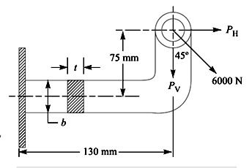
Continue…
A mild steel bracket as shown in fig., is subjected to a pull of 6000 N acting at 45º to its horizontal axis. The bracket has a rectangular section whose depth is twice the thickness. Find the cross- sectional dimensions of the bracket, if the permissible stress in the material of the bracket is limited to 60 MPa.

Slide 39
Continue…
Ex:-
4. A wall bracket of rectangular cross-section as shown in fig. It is subjected to a pull of 6 kN acting at 30º to the horizontal. If the maximum stress induced in the bracket material is not to exceed 25 N/mm² in both tension and compression. Design the cross-section of the bracket.

Slide 40
DESIGN OF CURVED BEAMS – CRANE HOOK AND C- FRAME
In the straight beam, the neutral axis of the section coincides with its centroidal axis and stress distribution in the beam is linear.
But in the case of curved beams, the neutral axis of the section not coincides with its centroidal axis and stress distribution in the beam is non-linear.
Bending stress general expression:
σ_{b} =
M – Bending moment
A – Area of cross-section

Slide 41
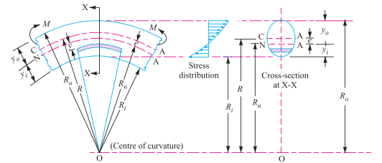
Bending stress in a curved beam

Slide 42
Continue…
e- Distance from centroidal axis to the neutral axis (R-R_{n})
R- Radius of curvature of the centroidal axis
R_{n} -Radius of the curvature of the neutral axis
y- Distance from the neutral axis to the fibre under consideration
If the section is symmetrical such as a circle, rectangle, I- beam with equal flange, then the maximum bending stress will always occur at the inside fibre.
If the section is unsymmetrical, then the maximum bending stress may occur at either the inside fibre (or) the outside fibre.

Slide 43
Continue…
Maximum Bending stress at the inside fibre:
σ_{bi} =
y_{i}= Distance from the neutral axis to the inside fibre = R_{n} –R _{i}
R _{i} = Radius of curvature of the inside fibre.
Maximum Bending stress at the outside fibre:
σ_{bo} =
y_{o} = Distance from the neutral axis to the outside fibre = R_{o} –R _{n}
R _{o} = Radius of curvature of the outside fibre.
Resultant stress σ =

Slide 44
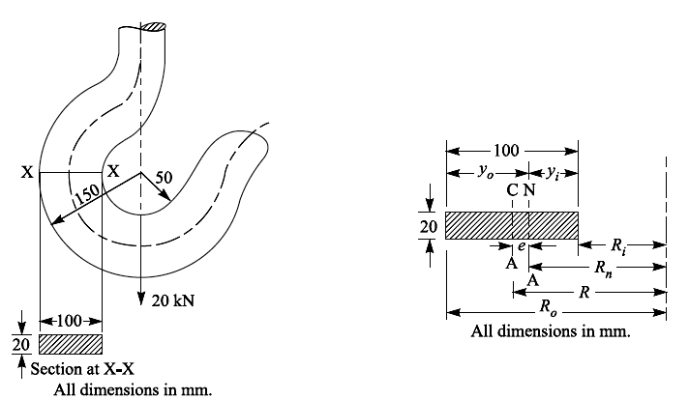
Problems
The crane hook carries a load of 20 kN as shown in fig. The section at X-X is rectanglar whose horizontal side is 100 mmm. Find the stresses in the inner and outer fibres at the given section.

Slide 45
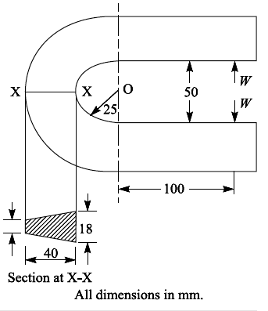
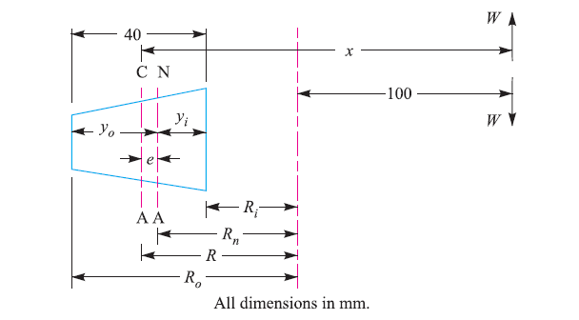
Continue…
2. The frame of a punch press is shown in fig. Find the stresses at the inner and outer surface at section X-X of the frame, if W= 5000N. (NOV/DEC 2013)

Slide 46
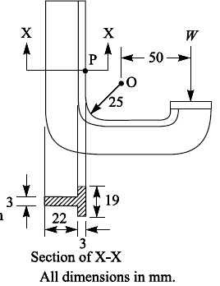
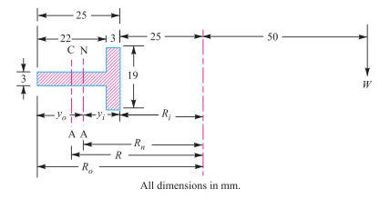
Continue…
3. A C- clamp is subjected to a maximum load of W, as shown in fig. If the maximum tensile stress in the clamp is limited to 140 Mpa, find the value of load W. (M/J 2012)

Slide 47
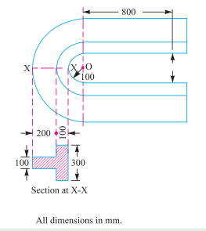
Continue…
Exercises:
A punch press, used for stamping sheet metal, has a punching capacity 50 kN. The section of the frame is as shown in fig. Find the resultant stress at the inner and outer fibre of the section.

Slide 48
Stress concentration
Stress concentration:
In most of the engineering components stress distribution is not uniform, stress distribution will be uniform only when there is no change in cross section.
Irregularity of the stress distribution due to abrupt changes of form is called stress concentration.
Stress raisers:
Sudden changes in cross section and material discontinuity is referred as stress raisers.
Ex: Holes, Notches, steps, threads, etc.

Slide 49
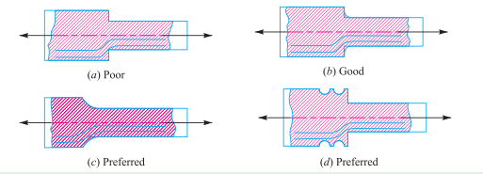
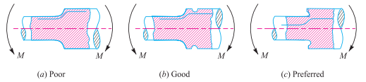
How to minimize stress concentration
Suitably modifying the shape of the components, stress concentration near the stress can be minimized.

Slide 50
Continue…
Stress concentration factor (k_{t}):
max. stress induced due to stress concentration
k_{t} = --------------------------------------------------------------------
stress caused without considering the stress concentration
maximum stress (σ_{max})
k_{t} = ----------------------------------
Nominal stress (σ)
σ_{max} = k_{t} × stress at net section
Notch Sensitivity (q):
This is defined as the degree to which the actual stress concentration effect compares with theoretical stress concentration effect.

Slide 51
Continue…
Endurance limit:
It is defined as maximum value of completely reversed bending stress which a polished specimen can withstand without failure for infinite number of cycles.
Fatigue stress concentration factor (k_{f}):
Endurance limit without stress concentration
k_{f} = --------------------------------------------------------
Endurance limit with stress concentration
K_{t}, k_{f} and q related as k_{f} = 1+q (K_{t} -1)

Slide 52
Continue…
Taking stress concentration into account find the maximum stress induced when a tensile load of 20 kN is applied to a stepped shaft of diameters 60 mm and 30 mm with fillet radius of 6 mm.

Slide 53

Design for variable loading
Variable load:
Variable load is a load which varies with respect to time either in magnitude or in direction, sometimes both.
design of variable loading:
Consider a rotating beam of circular cross section and carrying a load of W, this load induces stresses in the beam which are cyclic in nature.

Slide 54
Continue…
Upper fibers of beam(A) under compression and lower fiber (B) tensile after half revolution the point B occupies the position of point A and point A occupies the point of B. thus point B is now compression and point A is tensile.
The stresses which vary from one value of compressive to same value of tensile or vice versa are known as completely reversed or cyclic stresses.
The stresses which vary from a minimum value to a maximum value of same nature is called fluctuating stresses.
The stresses which vary from zero to a certain maximum value are called repeated stresses.

Slide 55
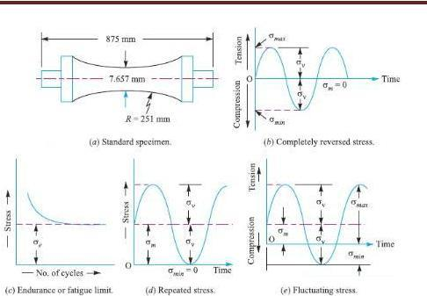
Continue…
The stresses which vary from a minimum value to a maximum value of the opposite nature is called alternative stresses (from a certain minimum compressive to a maximum tensile or minimum tensile to a certain maximum compressive).

Slide 56
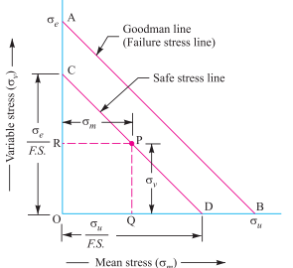
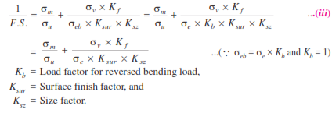
Continue…
Goodman Method:

Slide 57
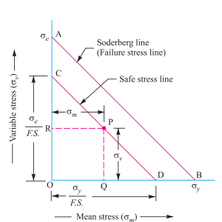

Continue…
Soderberg Method:

Slide 58
problems
1. A circular bar of 500 mm length is supported freely at its two ends. It is acted upon by a central concentrated cylic load having a minimum value of 20 kN and a maximum value of 50 kN. Determine the diameter of bar by taking a factor of safety of 1.5, size effect of 0.85, surface finish factor of 0.9. The material properties of bar are given by: ultimate strength of 650 MPa, yield strength of 500 MPa and endurance strength of 350 MPa.

Slide 59
Continue…
2. A simply supported beam has a concentrated load at the centre which fluctuates from a valve of P to 4P. The span of the beam is 500 mm and its cross-sectional is circular with a diameter of 60mm. Taking for the beam material an ultimate stress of 700 MPa, yield stress of 500 MPa, endurance limit of 330 MPa for reversed bending and a factory of safety of 1.3, calculate the maximum valve of P. Take a size factor of 0.85 and a surface finish factor of 0.9

Slide 60
Continue…
3. A hot rolled steel shaft is subjected to a torsional moment that varies from 330 N-m clockwise to 110 N-m counterclockwise and an applied bending moment at a critical section varies from 440 N-m to -220 N-m. The shaft is of uniform cross-section and no keyway is present at the critical section. Determine the required shaft diameter. The material has an ultimate strength of 550 MN/m2 and a yield strength of 410 MN/m2. Take the endurance limit as half the ultimate strength, factor of safety of 2, size factor of 0.85 and a surface finish factor of 0.62.

Slide 61
Continue…
A pulley is keyed to a shaft midway between two bearings. The shaft is made of cold drawn steel for which the ultimate strength is 550 MPa and the yield strength is 400 MPa. The bending moment at the pulley varies from -150 N-m to 400 N-m as the torque on the shaft varies from -50 N-m to 150 N-m. Obtain the diameter of the shaft for an indefinite life. The stress concentration factors for the keyway at the pulley in bending and in torsion are 1.6 and 1.3 respectively. Take the following values:
Factor of safety = 1.5
Load correction factors = 1.0 in bending, 0.6 in torsion
Size effect factor = 0.85
Surface effect factor =0.88

Slide 62
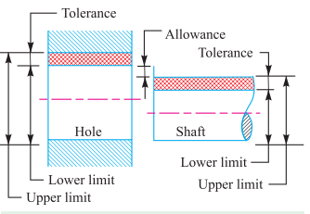
Limits, Fits & Tolerance

Slide 63
Continue…
1. Nominal size:
It is the size of a part specified in the drawing.
2. Basic size:
It is the size of a part to which all limits of variation (i.e tolerances) are applied to arrive at final dimensioning of the mating parts. The nominal or basic size of a part is often the same.
3. Actual size:
It is the actual measured dimension of the part.
4. Upper limit:
The largest size for a dimension of the part is called upper limit.

Slide 64
Continue…
5. Lower limit:
The smallest size for a dimension of the part is called lower limit.
6. Allowance:
It is the difference between the basic dimensions of the mating parts.
Tolerance
It is the difference between the upper limit and lower limit of a dimension.

Slide 65
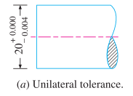
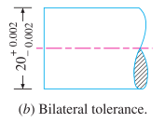
Continue…
Unilateral tolerance:
When all the tolerance is allowed on one side of the nominal size.
Ex:
Bilateral tolerance:
When the tolerance is allowed on both sides of the nominal size.
Ex:

Slide 66
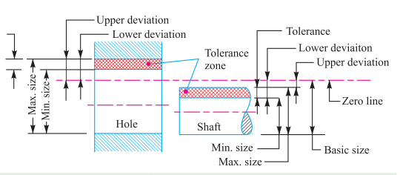
Continue…

Slide 67
Continue…
Zero line:
It is a straight line corresponding to the basic size. The deviations are measured from this line.
Upper deviation:
It is the algebraic difference between the maximum size and basic size. The upper deviation of a hole is represented by a symbol ES (Ecart Superior) and of a shaft, it is represented by es.
Lower deviation:
It is the algebraic difference between the minimum size and basic size. The lower deviation of a hole is represented by a symbol EI (Ecart Inferior) and of a shaft, it is represented by ei.

Slide 68
Continue…
Actual deviation:
It is the algebraic difference between in actual size and the corresponding basic size.
Mean deviation:
It is the arithmetical mean between the upper and lower deviations.

Slide 69
Fits
The degree of tightness or looseness between the two mating parts is known as a fit of the parts.
Types of fits:
1. Clearance fit
2. Interference fit
3. Transition fit
Clearance fit:
The difference between the sizes of the hole and the shaft before assembly. The difference must be positive.
Interference fit:
The arithmetical difference the sizes of the hole and shaft, before assembly. The difference must be negative.

Slide 70
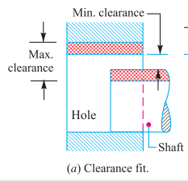
Continue…
Clearance fit:
In a clearance fit, the difference between the minimum size of a hole and the maximum size of the shaft is known as minimum clearance.
The difference between the maximum size of a hole and the maximum size of the shaft is called maximum clearance.
The clearance fits may be slide fit, easy sliding fit, running fit, slack running fit and loose running fit.

Slide 71
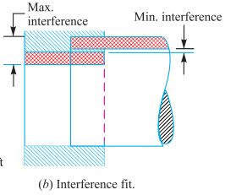
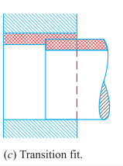
Continue..
Interference fit:
In an Interference fit, the tolerance zone of the hole is entirely below the tolerance zone of the shaft.
Transition fit:
In a transition fit, the tolerance zones of hole and shaft over lap.

Slide 72
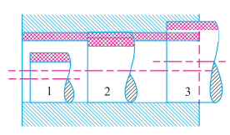
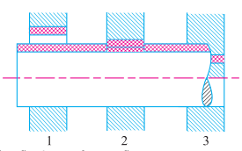
Basis of limit system
Hole basis system:
When the hole is kept as a constant member and different fits are obtained by varying the shaft size.
Shaft basis system:
When the shaft is kept as a constant member and different fits are obtained by varying the hole size.

Slide 73
END
SEMBODAI RV ENGINEERING COLLEGE

