Slide 1
UNIT – I
DESIGN OF TRANSMISSION SYSTEMS FOR FLEXIBLE ELEMENTS
Presented by
PANDIAN.K
TRANSMISSION SYSTEM
DESIGN
OF

Slide 2
OBJECTIVE:
The objective of the subject is to gain knowledge on the principles and procedure for the design of mechanical power transmission component.
To understand the standard procedure available for design of transmission elements.
To learn to use standard data and catalogues.
Normally we are using PSG design data book for designing the mechanical components.
OUTCOME:
Upon completion of this course, the students can able to successfully design transmission components used in Engine and machines.

Slide 3
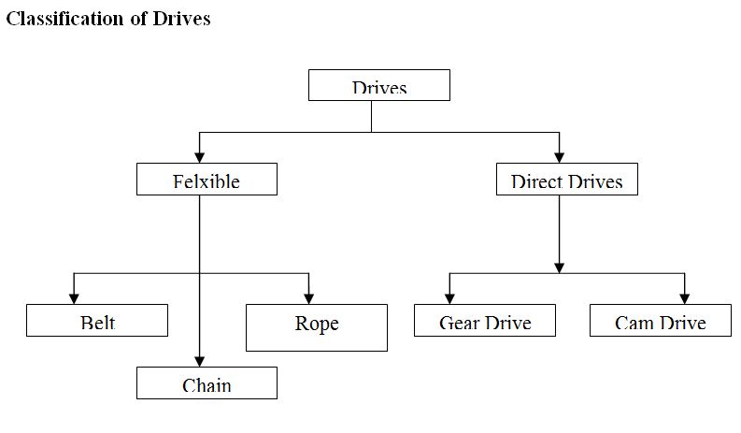

Slide 4
UNIT-I Introduction
To transmit power from flexible elements such as belts, chains and ropes are frequently used.
Pulleys are mounted on a shaft and a continuous belt or rope is passed over them.
In belt and ropes, power is transmitted due to friction between them and pulleys. In case of chain drives, sprocket wheels are used.

Slide 5
BELT DRIVES
Belt drive is a mechanical drive in which the driving and driven shaft are connected by a loop of flexible material called as belt through pulleys mounted on the shafts
The distance between the shaft is large, then belts (or) ropes (or) chains are used
It can absorb a good amount of shock and vibration
It can take care of some degree of misalignment between the driven and the driver machine shafts

Slide 6
Design
Material - Leather, Rubber, Plastics, Fabric
No. of ply and Thickness
Maximum belt stress per unit width
Density of Belt material
Coefficient of friction of the belt material

Slide 7
Types of Belts
Flat Belts
V – Belts
Ribbed Belts
Toothed or timing belts

Slide 8
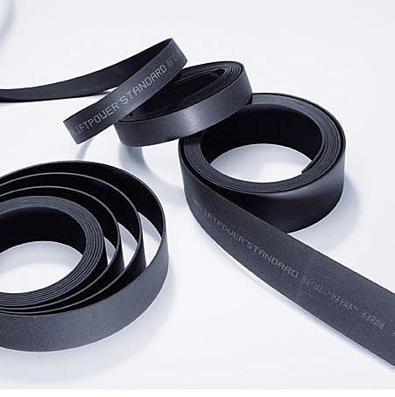
FLAT BELTS

Slide 9
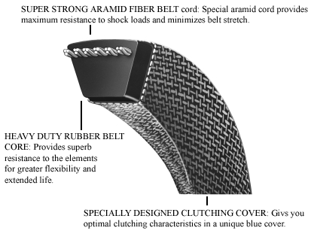
V - BELT

Slide 10
V-belt drive

Slide 11
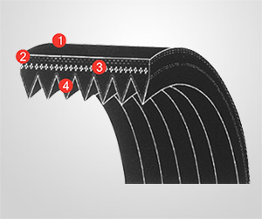
RIBBED BELTS

Slide 12
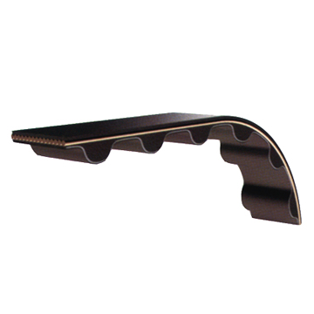
TOOTHED OR TIMING BELTS

Slide 13
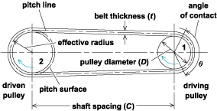
Types of Flat Belt Drives
Open Belt Drive
shafts arranged parallel and rotating in same directions

Slide 14
Open belt drive

Slide 15
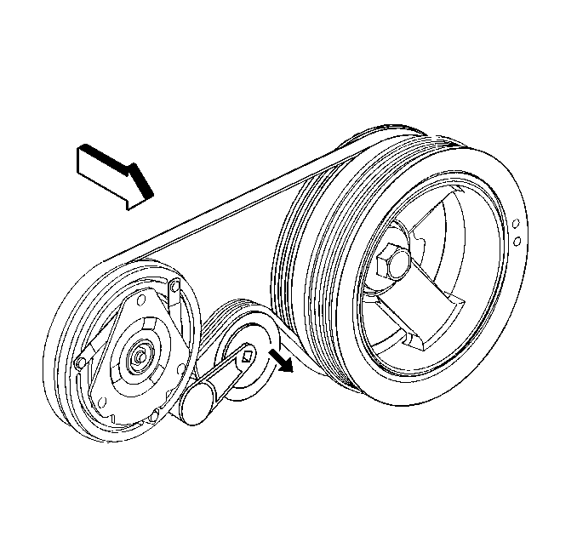
Open Belt Drive with One Idler Pulley
when an open belt drive can be used due to small angle of contact on the smaller pulley.
Idler pulleys also known as jockey pulleys. It are used to obtain high velocity ratio and required belt tension

Slide 16
Flat belt drive with idler pulley

Slide 17
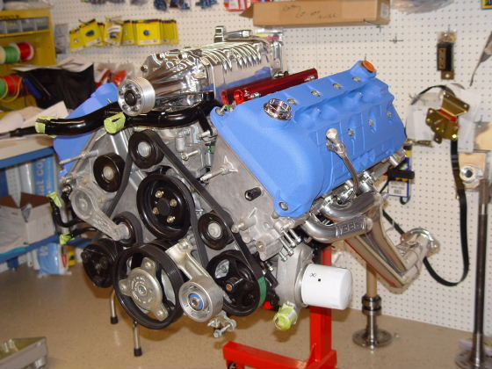
Open belt drive with many idler pulley

Slide 18
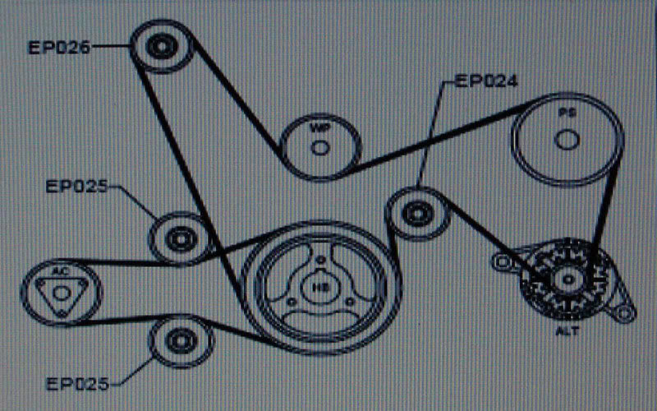
Used when it is desired to transmit motion from one shaft to several parallel shafts

Slide 19
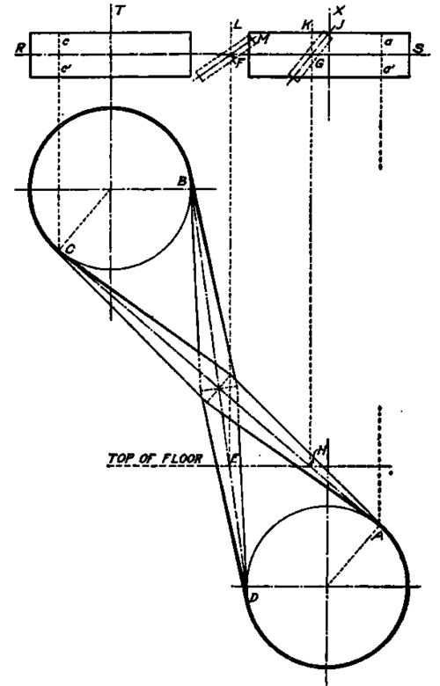
Crossed or twisted belt drive
Used with shafts arranged parallel and rotating in the opposite directions

Slide 20
Crossed belt drive

Slide 21
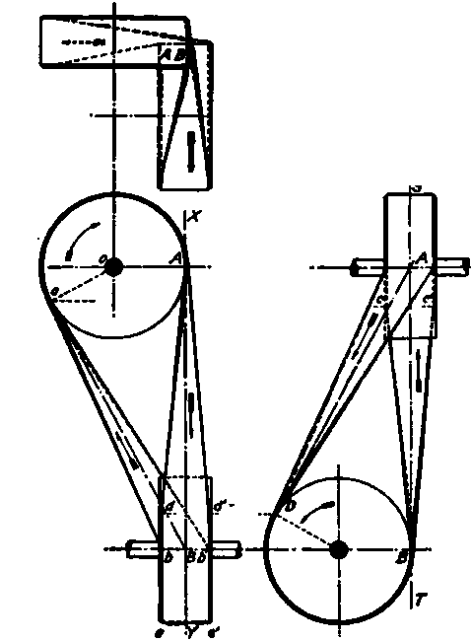
Quarted twist or Quarter turn drive
Used with shafts arranged at right angles and rotating in one definite directions

Slide 22
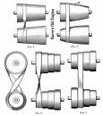
Stepped or Cone pulley drive
Used for changing the speed of the driven shaft while the main or driving shaft runs at constant speed

Slide 23
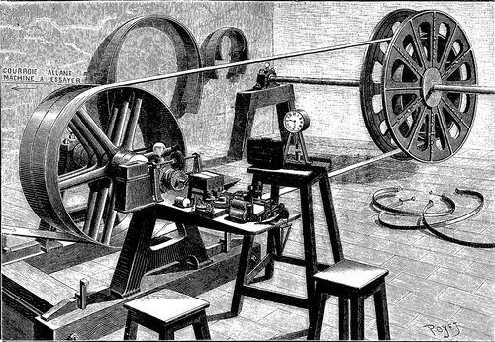
Fast and loose pulley
Used when the driven shaft is to be started or stopped whenever desired without interfering with the driving shaft

Slide 24
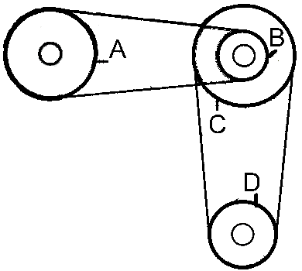
Compound drive
Used when several units are to be driven from one central shaft

Slide 25
Selection of Flat Belt Drive
It depends on
Power to be Transmitted
Speed of Driver and Driven Shafts
Shaft relationship
Service conditions
Speed reduction ratio
Centre distance
Space available

Slide 26
Belt Materials
The desirable properties of belt materials are
High C.O.F
Flexibility
Durability
Strength

Slide 27
Leather Belts
made of animal hides
Leathers for belting may be tanned with oak, or chrome salts.
Oak tanned belt is fairly stiff
Chrome tanned leather is soft and pliable
Belts specified according to number of layers as single ply, double ply or triple ply belts. Double belts or triple belts are made by cementing two or three strips together with hair sides outside

Slide 28
Fabric & Cotton Belts
Obtained by stitching two or more plies of canvas or cotton duck.
Treated with linseed oil to make it water proof.
These belts are cheap and most suitable for farmwork, quarry and saw mills

Slide 29
Rubber Belts
These belts are made up of plies of fabric impregnated with vulcanized rubber or synthetic rubber
Easily made endless
Saw mills, chemical plants and paper mills largely use rubber belts

Slide 30
Balata Belts
Balata is gum similar to rubber. Balata belts are made in the same manner as the rubber belts made.
They are acid proof and water proof. These belts cannot be used at temperature above 40°C, because at this temperature it softens and became sticky.
Nylon Core Belts
Camel’s Hair belts

Slide 31
Velocity ratio of belt drive
The ratio between the speeds of the driver and driven respectively.
Velocity ratio = N₂/N₁ = ω₂/ω₁ = D/d
Where D & d = diameter of driver and driven respectively
N_{2 &} N₁ = Speed of driven & driver respectively
ω₂ & ω₁ = Angular velocities of driven & driver respectively

Slide 32
Effect of belt thickness on velocity ratio:
Considering the thickness of belt (t)
N₂/N₁ = (D + t)/(d + t)
Effect of slip on velocity ratio:
Slip is defined as the relative motion between the belt and pulley.
The difference between the linear speed of the pulley rim and belt is the measure of slip.
The reason is, there is a tendency for the belt to carry with it on the underside between the pulley and the belt. The frictional grip between the pulley and the grip is insufficient in lower side.
The slip reduces the velocity ratio of the drive.

Slide 33
Slip can be reduced BY
Roughening the belt by dressing
By crowning the pulley
Let S₁ = Percentage slip between the driver and the belt.
S₂ = Percentage slip between the driven and the belt.
S = Total percentage slip = S₁ + S₂
Velocity ratio = N₂/N₁ = D/d [1 – ((S₁ ₊ S₂)/100)] = D/d [1 – (S/100)]
If thickness of the belt (t) is considered, then
Velocity ratio = N₂/N₁ = (D+t)/(d+t) [1 – ((S₁ ₊ S₂)/100)]
= (D+t)/(d+t) [1 – (S/100)]

Slide 34
Effect of creep on belt
Let
σ₁ = stresses in the belt on tight side
σ₂ = stresses in the slack side
E = Young’s modulus of belt material
Velocity ratio = N₂/N₁ = (D)/(d) [[E + √ σ₁ ]/[E + √ σ₂ ]]
Law of Belting
Law of belting states that, the centre line of the belt, as it approaches the pulley, must lie in a plane perpendicular to the axis of that pulley or must lie in the plane of the pulley. Otherwise the belt will run off the pulley

Slide 35
Power Transmitted by the belt
Power Transmitted by the belt
P = (T₁ – T₂ ) v watts
Where T₁ = tension in the tight side.
T₂ = tension in the slack side.
V = linear velocity of the belt in m/s

Slide 36
Centrifugal Tension (T_{c})
T_{c} = waste load, increases the tension without increasing power capacity.
T_{c} = mV²
m = mass / unit length (Kg/m)
V = linear velocity (m/s)
Initial tension
T_{o} = [T₁ + T₂]/2 [neglecting centrifugal tension]
T_{o} = [T₁ + T₂ + 2T_{c}]/2 [considering centrifugal tension]

Slide 37
Continue…
Maximum tension when the belt subjected to centrifugal tension
T = T₁ + T_{c}
T = maximum stress X cross sectional area of the belt
= σ b t
σ = maximum stress in N/m²
b = width in m
t = thickness in m

Slide 38
Continue…
When Centrifugal tension taken for consideration
Tension in tight side is T_{t1} = T₁ + T_{c}
Tension in tight side is T_{t2} = T₂ + T_{c}
Then Power Transmitted by the belt
P = (T_{t1} – T_{t2} ) V watt
After simplification P = (T₁ – T₂ ) V watt
It shows centrifugal tension doesn’t have any effect on power transmission

Slide 39
V – BELTS AND PULLEYS
v-belts are used with electric motors to drive blowers, compressors, appliances (like mixer, grinder, etc., machine tools (like lathe, drilling machine, etc), farm and industrial machinery, and so on. V-belts are endless and run in grooved pulleys.
V-belts are made in trapezoidal section. The power is transmitted by the wedging action between the belt and the V-groove in the pulley or sheave.

Slide 40
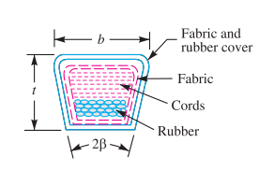
MATERIALS OF V-BELTS
V-belts are made of cotton fabric and cords moulded in rubber and covered with fabric and rubber.

Slide 41
ADVANTAGES
Power transmitted is more due to wedging action in the grooved pulley.
V-belt is more compact, quiet and shock absorbing.
Higher velocity ratio(upto 10)can be obtained.
DISADVANTAGES
It cannot be used with large centre distances.
It cannot be used for large power.
The efficiency of the V-belt is lower than that of the flat belt.

Slide 42
Continue…
TYPES OF V-BELTS
According to Bureau of Indian standards (BIS :2494-1974), the V-belts are classified as A,B,C,D and E type (based on the cross-section of V-belts).
SPECIFICATIONS OF V-BELTS
V-belts are designated by its type and nominal inside length. For example, a C2845 belts has a cross-section of type C and has a nominal inside length of 2845mm.

Slide 43
ADVANTAGES OF V – BELT DRIVE OVER FLAT BELT DRIVE
Power transmitted is more due to wedging action in the grooved pulley.
V – belt is more compact, quiet & shock absorbing.
The drive is positive because, the slip is negligible due to wedge action.
Higher velocity ratio (upto 10)
V – belt drive can operate in any position (i.e., horizontal, vertical, inclined)
Multiple V – belts can be used, thus enabling more power transmission.

Slide 44
DISADVANTAGES OF V – BELT DRIVE OVER FLAT BELT DRIVE
It cannot be used with large centre distances.
It is not durable because bending stress is more.
V – belt is subjected to certain amount of creep, therefore it is not suitable for constant speed application & timing devices.
It cannot be used for large power
V – belt efficiency less than flat belt efficiency
The construction of V – grooved pulleys is complicated and costlier compared with flat belt pulley.

Slide 45
V – FLAT DRIVES
In a V – belt drive, if the large grooved pulley is replaced by a Flat – faced pulley & smaller pulley remains V – grooved), then the drive is known as V – flat drive.
V – flat drives are used in domestic piston pumps, domestic clothes drier and larger punch press.

Slide 46
DESIGN WIRE ROPES AND PULLEYS
Wire ropes are used whenever large power is to be transmitted over long distances (upto 150 m).
The wire ropes are extensively used in elevators, oil well drilling, mine hoists, cranes, conveyors, suspension bridges and other material handling equipments.

Slide 47
ADVANTAGES OF WIRE ROPES
Lighter weight and high strength to weight ratio.
More reliable in operation.
Silent operation even at high working speeds.
Less danger for damage due to jerks.

Slide 48
Continue…
Materials of wire ropes:
Wrought iron, cast steel, plow steel and alloy steel.
Classification of wire ropes:
Cross lay ropes:
In these ropes, the strands are twisted into a rope in the opposite direction to that of the wires in the strands.

Slide 49
Continue…
Parallel lay ropes:
In these ropes, the direction of twist of the wires in the strand is the same as that of the strands in the rope .
Composite laid ropes:
In these ropes, the wires in two adjacent strands are twisted in the opposite direction.

Slide 50
Continue…
Specification of wire ropes:
For example, a 6 × 7 rope means a rope made from six strands with seven wires in each strand.
Design procedure for a wire rope :
1.Selection of suitable wire rope:
First select the suitable type of wire rope for the given application

Slide 51
Continue…
Standard designation | Application | Metallic area of rope A,mm²
6 × 7 ropes | Used as haulage and guy rope in mines, tramways and power transmission | 0.38d²
6 × 19 ropes | Used as hoisting ropes in mines, quarries, cranes, derricks, dredges, elevators, tramways, well drilling,etc. | 0.40d²
6 × 37 ropes | Used as an extra flexible hoisting rope in steel mill laddles, cranes, high speed elevators | 0.40d²
8 × 19 ropes | Used as an extra flexible hoisting rope | 0.40d²

Slide 52
CHAIN DRIVES
Chain drive is intermediate between belt and gear drives.
Chain drives are used for velocity ratios less than 10m/s, power ratings upto 125kW.
Application:
Transportation industry such as bicycles, motor cycles and automobile vehicles, agricultural machinery, metal and wood working machine, textile machinery, building construction, material handling machinery.

Slide 53
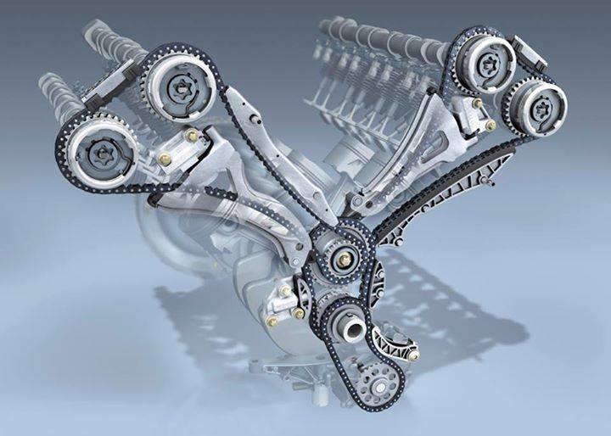

Slide 54
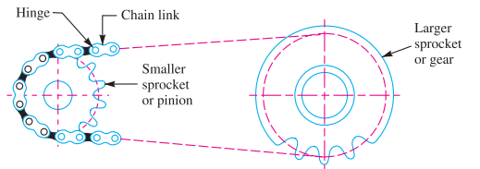
CHAIN DRIVE

Slide 55
ADVANTAGES
They can be used for long as well as short centre distances.
More compact than belt
No slip between chain & sprocket. So they provide positive drive.
One chain can be arranged to drive several sprockets.
Higher efficiency (upto 98%) of the drive
Transmit more power than belt drives
Smaller load on the shafts than in belt drives.

Slide 56
Disadvantages:
Precise alignment of shafts than the belt drives
They require proper maintenance
Noisy operation
More complicated design
Types of chain drives:
Link chains (or) welded chains
Transmission chains (or) roller chains
Silent chains (or) inverted tooth chains

Slide 57
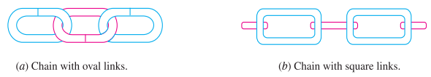
LINK CHAINS
Low capacity hoisting machines such as hoists and hand operated cranes, lifting.

Slide 58
Advantages:
Good flexibility in all directions
Smaller than pulley diameters and drums
Simple design and manufacture
Disadvantages:
Heavy weight
Sudden jerk
Sudden failure
Intensive wear

Slide 59
TRANSMISSION (OR) ROLLER CHAINS
Readily available, transmitting power between parallel shafts.
Roller chain consists of an endless chain running over two sprockets.
Construction of roller chains:
It consists of alternate links made of inner and outer link plates.
Outer plates are known as pin link (or) coupling link.
Inner plate… roller link, pin, bushing & roller.

Slide 60
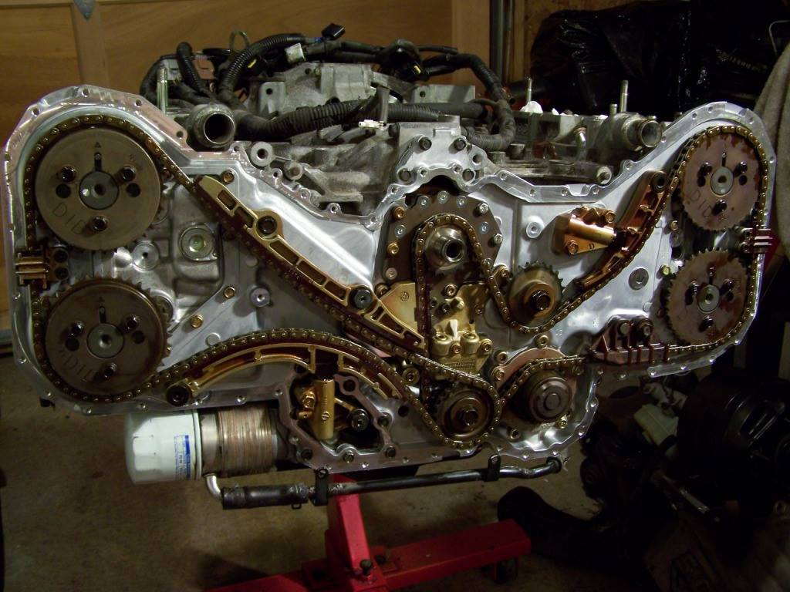

Slide 61
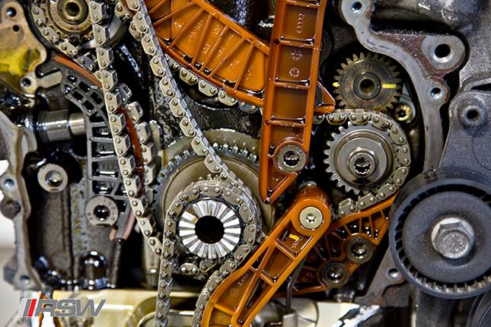
SILENT CHAINS (OR) INVERTED TOOTH CHAINS

Slide 62
CHAIN MATERIALS
Link plates are made of cold-rolled, medium-carbon (or) alloy steels such as C45, C50 & 40crl.
Pin, bushing, rollers are made of carburizing steel such as C15, C20, 30Ni4crl.

Slide 63
END

