Slide 1
INVOLUTES
VEERAPANDIAN.K
AP/MECH
SINCET

Slide 2
An involute is a curve that is traced by a point on a taut cord unwinding from a circle or regular polygon, which is called a base or (plane figures for part of this unit which includes a line, triangle, square, hexagon) The involute is a form of spiral, the curvature of which becomes straighter as it is drawn from a base circle and becomes a straight line at infinity. An involute drawn from a small base circle is more curved than one drawn from a larger base circle.

Slide 3
The involute of a circle has a property that makes it important to the gear industry: if the teeth of two mating gears have the shape of an involute, their relative rates of rotation are constant while the teeth are engaged. With teeth of other shapes, the relative speeds rise and fall as successive teeth engage, resulting in vibration, noise, and excessive wear. For this reason, nearly all modern gear teeth bear the involute shape.

Slide 4
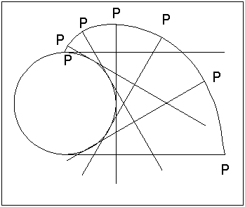
The Involute Curve.
There is another approach used to simulate rolling action. Consider what happens when you place one end of a straight line (with a length equal to half the circumference of the circle) on the perimeter of a circle and then rotate that line around the perimeter of the circle until the other end touches the perimeter of the circle.
If you observe what happens to the end of the line, you will see how it moves away from the circle. If you trace a line along the path taken by the end of the straight line as it rolls around the circle, the result is an Involute Curve

Slide 5
Involute of a straight line
Step 1. Extend line AB as shown.
Step 2. With centre B and radius AB draw a semi-circle.
Step 3. With Centre A and radius AC draw the second semi-circle.
Step 4. With centre B and radius BD draw another semi-circle.
Step 5. Darken the three semi-circles to give the involute of the straight line.

Slide 6
Involute of a Triangle
Step 1. Extend lines BC, AB and CA as shown.
Step 2. With centre C and radius AC strike an arc to intersect line BC.
Step 3. Repeat the step at points B and A.
Step 4. Darken the involute.

Slide 7
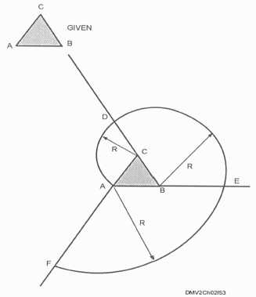
COMPLETED INVOLUTE OF A TRIANGLE

Slide 8
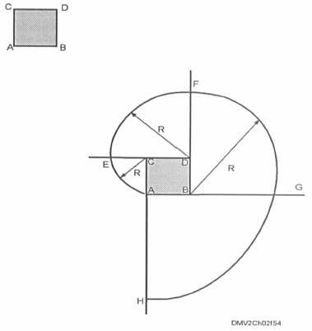
COMPLETED INVOLUTE OF A SQUARE

Slide 9
Involute of a Hexagon
Step 1. Extend the sides of the hexagon as shown.
Step 2. Draw arcs and darken the involute.

Slide 10
Involute of a Circle
Step 1. Divide the circle into 12 equal divisions.
Step 2. Draw lines tangent to the 12 divisions as shown.
Step 3. With a compass draw arcs as shown.

Slide 11
Step 4. Darken the involute.

Slide 12
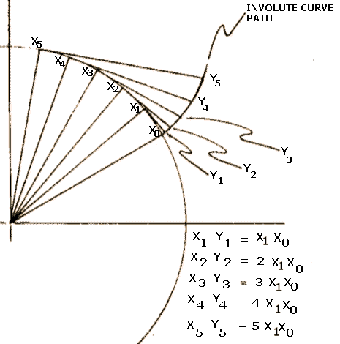
HOW IS THE INVOLUTE OF A CIRCLE USED TO PRODUCE GEAR TEETH
An animated path of an involute of a circle
Five points showing the trace of the involute which is in fact the construction of a gear tooth.
The movement of a mating gear tooth.

Slide 13
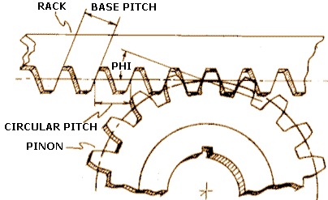
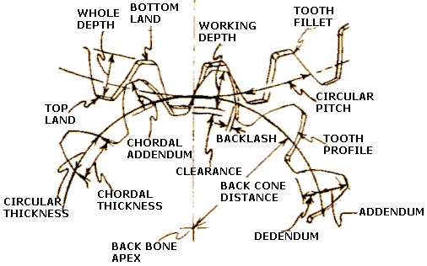
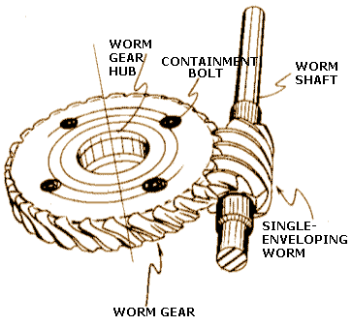
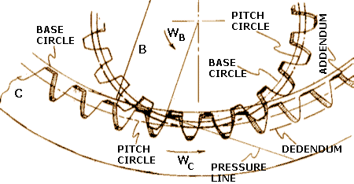
EXAMPLES OF MATING GEARS

