Slide 1
Engineering Graphics-Free Hand Sketch
VEERAPANDIAN.K
AP/MECH
SINCET

Slide 2
Unit I
Plane curves and Free hand sketching
Curves used in engineering practices:
Conics – Construction of ellipse, parabola and hyperbola by eccentricity method – Construction of cycloid – construction of involutes of square, pentagon and circle - Drawing of tangents and normal to the above curves.
Free hand sketching:
Representation of Three Dimensional objects – Need for and importance of multiple views and their placement – Developing visualization skills through free hand sketching of multiple views from pictorial views of objects.

Slide 3
FIRST ANGLE
PROJECTION
FOR T.V.
IN THIS METHOD,
THE OBJECT IS ASSUMED TO BE
SITUATED IN FIRST QUADRANT
MEANS
ABOVE HP & INFRONT OF VP.
V.P.
P.P.
F.V.
S.V.
OBJECT IS INBETWEEN
OBSERVER & PLANE.
OBJECT
VP
PP
FV
LSV
X
Y
FOR S.V.
FOR F.V.
TV
HP
ACTUAL PATTERN OF
PLANES & VIEWS
IN
FIRST ANGLE METHOD
OF PROJECTIONS

Slide 4
1st ANGLE PROJECTION
X
OBSERVER

Slide 5
FOR T.V.
ORTHOGRAPHIC PROJECTIONS
ALL VIEWS IDENTICAL
FV
SV
x
y
10
FOR S.V.
FOR F.V.
40
PICTORIAL PRESENTATION IS GIVEN
DRAW THREE VIEWS OF THIS OBJECT
BY FIRST ANGLE PROJECTION METHOD
40
TOP VIEW

Slide 6
FOR T.V.
S.V.
F.V.
ORTHOGRAPHIC PROJECTIONS
FRONT VIEW
L.H.SIDE VIEW
FOR F.V.
FOR S.V.
x
y
PICTORIAL PRESENTATION IS GIVEN
DRAW THREE VIEWS OF THIS OBJECT
BY FIRST ANGLE PROJECTION METHOD
TOP VIEW

Slide 7
FOR T.V.
S.V.
F.V.
ORTHOGRAPHIC PROJECTIONS
FRONT VIEW
L.H.SIDE VIEW
X
Y
FOR S.V.
FOR F.V.
TOP VIEW
PICTORIAL PRESENTATION IS GIVEN
DRAW THREE VIEWS OF THIS OBJECT
BY FIRST ANGLE PROJECTION METHOD

Slide 8
FOR T.V.
ORTHOGRAPHIC PROJECTIONS
FRONT VIEW
L.H.SIDE VIEW
X
Y
FOR S.V.
FOR F.V.
PICTORIAL PRESENTATION IS GIVEN
DRAW THREE VIEWS OF THIS OBJECT
BY FIRST ANGLE PROJECTION METHOD
TOP VIEW

Slide 9
FOR T.V.
S.V.
F.V.
ORTHOGRAPHIC PROJECTIONS
FRONT VIEW
L.H.SIDE VIEW
FOR S.V.
FOR F.V.
X
Y
TOP VIEW
PICTORIAL PRESENTATION IS GIVEN
DRAW THREE VIEWS OF THIS OBJECT
BY FIRST ANGLE PROJECTION METHOD

Slide 10
FOR T.V.
ORTHOGRAPHIC PROJECTIONS
FRONT VIEW
L.H.SIDE VIEW
FOR F.V.
X
Y
FOR S.V.
TOP VIEW
PICTORIAL PRESENTATION IS GIVEN
DRAW THREE VIEWS OF THIS OBJECT
BY FIRST ANGLE PROJECTION METHOD

Slide 11
FOR T.V.
ORTHOGRAPHIC PROJECTIONS
FRONT VIEW
L.H.SIDE VIEW
X
Y
FOR S.V.
FOR F.V.
PICTORIAL PRESENTATION IS GIVEN
DRAW THREE VIEWS OF THIS OBJECT
BY FIRST ANGLE PROJECTION METHOD
TOP VIEW

Slide 12
FOR T.V.
S.V.
F.V.
ORTHOGRAPHIC PROJECTIONS
FRONT VIEW
L.H.SIDE VIEW
X
Y
FOR S.V.
FOR F.V.
TOP VIEW
PICTORIAL PRESENTATION IS GIVEN
DRAW THREE VIEWS OF THIS OBJECT
BY FIRST ANGLE PROJECTION METHOD

Slide 13
FOR T.V.
F.V.
S.V.
ORTHOGRAPHIC PROJECTIONS
FRONT VIEW
L.H.SIDE VIEW
FOR S.V.
FOR F.V.
X
Y
PICTORIAL PRESENTATION IS GIVEN
DRAW THREE VIEWS OF THIS OBJECT
BY FIRST ANGLE PROJECTION METHOD
TOP VIEW

Slide 14
FOR T.V.
ORTHOGRAPHIC PROJECTIONS
FRONT VIEW
L.H.SIDE VIEW
X
Y
FOR F.V.
FOR S.V.
PICTORIAL PRESENTATION IS GIVEN
DRAW THREE VIEWS OF THIS OBJECT
BY FIRST ANGLE PROJECTION METHOD
TOP VIEW

Slide 15
FOR T.V.
F.V.
S.V.
ORTHOGRAPHIC PROJECTIONS
FRONT VIEW
L.H.SIDE VIEW
X
Y
FOR S.V.
FOR F.V.
TOP VIEW
PICTORIAL PRESENTATION IS GIVEN
DRAW THREE VIEWS OF THIS OBJECT
BY FIRST ANGLE PROJECTION METHOD

Slide 16
General procedure for sketching orthographic views
from pictorial view (isometric view):
Step 1 : Sketch with free hand, the outline of all the required views with thin line (2H pencil).
Step 2 : Sketch with free hand, all the visible lines and visible circles in all the required views with thin line (2H pencil).
Step 3 : Sketch with free hand, all the hidden lines and hidden circles in all the required views with thin line (2H pencil).
Step 4 : After checking for technical mistakes if any, darken (with free hand) all the visible lines, hidden lines, visible circles/arcs and hidden circles/arcs forming the required views with HB pencil.
Step 5 : Lettering (both alphabets and numbers) should be done with free hand.
c

Slide 17
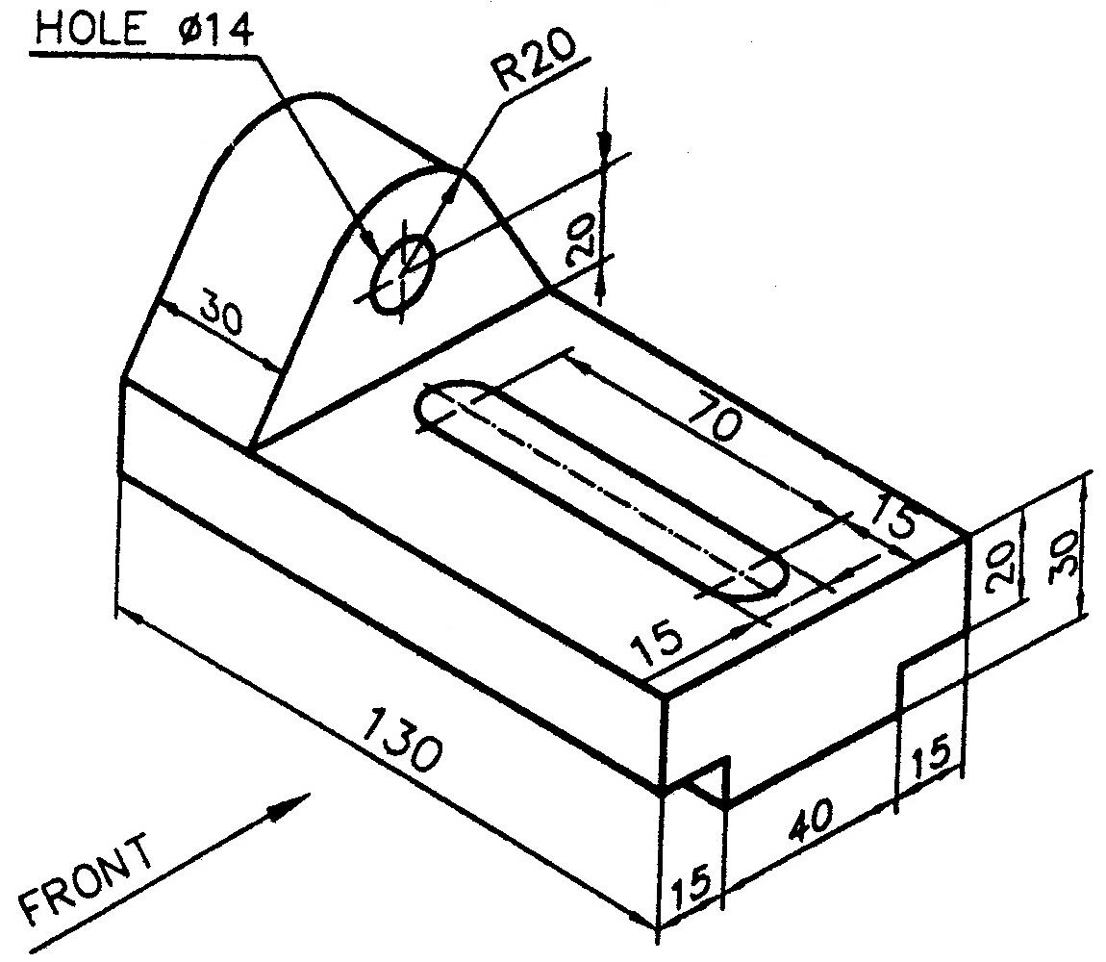
An example :
Make free-hand sketches of front, top and right side views of the
pictorial view shown below.

Slide 18
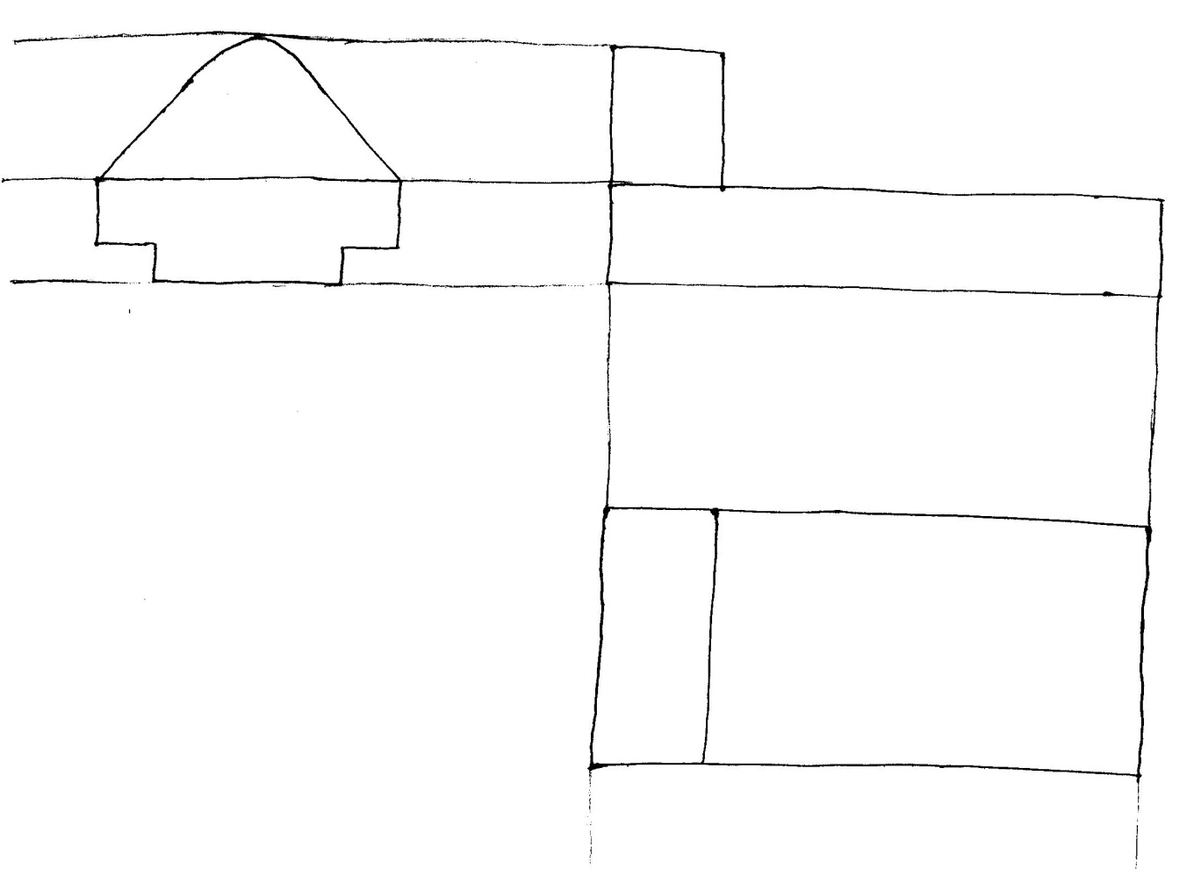
Step 1 :

Slide 19
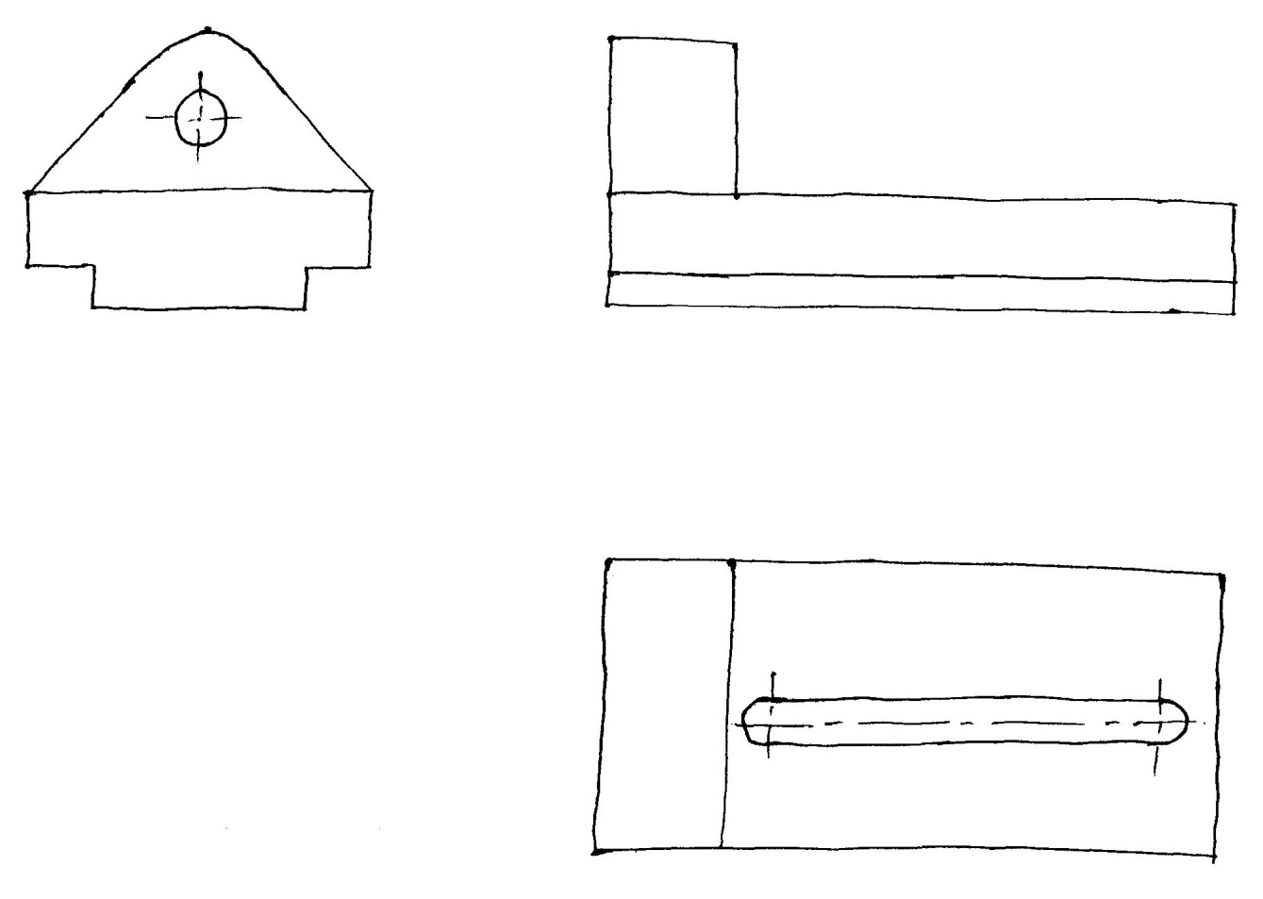
Step 2

Slide 20
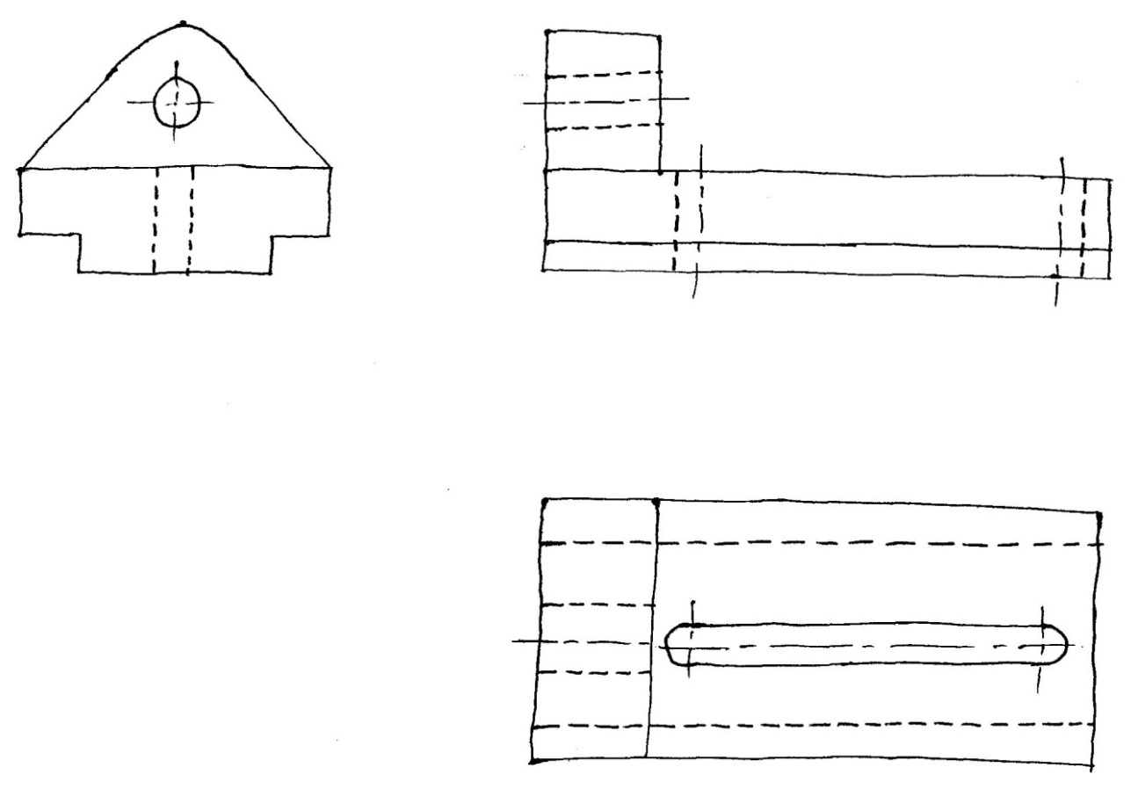
Step 3 :

Slide 21
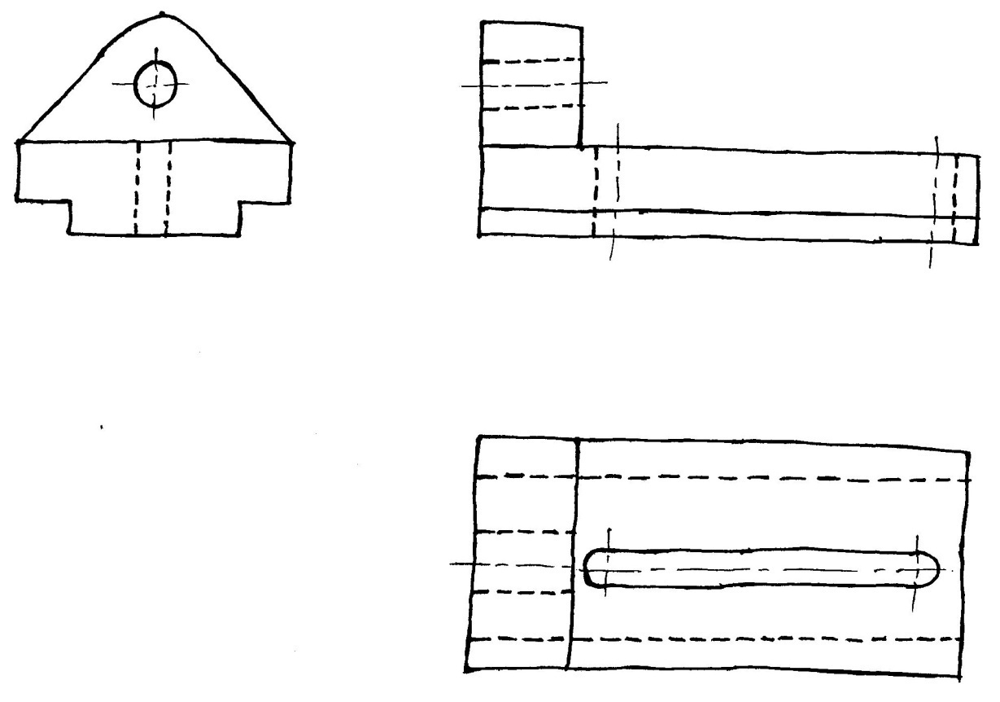
Step 4 :

Slide 22

