Slide 1
Geometry for BOARD Drafting
VEERAPANDIAN.K
AP/MECH
SINCET

Slide 2
Vocabulary
  Geometry
  Geometric Construction
  Vertex
  Bisect
  Perpendicular
  Parallel
  Polygon
  Inscribe
  Circumscribe
  Regular Polygon
  Ellipse

Slide 3
5
Geometry for Drafting
Chapter Objectives
Identify geometric shapes and constructions used by drafters.
Construct various geometric shapes.
Solve technical and mathematical problems through geometric
constructions using drafting instruments.
Solve technical and mathematical problems through geometric
constructions using a CAD system.
Use geometry to reduce or enlarge a drawing or to change its proportions.

Slide 4
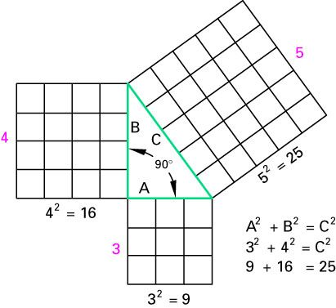
Applied Geometry for Board
Drafting
Figure 5-2

Slide 5
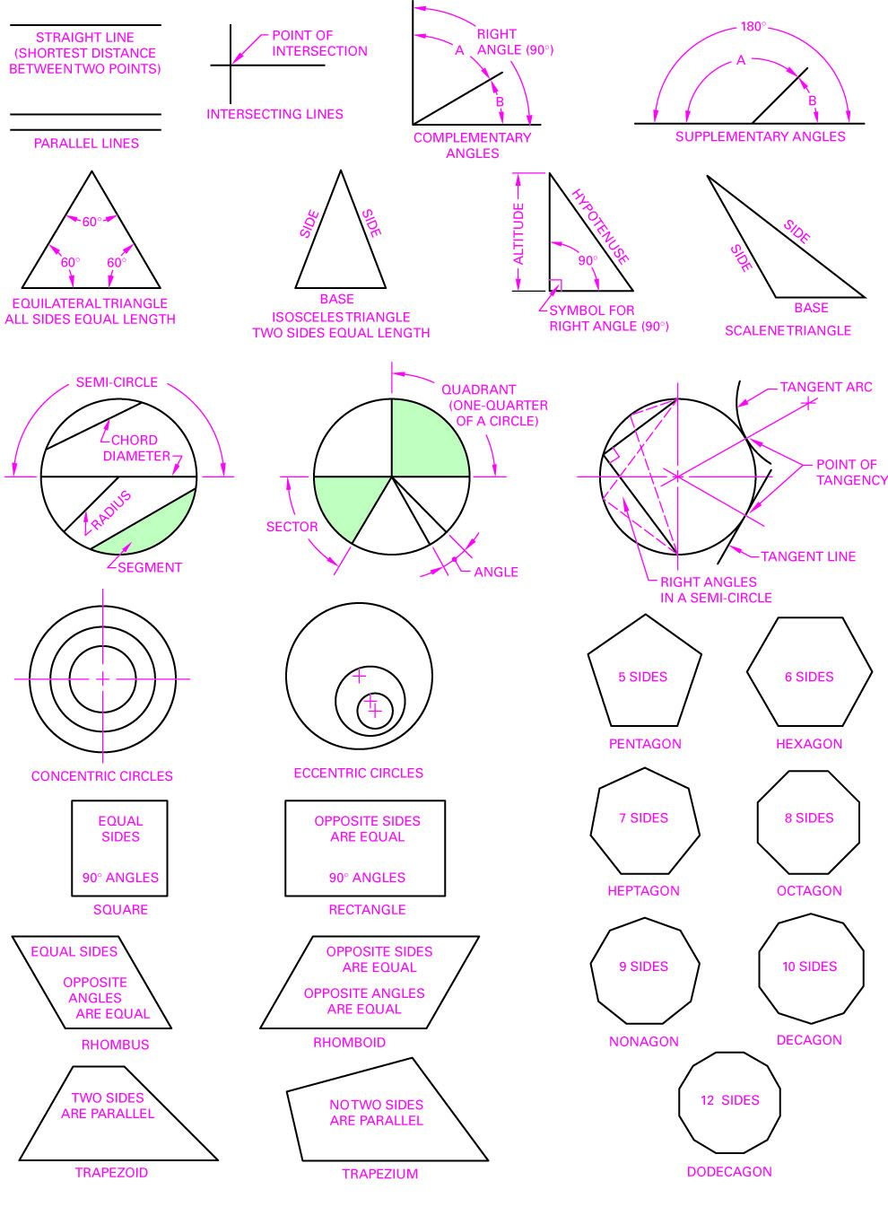
Applied Geometry for Board
Drafting
Figure 5-3

Slide 6
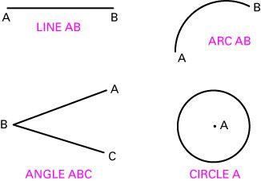
Applied Geometry for Board
Drafting
Figure 5-4

Slide 7
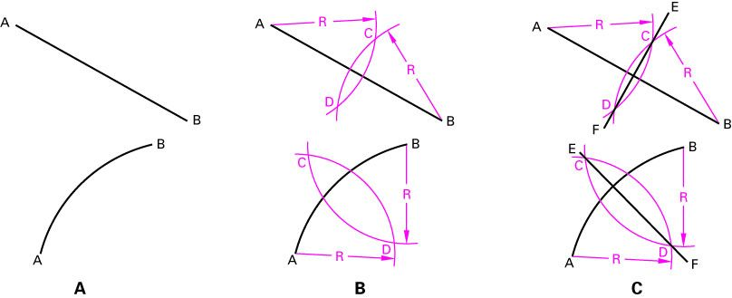
Applied Geometry for Board
Drafting
Figure 5-5

Slide 8
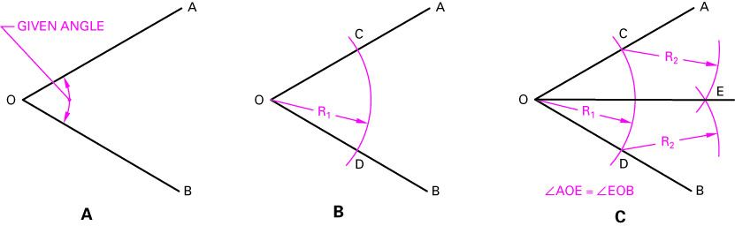
Applied Geometry for Board
Drafting
Figure 5-6

Slide 9
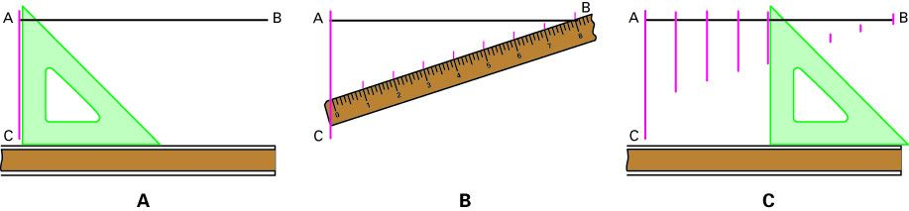
Applied Geometry for Board
Drafting
Figure 5-7

Slide 10
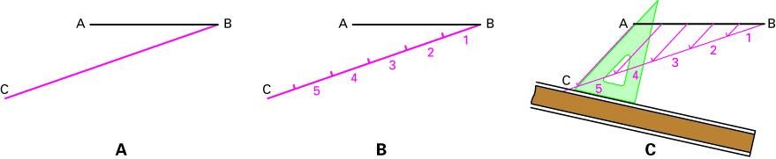
Applied Geometry for Board
Drafting
Figure 5-8

Slide 11
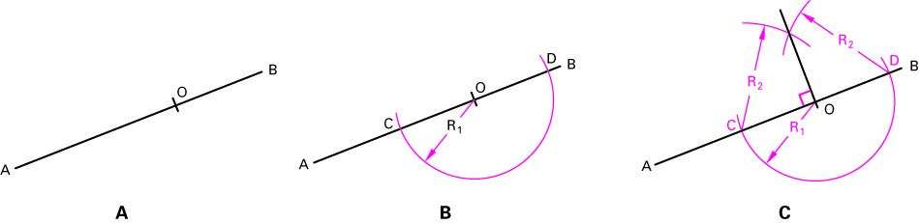
Applied Geometry for Board
Drafting
Figure 5-9

Slide 12
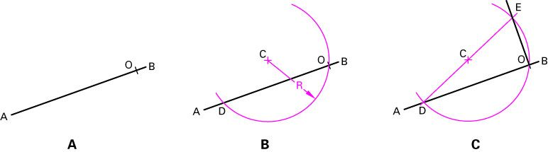
Applied Geometry for Board
Drafting
Figure 5-10

Slide 13
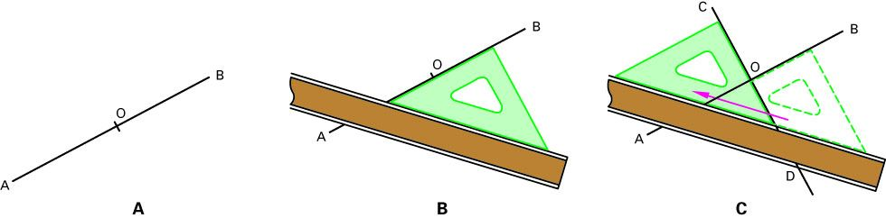
Applied Geometry for Board
Drafting
Figure 5-11

Slide 14
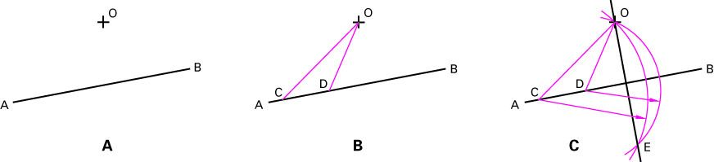
Applied Geometry for Board
Drafting
Constructing a perpendicular to a given line through a point is not one the given line. METHOD 4
Figure 5-12

Slide 15
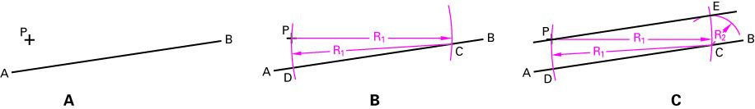
Applied Geometry for Board
Drafting
Using a compass to construct a line parallel to a given line through a given point. METHOD 1
Figure 5-13

Slide 16
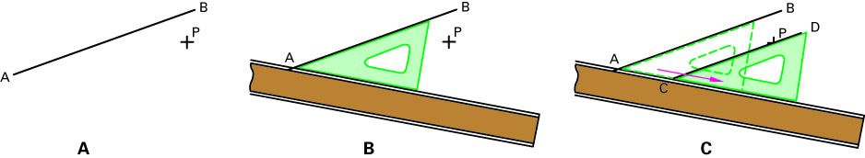
Applied Geometry for Board
Drafting
Using a compass to construct a line parallel to a given line through a given point. METHOD 2
Figure 5-14

Slide 17
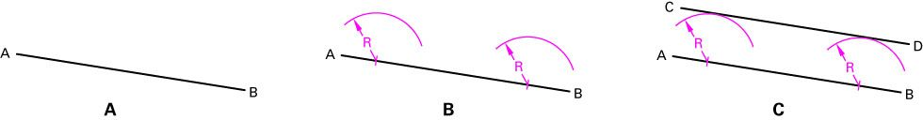
Applied Geometry for Board
Drafting
Using a compass to construct a line parallel to a given line through a given point. METHOD 3
Figure 5-15

Slide 18
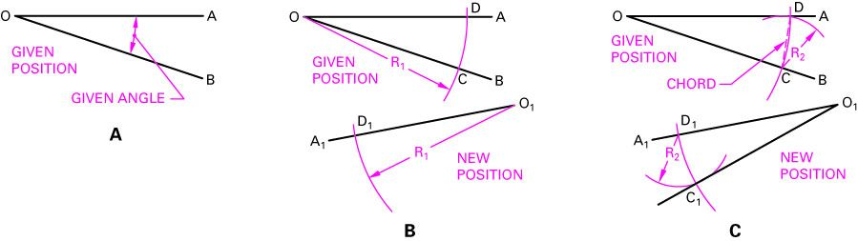
Applied Geometry for Board
Drafting
Copy an Angle
Figure 5-16

Slide 19
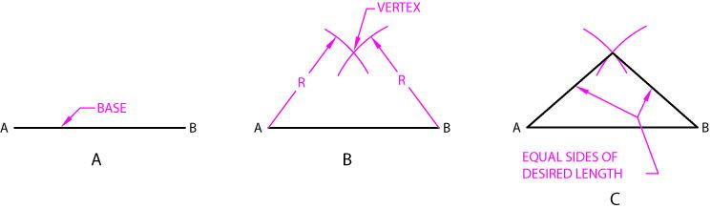
Applied Geometry for Board
Drafting
Constructing an isosceles triangle. METHOD 1
Figure 5-17

Slide 20
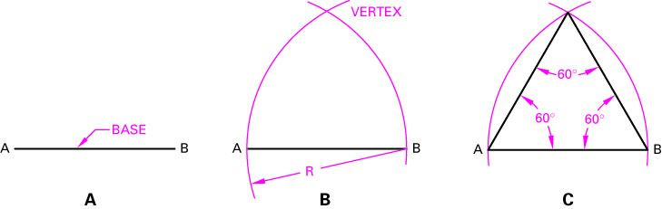
Applied Geometry for Board
Drafting
Constructing an equilateral triangle. METHOD 2
Figure 5-18

Slide 21
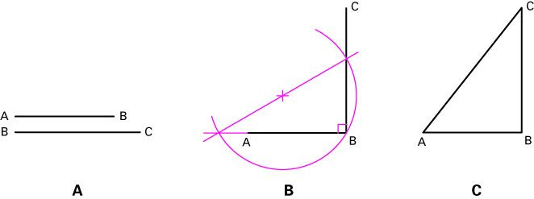
Applied Geometry for Board
Drafting
Constructing a right triangle given the length of two sides. METHOD 3
Figure 5-19

Slide 22
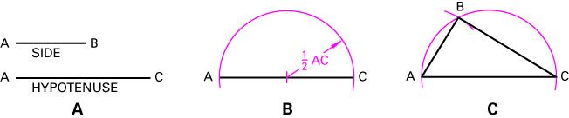
Applied Geometry for Board
Drafting
Constructing a right triangle given the length of one side and the length of the hypotenuse. METHOD 4
Figure 5-20

Slide 23
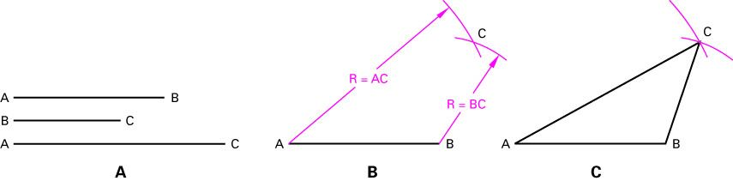
Applied Geometry for Board
Drafting
Constructing an triangle. METHOD 5
Figure 5-21

Slide 24
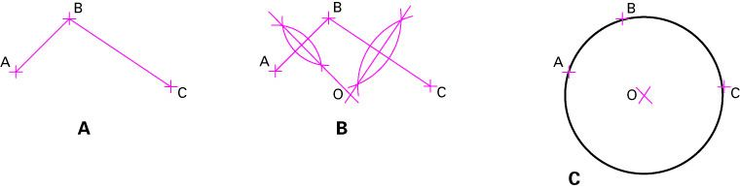
Applied Geometry for Board
Drafting
Constructing a circle given three points that lie on the circle. METHOD 1
Figure 5-22

Slide 25
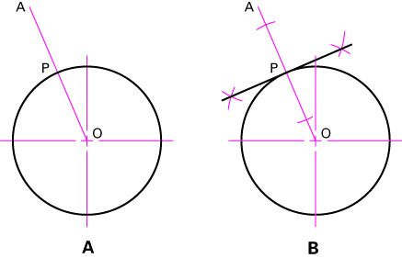
Applied Geometry for Board
Drafting
Constructing a line tangent to a circle through a given point on the circle. METHOD 1
Figure 5-23

Slide 26
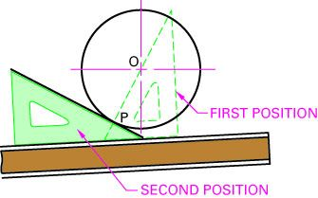
Applied Geometry for Board
Drafting
Constructing a line tangent to a circle through a given point on the circle. METHOD 2
Figure 5-24

Slide 27
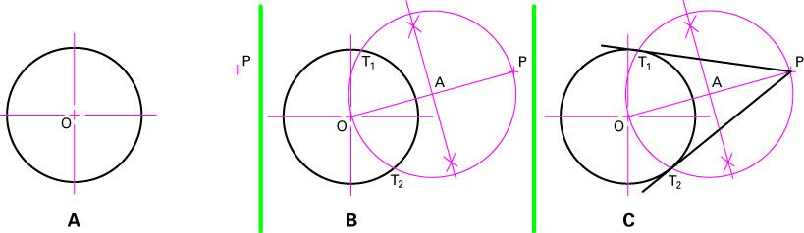
Applied Geometry for Board
Drafting
Constructing a line tangent to a circle through a given point outside the circle. METHOD 3
Figure 5-25

Slide 28
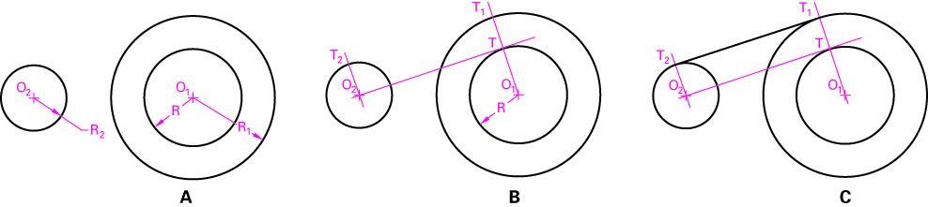
Applied Geometry for Board
Drafting
Constructing an exterior common tangent to two circles of unequal radii. METHOD 4
Figure 5-26

Slide 29
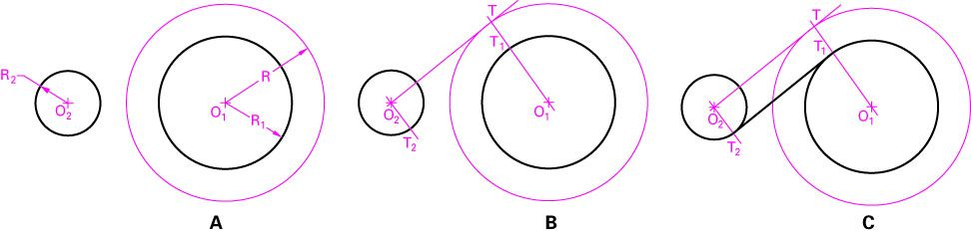
Applied Geometry for Board
Drafting
Constructing an exterior common tangent to two circles of unequal radii. METHOD 4
Figure 5-27

Slide 30
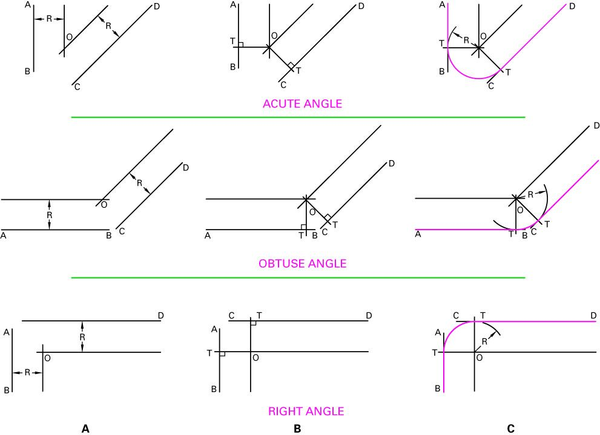
Applied Geometry for Board
Drafting
Constructing an arc tangent to two straight lines at an acute angle, an obtuse angle, and a right angle.
Figure 5-28

Slide 31
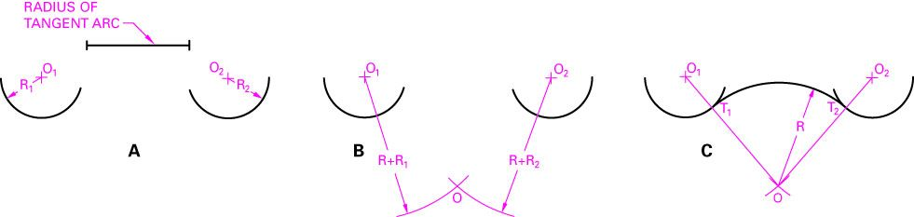
Applied Geometry for Board
Drafting
Figure 5-29
Constructing an arc tangent to two given arcs.

Slide 32
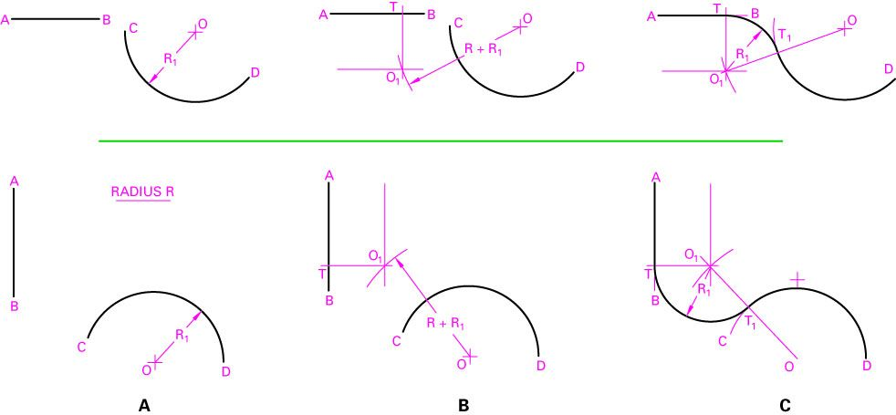
Applied Geometry for Board
Drafting
Constructing an arch tangent to line and an arc.
Figure 5-30

Slide 33
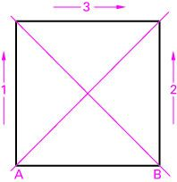
Applied Geometry for Board
Drafting
Constructing a square given the length of a side.
Figure 5-31

Slide 34
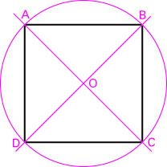
Applied Geometry for Board
Drafting
Constructing a square inscribed with in a circle.
Figure 5-32

Slide 35
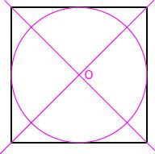
Applied Geometry for Board
Drafting
Figure 5-33

Slide 36
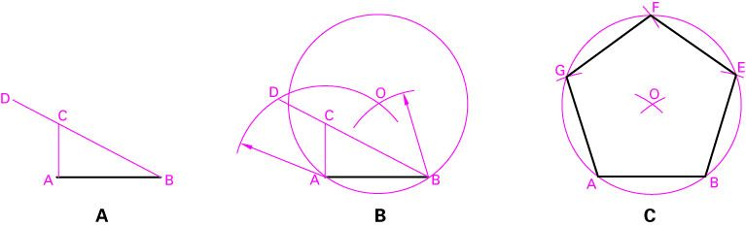
Applied Geometry for Board
Drafting
Figure 5-34

Slide 37
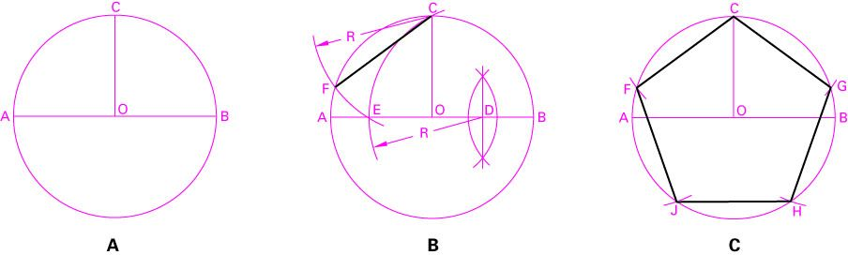
Applied Geometry for Board
Drafting
Figure 5-35

Slide 38
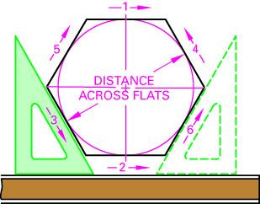
Applied Geometry for Board
Drafting
Figure 5-36

Slide 39
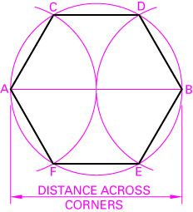
Applied Geometry for Board
Drafting
Figure 5-37

Slide 40
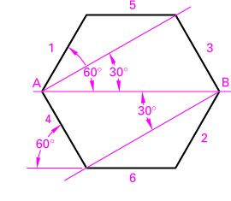
Applied Geometry for Board
Drafting
Figure 5-38

Slide 41
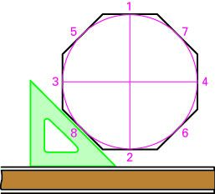
Applied Geometry for Board
Drafting
Figure 5-39

Slide 42
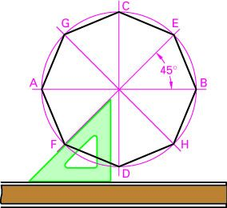
Applied Geometry for Board
Drafting
Figure 5-40

Slide 43
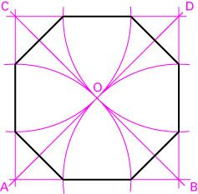
Applied Geometry for Board
Drafting
Figure 5-41

Slide 44
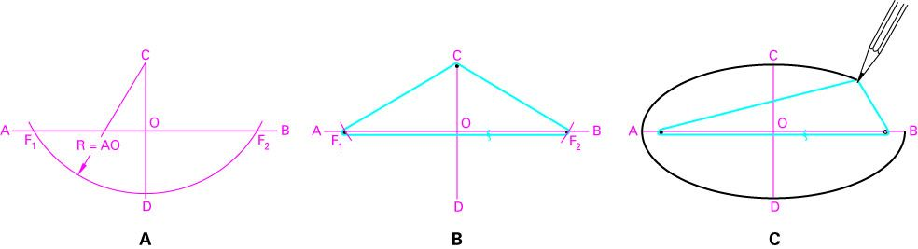
Applied Geometry for Board
Drafting
Figure 5-42

Slide 45
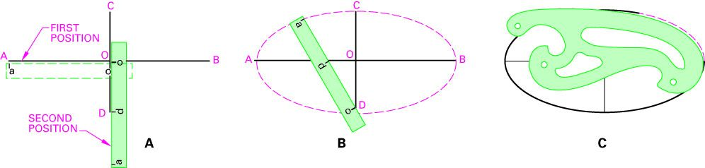
Applied Geometry for Board
Drafting
Figure 5-43

Slide 46
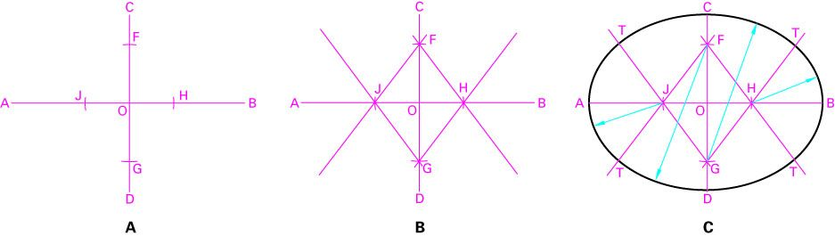
Applied Geometry for Board
Drafting
Figure 5-44

Slide 47
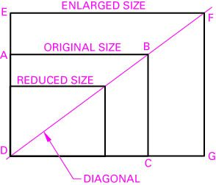
Applied Geometry for Board
Drafting
Figure 5-45

Slide 48
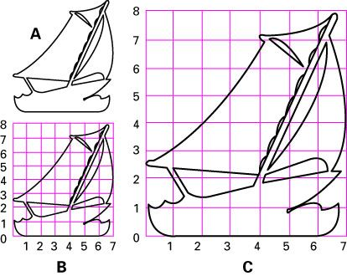
Applied Geometry for Board
Drafting
Figure 5-46

Slide 49
Chapter 6: Multiview Drawings

Slide 50
Multiview Drawing
Chapter Objectives
Explain orthographic projection.
Describe first- and third-angle projection.
Determine the number of views needed to describe fully
the shape and size of an object.
Locate multiple views on a drawing.
Create the various views of an object.
Develop a multiview drawing using board drafting.
Develop a multiview drawing using CAD.
Explain the advantages of using solid models in CAD.

Slide 51
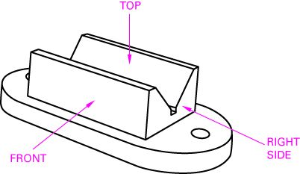
Understanding Orthographic
Projection
Figure 6-1

Slide 52
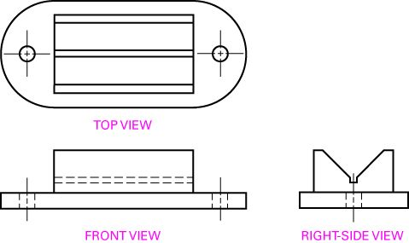
Understanding Orthographic
Projection
Figure 6-2

Slide 53
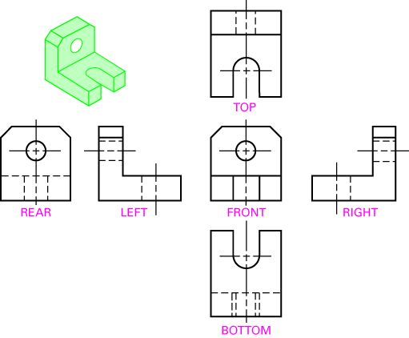
Understanding Orthographic
Projection
Figure 6-3

Slide 54
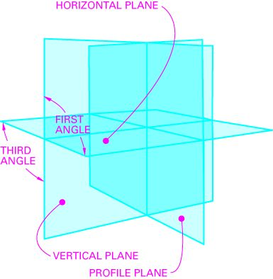
Understanding Orthographic
Projection
Figure 6-4

Slide 55
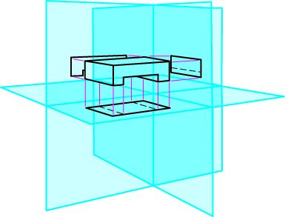
Understanding Orthographic
Projection
Figure 6-5

Slide 56

Understanding Orthographic
Projection
Figure 6-6

Slide 57

Understanding Orthographic
Projection
Figure 6-7

Slide 58

Understanding Orthographic
Projection
Figure 6-8

Slide 59

Understanding Orthographic
Projection
Figure 6-9

Slide 60

Understanding Orthographic
Projection
Figure 6-10

Slide 61

Understanding Orthographic
Projection
Figure 6-11

Slide 62

Understanding Orthographic
Projection
Figure 6-12

Slide 63

Understanding Orthographic
Projection
Figure 6-13

Slide 64

Understanding Orthographic
Projection
Figure 6-14

Slide 65

Understanding Orthographic
Projection
Figure 6-15

Slide 66

Understanding Orthographic
Projection
Figure 6-16

Slide 67

Understanding Orthographic
Projection
Figure 6-17

Slide 68

Understanding Orthographic
Projection
Figure 6-18

Slide 70

Understanding Orthographic
Projection
Figure 6-19

Slide 71

Understanding Orthographic
Projection
Figure 6-20

Slide 72

Understanding Orthographic
Projection
Figure 6-21

Slide 73

Understanding Orthographic
Projection
Figure 6-22

Slide 74

Understanding Orthographic
Projection
Figure 6-23

Slide 75

Understanding Orthographic
Projection
Figure 6-24

Slide 76
All Drafting
  Math Packet
  Page 204-205 (#1-7)
  Drafting 1-2
  Page 206 (1,2,4,5,11,14)
  Design Problem (1)

Slide 77
Applied Geometry for CAD Systems
Vocabulary
  Object Snap
  Ogee Curve
  Intervals
  Specify

Slide 78
Chapter 5.2
What do object snaps allow a drafter to do?
  Midpoint
  Nearest
  Endpoint
  Center
  Intersection
  Quadrant
  Perpendicular
  Tangent

Slide 79

Applied Geometry for CAD
Systems
Figure 5-48

Slide 80

Applied Geometry for CAD
Systems
Figure 5-49

Slide 81

Applied Geometry for CAD
Systems
Figure 5-50

Slide 82

Applied Geometry for CAD
Systems
Figure 5-51

Slide 83

Applied Geometry for CAD
Systems
Figure 5-52

Slide 84

Applied Geometry for CAD
Systems
Figure 5-53

Slide 85

Applied Geometry for CAD
Systems
Figure 5-54

Slide 86

Applied Geometry for CAD
Systems
Figure 5-55

Slide 87

Applied Geometry for CAD
Systems
Figure 5-56

Slide 88

Applied Geometry for CAD
Systems
Figure 5-57

Slide 89

Applied Geometry for CAD
Systems
Figure 5-58

Slide 90

Applied Geometry for CAD
Systems
Figure 5-59

Slide 91

Applied Geometry for CAD
Systems
Figure 5-60

Slide 92

Applied Geometry for CAD
Systems
Figure 5-61

Slide 93

Applied Geometry for CAD
Systems
Figure 5-62

Slide 94

Applied Geometry for CAD
Systems
Figure 5-63

Slide 95

Applied Geometry for CAD
Systems
Figure 5-64

Slide 96
Chapter 6.2: Multiview

Slide 97

Creating a Multiview Drawing
Using CAD
Figure 6-27

Slide 98

Creating a Multiview Drawing
Using CAD
Figure 6-28

Slide 99

Creating a Multiview Drawing
Using CAD
Figure 6-29

Slide 100

Creating a Multiview Drawing
Using CAD
Figure 6-30

Slide 101

Creating a Multiview Drawing
Using CAD
Figure 6-31

Slide 102

Creating a Multiview Drawing
Using CAD
Figure 6-32

Slide 103

Figure 6-33

Slide 104

Creating a Multiview Drawing
Using CAD
Figure 6-34

Slide 105

Creating a Multiview Drawing
Using CAD
Figure 6-35

Slide 106
All Drafting
  Math Packet
  Page 204-205 (#1-7)
  Drafting 1-2
  Page 206 (1,2,4,5,11,14)
  Design Problem (1)

