Slide 1
ME3492-HYDRAULICS AND PNEUMATICS
BE-MECHANICAL-II YEAR & III SEMESTER
PRESENTED BY,
S.VIGNESH, ME
ASSISTANT PROFESSOR,
DEPARTMENT OF MECHANICAL ENGINEERING,
SIR ISSAC NEWTON COLLEGE OF ENGINEERING AND TECHNOLOGY,
NAGAPATTINAMBY

Slide 2
UNIT-I FLUID POWER PRINCIPLES AND HYDRAULIC PUMPS
Introduction to Fluid power – Advantages and Applications – Fluid power systems – Types of fluids - Properties of fluids and selection – Basics of Hydraulics – Pascal’s Law – Principles of flow Friction loss – Work, Power and Torque- Problems, Sources of Hydraulic power: Pumping Theory-– Pump Classification – Construction, Working, Design, Advantages, Disadvantages, Performance, Selection criteria of pumps – Fixed and Variable displacement pumps – Problems.

Slide 3
COURSE OBJECTIVES
To provide the knowledge on the working principles of fluid power systems.
To study the fluids and components used in modern industrial fluid power system.
To develop the design, construction and operation of fluid power circuits.
To learn the working principles of pneumatic power system and its components.
To provide the knowledge of trouble shooting methods in fluid power systems.

Slide 4
COURSE OUTCOMES:
At the end of the course the students would be able to
Apply the working principles of fluid power systems and hydraulic pumps.
Apply the working principles of hydraulic actuators and control components.
Design and develop hydraulic circuits and systems.
Apply the working principles of pneumatic circuits and power system and its components.
Identify various troubles shooting methods in fluid power systems.

Slide 5
OBJECTIVES
Knowledge On The Applications Of Fluid Power In
Power Transmission System.
To Study The Fundamental Principles, Design And Operation Of Hydraulic And Pneumatic Machines, Components And Systems And Their Application In Recent Automation Revolution.
Understanding Of The Fluids And Components
Utilized In Modern Industrial Fluid Power System.
To Design, Construction And Operation Of Fluid Power Circuits.

Slide 6
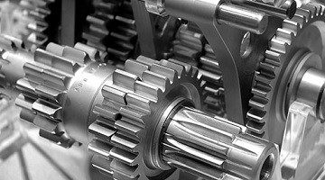
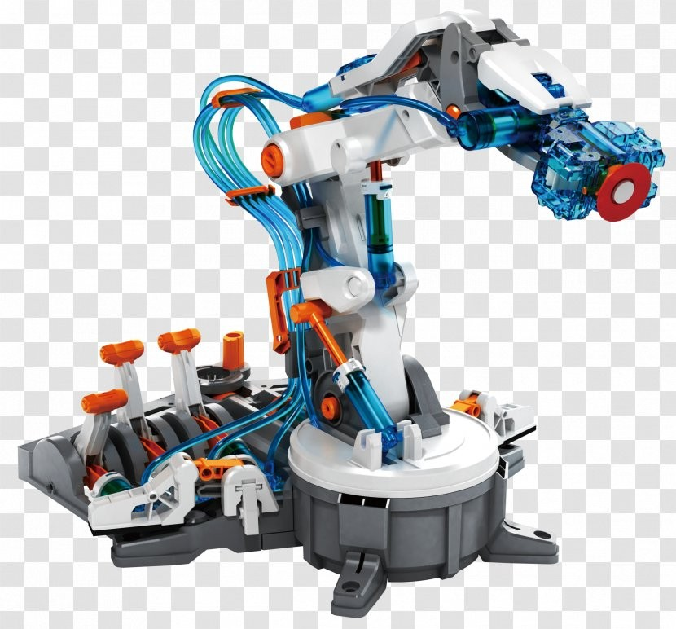
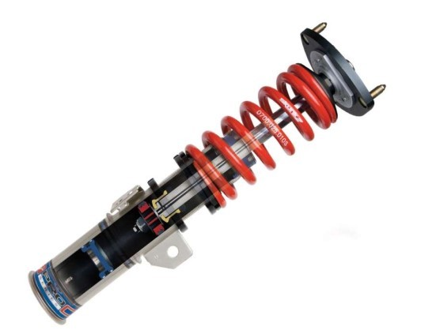
FLUID POWER:
The Common Methods Of Power Transmission are
Electrical, Mechanical, and Fluid Power.

Slide 7
FLUID POWER:
It may be defined as the technology that deals with the generation,
Control and transmission of power using pressurized fluids.
Use a fluid (liquid or gas) to transmit power from one location to another.
Hydraulics - liquid (usually oil),
Pneumatics - gas (usually compressed air).

Slide 8
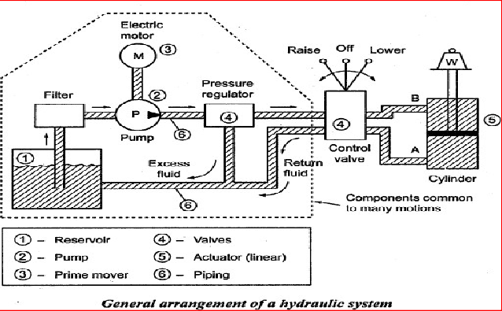
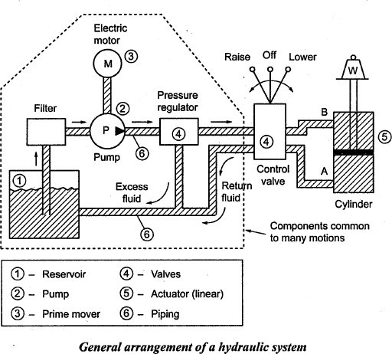
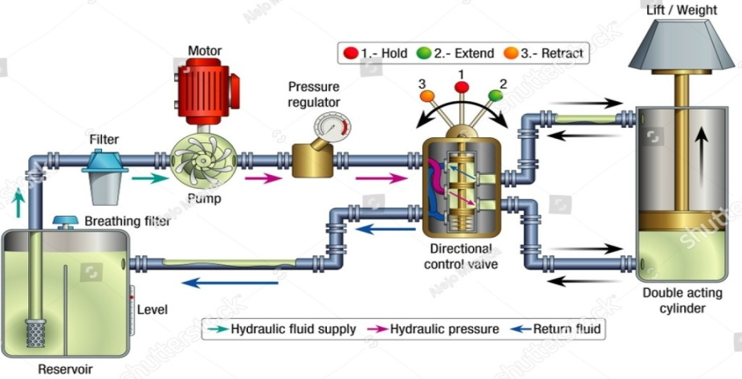
HYDRAULIC SYSYEM

Slide 9
HYDRAULIC SYSYEM Hydraulics is a mechanical function that operates through the force of liquid pressure. In hydraulics-based systems, mechanical movement is produced by contained, pumped liquid, typically through hydraulic cylinders moving pistons.

Slide 10
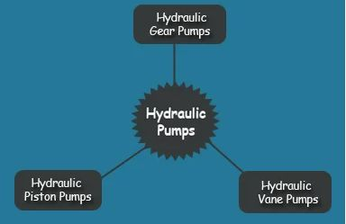
HYDRAULIC PUMP

Slide 11
INTERNAL GEAR PUMP A gear pump is a type of positive displacement (PD) pump. Gear pumps use the actions of rotating cogs or gears to transfer fluids. The rotating gears develop a liquid seal with the pump casing and create suction at the pump inlet

Slide 12
EXTERNAL GEAR PUMP External gear pump consists of two identical, interlocking gears supported by separate shafts. Generally, one gear is driven by a motor and this drives the other gear (the idler). In some cases, both shafts may be driven by motors. The shafts are supported by bearings on each side of the casing

Slide 13
ROTARY VANE PUMP A rotary vane pump is a type of positive-displacement pump that consists of vanes mounted to a rotor that rotates inside a cavity. In some cases these vanes can have variable length and/or be tensioned to maintain contact with the walls as the pump rotates.

Slide 14
LOBEPUMP A lobe pump, or rotary lobe pump, is a type of positive displacement pump. It is similar to a gear pump except the lobes are designed to almost meet, rather than touch and turn each other.

Slide 15
AXIAL PISTON PUMP An axial piston pump is a positive displacement pump that has a number of pistons in a circular array within a cylinder block. It can be used as a stand-alone pump, a hydraulic motor or an automotive air conditioning compressor.

Slide 16
RADIAL PISTON PUMP A radial piston pump is a form of hydraulic pump. The working pistons extend in a radial direction symmetrically around the drive shaft, in contrast to the axial piston pump.

Slide 17
BALANCED VANE PUMP Balanced vane pumps are fixed displacement pumps consisting of a two-lobe cam ring with two pressure and suction quadrants opposite each other, as shown in Fig. 1. Thus, the rotor is hydraulically balanced and bearing loads are reduced greatly. It is driven by the prime mover and carries the vanes in radial slot.

Slide 18
UNBALANCED VANE PUMP No leakage exists between the housing and the vane tip. Due to pressure variations between the intake and exhaust ports, a side thrust is formed on the rotor shaft. The bearing life is reduced due to the lateral force on the shaft.

