Slide 1
UNIT II COMPRESSION IGNITION ENGINES

Slide 2
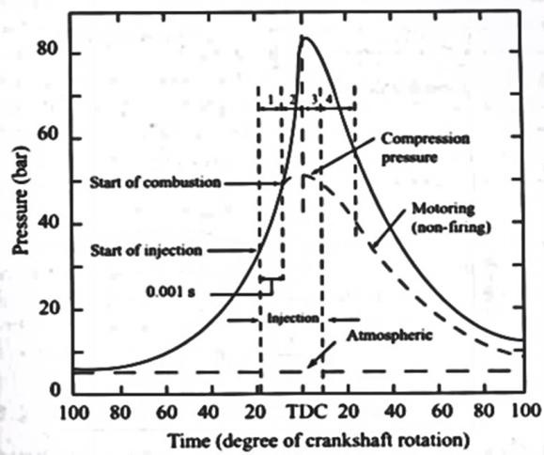
STAGES OF COMBUSTION IN CI ENGINE
The combustion in CI engine is considered to be taking place in four phases:
Ignition Delay period /Pre-flame combustion
Uncontrolled combustion
Controlled combustion
After burning

Slide 3
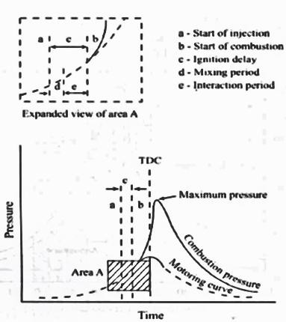
IGNITION DELAY PERIOD
Point a
represents the time of injection Point b
Represents the time at which the pressure curve (caused by combustion) first separates from the compression process

Slide 4
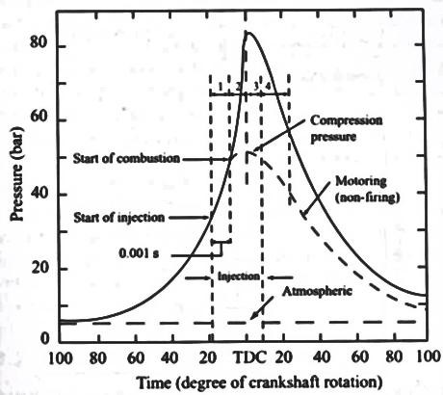
IGNITION DELAY PERIOD
Ignition delay (0.7-3ms) period is counted from the start of injection to the point where the pressure time curve separates from the compression curve indicated as start of combustion.
The ignition delay period can be divided into two parts,
Physical delay
Chemical delay.

Slide 5
IGNITION DELAY PERIOD
The physical delay depends on
The type of fuel,
For light fuel the physical delay is small
For heavy viscous fuels the physical delay is high
Injection Pressure
The physical delay is greatly reduced by using high injection pressures
Combustion chamber temperatures and Turbulence to facilitate
break up of the jet and
Improving evaporation.

Slide 6
IGNITION DELAY PERIOD
Chemical delay depends,
On the temperature of the surroundings
At high temperatures, the chemical reactions are faster
In most CI engines the ignition lag is shorter than the duration of injection.
Generally, the chemical delay is larger than the physical delay.

Slide 7
PERIOD OF UNCONTROLLED COMBUSTION
The uncontrolled combustion also called the period of rapid combustion, is that phase in which the pressure rise is rapid.
The period of rapid combustion is counted from the beginning of the combustion to the point of maximum pressure on the indicator diagram.

Slide 8
PERIOD OF CONTROLLED COMBUSTION
The temperature and pressure in the second stage is already quite high.
Hence the fuel droplets injected during the second stage burn faster with reduced ignition delay as soon as they find the necessary oxygen and any further pressure rise is controlled by the injection rate.
The period of controlled combustion is assumed to end at maximum cycle temperature.

Slide 9
PERIOD OF AFTER BURNING
Combustion does not cease with the completion of the injection process.
The unburnt and partially burnt fuel particles left in the combustion chamber start burning as soon as they come into contact with the oxygen.
This process continues for a certain duration called the after-burning period.

Slide 10
PERIOD OF AFTER BURNING
Usually this period starts from the point of maximum cycle temperature and continues over a part of the expansion stroke.
Rate of after-burning depends on
The velocity of diffusion and
Turbulent mixing of unburnt and partially burnt fuel with the air

Slide 11
FLAME FORMATION IN A CI ENGINE

Slide 12
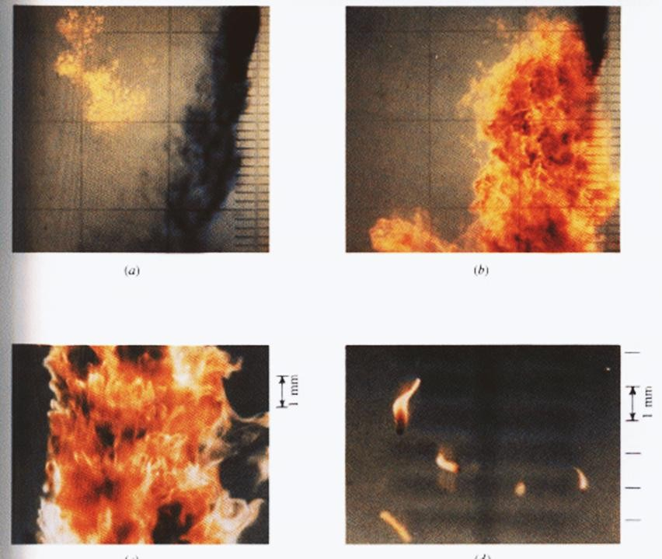
COMBUSTION IN A CI ENGINE

Slide 13
PHENOMENON OF DIESEL KNOCK
Knocking is violent gas vibration and audible sound produced by extreme pressure differentials leading to the very rapid rise during the early part of uncontrolled second phase of combustion.
In C.I. engines the injection process takes place over a definite interval of time.
Consequently, as the first few droplets injected are passing through the ignition lag period, additional droplets are being injected into the chamber.
If the ignition delay is longer, the actual burning of the first few droplets is delayed and a greater quantity of fuel droplets gets accumulated in the chamber.
When the actual burning commences , the additional fuel can cause too rapid rate of pressure rise.

Slide 14
FACTORS AFFECTING DIESEL KNOCK
A low combustion pressure due to worn out piston, rings and bad valves
Low cetane number of fuel
Poorly atomized fuel spray preventing early combustion
Coarse droplet formation due to malfunctioning of injector parts like spring
Low intake temperature and pressure of air

Slide 15
METHODS OF CONTROLING DIESEL
KNOCK
Using a better fuel:
➢Higher CN fuel has lower delay period and reduces knocking tendency.
Controlling the Rate of Fuel Supply:
➢By injecting less fuel in the beginning and then more fuel amount in the combustion chamber detonation can be controlled to a certain extent.
➢Cam shape of suitable profile can be designed for this purpose.

Slide 16
METHODS OF CONTROLING DIESEL
KNOCK
Knock reducing fuel injector:
➢This type of injector avoids the sudden increase in pressure inside the combustion chamber because of accumulated fuel.
➢This can be done by arranging the injector so that only small amount of fuel is injected first.
➢This can be achieved by using two or more injectors arranging in out of phase.

Slide 17
METHODS OF CONTROLING DIESEL
KNOCK
By using Ignition accelerators:
➢Cetane Number can be increased by adding chemical called dopes.
➢The two chemical dopes are used are ethyl-nitrate and amyle - nitrate in concentration of 8.8 gm/Litre and 7.7 gm/Litre.
➢But these two increase the NOx emissions.

Slide 18
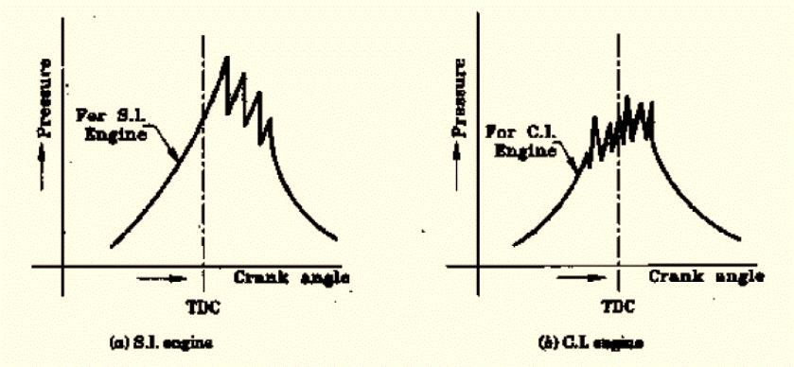
COMPARISION OF SI AND CI ENGINE
KNOCK

Slide 19
COMPARISION OF SI AND CI ENGINE
KNOCK
In order to avoid knocking in SI engine, it is necessary to prevent auto ignition of the end gas to take place. In CI engine, the earliest auto ignition is necessary to avoid knocking.
The knocking in SI engine takes place in homogeneous mixture, therefore , the rate of pressure rise and maximum pressure is considerably high. In case of CI engine, the mixture is not homogenous and hence the rate of pressure is lower than in SI engine.
In CI engine only air is compressed, therefore there is no question of Pre-ignition in CI engines as in SI engines.
SI fuels should have long delay period to avoid knocking. CI fuels should have short delay period to avoid knocking.

Slide 20
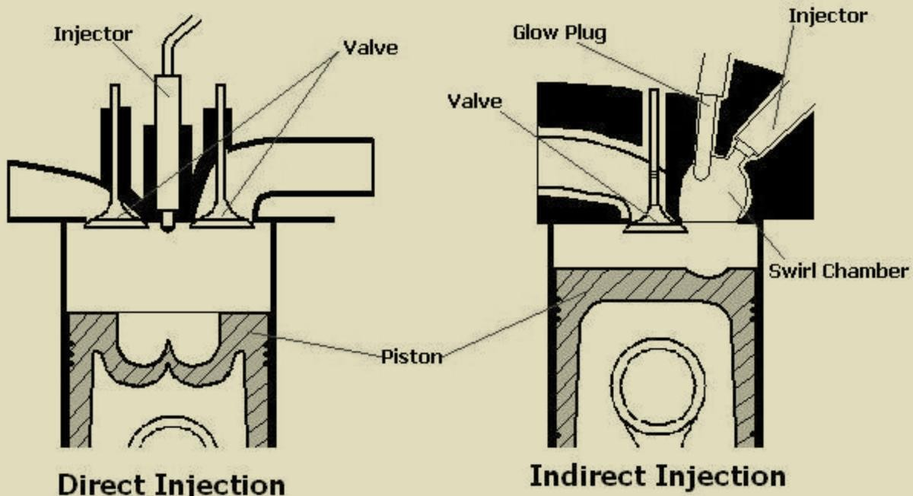
DIRECT AND INDIRECT INJECTION SYSTEMS

Slide 21
DIRECT INJECTION DIESEL ENGINE
Direct injection diesel engines have injectors mounted at the top of the combustion chamber.
The injectors are activated using one of two methods
hydraulic pressure from the fuel pump
an electronic signal from an engine controller.
Hydraulic pressure activated injectors can produce harsh engine noise.
Fuel consumption is about 15 to 20% lower than indirect injection diesels.
Electronic control of the fuel injection transformed the direct injection engine by allowing much greater control over the combustion.

Slide 22
INDIRECT INJECTION DIESEL ENGINE
An indirect injection diesel engine delivers fuel into a chamber off the combustion chamber, called a pre-chamber or ante-chamber, where combustion begins and then spreads into the main combustion chamber, assisted by turbulence created in the chamber.
This system allows for a smoother, quieter running engine, and because combustion is assisted by turbulence.
Injector pressures can be lower, about 100 bar, using a single orifice tapered jet injector.
The pre-chamber had the disadvantage of increasing heat loss to the engine's cooling system, which reduced the efficiency.
The emissions are comparatively lower than the direct injection engines.

Slide 23
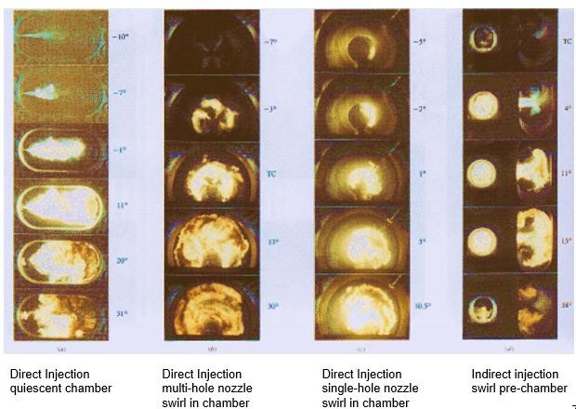
DIRECT AND INDIRECT INJECTION SYSTEMS

Slide 24
TYPES OF COMBUSTION CHAMBERS
C I engine combustion chambers are classified into two categories:
OPEN INJECTION (DI) TYPE
INDIRECT INJECTION (IDI) TYPE

Slide 25
OPEN INJECTION (DI) TYPE COMBUSTION
CHAMBER
This type of combustion chamber is also called an Open combustion chamber.
In this type the entire volume of combustion chamber is located in the main cylinder and the fuel is injected into this volume.
The following are the different types of open injection type combustion chambers,
Shallow Depth Chamber
Hemispherical Chamber
Cylindrical Chamber
Toroidal Chamber

Slide 26
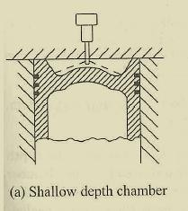
SHALLOW DEPTH CHAMBER
In shallow depth chamber the depth of the cavity provided in the piston is quite small.
This chamber is usually adopted for large engines running at low speeds.
Since the cavity diameter is very large, the squish is negligible.

Slide 27
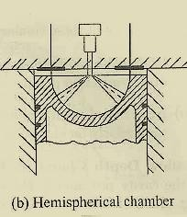
HEMISPHERICAL CHAMBER
This chamber also gives small squish.
However , the depth to diameter ratio for a cylindrical chamber can be varied to give any desired squish to give better performance.

Slide 28
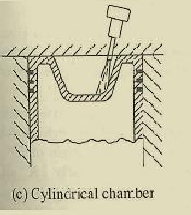
CYLINDRICAL CHAMBER
This design was attempted in recent diesel engines.
This is a modification of the cylindrical chamber in the form of a truncated cone with base angle of 30°.
Squish can also be varied by varying the depth.

Slide 29
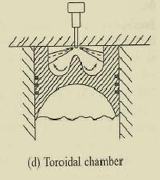
TOROIDAL CHAMBER
The idea behind this shape is to provide a powerful squish along with the air movement.
The cone angle of spray for this type of chamber is 150° to 160°.

Slide 30
INDIRECT INJECTION (IDI) TYPE
COMBUSTION CHAMBER
In this type of combustion chambers, the combustion space is divided into two parts, one part in the main cylinder and the other part in the cylinder head.
The fuel injection is effected usually into the part of chamber located in the cylinder head.
The following are the some of the examples of indirect injection type combustion chamber,
Ricardo’s Swirl Chamber
Pre Combustion Chamber

Slide 31
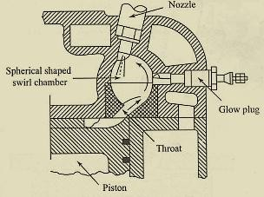
RICARDO’S SWIRL CHAMBER
Swirl chamber consists of a spherical shaped chamber separated from the engine cylinder and located in the cylinder head.
In to this chamber, about 50% of the air is transferred during the compression stroke.
A throat connects the chamber to the cylinder which enters the chamber in a tangential direction so that the air coming into this chamber is given a strong rotary movement inside the swirl chamber.

Slide 32
RICARDO’S SWIRL CHAMBER
After combustion, the products rush back into the cylinder through same throat at much higher velocity.
The use of single hole of larger diameter for the fuel spray nozzle is often important consideration for the choice of swirl chamber engine.

Slide 33
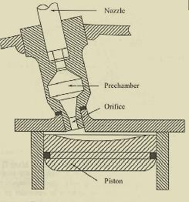
PRE COMBUSTION CHAMBER
Typical pre-combustion chamber consists of
an anti-chamber connected to the main
chamber through a number of small holes.
The pre-combustion chamber is located in the cylinder head and its volume accounts for about 40% of the total combustion space.
During the compression stroke the piston forces the air into the pre-combustion chamber.

Slide 34
PRE COMBUSTION CHAMBER
The fuel is injected into the pre-chamber and the combustion is initiated.
The resulting pressure rise forces the flaming droplets together with some air and their combustion products to rush out into the main cylinder at high velocity through the small holes.

