Slide 1
UNIT IV

Slide 2
Polymers are used in number of applications ----
toys,
home appliances,
structural and decorative items,
coatings, paints, adhesives,
automobile tyres
Feams and packing

Slide 3
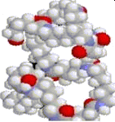
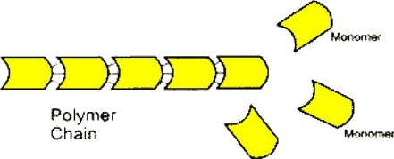
Large size molecule
monomer 2

Slide 4
A re made
of ma ny
sma r
ng
epeat
 | its |  | k
molecular n
nown as
means

Slide 5
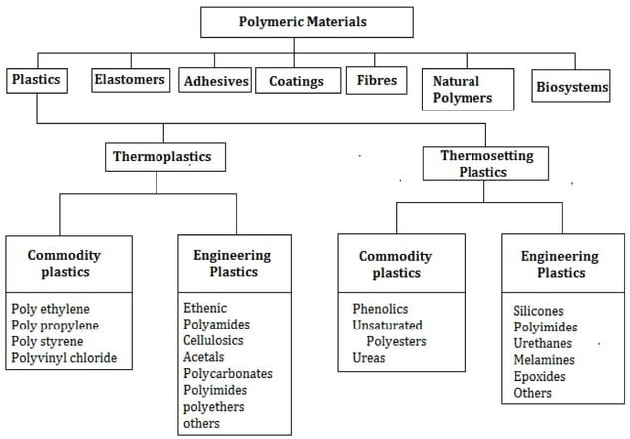

Slide 6
properties of Polymers
Excellent mechanical properties over temperatures from below -40°C (-40°F) to above 148°C (300°F),
Self-extinguishing, non-dripping characteristics,
Excellent durability, dimensional stability and low water absorption,
Resistance to aqueous chemical environments.
EKcelient impact strength.

Slide 7
POLYMERISATION
Its reaction of joining of small molecules to form molecule having higher weight called polymer.

Slide 8
Classification of Polymers:
Homopolymers consist of chains with identical bonding linkages to each monomer unit. This usually implies that the polymer is made from all identical monomer molecules.
These may be represented as : [A-A A A A A]
Copolymers - consist of chains with two or more linkages usually implying two or more different types of monomer units.
These may be represented as : -[A-B-A-B-A-B]-

Slide 9
Addition Polymers
the monomer molecules
bond to each other without the loss of any
other atoms. Alkene monomers are
the
biggest groups of polymers in this class.
Condensation Polymers - usually two different monomer combine with the loss of a small
molecule, usually water. Polyesters and
of
polyamides (nylon) are in this class
polymers. Polyurethane Foam in graphic.

Slide 10
Thermoplastics - plastics that soften when
heated and become firm again when cooled.
Thermosets plastics that heated and can be molded,
soften but
when harden when
permanently. They will decompose
reheated. An example is Bakelite, which is used in toasters, handles for pots and pans, dishes, electrical outlets and billiard balls.

Slide 11
Terminology used in polymers
Monomer
They are made up of small and repeating molecular units known as Monomers
Polymer
it's a macro molecule formed by repeated linking nf many monomers
polymerization
it's a process of forming a polymer

Slide 12
Terminology used in polymers
4. homopolymer
It consist of chains with identical
unit. This
bonding usually
linkages to each monomer
implies that the identical
polymer is made from all monomer molecules.
These may be represented as : -[A-A-A-A-A-A]-
5. Copolymers
It consist of chains with two or more linkages usually implying two or more different types of monomer units.
These may be represented as : -[A-B-A-B-A-B]-

Slide 13
Terminology used in polymers
Degree of polymerization
molecular weight of a polymer
" molecular weight of a single monomer
High polymer
Solid polymer which have very high molecular weights ( 10000 to 1000000 g/mol)
Oligo polymer
They are liquid / gas polymers with very short chains ( having the molecular weight en the order of 100 g/mol)

Slide 14
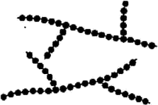
Types of homo polymers
Linear polymer
Here the mer units are joined to end to end in single chain.
Branched polymer
Here the side branch chains are connected to the main chain

Slide 15
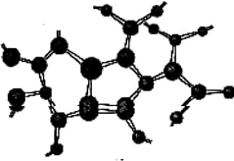
Types of homo polymers
Cross linked polymer
Here
chains
the adjacent
are joined
at
linear
one to
another
various
positions by covalant bond
Network polymers
It has three active covalent bonds (trifunctional mer units) which form these dimensional networks instead of the linear chain frame work

Slide 16
Types of copolymers
Random copolymers
Here 2 different units are randomly dispersed along a chain
Random Copolymers
Alternating copolymer
The 2 mer units placed alternatively

Slide 17
Types of copolymers
Block copolymer
Identical mers are clustered in blocks along the chain.
Graft copolymer
In this , homopolymer side branches of one type may be grafted to homopolymer main chains that are composed of a different mer.
Bloc[‹ Copolymers
Gradient Copolyrners

Slide 18
Types of copolymers
5. Isomerism:
It is a phenomenon wherein different atomic configurations are possible for the same configuration. For example, there are two isomers for butane (CtH₁₀) as shown in Fig.
H-C—.0 H H
H — C — C — C — N
H H H H
.
H — C — C — C — U — H
I I I
H H H H

Slide 19
Polymerization may be defined as the process of growing large molecules from small ones. Polymerization links together monomers.
MonDmers are molecules which combined end to end to form large molecules known as polymer. They are three general methods (or) mechanism of polymerization.
Addition of polymerization
Condensation of polymerization
Copolymerization

Slide 20
Addition polymerisation
Definition: A chemical reaction in which simple molecules (monomers) are added to each other to form long-chain molecules (polymers) without by-products. The molecules of the monomer join together to form a polymeric product in which the molecular formula of the repeating unit is identical with that of the monomer. The molecular weight of the polymer so formed is thus the total of the molecular weights of all of the combined monomer units.
H_{I}
Heat .Ligliy
^{H}I"
—C'— C'
I Ï
H H

Slide 21
Copolymerization:
Copolymerization is another kind of
addition
polymerization. Many monomers will
but
not
will
polymerize copolymerize
with
with
themselves,
other compounds.
Copolymerization is the addition polymerization of two or more different monomers. Examples of butadiene-styrene, a rubber used in tires.

Slide 22
Condensation polymerization:
Bakelite, the first commercial plastics, owes its
origin to the
polymerization.
Condensation
process called condensation
polymerization occurs in the
combination of a compound with itself or other compounds, accompanied by the elimination of some simple compound as H₂O, HCI ,etc .,as a result of polymerization.
Phenol + Formaldehyde •g• Water + Phenol- formaldehyde
C₆^ OH + CH₂O H₂O +
^{C}13’10(^{OH})
n

Slide 23
Properties and applications of thermoplastics

Slide 24
Polyethylene (PE)
Polyethylene is made from petroleum or natural gas Raw product s.
The early processes for production involved extremely high pressure and temperature as high as 400 low density Polyethylene.
It‘s produced two process. High density and low density
Polyethylene.
High density Polyethylene is made by low pressure and low temperature. The current trend is to use these latter processes because of their lower energy requirements.
The most recent processes produces' Polyethylene grade called linear low-density Polyethylene (LLDPE).

Slide 25
Properties of PE
They have excellent resistance to most solvent and chemicals.
It has a good flexibility property.
They are non-toxic.
They possess good electrical insulation
properties.

Slide 26
Application of PE
Polyethylene used in packaging film, coating and laminations.
It used to produced gaskets and seals.
Wrapping for textile products.
It is used for Cable coating and insulation tapes.
They are used for transporting water and various other chemicals.
Polyethylene containers are used as packaging material for pharmaceuticals, corrosive chemicals, and cosmetics.

Slide 27
Polypropylene (PP)
Polypropylene is formed the manomer propane
i.e., Propylene.
Polypropylene has becomes a major plastics, especially for injection molding.
It is similar to high density polyethylene (HDPE). It is lightest of the plastics and strength to weight ratio is high.

Slide 28
Properties of PP
They are high melting point.
They are lighter weight.
It has excellent fatigue resistance.
They are stiffer, hardener and stronger.
It has good chemical and thermal resistance.
Low density.
Good surface hardness and good dimensional stability.
Good resistance against moisture and chemicals.

Slide 29
Application of PP
Automotive and house ware.
Fiber products for carpeting.
it is also used for hinges components.
Laboratory ware and bottles of various types.
Shoes, textile cones and bobbins, toys.

Slide 30
Polystyrene (PS)
This plastics account for about 20% of all the thermoplastics in commercials use.
Polystyrene is made from ethyl benzene.
A large benzene ring replaces a hydrogen atom on an ethylene molecule.
Polystyrenes are predominantly amorphous and a tactic.

Slide 31
Properties of PS
PS possesses good dimensional stability
Low mould shrinkage and can be processed at a low cost.
Dielectric resistance is satisfactory.
Surface hardness of PS is better than PP.
Mechanical properties within the operating temperature limit.
It is soluble in many hydrocarbons.
It is easy thermoform ability.

Slide 32
Application of PS
It is used for household items such as imitation glass and cut glass varieties.
The copolymerized PS can be used for injection molded industrial components.
PS is also used in refrigeration components and many applications.
PS are used in the insulation of cold storage warehouse, building foundations.
Packaging items for delicate instruments such as cameras, calculators.
Other application includes automobile interior parts dials and knobs.

Slide 33
Polyvinyl Chloride (PVC)
Th€' widely uSE'd acronym for polyvinyl chloride is PVC.
It is one of the most widely used plastics in tE'rms of
volume produced.
PVC is made by reacting acetVlene gas ( C₂H ) with hydrochloride acid in the presence of a suitable catalyst.
The manomer has one chlorine atom substituted for a hydrogen atom.

Slide 34
Properties of PVC
PVC has a relative high density 52.5 — 63 )
Medium heat deflection temperature ( 52 -82 )
Good electrical properties
High solvent resistance, flame and chemical resistance.
PVC is a high rigid and brittle material.

Slide 35
Application of PVC
Non plasticized PVC grade are widely used for manufacturing of pipes and conduits.
PVC finds use in furniture and automobile upholstery, shaped cushion, interior wall coverings, rainwear, shoes, luggage and shower curtains.
PVC is used for auto top covering, electric wires insulation, floor mats and interior and exterior trim.
Other applications include garden hoses, refrigerator gaskets, appliance components and house ware.
PVC organ sol, which is a solution of the resin in solvent is used for Impregnating fabrics, paper coatings, lamp shade etc.,

Slide 36
Polymethyl methacrylate (PMMA)
This complicated name applies to a polymer that everyone is familiar with. Polymethyl methacrylate is the polymer used to make the clear, sheet material in unbreakable windows.
It may be more readily recognized by the trade name Plexiglas.
Another name commonly used for polymers based on polymethyl methacrylate is acrylics.

Slide 37
Properties of PTFE
Acrylics are noted for excellent optical properties.
Its have good mechanical properties.
Good thermal resistance and very good dimensional stability.
It also has an excellent weather resistance.
Acrylic moldings have deep luster and high
surface gloss.

Slide 38
Application of PTFE
One of the most popular applications of acrylics is in making thermoformed sheets.
It is used in wind shield for automobile, boats, and snow mobiles, aircraft and instruments dials.
” Due to glDssiness and transparency acrylics find uses as decorative and novelty items.

Slide 39
Polypthylene Terephthalate (PET)
Thermoplastics polyesters have been used for about 35 years, predominantly in films for packaging and in fibers.
Everyone is familiar with polyester clothing and polyester auto tire reinforcement.
These are thermoplastics polyester, usually polyethylene terephthalate.

Slide 40
Properties (PET)
PBT has good injection characteristics and mechanical properties similar to nylon.
It has a use temperature above that of most nylons, and it does not have the moisture absorption problems of nylon.
PET and PBT are closely related polymers in use properties with only subtle difference.
PET is slightly stronger and lower in cost.

Slide 41
Application of (PET)
Structural application in appliances, automobiles, and consumer products.
About 4Sº/ of the production of PET goes into
films for photography and packaging.
PET has been used for plastics liter-size beverage bottles and for engineering plastics application such as auto parts, gear, and cams.
PBT is widely used in blends.
It is also used in electrical application.

Slide 42
Polycarbonates ( PC )
Polycarbonates are really polyester, since both are ester of carbonic acid and an aromatic biphenol.
The polycarbonate is amorphous linear polyesters with excellent mold ability and impact strength.
Which is made from the condensation of biphenol A and carbonic acid.

Slide 43
Properties of (PC)
PCs possess excellent dimensional stability over
a wide range of temperature.
Good ductility properties they can be nailed
sawed, punched, drilled, cold drawn.
It has electrical and chemical resistance properties.
They have a good strength and rigidity and because of high modulus of elasticity, possess good creep resistance.
PC parts have good stability and accurate
molded parts.

Slide 44
Application of (PC)
PCs are used in the manufacture of helmets, safety shields, street lamp cover, factories and school windows, machine guard, gears and cams.
PCs find uses as housing for high voltage lamps, aircraft parts, instruments panel.
Other applications include electronic equipment,
equipment machine, machine.
for cars, electrical relay covers, business
gauges, refrigerator parts, food vending
It is used in structural application. Principle application for automotive trim, lenses and like, and for all sorts of application parts.

Slide 45
Polyamides (PA)
An important polymer family that forms characteristics amid linkage ( CO-NH ) during polymerization is called the polyamides ( PA ).
The most important members of the PA family are nylons, of which the two principle grade are nylon - 6 and nylon 6, 6 ( the number are codes that indicate the number of carbon atoms in the monomer ) . Nylon — 6, which were developed at Du point in the 1930s.Properties of nylon 6, developed in Germany are similar.

Slide 46
Properties of (PA)
Nylon is strong, highly elastics, tough abrasion resistant, and self — lubricating.
It retain good mechanical properties at temperature up to about 125 (250)
One shortcoming is that it absorbs water with an accompanying degradation in properties.

Slide 47
Application of (PA)
Nylon is commonly a good substitute for metals in bearings, gear, and similar parts.
The majority of applications of nylon (about) are in fiber for carpets, apparel, and tire cord.

Slide 48
Acrylonitrile Butadiene Styrene (ABS)
It’s a type of polystyrene (PS)
- This material is a terpolymer of acrylonitrile, butadiene and styrene.
Usual compositions are about half styrene with the balance divided between butadiene and acrylonitrile.
Acrylonitrile Butadiene Styrene (ABS) polymer was first discovered during World War II

Slide 49
FEATURES
Flame Retardant ,
° High Heat Resistance ,
° Good Impact Resistance ,
High Impact Resistance ,
High Flow ,
° General Purpose ,
Good Flow ,
Good Process ability,
High Gloss ,
° Good Dimensional Stability

Slide 50
USES
Automotive Applications ,
° Electrical/Electronic Applications ,
° General Purpose ,
Housings ,
Appliances ,
° Business Equipment ,
Automotive Interior Parts ,
Thin-walled Parts ,
Appliance Components ,
° Computer Components ..

Slide 51
Application of ABS
° helmets,
refrigerator doors,
computer housings,
suitcases,
steering wheels,
grills for hot air systems,
pump impellers,
telephone housings,
electrical conduct, tubes and pipes.
In view of its low temperature resistance, ABS is used for fishing tackle boxes, fishing reels, etc.
Various thermoformed components are used in boats and trailer components.

Slide 52
Disadvantages
Limited weathering resistance
Moderate heat, moisture and chemical resistance
Relatively high cost
Flammable with high smoke generation

Slide 53
Polyimides (PI)
Polyimides are a group of linear aromatic polymers
They are produced in condensation reaction
Characteristics of Pis:
Good mechanical properties
Excellent thermal resistance up to 250-"C
Good resistance to organic solvents expect, alikies and concentrated acids
Applications of Pis:
High temperature electrical cables.
Printed circuit boards,
Turbine blades and other components requiring fire
resistance, strength at high temperatures and good electrical properties.

Slide 54
Polyamide—imides (PAI)
Polyamide-imides are amorphous thermoplastic materials with excellent mechanical properties, especially at elevated temperatures.
Its similar to PI .
Its also a aromatic polymer for use at high temp.

Slide 55
Properties of polyamide imide
The distinguishing characteristic of this family of polymers is high strength and a high maximum operating temperature.
Polyamide imides have a high modulus of elasticity.
They are transparent to microwave and are not
affected by radiations.
They have excellent thermal resistant upto 250 " Celcius.
Used in spark ignition engines.

Slide 56
Applications of polyamide imide
Most involve carrying loads at elevated temperatures or some elevated temperature electrical application.
Users capitalize on this PAT's elevated temperature strength.
Valves made from PAI replace bronze castings in hot water plumbing systems.
Polyamide imides are premium engineering plastics.
They should be used where elevated temperature strength and injection moldability are important selection factors.

Slide 57
Polyphenylene oxide (PPO)
Its a high-temperature thermoplastic.
It is rarely used in its pure form due to difficulties in processing.
It is mainly u5ed as blend with polystyrene, high impact styrene-butadiene copolymer or polyamide.

Slide 58
Properties of PPOs
PPE is an amorphous high-performance plastic. The glass transition temperature is 215 °C, but it can be varied by mixing with polystyrene. Through modification and the incorporation of fillers such as glass fibers, the properties can be extensively modified.
Applications of PPOs:
structural parts, electronics, household and automotive items that depend on high heat resistance, dimensional stability and accuracy.

Slide 59
Polyphenylene sulphide (PPS)
It is an organic polymer consisting of aromatic rings linked by sulfides. Synthetic fiber and teXtiles derived from this polymer resist chemical and thermal attack.
Characteristics of PPSs
It's a high temperature thermoplastic polymers
resistance to heat, acids, alkalies, mildew, bleaches, aging, sunlight, and abrasion.
It absorbs only small amounts of solvents and
resists dyeing.

Slide 60
Applications of PPSs
filter fabric for coal boilers,
papermaking felts,
electrical insulation,
film capacitors, specialty
ga5kets, and packings.
membranes,

Slide 61
Polyether ether ketone (PEEK)
It is a linear crystalline hetro chain polymer for High temperature plastics
characteristics of PEEKs:
Melting temperature is high.
Low flammability and low smoke emission.
Good fatigue and chemical resistance. Applications of PEEKs:
High temperature engineering components, high temperature electrical coatings and aerospace applications.

Slide 62
nginee ng
CERAMICS

Slide 63
Classifications of engineering ceramics
Alumina (AI₂0₃)
Silicon Carbide (SiC)
Silicon Nitride (Si₃N₄)
Partially stabilized Zirconia
Sialons

Slide 64
Alumina (aluminium oxide) AI,O₃
Its produced from bauxite
It is the most widely used oxide ceramic material. As a raw material, AI₂O₃ powder i5 produced in large quantities from the mineral bauxite
It is most cost effective & widely used material.

Slide 65
Properties of Alumina
Excellent hardness, wear resistance
They are more stiffer than steel
More stronger in compression than hardened steel
Very good environmental resistance
high tensile and toughness properties.
Excellent dielectric properties
Resist strong acid and alkali attack at high temperatures.
Good thermal conductivity.
Excellent size and shape capability.

Slide 66
Applications of alumina
Spark plug insulators
Electronic circuits
Rocket nozzles
Electrical and electronics devices
Bearings and seal rings
Gas laser tubes
Wear pads
High temperature electrical insulators
High voltage insulators
Furnace liner tubes

Slide 67
Silicon carbide (sic)
Silicon carbide (SiC) is an important ceramic material that is made by allowing sand to react with powdered carbon at high temperature round 2o0 ºC . Carbon monoxide is also formed.
The powdered material is formed or compacted by using most of the conventional ceramic forming processes such as die pressing, isostatic pressing and injection moulding. Then sintered silicon carbide can then be machined to precise tolerances using a range of precision diamond grinding or lapping techniques.

Slide 68
Properties of Sic
High tensile strength
High stiffness , hardness
Better dimensional stability
Good wear resistant, Low porosity
Good corrosion resistant.
Applications of Sic
As a abrasives for grinding wheel
As a coating material
As a refractory tubes In nuclear reactor
In bearings
And in very high temperature places

Slide 69
Silicon nitrate (Si n₄)
The silicon nitride ceramics involves powder preparation, mixing, shaping and sintering or hot- pressing at temperatures typically above 1700°C.
The material is dark gray to black in cOlOr and can be polished to a very smooth reflective surface, giving parts with a striking appearance.

Slide 70
Properties of silicon nitrides
Resistant to strong acids
Resistance to thermal shock
Low density and low weight
Low thermal expansion
More stiffer
Applications of silicon nitrides
Used in
Cutting tool materials
Turbine parts
Pump parts
High temperature engineering components

Slide 71
Partially stabilized zirconia (PSZ)
It's a zirconium oxide
Blended and sintered with others like magnesium
oxide, calcium oxide
Zirconia is an extremely refractory material.
Properties of PSZ
High tensile strength
Low thermal conductivity
Applications of PSZ
As a blade in jet engine
As a joint in furnace portions
Internal combustion engine parts

Slide 72
Sialons
They are
Si — Al — 0 — N
They are formed when Aluminium and oxygen partially substitute for silicon and nitrogen in silicon nitride
•Sialon, is a silicon nitride ceramic with a small percentage of aluminum oxide added.
They are formed when silicon nitride (Si₃N₄), Ziluminium oKide (AI₂O₃) find aluminium nitride (AIN) are reacted together

Slide 73
Properties of sialons
High tough and strength
Good mechanical properties
Light weight
Low co-efficient of thermal expansion
Applications of sialons
Used in
Cutting material
Nozzles , Welding shields
Radiant heater tubes
impeilers

Slide 74
composites
To get a require properties in metals

Slide 75
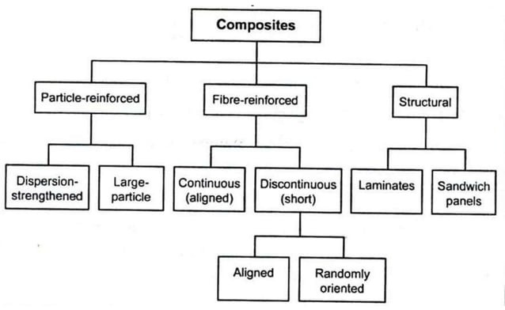

Slide 76
why
Two or more metals added to get require qualities in metal.
The weakness of one metal rectified by the strength of second metal
Example
Aerospace components
That should have low weight , stiffness, impact and corrosion re5istance, goOd abrasive properties.

Slide 77
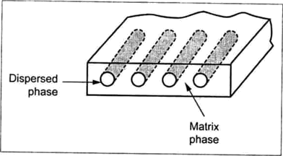
Constituents of composites

Slide 78
most common man-made composites
Polymer Matrix Composites (PMC's) —as FRP - Fibre Reinforced Polymers (or Plastics) — these materials use a polymer-based resin as the matrix, and a variety of fibres such as glass, carbon and aramid as the reinforcement.
Metal Matrix Composites (MMC's) - Increasingly found in the automotive industry, these materials use a metal such as aluminium as the matrix, and reinforce it with fibres such as silicon carbide.
Ceramic Matrix Composites (CMC's) - Used in very high temperature environments, these materials use a ceramic as the matrix and reinforce it with short fibres, or whiskers such as those made from silicon carbide and boron nitride.

Slide 79
Particle re-inforced composites
Its consist of particles of one material dispersed in a matrix of a second material
The fine dispersion particle posses
good strength in composites.
The size, distribution and orientation of particles
defines the strength of the composite.
Types
dispersion strengthened composites
Large particle composites

Slide 80
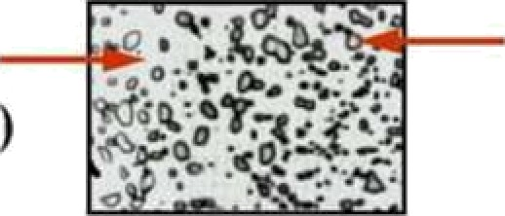
Pai•ticle Reinforced Composites
Spheroidized Steel
M.‹.:^{g} Pai icle:
(m - iron} Ductile
(cementite) Bi•ittle
»‘
Particle: Carbon (Stiffer)
Rubber
(Compliant
Automobile Tire

Slide 81
1.Dispersion strengthened composites
The particles are smaller and having diameter 0.01 — 0.1 microns and volume concentration 1 — 15 %
This method is similar to that for precipitation hardening.
Due to this , the composites have good yield and tensile strength. And the plastic deformation is restricted.

Slide 82
E.znmptes and opplicotions ofsome dispemiozi-strengthened composites
S.Np. | Composite system | Applications
I. | Ag—CdO | Electrical coniaci materials
2. | AI—A1₂O | Possiblc use in nuclear reactors.
3. | De-BcO | Aerospace and nuclear ieaciors.
4. | Co-ThO/. Y O/ | Possihle creep-resistant magnetic
5. | Ni. Cr-ThO | Turbine engine coniponcnis
6. | Pt›-PbO | Battery grids
 |  | Fil8meCts, clocifical components
8. | W-” O . ZrOy | Filaments Centers

Slide 83
2. Large particle composites
The particles diameter greater than 1 micrometer and volume concentration are greater than 25 %
Here the load on this composite is shared by both matrix and particles.
It posses good strength
Tungsten carbide or Titanium carbide embedded in a metal matrix of cobalt or nickel.
These composites used as a cutting tool

Slide 84
Other particle re-inforced composite
Bricks
Concrete
Grinding and cutting wheel
Electrical contacts (Tungsten re — Enforced silver)
Polymer & Elastomers ( such as vulcanised rubber)

Slide 85
FIBRE REINFORCED COMPOSITES
Here the dispersed phase is in the form of fibres.
These fibre reinforced composites having
resistant, stiffness
improved strength, fatigue
and strength-to-weight ratio

Slide 86
Fiber Orientations in Fiber Reinforced Composites
Continuous | Discontinuous | Discontinuous
and aligned | and aligned | and random›
** | fibers | oricntedfibers

Slide 87
Jome fibre and mofrfi materials used in ffie
Abie-reinforced composites
Fibre materials | Matrix materials
Polymers Kevlar, nylon, polyethylene Metals Be, Boron, W Glass E-glass, S-glass Carbon HS (high strength) HM (high modulus) Ceramics AljO3t B4C, SiC, Z ₂ Whiskerst Al₂O₃, Cr, graphite, SiC, 5i3 g | l. l'hermosctting rcsins Polyester rcsins, epoxide resins Thermoplastics PA, PAI, PBT, PET, PES, PPS, PEFK Metal mai‹ices A\, Ti, Mg, Cr and Ni, togethcr with their a\ loys. Composite matrices

Slide 88
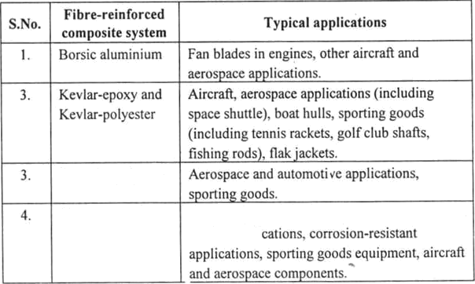
Somefibre-reinforced composites an‹t their applications
Graphite-pol er
Glass•polymcr
Light weight automotive appIi‹ »lions, wcar and
marine appli

Slide 89
C‹itnmerrivl ‹iirrruft Llsed for air candid ioning 4uct, radar do\nc, landing gear Jonr. seats. I1oarin¿s, window reveals, ceiJ iny panels, propel lcr blades, nuse. \ving body, elevators, ailerons, air brak0, efc’.
2. | Used for speed brake. rubber trunnion, forz'ard fuse lag. elevators. ailerons, landing gear doors. horizontal stabilizers.
3. | Used for remoie piloted vehicles, filament wound rocket motors, wiiTgs, rotor cases, cfc.
4.
 | Used for antennas, struts, supgon trusses, trussCs far
 | telescopes, storage tasks fot gases and fluids at cryogenic
 | temperatures, e/c.

Slide 90
5. Automobile and trucks Used for drive shafts, bumpers, doar aod window frames, starter motor commutators, body panels, radiator and other hoses, timing and V belts, drive chains. e/c.
6. Elecvicat and electronics Used for microphone housing, miniature-electronic card holder, ribs in protect printed circuit boards, parabolic antenna, etc , chemical equipments—switch casings, cable and distribulion cabinets. junction boxes, etc,
Serine applicniioiis Used for s‹ziaIl hoat hulls, sonar domes, masts, tanks, decLs, submarine inasls, spinnakar pole on the racin,g yatcl plates in nuclear suhinarinc lead acid batteries, cm.

Slide 91
Used for tennis rackets, golf club shafts: bicycle components such as wheel, frame, forks, handlebars, pedal crank anus, package carriers, tenders, e/c.; gliders; boats; sail boards.
8.
Other applicaiions include bridge buildin8; joini implants.
heart valves; leaf springs; chemical industries application—
for storing aggreuive chemicals; wine vats and pipelines for
water and sewage; in reinforced wood products, etc.

