Slide 1
ME3392 - ENGINEERING MATERIALS AND METALLURGY
Presented by PANDIAN.K
ALLOYS AND PHASE DIAGRAMS
UNIT - I

Slide 2
OBJECTIVE:
To impart knowledge on the structure, properties, treatment, testing and applications of metals and non-metallic materials so as to identify and select suitable materials for various engineering applications.
OUTCOME:
Upon completion of this course, the students can able to apply the different materials, their processing, heat treatments in suitable application in mechanical engineering fields.

Slide 3
UNIT I ALLOYS AND PHASE DIAGRAMS
Constitution of alloys – Solid solutions, substitutional and interstitial – phase diagrams, Isomorphous, eutectic, eutectoid, peritectic, and peritectoid reactions, Iron – carbon equilibrium diagram. Classification of steel and cast Iron microstructure, properties and application.

Slide 4
Introduction
The matter is usually found to exist in solids and fluids.
All these materials consist of atoms and molecules.
Solids are brittle, some are ductile, some are malleable, some are strong, some are weak, some are good conductors of heat and electricity, some are magnetic, some are non-magnetic and so on.
The reasons for these different properties of the solids are due to their structure.

Slide 5
Thus the study of crystal geometry helps us understand the behaviour of solids in their mechanical, metallurgical, electrical, magnetic and optical properties.
The solids are classified crystalline or noncrystalline.
Crystalline:
Atoms are arranged in some regular repetition pattern .
Classified: monocrystal and polycrystalline
Monocrystal consist of only one crystal whereas the polycrystalline consist many crystals

Slide 6
Non-crystalline or Amorphous materials
Atoms are arranged in an irregular fashion. It is not based on a regular repetition pattern.
It is super cooled liquid with very high viscosity.
Example: Glass, rubber and polymers

Slide 7
Crystallographic terms
Crystal: A crystal is a solid whose constituent atoms or molecules are arranged in a systematic geometric pattern.
Lattice points: Lattice points denote the position of atoms or molecules in the crystals.
Space lattice or crystal lattice:
The periodic arrangement of atoms in a crystal is called as lattice.
A space lattice is defined as an array of points arranged in a regular periodic fashion in three dimensional space such that each point in the lattice has exactly identical surroundings

Slide 8
Basis: A crystal structure is formed by associating with every lattice point a unit assembly of atoms or molecules identical in composition.
Basis consisting of a group of two atoms.
Space lattice + basis-------- crystal structure

Slide 9
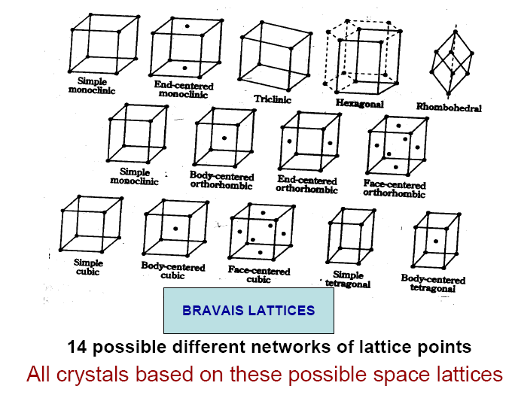
Crystal systems

Slide 10
Crystal structure

Slide 11
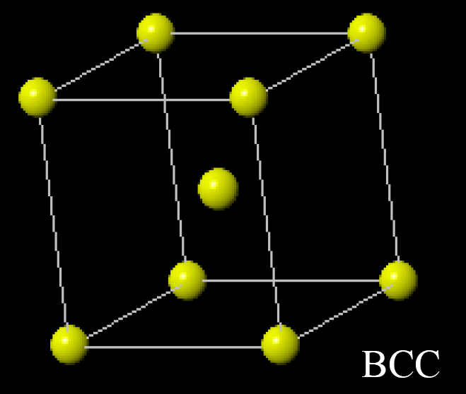
BCC (Body Centre Cubic)
Tungsten
Vanadium
Molybdenum
chromium

Slide 12
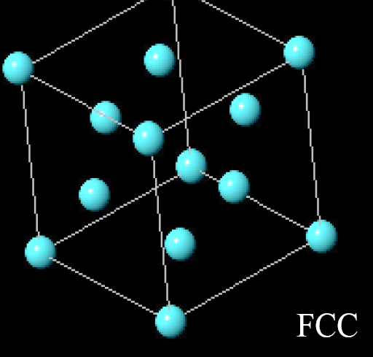
FCC (Face Centred Cubic)
Copper
Silver
Gold
Aluminium
Nickel
Lead
Platinum

Slide 13
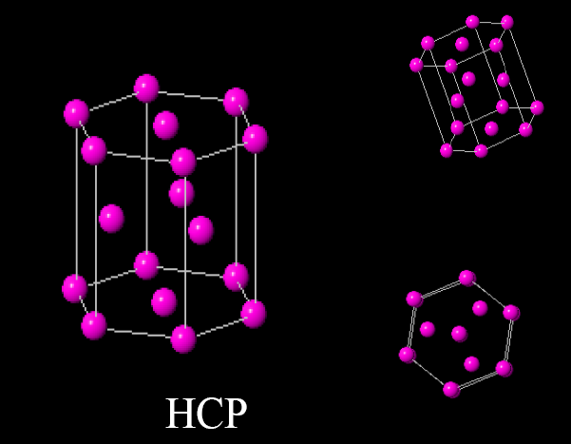
HCP (Hexagonal Close Packed)
Magnesium
Zinc
Titanium
Zirconium
Beryllium
cadmium

Slide 14
Alloys
A metal alloy or simply an alloy, is a mixture of two or more metals or a non-metal
Largest portion is called the base metal
All other elements present are called alloying elements.
The presence of alloying elements changes the physical, chemical and mechanical properties of the base metal.
The type and extent of change of properties depends on whether the alloying elements are insoluble, dissolve in the base metal or react with the base metal to form other phases.

Slide 15
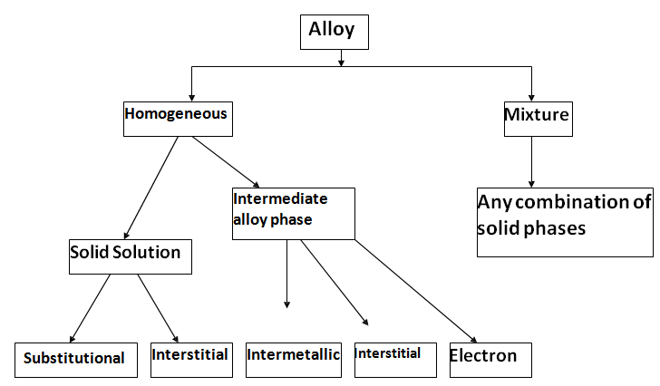
Based on the structures

Slide 16
Solid Solutions
It is the simplest type of alloy
A solid solution occurs when we alloy two metals and they are completely soluble in each other.
If a solid solution alloy is viewed under a microscope only one type of crystal can be seen just like a pure metal.
Solid solution alloys have similar properties to pure metals but with greater strength but are not as good as electrical conductors.
Solid solution is composed of two parts:
Solute and solvent

Slide 17
Types of Solid Solution
Substitutional
a) Disordered or Random
b) Ordered
2. Interstitial

Slide 18
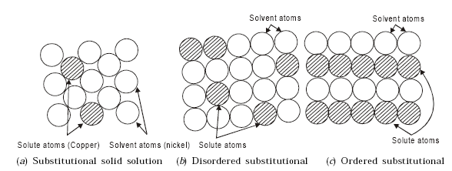
Substitutional Solid Solutions

Slide 19
If the atoms of the solvent or parent metal are replaced in the crystal lattice by atoms of the solute metal then the solid solution is known as substitutional solid solution.
The substitutional solid solution is further subdivided into
– Disordered (or) random substitutional solid solution (where the solute atoms are randomly substituted for the solvent atoms)
– Ordered substitutional solid solution (where the solute atoms are orderly substituted for the solvent atoms)
– Example, copper atoms may substitute for nickel atoms without disturbing the F.C.C. structure of nickel (Fig. a)

Slide 20
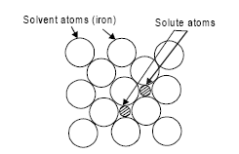
Interstitial Solid Solutions
The solute atom does not displace a solvent atom, but rather it enters one of the holes or interstices between the solvent atoms.
Interstitial solid solutions normally have a limited solubility
Example is iron-carbon system

Slide 21
Intermetallic Compounds
Intermetallic compounds are generally formed when one metal (for example magnesium) has chemical properties which are strongly metallic and the other metal (for example antimony, tin or bismuth) has chemical properties which are only weakly metallic.
Examples of intermetallic compounds are Mg2Sn, Mg2Pb, Mg3Sb2.
These intermetallic compounds have higher melting point than either of the parent metal.
This higher melting point indicates the high strength of the chemical bond in intermetallic compounds.

Slide 22
Intersitial compounds
Difference between interstitial solutions and interstitial compounds
In interstitial solutions, the solute atoms are not in regular patterns but are randomly distributed throughout the solvent.
In interstitial compounds, there is a regular pattern .

Slide 23
Electron compounds
If two metals consist of atoms of more or less similar size but different valency, then the compound formed are called electron compounds.
Ex: Cu3Al, CuZn, NiAl, Cu3Sn.

Slide 24
Hume Rothery’s Rule
Size factor: The atoms must be of similar size, with less than a 15% difference in atomic
radius.
Crystal structure: The materials must have the same crystal structure.
Valence(electronic charge of an iron): The atoms must have the same valence.
Electro negativity(ability of atom to attract an electron): The atoms must have approximately the same electro negativity.

Slide 25
Introduction to phase diagram
The solidification of a metal or an alloy is clearly understood by means of phase diagram
Component: Pure metal or compound
(e.g., Cu, Zn in Cu-Zn alloy, sugar, water, in syrup.)
Solvent: Host or major component in solution.
Solute: Dissolved, minor component in solution.
System: Set of possible alloys from same component (e.g., iron-carbon system.)
Solubility Limit: Maximum solute concentration that can be dissolved at a given temperature.

Slide 26
Introduction to phase diagram
Phase: Part with homogeneous physical and chelmical characteristics
One-phase systems are homogeneous.
Phases:
Systems with two or more phases are
heterogeneous, or mixtures. This is the case of most metallic alloys, but also happens in ceramics and polymers.
A two-component alloy is called binary. One with three components is called ternary.

Slide 27
Microstructure:
The properties of an alloy do not depend only on concentration of the phases but how they are arranged structurally at the microscopy level. Thus, the microstructure is specified by the number of phases, their proportions, and their arrangement in space.
A binary alloy may be
A single solid solution
Two separated essentially pure components.
Two separated solid solutions.
A chemical compound, together with a solid solution.

Slide 28
Phase diagram:
A graph showing the phase or phases present for a given composition as a function of temperature.
A plot with the temperature on the vertical scale and the percentage of composition by weight on the horizontal scale is termed a phase diagram.
Poly phase material:
A material in which two or more phases are present.

Slide 29
Gibbs Phase Rule
In a system under a set of conditions, the relationship between number of phases (P) exist can be related to the number of components (C) and degrees of freedom (F) by Gibbs phase rule.
P + F = C + 2
Where,
P – no of phases (solid, liquid, Gaseous etc)
C – No of components in the alloy
F – Degrees of freedom refers to the number of independent variables (e.g.: pressure, temperature) that can be varied individually to effect changes in a system.

Slide 30
Gibbs Phase Rule
In practical conditions for metallurgical and
materials systems, pressure can be treated as
a constant (1 atm.). Thus Condensed Gibbs
phase rule is written as:
P + F = C + 1

Slide 31
Cooling Curves

Slide 32
Cooling Curves
Cooling curves are obtained by plotting the measured temperatures at equal intervals during the cooling period(time) of a metal
It is useful for constructing the phase diagram.
Apply Gibb’s phase rule, for single phase
F = C-P+1
= 1-1+1 = 1 (one degree of freedom)
For two phases
F = C-P+1
= 1-2+1 = 0 (zero degree of freedom)

Slide 33
Equilibrium Phase Diagrams
It is also known as equilibrium or constitutional diagram.
Equilibrium phase diagrams represent the relationships between temperature and the compositions and the quantities of phases at equilibrium
In general practice it is sufficient to consider only solid and liquid phases, thus pressure is assumed to be constant (1 atm.) in most applications.

Slide 34
Important information, useful for the scientists and engineers who are involved with materials development, selection, and application in product design, obtainable from a phase diagram can be summarized as follows:
To show phases are present at different compositions and temperatures under slow cooling (equilibrium) conditions.
To indicate equilibrium solid solubility of one element/compound in another.
To indicate temperature at which an alloy starts to solidify and the range of solidification.
To indicate the temperature at which different phases start to melt.
Amount of each phase in a two-phase mixture can be obtained.

Slide 35
Types of equilibrium phase diagram
Single component systems have unary
diagrams
Two-component systems have binary diagrams
Three-component systems are represented by ternary diagrams, and so on

Slide 36
Construction of phase diagram
Liquidus line and Solidus line:
The line obtained by joining thee points showing the beginning of solidification is called liquidus line.
The liquidus line indicates the lowest temperature at which a given alloy of the series in the liquid start to freeze.
The lower line of the diagram is known as the solidus.

Slide 37
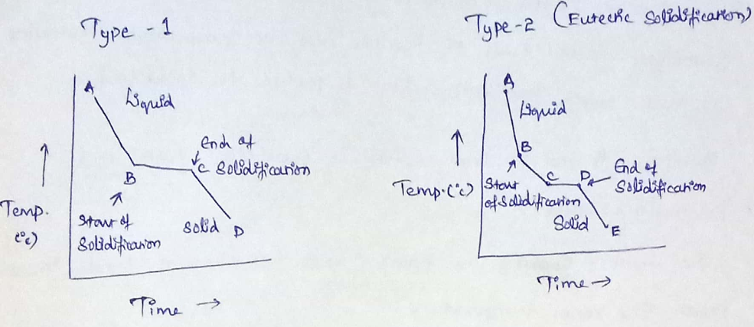
Cooling curve for binary alloy

Slide 38
Eutectic reaction:
For a mixture with two components at a fixed pressure, the eutectic reaction can only happen at a fixed chemical composition and temperature called eutectic point.
It describes the thermodynamic equilibrium conditions where a liquid co exists with two solid phases.
The microstructure of solid that results from the transformation consist of alternate layers of α and β phases that from simultaneously during the transformation.

Slide 39
Eutectoid reaction:
It describes the phase changes reaction of an alloy in which on cooling, a single solid phase transforms into two other solid phases.
Peritectic reaction:
It describes the isothermal reversible reaction of a liquid phase and a solid phase to form a second solid phase during cooling.

Slide 40
Micro-constituents of Iron-Carbon alloys
The study of these micro- constituents is essential in order to understand iron-iron carbide (Fe-Fe₃C) equilibrium phase diagram
Various micro-constituents of iron-carbon alloys are:
Ferrite:
Ferrite is a primary solid solution based on α iron having BCC structure.
It is nothing but the interstitial solution of carbon in iron.

Slide 41
Max. solubility of carbon in iron is 0.025% carbon at 723ºC.
Ferrite is soft, ductile, and highly magnetic.
It is used in cold working process.
2. Austenite or γ iron:
Austenite is a primary solid solution based on γ iron having FCC structure.
Max. solubility of carbon in iron is 2% at 1140ºC.
It is soft, tough, highly ductile and non-magnetic.
High electrical resistance and highcoefficient of expansion.

Slide 42
3. Cementite:
Cementite also called as carbide of iron (Fe₃C)
It is hard, brittle, intermetallic compound of iron with 6.69% carbon
The hardness and brittleness of cast iron is based on the presence of cementite.
It is magnetic below 250ºC
4. Pearlite:
Eutectoid mixture of ferrite (87.5%) and cementite (12.5%)
It is formed when austenite decomposes during cooling. It contains 0.8% of carbon
It is strong, hard and ductile

Slide 43
5. Ledeburite:
Eutectic mixture of austenite and cementite containing 4.3% carbon.
It is forms at 1140ºC
Pig iron, most important engineering materials are ledeburite
6. Martensite:
Super saturated solid solution of carbon in α iron.
It is formed when steel is rapidly cooled from the austentic state.
It is very hard, more brittle and low ductility.

Slide 44
7. Troostite:
A mixture of radial lamellae of ferrite and cementite
It hardness is intermediate between martensite and sorbite.
8. Sorbite:
A mixture of ferrite and finely divided cementite.
Tensile and yield strength are high.
9. Bainite:
Eutectoid of ferrite and cementite.
It harness is between the pearlite and martensite.

Slide 45
END

