Slide 1
CME394 ADVANCED INTERNAL COMBUSTION ENGINEERING
Presented By
VEERAPANDIAN.K
ASSISTANT PROFESSOR
DEPARTMENT OF MECHANICAL ENGINEERING

Slide 2
Unit-1

Slide 3
SYLLABUS
Mixture requirements – Fuel injection systems – Mono-point, Multipoint & Direct injection -Stages of combustion – Normal and Abnormal combustion, Spark Knock, Factors affecting knock, Combustion chambers.

Slide 4
COURSE OBJECTIVE -1
Explain the working of Gasoline fuel injection systems and SI combustion

Slide 5
Discuss Air/fuel ratio requirements of a S.I engine.
Idling (mixture must be enriched)
Cruising (mixture must be leaned)
High Power (mixture must be enriched)

Slide 6
Idling Range
An idling engine is one which operates at no load and with nearly closed throttle.
Under idling conditions, the engine requires a rich mixture, as indicated by point A in above Fig. This is due to the existing pressure conditions within the combustion chamber and the intake manifold which cause exhaust gas dilution of the fresh charge.
The pressures indicated in below Fig. are representative values which exist during idling.

Slide 7
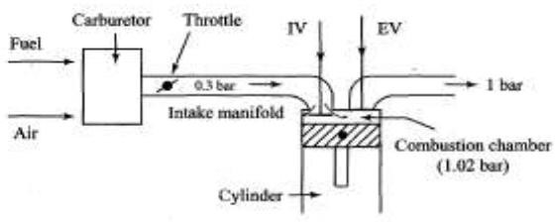
Idling Range

Slide 8
Cruising Range
In the cruising range from B to C , the exhaust gas dilution problem is relatively insignificant. The primary interest lies in obtaining the maximum fuel economy.
Consequently, in this range, it is desirable that the carburetor provides the engine with the best economy mixture

Slide 9
Power Range
During peak power operation the engine requires a richer mixture,as indicated by the line CD, for the following reasons
To provide best power:
Since high power is desired, it is logical to transfer the economy settings of the cruising range to that mixture which will produce the maximum power, or a setting in the vicinity of the best power mixture, usually in the range of 12:1.
To prevent overheating of exhaust valve and the area near it:
At high power, the increased mass of gas at higher temperatures passing through the cylinder results in the necessity of transferring greater quantities of heat away from critical areas
such as those around the exhaust valve.

Slide 10
EXPLAIN PORT INJECTION AND THROTTLE BODY INJECTION WITH NEAT SKETCH
Port Injection
Throttle body injection
Continuous injection system
Timed injection system

Slide 11
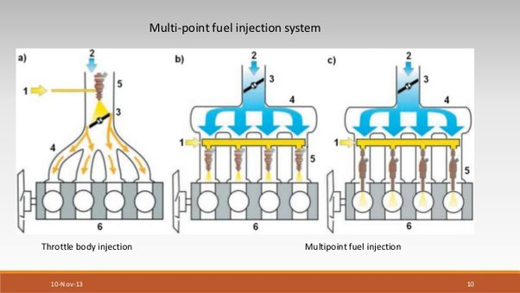
Types of injection

Slide 12
Port Injection
In this system, the injector is placed on the side of the intake manifold near the intake port. The injector sprays gasoline into the air, inside the intake manifold.
The gasoline mixes with the air in a reasonably uniform manner.
This mixture of gasoline and air then passes through the intake valve and enters into the cylinder.Every cylinder is provided with an injector in its intake manifold.
If there are six cylinders, there will be six injectors.

Slide 13
Throttle Body Injection
This throttle body is similar to the carburetor throttle body, with the throttle valve controlling the amount of air entering the intake manifold.
An injector is placed slightly above the throat of the throttle body.
The injector sprays gasoline into the air in the intake manifold where the gasoline mixes with air. This mixture then passes through the throttle valve and enters into intake manifold.

Slide 14
Continuous Injection Systems
In continuous injection system, gasoline is sprayed continuously from the injectors.
This system usually has a rotary pump. The pump maintains a fuel line gauge
pressure of about 0.75 to 1.5 bar.
The system injects fuel through a nozzle located in the manifold immediately downstream of the throttle plate.
In a supercharged engine, fuel is injected at the entrance of the supercharger.
The timing and duration of the fuel injection is determined by Electronic Control Unit (ECU) depending upon the load and speed

Slide 15
Timed Injection Systems
In the timed injection system, gasoline is sprayed from the injectors in pulses.
This system has a fuel supply pump which sends fuel at a low pressure of about 2 bar when the engine is running at maximum speed.
A fuel metering or injection pump and a nozzle are the other parts of the system.
The nozzle injects the fuel in the manifold or the cylinder head port at about 6.5 bar or into the combustion chamber at pressures that range from 16 to 35 bar.
Timed injection system injects fuel usually during the early part of the suction stroke

Slide 16
Describe the various stages of combustion in a S.I engine with a P-θ diagram.
Ignition lag stage
Flame propagation stage
After burning stage

Slide 17
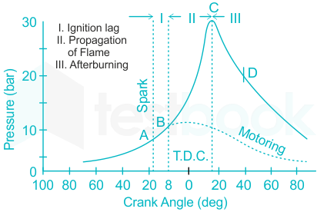
various stages of combustion in a S.I engine

Slide 18
Ignition lag stage
The first stage (A~B) is referred to as the ignition lag or preparation phase in which growth and development of a self propagating nucleus of flame takes place.
This is a chemical process depending upon both temperature and pressure, the nature of the fuel and the proportion of the exhaust residual gas.
Further, it also depends upon the relationship between the temperature and the rate of reaction.

Slide 19
Flame propagation stage
The second stage (B~C) is a physical one and it is concerned with the spread of the flame
throughout the combustion chamber.
The starting point of the second stage is where thefirst measurable rise of pressure is see n on the indicator diagram i.e., the point wherethe line of combustion departs from the compression line (point B).
This can be seen from the deviation from the motoring curve.
During the second stage the flame propagates practically at a constant velocity.
Heat transfer to the cylinder wall is low, becauseonly a small part of the burning mixture comes in contact with the cylinder wall during this period.
The rate of heat-release depends largely on the turbulence intensity and also on the reaction rate which is dependent on the mixture composition.
The rate of pressure rise is proportional to the rate of heat-release because during this stage,the combustion chamber volume remains practically constant (since piston is near the top dead centre).

Slide 20
After burning stage
The starting point of the third stage is usually taken as the instant at which the maximum pressure is reached on the indicator diagram (point C).
The flame velocity decreasesduring this stage.
The rate of combustion becomes low due to lower flame velocity and reduc ed flame front surface.
Since the expansion stroke starts before this stage of combustion, with the
piston moving away from the top dead centre, there can be no pressure rise during this stage.

Slide 21
EXPLAIN IN DETAIL ABOUT NORMAL AND ABNORMAL COMBUSTION IN S.I ENGINES.
Normal combustion
Abnormal combustion

Slide 22
Normal combustion
Spark-ignited flame moves steadily across the combustion chamber until the charge is fully consumed. A combustion process which is initiated solely by a timed spark and in which the flame front moves completely across the combustion chamber in a uniform manner at a normal velocity

Slide 23
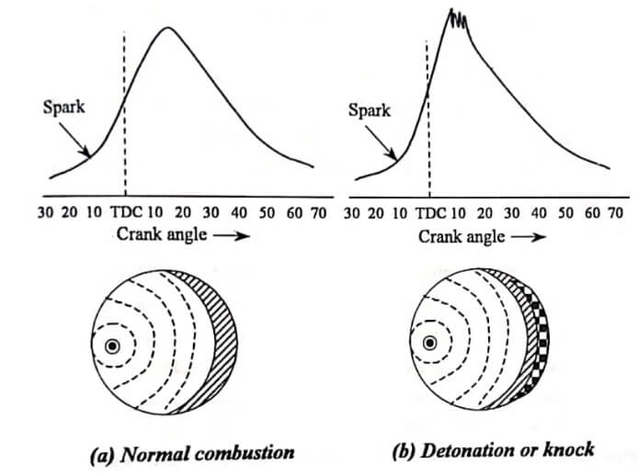
NORMAL AND ABNORMAL COMBUSTION IN S.I ENGINES

Slide 24
Abnormal combustion
There are two types of abnormal combustion:
Knock
Surface ignition

Slide 25
Knock
Knock is the auto ignition of the portion of fuel, air and residual gas mixture ahead of the advancing flame that produces a noise.
As the flame propagates across combustion chamber, end gas is compressed causing
pressure, temperature and density to increase.
This causes high frequency pressure oscillations inside the cylinder that produce sharp metallic noise called knock.
Knock will not occur when the flame front consumes the end gas before these reactions have time to cause fuel-air mixture to autoignite.
Knock will occur if the precombustion reactions produce auto ignition before the flame front arrives.

Slide 26
Surface Ignition
Surface ignition is ignition of the fuel-air charge by overheated valves or spark plugs, by glowing combustion chamber deposits or by any other hot spot in the engine combustion chamber - it is ignition by any source other than the spark plug.
It may occur before the spark plug ignites the charge (preignition) or after normal ignition (postignition).

Slide 27
Discuss the effect of following engine variables on flame propagation. A) Fuel air ratio b)compression ratio c) Engine load d) Turbulence e) Engine speed.
The factors which affect the flame propagations are
Air fuel ratio
Compression ratio
Load on engine
Turbulence
Engine speed
Engine size

Slide 28
Explain various factors that affect knock in S.I engine
Factors affecting knocking in SI engines
Temperature factors
Density factors
Time factors
Composition factors

Slide 29
TEMPERATURE FACTORS
Raising the Compression Ratio
Supercharging
Coolant Temperature
Temperature Of The Cylinder And Combustion Chamber Walls

Slide 30
DENSITY FACTORS
Compression ratio
Mass of inducted charge
Temperature of the combustion chamber walls
Retarding the Spark timing
Powe r output of the engine

Slide 31
TIME FACTORS
Flame travel distance
Location of sparkplug
Location of exhaust valve
Engine size
Turbulence of mixture

Slide 32
COMPOSITION FACTORS
Molecular Structure
Fuel-air ratio
Humidity of air

Slide 33
DISCUSS THE DIFFE RENT TYPES OF COMBUSTION CHAMBERS EMPLOYED IN S.I ENGINE
DIFFERENT TYPES OF COMBUSTION CHAMBERS IN SI ENGINE
T-head combustion chamber
L-head combustion chamber
I-head (or overhead valve) combustion chamber
F-head combustion chamber

Slide 34
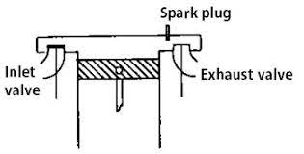
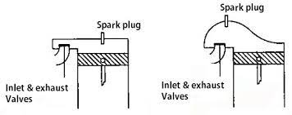
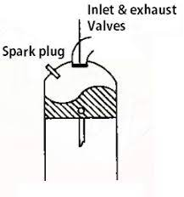
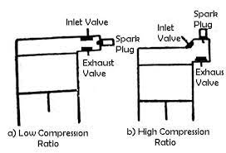
DIFFERENT TYPES OF COMBUSTION CHAMBERS IN SI ENGINE

Slide 35
T Head Type Combustion chambers
This was first introduced by Ford Motor Corporation in 1908.
This design has following disadvantages.
Requires two cam shafts (for actuating the in- let valve and exhaust valve separately) by
two cams mounted on the two cam shafts.
Very prone to detonation. There was violent detonation even at a compression ratio of 4. This is because the average octane number in 1908 was about 40 -50.

Slide 36
L Head Type Combustion chambers
It is a modification of the T-head type of combustion chamber. It provides the two values on the same side of the cylinder, and the valves are operated through tappet by a single camshaft. This was first introduced by Ford motor in 1910-30 and was quite popular for some time. This design has an advantage both from manufacturing and maintenance point of view.

Slide 37
Overhead valve or I head combustion chamber
The disappearance of the side valve or L-head design was inevitable at high compression ratio of 8:1 because of the lack of space in the combustion chamber to accommodate the valves.
Diesel engines, with high compression ratios, invariably used overhead valve design.
Since 1950 or so mostly overhead valve combustion chambers are used.
This type of combustion chamber has both the inlet valve and the exhaust valve located in the cylinder head.

Slide 38
F- Head combustion chamber
In such a combustion chamber one valve is in head and other in the block. This design is a compromise between L- head and I- head combustion chambers. One of the most F head engines (wedge type) is the one used by the Rover Company for several years. Another successful design of this type of chamber is that used in Willeys jeeps.
Advantages
High volumetric efficiency
Maximum compression ratio for fuel of given octane rating
High thermal efficiency
It can operate on leaner ai-rfuel ratios without misfiring.
The drawback
This design is the complex mechanism for operation of valves and expensive special shaped piston.

Slide 39
Thanks

