Slide 1



UNIT V LECTURE VI
1
UNIT - V
MECHANICAL PROPERTIES AND DEFORMATION MECHANISMS

Slide 2
MECHANICAL PROPERTIES
UNIT V LECTURE VI
2

Slide 3
Strength
UNIT V LECTURE VI
3
The ability of a material to stand up to forces being applied without it bending, breaking, shattering or deforming in any way.
Elasticity
The ability of a material to absorb force and flex in different directions, returning to its original position.
Plasticity
The ability of a material to be change in shape permanently.
Ductility
The ability of a material to change shape (deform) usually by stretching along its length.

Slide 4
Tensile Strength
UNIT V LECTURE VI
4
The ability of a material to stretch without breaking or snapping.
Malleability
The ability of a material to be reshaped in all directions without cracking.
Toughness
A characteristic of a material that does not break or shatter when receiving a blow or under a sudden shock.
Hardness
The ability of a material to resist scratching, wear and tear and indentation.
Conductivity
The ability of a material to conduct electricity.

Slide 5
Creep
UNIT V LECTURE VI
5
It is the property of the material by virtue of which it deforms continuously under a steady load.
Brittleness
It is the property of a material by virtue of which it will fracture without any deformation.
Stiffness
It is the property of a material by virtue of which it resists deformation.

Slide 6
Technological Properties of Metallic Materials
UNIT V LECTURE VI
6
Technological properties are those properties that apply during manufacturing and forming processes using metal. Hence, the technological properties of metals are:
  Machinability
  Weldability
  Castability and
  formability

Slide 7
Machinability
UNIT V LECTURE VI
7
It is the ability of any metal to be machined or the ability of metals to be cut by machine tools. Examples of machine operations are turning, milling, and boring.

Slide 8
Formability
UNIT V LECTURE VI
8
It is the property of the material, which indicates the ease with which it can be formed in to different types.
WELDABILITY
The weldability, also known as join ability, of a material refers to its ability to be welded. A material's weldability is used to determine the welding process and to compare the final weld quality to other materials.
CASTABILITY
The ability of materials to set in a mould when mixed with water and a bonding agent

Slide 9
Factors Affecting Mechanical Properties
The mechanical properties of materials are affected by various factors
1.
2.
3.
4.
Grain size Heat treatment
Atmospherics exposure Low and high temperature

Slide 10
Effect of Grain size
➢The metals are composed of crystals (or) grains. If the grain size of a metal is small, it is called a fine grained metal, on the other hand, when the grain size is comparatively large, then it is called a coarse grained metal.
➢A fine grained metal has a greater tensile and fatigue strength. It can be easily work hardened.
➢A coarse grain causes surface roughness.
➢Coarse grain metal is difficult to polish.

Slide 11
Effect of Heat Treatment
Mechanical properties like ductility hardness, tensile strength, toughness and shock resistance can be improved by heat treatment.
Heat treatment is generally done for the following purposes:
To refine the grain and improve mechinability.
To relieve the internal stresses induced in the metals during cold and hot working of the metals.
To improve resistance to corrosion.
To modify the structure, either coarse grained or fine grained.
To improve chemical, magnetic, electrical and thermal properties.
To improve mechanical properties like ductility, hardness, tensile strength, shock resistance etc.

Slide 12
Effect of Atmospheric Exposure
Most of the metals get oxidized when exposed to the atmospheric.
Due to oxidation, of metal surface, a film is formed.
The presence of moisture, sulphur dioxide, hydrogen sulphide and other corrosive conditions decrease the electrical resistivity of metals.
The atmospheric effect on the metal depends on the following:
Characteristics properties of the metal
Value of the protective film on its surface
Presence of certain reducing agents
Local cells formed due to development of cracks and discontinuity on the protective film surface.

Slide 13
Effect of low temperature
Decrease in temperature there is an increase in the tensile strength and yield strength of all metals.
Alloys of nickel, copper and aluminium retain most of their ductility and toughness at low temperature.
For mild steel, the elongation and reduction in cross – sectional area is satisfactory upto - 180°c but after that it goes down to a large extent.
Near absolute zero temperature many metals exhibit the phenomenon of super conductivity
Below - 100°c non-ferrous metals show better properties than ferro metals.
Low temperature causes low thermal vibrations and lattice parameters are stabilized.

Slide 14
Effect of high temperature
Field stress and ultimate tensile strength decrease with rise in temperature
Stiffness and fracture stress of many metals also decrease with increasing temperature
At high temperatures, the toughness of steel is reduced.
At high temperature, creep takes place and the material fails even at a very small stress.
Due to rise in temperature, there is a corresponding rise in thermal vibration of atoms causing changes in structural properties.

Slide 15
DEFORMATION MECHANISMS
UNIT V LECTURE VI
15

Slide 16
Deformation of metals
UNIT V LECTURE VI
16
When a force is applied on a metal piece, then the size and shape will be altered.
Any changes in metal is called deformation of metals.

Slide 17
Types of deformation
UNIT V LECTURE VI
17
Elastic deformation
Plastic deformation

Slide 18
Mechanism of plastic deformation
UNIT V LECTURE VI
18
Slip
Twinning

Slide 19
Deformation by slip
UNIT V LECTURE VI
19
Slip is the prominent mechanism of plastic deformation in metals.
It involves sliding of blocks of crystal
over one other along definite crystallographic planes, called slip planes.
It is analogous to a deck of cards when it is pushed from one end. Slip occurs when shear stress applied exceeds a critical value.
During slip each atom usually moves same integral number of atomic distances along the slip plane producing a step, but the orientation of the crystal remains the same.

Slide 20
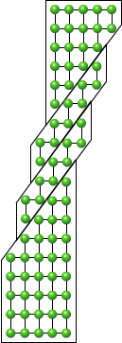
UNIT V LECTURE VI
20

Slide 21
Deformation by twinning
UNIT V LECTURE VI
21
Portion of crystal takes up an orientation that is related to
the orientation of the rest of the untwined lattice in a definite, symmetrical way.
The twinned portion of the crystal is a mirror image of the parent crystal.
The plane of symmetry is called twinning plane.
The important role of twinning in plastic deformation is
that it causes changes in plane orientation so that further slip can occur.

Slide 22
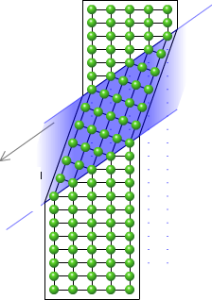
UNIT V LECTURE VI
22

Slide 23
FRACTURE MECHANISM
UNIT V LECTURE VI
23

Slide 24
Fracture
UNIT V LECTURE 5
24
Fracture is the separation of a specimen info two or more parts by an applied stress.
Fracture takes place in two stages:
  initial formation of crack and
  spreading of crack.
Depend upon the type of materials, the applied load, state of stress and temperature metals have different types of fracture.
Types of fracture
Brittle Fracture
Ductile Fracture
Fatigue Fracture
Creep Fracture

Slide 25
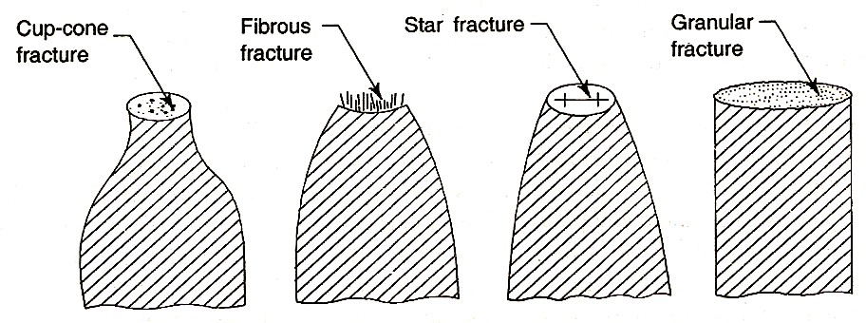
Fracture
UNIT V LECTURE 5
25
Fracture is usually undesirable in engineering applications.
Flaws such as surface cracks lower the stress for brittle fracture where as line defects are responsible for initiating ductile fractures.
Different types of fracture

Slide 26
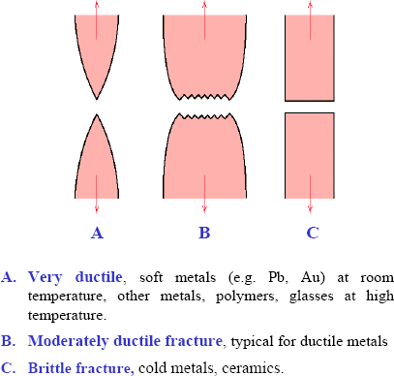
Brittle vs. Ductile Fracture
26

Slide 27
Brittle Fracture
UNIT V LECTURE 5
27
Brittle fracture is the failure of a material with minimum of plastic deformation. If the broken pieces of a brittle fracture are fitted together, the original shape & dimensions of the specimen are restored.
Brittle fracture is defined as fracture which occurs at or below the elastic limit of a material.
The brittle fracture increases with
Increasing strain rate
Decreasing temperature
Stress concentration conditions produced by a notch.

Slide 28
Salient Features of Brittle Fracture
UNIT V LECTURE 5
28
Brittle fracture occurs when a small crackle in materials grows. Growth continues until fracture occurs.
The atoms at the surfaces do not have as many neighbors as those in the interior of a solid and therefore they form fever bonds. That implies, surface atoms are at a higher energy than a plane of interior atom. As a result of Brittle fracture destroying the inter atomic bonds by normal stresses.
In metals brittle fracture is characterized by rate of crack propagation with minimum energy of absorption.
In brittle fracture, adjacent parts of the metal are separated by stresses normal to the fracture surface.
Brittle fracture occurs along characteristics crystallographic planes called as cleavage planes. The fracture is termed as cleavage fracture.
Brittle fracture does not produce plastic deformation, so that it requires less energy than a ductile failure.

Slide 29
Mechanism of Brittle Fracture
UNIT V LECTURE 5
29
The mechanism of Brittle fracture is explained by Griffith theory.
Griffith postulated that in a brittle material there are always presence of micro cracks which act to concentrated the stress at their tips.
The crack could come from a number of source, e.g. as a collection of dislocations, as flow occurred during solidification or a surface scratch.
In order to explain the mechanism of ideal brittle fracture, let us consider the stress distribution in a specimen under constant velocity in the vicinity of crack.

Slide 30
Mechanism of Brittle Fracture
UNIT V LECTURE 5
30
σ =
2γE
πe
Where,
e is half of the crack length,
γ is the true surface energy
E is the Young's modulus.
the stress is inversely proportional to the square root of the crack length. Hence the tensile strength of a completely brittle material is determined by the length of the largest crack existing before loading.
For ductile materials there is always some plastic deformation before fracture. This involves an additional energy term γp. Therefore the fracture strength is given by
σ
⎡
⎢
⎣
1
2Eγ ⎤ ²
=
πe ⎥
⎦

Slide 31

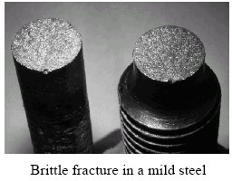
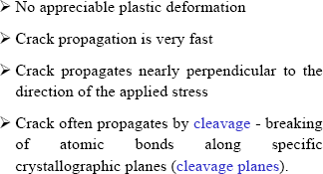
Brittle Fracture
31

Slide 32
Ductile Fracture
UNIT V LECTURE 5
32
Ductile fracture is defined as the fracture which takes place by a slow propagation of crack with considerable amount of plastic deformation.
There are three successive events involved in a ductile fracture.
The specimen begins necking and minute cavities form in the necked region. This is the region in which the plastic deformation is concentrated. It indicates that the formation of cavities is closely linked to plastic deformation.
It has been observed that during the formation of neck small micro cracks are formed at the centre of the specimen due to the combination of dislocations.
Finally these cracks grow out ward to the surface of the specimen in a direction 45° to the tensile axis resulting in a cup- end-cone-type fracture 0

Slide 33
Ductile Fracture
UNIT V LECTURE 5
33
An important characteristic of ductile fracture is that it occurs through a slow tearing of the metal with the expenditure of considerable energy.
The fracture of ductile materials can also explained in terms of work-hardening coupled with crack-nucleation and growth.
The initial cavities are often observed to form at foreign inclusions where gliding dislocations can pile up and produce sufficient stress to form a void or micro-crack.
Consider a specimen subjected to slow increasing tensile load. When the elastic limit is exceeded, the material beings to work harden.
Increasing the load, increasing the permanent elongation and simultaneously decrease the cross sectional area.
The decrease in area leads to the formation of a neck in the specimen, as illustrated earlier.

Slide 34
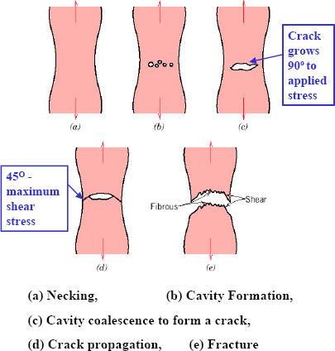
Ductile Fracture
34

Slide 35
Ductile Fracture
UNIT V LECTURE 5
35
The neck region has a high dislocation density and the material is subjected to a complex stress.
The dislocations are separated from each other because of the repulsive inter atomic forces.
As the resolved shear stress on the slip plane increase, the dislocation comes closed together.
The crack forms due to high shear stress and the presence of low angle grain boundaries.
Once a crack is formed, it can grow or elongated by means of dislocations which slip.
Crack propagation is along the slip plane for this mechanism.
Once crack grows at the expense of others and finally cracks growth results in failure.

Slide 36
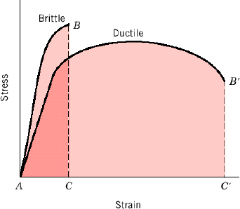
Brittle vs. Ductile Fracture
36
Ductile materials - extensive plastic deformation and energy absorption (“toughness”) before fracture
Brittle materials - little plastic deformation and low energy absorption before fracture

Slide 37
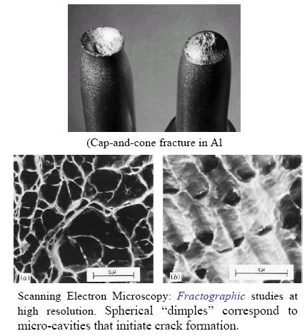
Ductile Fracture
37

Slide 38
Comparison between Brittle and Ductile fracture
Ductile fracture | Brittle fracture
Material fractures after plastic deformation and slow propagation of crack | Material fractures with very little or no plastic deformation.
Surface obtained at the fracture is dull or fibrous in appearance | Surface obtained at the fracture is shining and crystalling appearance
It occurs when the material is in plastic condition. | It occurs when the material is in elastic condition.
It is characterized by the formation of cup and cone | It is characterized by separation of normal to tensile stress.
The tendency of ductile fracture is increased by dislocations and other defects in metals. | The tendency brittle fracture is increased by decreasing temperature, and increasing strain rate.
There is reduction in cross – sectional area of the specimen | There is no change in the cross – sectional area.

Slide 39
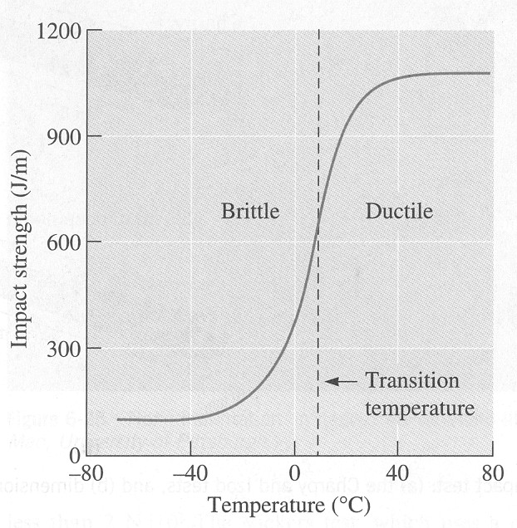
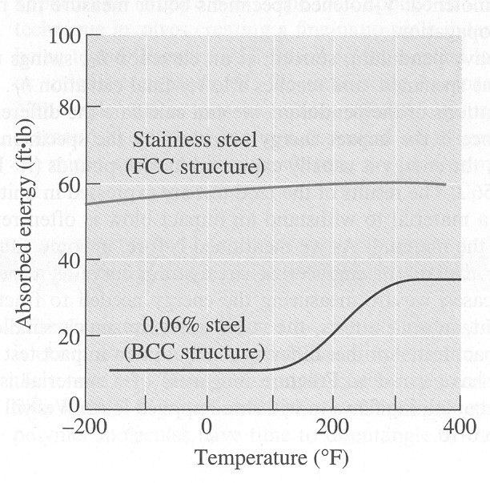
Ductile to Brittle Transition
The results of impact tests are absorbed energy, usually as a function of temperature. The ABSORBED ENERGY vs. TEMPERATURE curves for many materials will show a sharp decrease when the temperature is lowered to some point. This point is called the ductile to brittle transition temperature (relatively narrow temperature range) .
A typical ductile to brittle transition as a function of temperature. The properties of BCC carbon steel and FCC stainless steel, where the FCC crystal structure typically leads to higher absorbed energies and no transition temperature.

Slide 40
Transition Temperatures
40
BCC metals have transition temperatures
FCC metals do not
Can use FCC metals at low temperatures (eg Austenitic Stainless Steel)

Slide 41
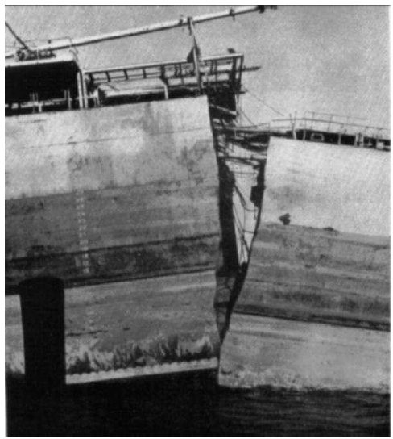
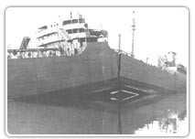
Brittle Fracture
41
Failure of Liberty ships in WW II - Low-carbon steels were ductile at RT tensile tests, they became brittle when exposed to lower-temperature ocean environmets.The ships were built and used in the Pacific Ocean but when they were employed in the Atlantic Ocean, which is colder, the ship’s material underwent a ductile to brittle transition.

Slide 42
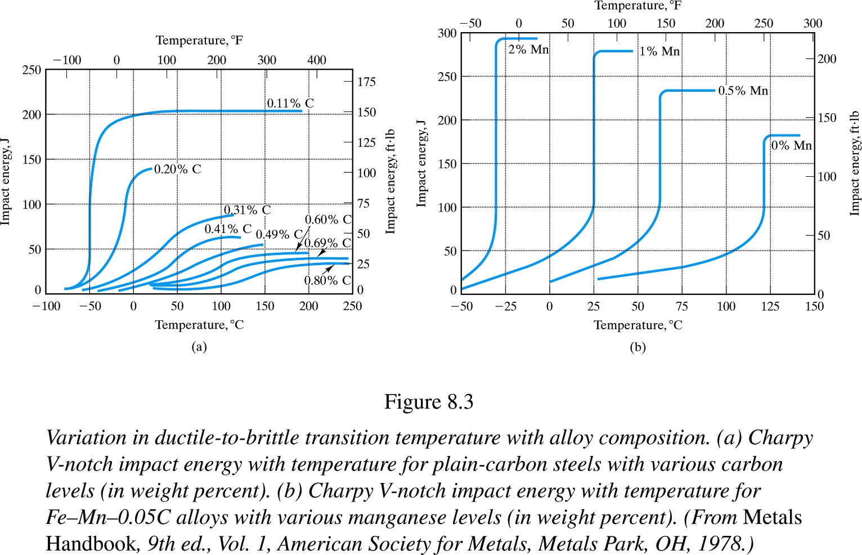
42
Alloying usually shifts the ductile-to-brittle transition temperature
Carbon content increases the brittleness

Slide 43
Transition Temperatures
43
As temperature decreases a ductile material can become brittle - ductile-to-brittle transition
  The transition temperature is the temp at which a material changes from ductile-to-brittle behavior
Alloying usually increases the ductile-to-brittle transition temperature. FCC metals remain ductile down to very low temperatures. For ceramics, this type of transition occurs at much higher temperatures than for metals.

Slide 44
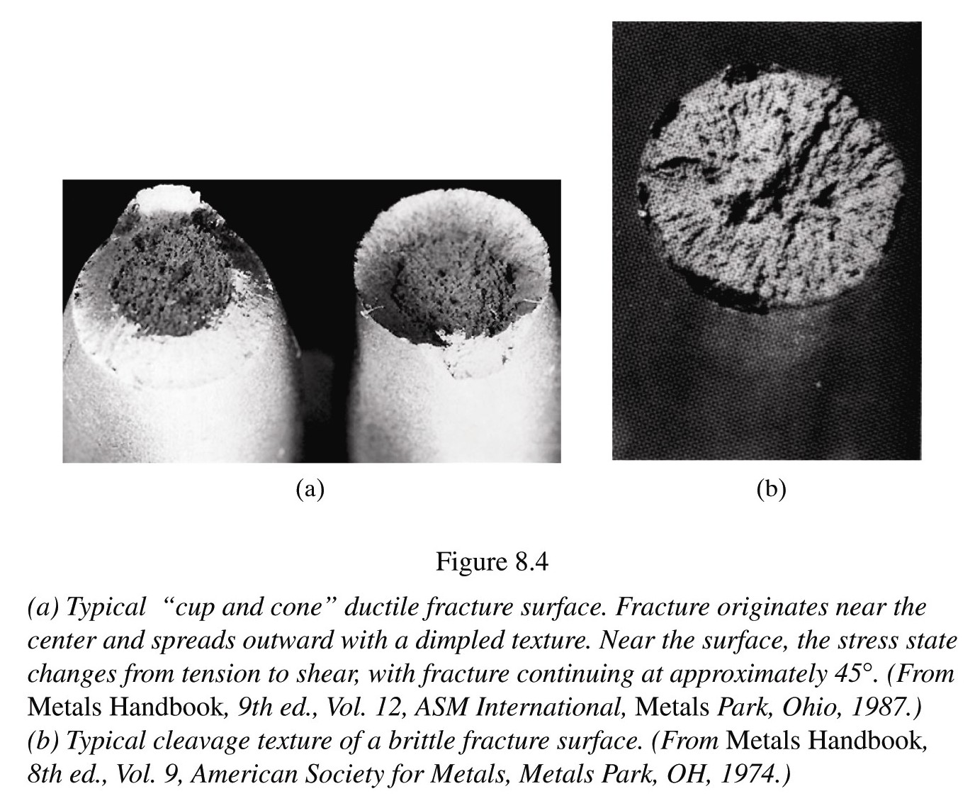
The fracture surface
44
Ductile → a dimpled texture
Brittle → cleavage surface
cleavage : The tendency of certain minerals to break along distinct planes in their crystal structures where the bonds are weakest
Near the ductile-to-brittle transition temperature, the fracture surface exhibits a mixed texture

Slide 45
Fatigue Fracture
UNIT V LECTURE 5
45
Fatigue fracture is defined as the fracture which takes place under repeatedly applied stresses.
It will occur at stresses well before the tensile strength of the materials.
The tendency of fatigue fracture increases with the increase in temperature and higher rate of straining.
The fatigue fracture takes place due to the micro cracks at the surface of the materials.
It results in, to and fro motion of dislocations near the surface.
The micro cracks act as the points of stress concentration.
For every cycle of stress application the excessive stress helps to propagate the crack.
In ductile materials, the crack grows slowly and the fracture takes place rapidly.
But in brittle materials, the crack grows to a critical size and propagates rapidly through the material.

Slide 46
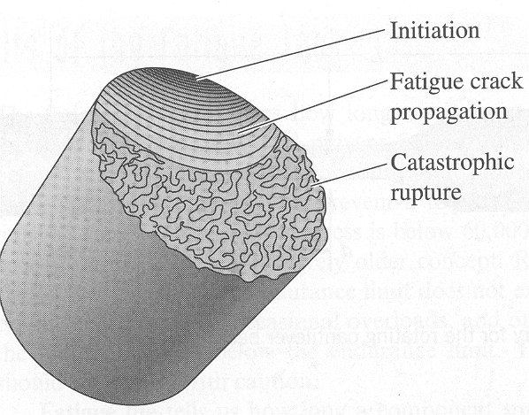
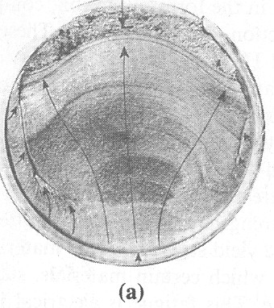
Fatigue
46
Fatigue failures are often easy to identify.
The fracture surface near the origin is usually smooth (Beach mark-crack initiation point). The surface becomes rougher as the crack increases in size.
Striations (concentric line patterns): the slow cyclic build up of crack growth from a surface intrusion. Striations are on a much finer scale and show the position of the crack tip after each cycle.
Granular portion of the fracture surface: rapid crack propagation at the time of catastrophic failure

Slide 47
Fatigue
47
Repeated, also called cyclic loads resulting in cyclic stresses can lead to microscopic physical damage.
Accumulation of this microscopic damage with continued cycling is possible until it develops into a macroscopic crack such as cracks that may lead to failure
Fatigue: Damage progression to failure due to repeated or cyclic loading at amplitudes considerably lower than tensile or yield strengths of material under a static load
Estimated to causes 90 % of all failures of metallic structures (bridges, aircraft, machine components, etc.)
Fatigue failure is brittle-like (relatively little plastic deformation) - even in normally ductile materials. Thus sudden and catastrophic!

Slide 48
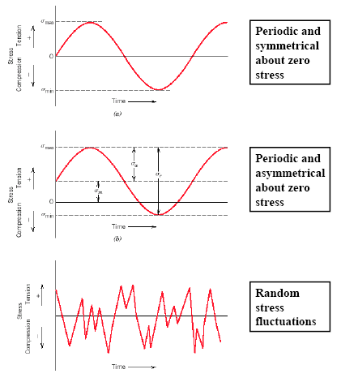
Dynamic Loading and Fatigue
48

Slide 49
Types of fatigue loading
UNIT V LECTURE VI
49
Completely reversed cycle of stress:
repeated stress cycles
irregular or random stress cycle:

Slide 50
Completely reversed cycle of stress
UNIT V LECTURE VI
50
Illustrates the type of fatigue loading where a member is subjected to opposite loads alternately with a means of zero.
For example bending of steel wire continuously in either direction leads to alternate tensile and compressive stresses on its surface layers and failure fatigue.
If the applied load changes from any magnitude in one direction to the same magnitude in the opposite direction, the loading is termed completely reversed,

Slide 51
Repeated stress cycles
UNIT V LECTURE VI
51
Type of fatigue loading where a member is subjected to only tension but to various degrees.
A spring subjected to repeated tension as in a toy would lead to fatigue failure.

Slide 52
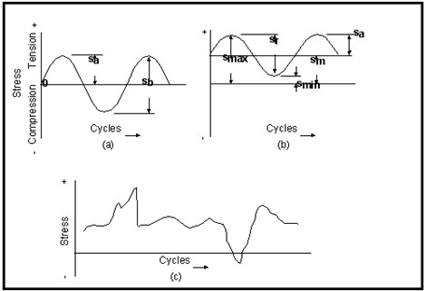
UNIT V LECTURE VI
52
Irregular or random stress cycle
This type of fatigue loading where a member could be subjected to irregular loads just as in the case of an aircraft wing subjected to wind loads

Slide 53
Fatigue limit or Endurance limit (σ_{E})
UNIT V LECTURE VI
53
It is stress below which a material will not fail for any number of cycles.
For ferrous materials it is approximately half of the ultimate tensile strength.
For non-ferrous metal since there is no fatigue limit.

Slide 54
UNIT V LECTURE VI
54
Endurance limit
It is taken to be the stress at which it endures, N number of cycles without failure .N is usually taken as 5 x 10⁸ cycles for non-ferrous metals.

Slide 55
Factors affecting fatigue
UNIT V LECTURE VI
55
Effect of stress concentration Size effect
Surface Roughness Surface Residual Stress Effect of temperature
Effect of metallurgical variables

Slide 56
EFFECT OF STRESS CONCENTRATION
It is most responsible for the majority of fatigue failures
All m/c elements contain stress raisers like fillets, key ways, screw threads, porosity etc. fatigue cracks are nucleated in the region of such geometrical irregularities.

Slide 57
The actual effectiveness of stress concentration is measured by the fatigue strength reduction factor K_{f}
K_{f} = σ_{n} / σ_{n}^{I}
σ_{n} = the fatigue strength of a member without any stress concentration
σ ^{I} = the fatigue strength of the same member with the specified
n
stress concentration.

Slide 58
Fatigue failure by stress concentration can be minimized by
Reducing the avoidable stress-raisers
Careful design and
The prevention of stress raisers by careful machining and fabrication.

Slide 59
SIZE EFFECT:
The strength of large members is lower than that of small specimens.
This may be due to two reasons.
•
The larger member will have a larger distribution of weak points than the smaller one and on an average, fails at a lower stress.
Larger members have larger surface Ares. This is important because the imperfections that cause fatigue failure are usually at the surface.
•

Slide 60
Effect of size:
Increasing the size (especially section thickness) results in larger surface area and creation of stresses.
This factor leads to increase in the probability of crack initiation.
This factor must be kept in mind while designing large sized components.

Slide 61
SURFACE ROUGHNESS:
UNIT V LECTURE VI
61
Almost all fatigue cracks nucleate at the surface of the members.
The conditions of the surface roughness and surface oxidation or corrosion are very important.
Experiments have shown that different surface finishes of the same material will show different fatigue strength.

Slide 62
SURFACE RESIDUAL STRESS:
UNIT V LECTURE VI
62
Residual stresses are nothing but locked up stresses which are present in a part even when it is not subjected to an external force.
Residual stresses arise during casting or during cold working when the plastic deformation would not be uniform throughout the cross section of the part.

Slide 63
Effect of metallurgical variables
UNIT V LECTURE VI
63
Fatigue strength generally increases with increase in UTS
Fatigue strength of quenched & tempered steels (tempered martensitic structure) have better fatigue strength
Finer grain size show better fatigue strength than coarser grain size.
Non-metallic inclusions either at surface or sub-surface reduces' the fatigue strength

Slide 64
EFFECT OF TEMPERATURE:
UNIT V LECTURE VI
64
•
Fatigue tests on metals carried out at below room temperature shows that fatigue strength increases with decreasing temperature.

Slide 65
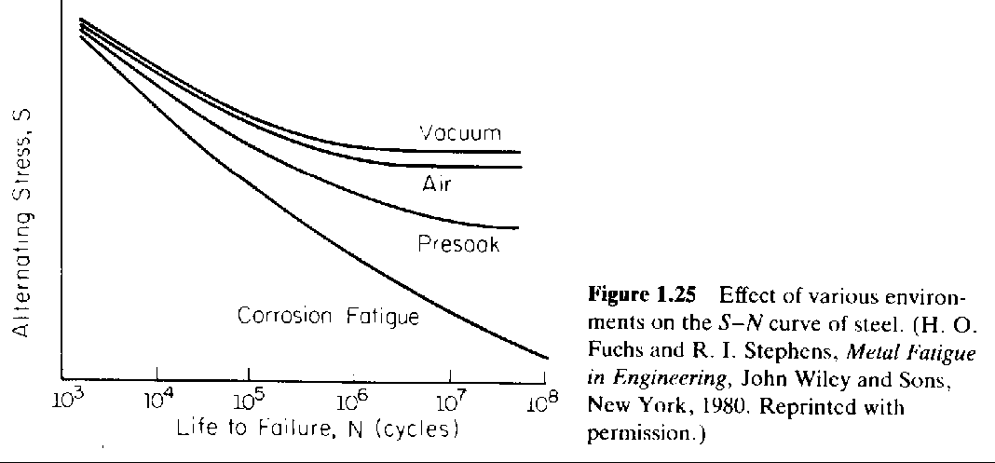
Environmental Effects
•
Environment. Corrosion has complex interactive effect with fatigue (attacks surface and creates brittle oxide
film, which cracks and pits to cause stress concentrations).
Often in practice, there are modifying factors for the above applied to the equation for the endurance limit.
•

Slide 66
The S-N curve
UNIT V LECTURE VI
66
A very useful way to visualize time to failure for a specific material is with the S-N curve.
The "S-N" means stress verse cycles to failure, which when plotted uses the stress amplitude, s_{a} plotted on the vertical axis and the logarithm of the number of cycles to failure.

Slide 67
UNIT V LECTURE VI
67
The significance of the fatigue limit is that if the material is loaded below this stress, then it will not fail, regardless of the number of times it is loaded.
Material such as aluminum, copper and magnesium do not show a fatigue limit, therefor they will fail at any stress and number of cycles.
Other important terms are fatigue strength and fatigue life.
The stress at which failure occurs for a given number of cycles is the fatigue strength.
The number of cycles required for a material to fail at a certain stress in fatigue life.

Slide 68
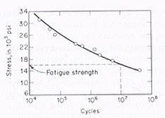
UNIT V LECTURE VI
68

Slide 69
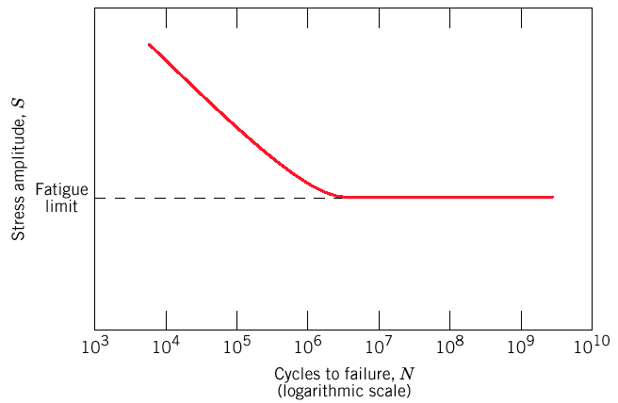
Fatigue: S—N curves (II)
Fatigue limit (some Fe and Ti alloys)
S—N curve becomes horizontal at large N
Stress amplitude below which the material never fails, no matter how large the number of cycles is

Slide 70
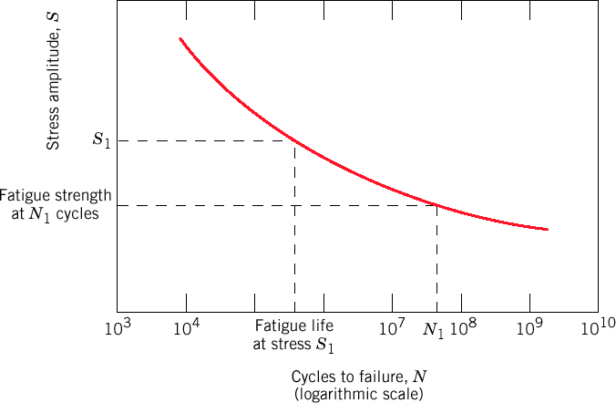
Fatigue: S—N curves (III)
Most alloys: S decreases with N.
Fatigue strength: Stress at which fracture occurs after specified number of cycles (e.g. 10⁷)
Fatigue life: Number of cycles to fail at specified stress level

Slide 71
Creep Fracture
UNIT V LECTURE 5
71
Creep fracture is defined as the fracture which takes place due to creeping of materials under steady loading.
It occurs in metals like iron, copper & nickel at high temperatures. The tendency of creep fracture increases with the increase in temperature and higher rate of straining.
The creep fracture takes place due to shearing of grain boundary at moderate stresses and temperatures and movement of dislocation from one slip to another at higher stresses and temperatures.
The movement of whole grains relation of each other causes cracks along the grain boundaries, which act as point of high stress concentration.
When one crack becomes larger it spreads slowly across the member until fracture takes place.
This type of fracture usually occurs when small stresses are applied for a longer period.
The creep fracture is affected by grain size, strain hardening, heat treatment and alloying.

Slide 72
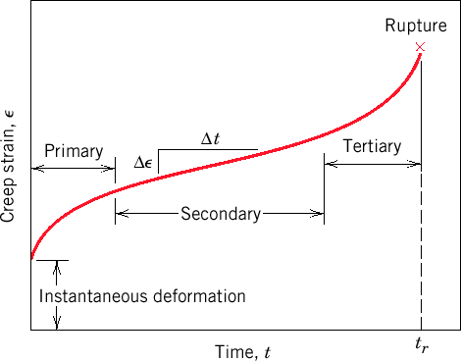
Stages of creep

Slide 73
Stages of creep
Instantaneous deformation, mainly elastic.
Primary/transient creep. Slope of strain vs. time decreases with time: work-hardening
Secondary/steady-state creep. Rate of straining constant: work-hardening and recovery.
Tertiary. Rapidly accelerating strain rate up to failure: formation of internal cracks, voids, grain boundary separation, necking, etc.

Slide 74
Parameters of creep behavior
Secondary/steady-state creep: Longest duration Long-life applications
ε& _{s}
^{= Δε / Δt} (creep rate)
Time to rupture ( rupture lifetime, t_{r}): Important for short-life creep
Δε/Δt
t_{r}

Slide 75
MECHANICAL TEST OF METALS
UNIT V LECTURE VI
75

Slide 76
TENSILE TEST
UNIT V LECTURE VI
76
Tensile testing, also
known as tension testing, is a
is
fundamental materials science test in which a sample
subjected to a controlled tension until failure.
The results from the test are commonly used to select a material for an application, for quality control, and to predict how a material will react under other types of forces.
From these measurements the following properties can also be determined: Young's modulus, Poisson's ratio, yield strength, and strain-hardening characteristics.
•

Slide 77
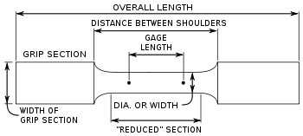
UNIT V LECTURE VI
77
Tensile specimen

Slide 78
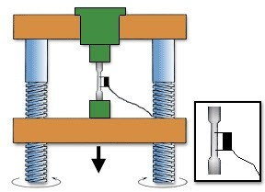
UNIT V LECTURE VI
78
EQUIPMENT

Slide 79
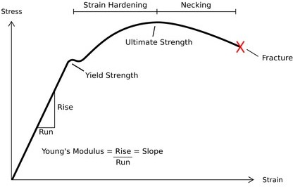
UNIT V LECTURE VI
79
STRESS–STRAIN CURVE

Slide 80
HARDNESS TEST
UNIT V LECTURE VI
80
Hardness, as a mechanical property, is the resistance of a material to surface penetration.
Therefore, most hardness tests involve measuring the amount of force required to implant a specified indentation in the surface of a specimen OR the size of the indentation produced from applying a specified load.
The indenter used varies with the test selected, but is generally hardened steel or diamond.

Slide 81
UNIT V LECTURE VI
81
Common hardness tests include the Rockwell and Brinell. Other test procedures used include the scleroscope, surface abrasion testing, Vickers, and Tukon-Knoop.
  Brinell Hardness Test
  Vickers hardness Test
  Rockwell Hardness Test

Slide 82
UNIT V LECTURE VI
82

Slide 83
Impact Test
UNIT V LECTURE VI
83
Impact Testing, ASTM E23 and IS/ BS Standard
The impact test is a method for evaluating the toughness and notch sensitivity of engineering materials. It is usually used to test the toughness of metals, but similar tests are used for polymers, ceramics and composites. Metal industry sectors include Oil and Gas, Aerospace, Power Generation, Automotive, and Nuclear.

Slide 84
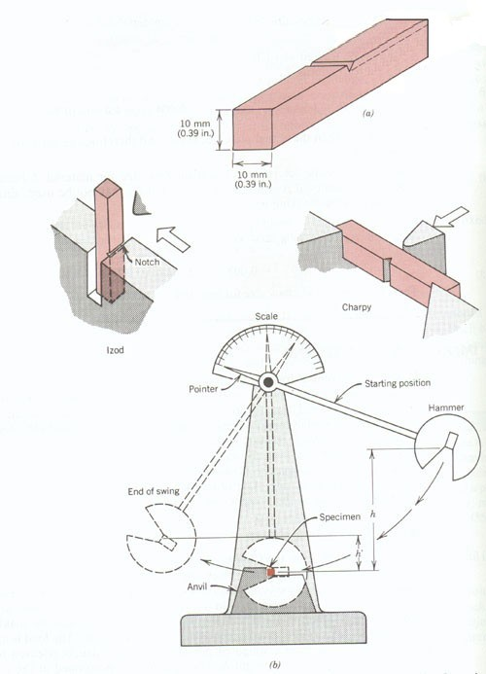
UNIT V LECTURE VI
84

Slide 85
Charpy Impact Test
UNIT V LECTURE VI
85
A test specimen is machined to a 10mm x 10mm (full size) cross-section, with either a "V" or "U" notch. Sub-size specimens are used where the material thickness is restricted. Specimens can be tested down to cryogenic temperatures.
The Charpy impact test is a dynamic test in which a test piece U-notched or V-notched in the middle and supported at each end, is broken by a single blow of a freely swinging pendulum. The energy absorbed is measured. This absorbed energy is a measure of the impact strength of material.

Slide 86
Izod Impact Test
UNIT V LECTURE VI
86
The test specimen is machined to a square or round section, with either one , two or three notches. The specimen is clamped vertically on the anvil with the notch facing the Hammer.
The Izod impact test is a dynamic test in which a test piece V-notched test piece, gripped vertically, is broken by a single blow of a freely swinging pendulum. The blow is struck on the same face as the notch and at the fixed height above it. The energy absorbed is measured. This absorbed energy is a measure of the impact strength of material.

Slide 87
Fatigue
UNIT V LECTURE VI
87
It has long been known that a component subjected to fluctuating stresses may fail at stress levels much lower than its monotonic fracture strength, due to a process called Fatigue.
In several applications, components have to withstand different kinds of load at different times .
Materials subjected to these fluctuating or repeated load tends to show a behavior which is different from what they show under steady loads.

Slide 88
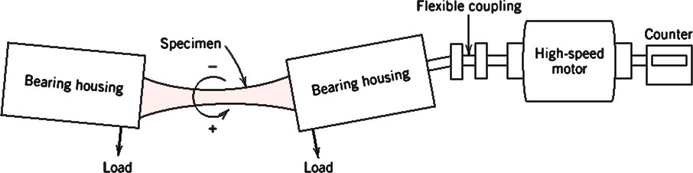
UNIT V LECTURE VI
88

Slide 89
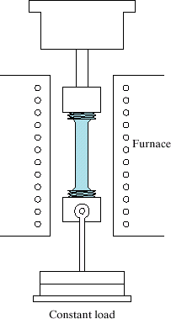
Creep
Time-dependent deformation due to constant load at high temperature
(> 0.4 T_{m})
Examples: turbine blades, steam generators.
Creep test:
Furnace
Creep testing

Slide 90
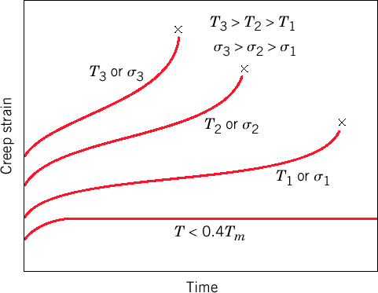
Creep: stress and temperature effects
With increasing stress or temperature:
The instantaneous strain increases
The steady-state creep rate increases
The time to rupture decreases

Slide 91
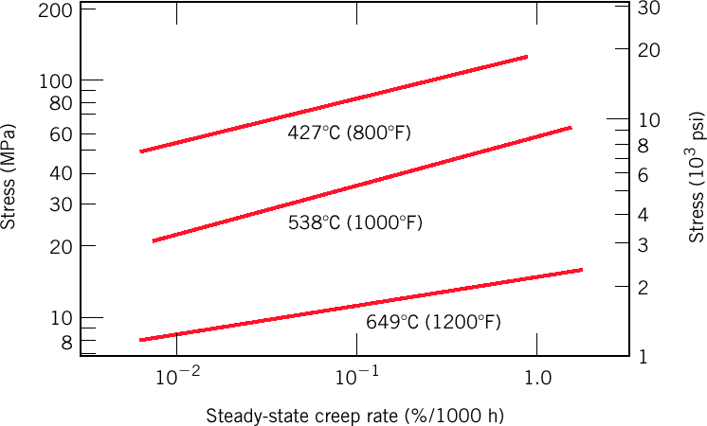
Creep: stress and temperature effects
Stress/temperature dependence of the steady-state creep rate can be illustrated by

Slide 92
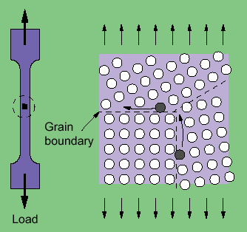
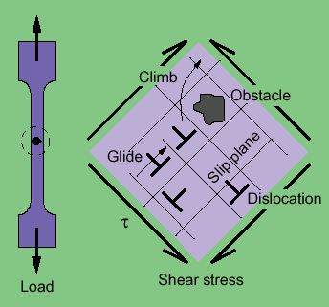
Mechanisms of Creep
Different mechanisms act in different materials and under different loading and temperature conditions:
Dislocation Glide
Dislocation Creep
Diffusion Creep
Grain boundary sliding
Different mechanisms → different n, Q_{c}.
Grain boundary diffusion
Dislocation glide and climb

Slide 93
Mechanisms of Creep
Dislocation glide- Involves dislocations moving along slip planes and overcoming barriers by thermal activation. This mechanism occurs at high stress levels.
Dislocation creep- Involves the movement of dislocations which overcome barriers by thermally assisted mechanisms involving the diffusion of vacancies or interstitials.

Slide 94
Mechanisms of Creep
Diffusion creep- Involves the flow of vacancies and interstitials through a crystal under the influence of applied stress. This mechanism occurs at high temperatures and low stress levels.
Grain boundary sliding- Involves the sliding of grains past each other.

