Slide 1
STUDY AND ANALYSIS OF MANUFACTURING CAR BODY BY TITANIUM MATERIAL
Presented by,
Aravindan.M (821716114303) Miss.B.Aswini .,M.E
Asarudeen.E (821716114305) Assistant professor
Ashok raja.S (821716114306)
Murugavel.C (821716114317)

Slide 2
ABSTRACT
In this study, the mechanical properties of carbon nanotube reinforced titanium(CNT-Ti) composites have been predicted using molecular dynamics approach.
The effect of variation in carbon nanotube volume fraction, temperature, and strain on the elastic moduli and the shear modulus of CNT-Ti composites was studied.

Slide 3
EXISTING PROJECT
In this car body can be manufactured by carbon fiber, stainless steel, aluminum and rubber.
It’s provide low breaking strength car parts.

Slide 4
DISADVANTAGE
Difficult to work with.
It can’t be easily bent.
More susceptible to rust and corrosion.
It can’t be easily molded to different shapes.

Slide 5
CURRENT PROJECT
To manufacturing the car body using titanium and carbon composites.
Carbon fiber and titanium are woven together to form strong, light material.

Slide 6
MATERIALS USED - CARBON
Carbon Fibers are 5–10 micrometres in diameter and composed mostly of carbon atoms.
Relatively expensive when compared with similar fibers, such as glass fibers or plastic fibers.

Slide 7
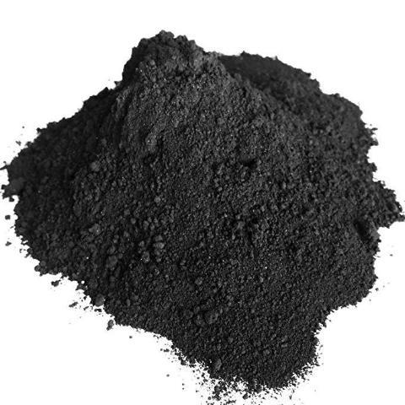
DIAGRAM
Amount of carbon (150–200)mg.

Slide 8
ADVANTAGE AND APPLICATIONS
High stiffness
High tensile strength
Low weight
High chemical resistance
Temperature tolerance
Low thermal expansion
Aerospace
Civil engineering
Military
Motorsports
Competition sports

Slide 9
TITANIUM
Titanium is a chemical element with the symbol Ti and atomic number 22.
It is lustrous transition metal with a silver color, low density, and high strength.
It is resistant to corrosion in sea water, aqua regia, and chlorine.

Slide 10
TITANIUM GRADE
Titanium CP4 – Grade 1
Titanium CP3 – Grade 2
Titanium CP2 – Grade 3
Titanium CP1 – Grade 4
Titanium Grade 7
Titanium Grade 11 – CP Ti-0.15Pd

Slide 11
TITANIUM CP3 – GRADE 2
It has moderate strength and excellent cold forming properties.
It provides excellent welding properties.
It has excellent resistance to oxidation and corrosion.

Slide 12
APPLICATION AND FORMS
Aerospace
Automotive
Marine
Power Generation
Medical
Architecture
Bar
Fittings
Flanges
Forgings
Pipe, Plate, Sheet
Tube, Welding

Slide 13
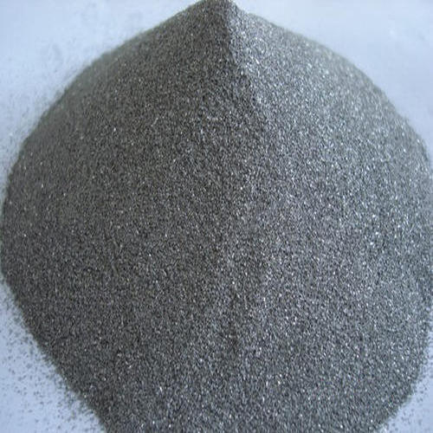
DIAGRAM
Amount of titanium (150-200 )mg

Slide 14
ADVANTAGE
It is strongest and most durable metals.
It has highest strength-to-density ratio.
It is natural resistance to rust and corrosion.
It is less dense.

Slide 15
CONCLUSION
The component of carbon fiber and titanium are woven together to form a strong.
And light weight material that can withstand significant amounts of heat and strain.

Slide 16
REFERENCE
Lijima S, Brabec C, Maiti A, et al. Structural flexbility of carbon nanotube. J chem phys 1996; 104; 2089.
George R, kashyap KT, Rahul R, et al. Strengthening in carbon nanotube/aluminium (CNT/AI) composites, Scripta master 2005; 53; 1159-1163.
Kuzumaki T, Hayashi T, Miyazawa K, et al. Processing of ductile carbon nanotube/ C60 composit. Mater trans 1998; 39; 574.
Xu CL, Wel BQ,Ma RZ et al. Fabrication of aluminium-carbon nanotube composites and their electrical properties carbon 1999: 37: 855-858.

Slide 17
PROJECT INFORMATION
COST OF ESTIMATION
DATE OF SUBMITION
Testing material – 5500Rs/-
Record fee- 1800Rs/-
Transport expences-1000Rs/-
March 2020

Slide 18
THANK YOU

