Slide 1
PREDICTION AND ANALYSIS OF MECHANICAL PROPERTIES OF ALUMINIUM ALLOY USING TAGUCHI AND REGRESSION ANALYSIS A PHASE -I Submitted by Guided by CHRISTOPHER S Mr. K.VEERAPANDIAN, M.E.,

Slide 2
ABSTRACT
The usage of aluminum based composite is increasing day by day
The properties can be improved by addition of RHA reinforcement and also by combination of oxides with A 6063
This present study gives sump-up of the latest developments taken place in aluminum based composite and other particulate reinforcement effects.

Slide 3
INTRODUCTION
Aluminium or aluminum is a chemical element with symbol Al and atomic number 13.
It is a silvery-white, soft, nonmagnetic and ductile metal in the boron group. By mass, aluminium makes up about 8% of the Earth's crust;
It is the third most abundant element after oxygen and silicon and the most abundant metal in the crust

Slide 4
LITERATURE REVIEW
Sajjadi et al. (2012) made a comparison of microstructure and mechanical properties of nano and micro-composites (A356 aluminium alloy Al2O3)with different weight percent of particles fabricated by stir and compocastingprocesses.

Slide 5
Topcu et al. (2009) made an attempt to improve the creep strength of pure aluminium by the presence of 10 B4C particle. In their study,density, hardness, impact and creep properties of base aluminium reinforced with 5, 10, 15 and 20 wt. % of B4C

Slide 6
Mehdi Rahimian et al. (2009) The experimental results showed that the highest hardness, greater compressive strength and elongation were obtained for the aluminium containing an average particle size of 3 and sintered at 600 for 45 min.

Slide 7
PROBLEM IDENTIFICATION
From the literature study, it is observed that the majority of the aluminium composite chose graphite as self lubricant reinforcement as graphite.
The main drawback of the graphite reinforced aluminium composites is the formation of brittle interfacial phases leading to a decrease in composites strength and wear properties as graphite materials can react with aluminium at elevated temperature during liquid processing.

Slide 8
. Reasonably fewer studies are found on the self lubricatedmechanical and wear characteristics of light weight aluminium-based composites.
Some of the research gap identified based on the literature surveyof the topics are listed

Slide 9
DESIGN OF ALUMINIUM COMPOSITE

Slide 10
COMPOSITE MIXING RATIO
MATERIAL | COMPOSITION
AA6063 | 85%
AL₂O₃ | 10%
RHA | 5%
RICE HUSK
Rice milling industry generates a lot of rice husk during milling of paddy which comes from the fields.

Slide 11
CHEMICAL COMPOSITION OF ALUMINIUM
Element | %
Silicon | 0.6%
Iron | 0.35%
Copper | 0.10%
Manganese | 0.10%
Magnesium | 0.9%
Chromium | 0.10%
Zinc | 0.10%
Titanium | 0.10%
Aluminium | Balance

Slide 12
STIR CASTING
STIR CASTING
Stir casting is an economical process for the fabrication of aluminum matrix composites. There are many parameters in this process, which affect the final microstructure and mechanical properties of the composites. In this study, micron-sized SiC particles were used as reinforcement to fabricate Al-3 wt% SiC composites at two casting temperatures (680 and 850 °C) and stirring periods (2 and 6 min).

Slide 13
MATERIAL SPECIMEN

Slide 14
MECHANICAL PROPERTIES TESTING
IMPACT TEST
IMPACT TEST (IZOD)
IMPACT TEST (CHARPY)
HARDNESS TEST
BRINELL'S HARDNESS TEST
ROCKWELL'S HARDNESS TEST
TENSION TEST
TORSION TEST

Slide 15
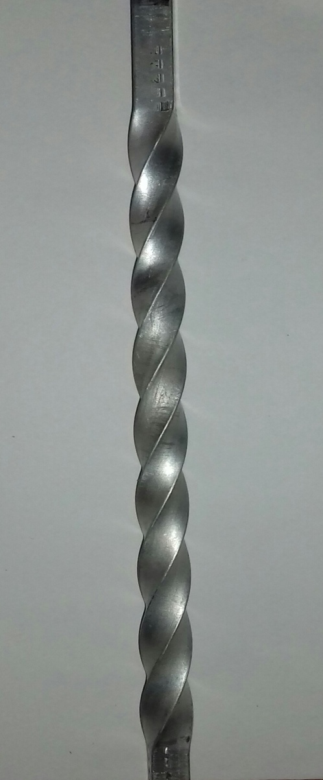
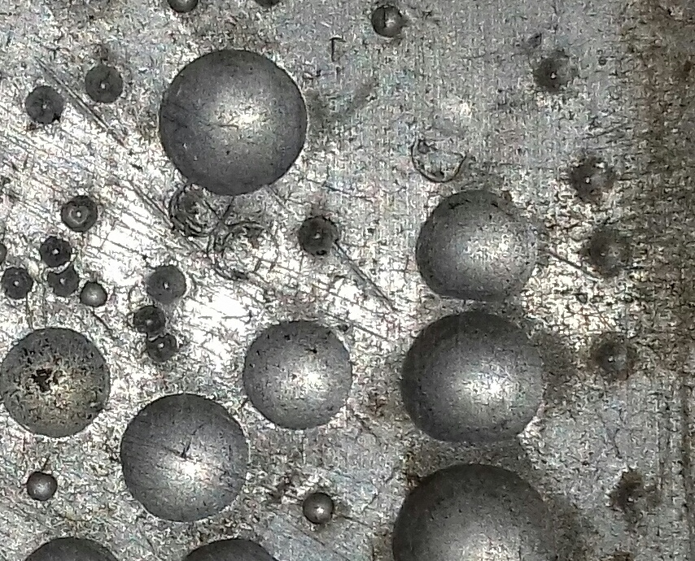
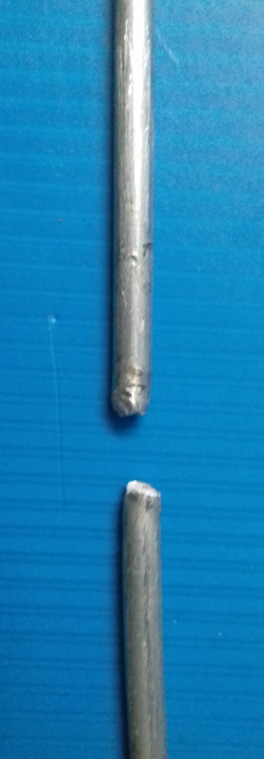
TESTED SPECIMEN PHOTOCOPY

Slide 16
CONCLUSION AND FUTURE ENHANCEMENT
The test report which clearly shows that the addition of Rice husk ash in to the aluminium alloy 6063 improve its mechanical properties.
The maximum hardness of composite is 58 HRB
The maximum twisting torque of composite is 90000 N-mm and its modulus of rigidity is 78.45 Gpa.
The maximum Tensile strength of composite is 13.84 KN.
The maximum shear strength of composite is 13.50 KN
There is no markable changes in impact test of the addition of RHA.
The various elements are mixed with aluminium to obtain the best results in future work and statical analysis of various aluminium alloys will be predicted and mechanical properties will be developed.

