Slide 1
INVESTIGATIONAL ANALYSIS OF PERFORMANCE CHARACTERISTICS AND EMISSION OF CASHEW NUT SHELL BIODIESEL ON DI DIESEL ENGINE PROJECT WORK
Under the Guidance of
Mr.RENURAMAN J
Assistant professor (O.G)
Department of Mechanical Engineering
SRM INSTITUTE OF SCIENCE AND TECHNOLOGY
Ramapuram, Chennai-600089

Slide 2
ABSTRACT
In this study, the combustion and emission characteristics of biodiesel produced from Cashew nut shell oil and its blends and diesel fuel were compared.
The experiments were performed in a single-cylinder direct injection diesel engine at steady-state conditions over the constant RPM (1500 RPM). During the experiments, the specific fuel consumption (SFC), pollutant emissions like hydrocarbon (HC), carbon monoxide (CO), oxides of nitrogen (NOx) and smoke, and in-cylinder pressures were measured.
The combustion analysis showed that the addition of Cashew nut shell oil biodiesel to diesel fuel reduced the ignition delay period and also reduced the premixed peak.
These results showed that Cashew nut shell oil biodiesel and its blends could be used without any modifications as an alternative fuel in diesel engine

Slide 3
INTRODUCTION TO CASHEW NUT SHELL OIL
Cashew Nut Shell Oil (CNSO) is a versatile component of the Cashew fruits’ nut. The oil which is a dark reddish-brown in color is resident in a soft honeycomb shell, that is the per carp of the nut.
It is a natural resin that could serve as a valuable raw material for multiple applications. Rapid growth in the world population and increasing standard of living has overstretched petroleum resources as petrochemical feedstock. This among other factors, has culminated in the fast depletion of global petroleum reserves.
Therefore, to maintain the standard of living and continuity of industrial sector which is paramount to human survival this decade and beyond, there is a need to find alternative sources of fuel and petrochemical feedstock.
Cashew nut shell, a by-product of the cashew industry, is an embodiment of a useful chemical serving as a raw material for the petrochemical industry. Cashew (Anacardium Occidentale L.), a well-known species of the Anacardiceae family [1], is a tropical plant (shrub) found within the region between 23°N and 23°S of the equator.
It is a drought resistant tree crop grown successfully in areas with annual rainfall of 50–350 cm. Its height is above 12 m and has a spread of about 25 m. It has an extensive root system which makes it adaptable to a wide range of moisture levels and soil types

Slide 4
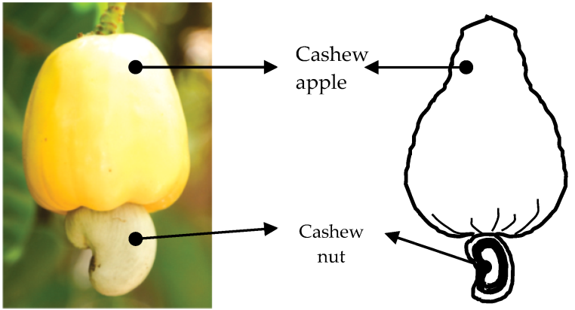
COMPONENTS AND ADVANTAGES
COMPONENTS OF AN IMPLANT,
The aliphatic side chains
70% anacardic acid, 5% cardanol, and 18% cardo
ADVANTAGES OF DENTAL IMPLANTS,
Improved appearance.
This oil will provide a smooth texture to your skin.
Apply this oil on a regular basis to find that your skin has retained its moisture. This is largely due to the abundance of moisture present in cashew nut oil. This in turn can be owed to the availability of high amounts of unsaturated fatty acids in it.
Being rich in Vitamin E, it plays a vital role in anti-aging mechanism and therefore has become an important ingredient in anti-aging products.

Slide 5
LITERATURE SURVEY
S.no | Title of the Paper | Concept | Remarks
1. | Chemical Composition and Physicochemical Properties of Cashew nut (D. Akinhanmi, T. F., Atasie, V. N. and Akintokun) | Paper talks about current scenario and future developments in cashew nut implants. | The mass of liquid extracted, feed rate, extraction efficiency, machine capacity and percentage liquid recovery were recorded. Analysis of variance (ANOVA) was used to determine the extent to which moisture content and pressing duration affected the performance indices. The F-ratio obtained from the ANOVA of the performance
2. | Friction and Evaluation of a locally fabricated oil screw expelling machine (Lin Wang et.al) | This paper helps in understanding the changes caused on natural Energy analysis of sugarcane biogases gasification. | The The concept of equilibrium modeling applies well for prediction of the effect of ER, MC and RT in gasification of CNSC. ER is observed to have a large impact on the composition of the producer gas.
3. | characteristics of Performance Evaluation of Kiln for Cashew Nut Shell Carbonization and Liquid (wernerh.Mormann et.al) | The paper talks about the wear characteristics of different types of An experimental study on biomass air-steam gasification in a fluidized bed | It is Diesel fuel exhibited a moderate level of NOx emission. It was observed that higher viscosity and density are the most desirable properties of biodiesel for lower NOx emission Lower in-cylinder pressure and lower heat release rate was found in all the biodiesel cases. .

Slide 6
LITERATURE SURVEY
4. | Modeling a biomass gasification system by means of EES, The Scandinavian Simulation Society, (Jeerapa Sripetchdanond et.al) | In this paper different An increment was observed in the EGT when the hydrogen is added at all engine loads. At full load conditions, the B206H2 has an exhaust gas temperature of 348 °C, while it was 312 °C in case of B20. | Within hydrogen dual fuel mode operated diesel engine upon parameters such as combustion, performance as well as the exhaust emission characteristics of single cylinder, water-cooled CI engine were investigated. The B20 blends of CNSL-diesel was optimized for maximum BTE and minimum HC and CO emission
5. | A study From coal to biomass gasification: Comparison of thermodynamic efficiency (Yu-Seok Jung et.al) | This study was conducted to learn wear characteristics of cashew nut shell oil . | In this study, the degree The HC and CO emission got increased for EGR addition with H2- enriched CNSL biodiesel engine at all load conditions. The percentage of increase in the HC emission for 30% EGR was 24% compared to B206H2 dual fuel engine without EGR.
6. | An Overview of Combustion and Gasification of Rice Husk in Fluidized Bed Reactors, Biomass and Bioenergy (Dr.Parvathy Sachethanan) | This paper helps in understanding the effects of commercially available produced a bio diesel from cashew nut shell. | Within the limitations of this study, it can be concluded that the use of The Exhaust Gas Temperature (EGT) decreased during EGR addition with H2-enriched CNSL biodiesel engine. But it got increased in case of H2-enriched CNSL biodiesel engine without EGR could be considered.

Slide 7
EMISSION CHARACTERISTICS
the variations of oxides of nitrogen with brake power. The oxides of nitrogen (NOx) emission after combustion is less in diesel fuel compared to Cashew nut shell oil biodiesel and its blends. From the graph it is clear that the NOx emission in B20, B40, B80 and B100 are less when compared with neat diesel.
The reason is the reduced combustion temperature that prevails inside the combustion chamber due to the higher heating value of the Cashew nut shell oil biodiesel blends. The blend B100 has shown aincrease of NOxemission 6.35% when compared to that of diesel fuel at full load.
The variation in HC emission with brake power results is shown in Fig. 6. The HC emission was increased to 35, 27.3, 27, 24, 22 and 18 ppm for the B100, B80, B60, B40 and B20 blends, respectively.
A possible explanation for the increment in the HC emission, when fueling with biodiesel and its blends is that lower calorific value and a certain number of the Cashew nut shell oilbiodiesel compared with the diesel fuel.
The reason may cause an incomplete combustion of fuel, increase the HC emission [9,13]. The HC emission increased 26.29% compared to that of diesel when B100 used as fuel.
The variation in CO emission with brake power is shown in Fig. 7. An average of 1.83% and 1.33% CO emission increment were observed in 20% and 40% Cashew nut shell oil biodiesel blends, respectively.

Slide 8
EMISSION CHARACTERISTICS
CO emission becomes highly significant, when the cylinder temperature is low and the in-cylinder combustion is incomplete.
CO emission for all Cashew nut shell oil biodiesel blends are in incomplete combustion. A lower cetane number of biodiesel blends exhibits a longer ignition delay and allows longer combustion duration.
Then the viscosity of biodiesel comes into play, which reduce the combustion process. The CO emission was 0.28% for diesel fuel and it was reduced to 0.38% by volume when B100 used as fuel. Smoke emission is the visible product of diesel engine emission.
The comparison of smoke emission of B20, B40, B60, B80, B100 and diesel fuel with respect to brake power is shown in Fig. 8. From the graph, it is observed that smoke emission of Cashew nut shell oil biodiesel and its blends are significantly higher than that of neat diesel at all load conditions.
However, when the load increases to maximum level, smoke emission is increased for Cashew nut shell oil biodiesel and its blends with diesel. The formation of local rich mixtures of fuel in the combustion chamber due to high viscosity and density of biodiesel blends results in poor atomization.

Slide 9
PROBLEM IDENTIFICATION
Dental The main purpose of this work is to reduce various emissions and also to improve the performance of the diesel engine when fueled with blends of hexane and neat cashew nut shell biodiesel.
Cashew nut shell oil is not edible, and hence it can be used as a viable alternative to diesel. Cashew nut shell biodiesel is prepared by conventional transesterification. Hexane with 99.2% purity was employed as an oxygenated additive.
Experimental studies were conducted by fueling diesel as a baseline and by fueling hexane and neat cashew nut shell biodiesel mixture. A fuel comprising 10% (by volume) of hexane and 90% (by volume) neat cashew nut shell biodiesel was referred to as CNSBD900H100 and fuel comprising 20% (by volume) of hexane and 80% (by volume) of neat cashew nut shell biodiesel was referred to as CNSBD800H200.
This study also investigated the possibility of using pure bio fuel in an unmodified naturally aspirated diesel engine. The outcome of this study showed that adding hexane at 10% and 20% (by volume) to cashew nut shell biodiesel results in a reduction in emissions.
In addition, a significant improvement in brake thermal efficiency and reduction in brake-specific fuel consumptions were achieved. Hence, it could be concluded that hexane could be a viable and promising additive for improving the drawbacks of biodiesel when it was used to fuel an unmodified diesel engine.

Slide 10
PROPOSED SOLUTION
Exploitation of agricultural waste as green starting materials to produce various valuable products is attracting the attention of academic, industrial and other practitioners.
Cashew nut shell (CNS) and its liquid extract (CNSL) in particular have been identified as agro-wastes rich in valuable and functional renewable products. The unique structural features of the CNSL constituents offer the possibility for different modifications to suit various applications.
This review article provides recent developments in CNS and CNSL as green sources for use in the production of bio renewable chemicals, materials and energy. Extraction methods and applications of CNS, CNSL and isolates are discussed.
Furthermore, a literature survey of the current status and efforts made on the utilization of these agricultural and food wastes for different applications is well outlined.

Slide 11
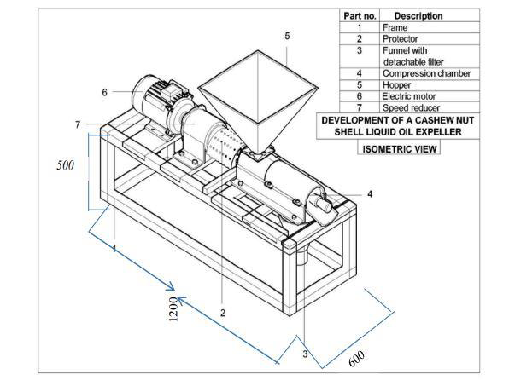
CASHEW NUT SHELL PROCESSING
Processing of cashew nuts can be defined as the recovery of the kernel (edible matter portion) from the raw nuts by manual or mechanical means. It consists of moisture conditioning, shelling, drying, peeling, grading and packing (Mandal, 2012). The nut consists of a coriaceous epicarp, spongy mesocarp containing a viscous resinous liquid and stony endocarp, that is, white kernel covered with a thin test membrane.The processing of the nuts may be done by manual method or through the factory processing.
MANUAL METHOD
INDUSTRIAL PROCESSING
Operation of developed expeller

Slide 12
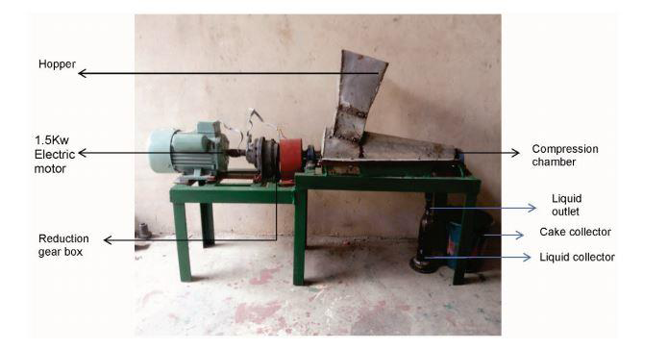
INDUSTRIAL PROCESSING
Graining
Machine setup

Slide 13
PROCESS FLOW
Pre – grading
packaging
cleaning
soaking
Roasting
CNSL Extraction
Solar drying
Biogas
peeling
grading
shelling
drying
PROCESS FLOWCHART

Slide 14
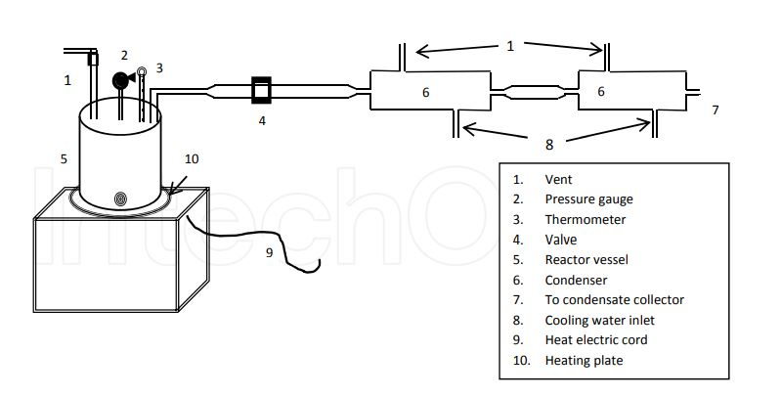
EXPERIMENTS AND TESTING
The pellets Basic physical operations before extraction are required on the samples of cashew nuts to ensure a high degree of purity and the quality of the product.
These operations constitute the Cashew Nut Shell Oil — A Renewable and Reliable Petrochemical Feed stock basic pretreatment on samples and include washing, drying, shelling and size reduction. Sometimes, washing may involve the use of detergents to remove likely contaminants.
Drying is purposely to make the nuts moisture-free.
Both sun- and oven-drying have been found effective.
Size reduction creates a better contacting surface area for the shell and solvent
to enhance removal of the CNSL.
The reactor is connected to a condensing unit which has several condensers in
series, in order to effectively recover the exhaust gases

Slide 15
CNSL AS BIODIESEL ON DI DIESEL ENGINE
As a substituted phenol which can take part in a variety of reactions, naturally occurring cashew nut shell liquid (CNSL), a renewable product, offers advantages over synthetics. Its innumerable application stems from the phenolic nature of its constituents, with enshrined features for transformation into high value specialty chemicals.
properties | diesel | ethanol | CNSL
Density (Kg/m³) | 0.84 | 0.789 | 0.9326
Kinematic viscosity (cost) | 2-5 | 1.19 | 17.2
Calorific value (kj/kg) | 42000 | 30000 | 47600
Flash point (°C) | 62 | 16 | 193
Auto-ignition trmperature (°C) | 210 | 362 | 206

Slide 16
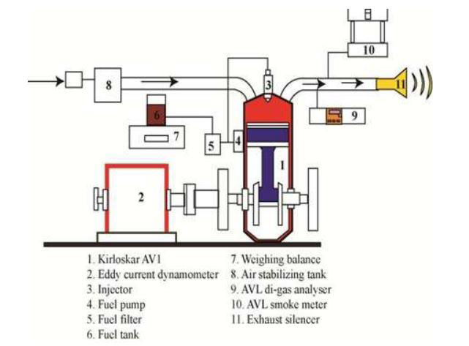
EXPERIMENTAL SETUP
The diesel engine used for experimentation is Kirloskar TV1, single cylinder, water cooled engine coupled to eddy current dynamometer with computer interface and it is shown in Fig.

Slide 17
PROPERTIES OF DIESEL ENGINE AND CNSL OIL
PROPERTIES | DIESEL | CNSL
Density at (g/cc) | 0.8/0.84 | 0.9326
Kinematic viscosity @ 40°C (cSt) | 2.0 to 4.5 | 12.27
Calorific value (kJ/kg) | 47693 | 20836
Flash point (°C) | 80 | 98
Fire point (°C) | 86 | 108
Experimental setup output

Slide 18
ENGINE SPECIFICATION

Slide 19
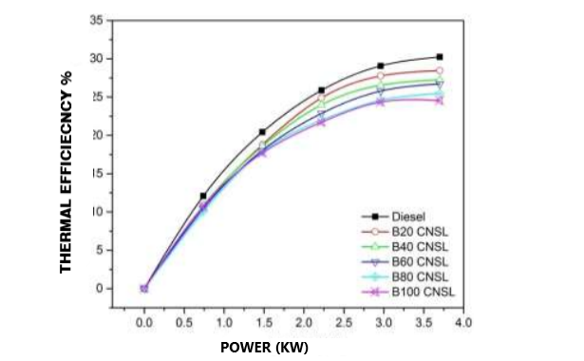
TESTING AND CALCULATION
The variations in brake thermal efficiency with respect to brake power.
The Brake thermal efficiency (BTE) of neat diesel is more than other blends, i.e., B20 has lower brake thermal efficiency followed by B40, B60, B80 and B100 respectively.
The reason may be the higher viscosity of the Cashew nut shell oil biodiesel blends that leads to poor atomization in the injector. B20 has shown better results than other blends since it has lower viscosity when compared to other biodiesel blends. The BTE of blend B20 shows an increase of 8.04% when compared to B100 at full load

Slide 20
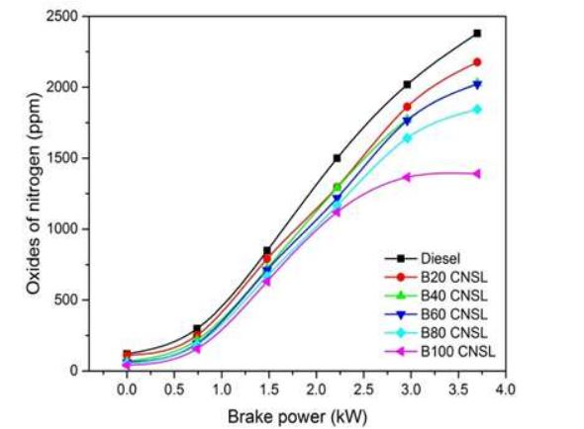
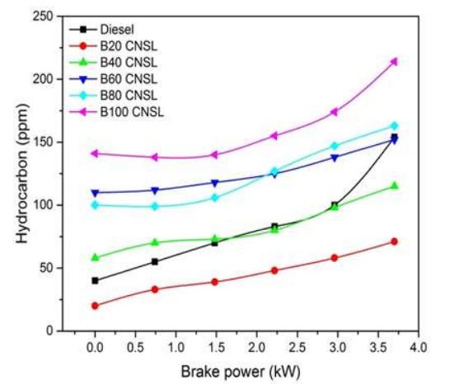
TESTING AND CALCULATION
The oxides of nitrogen (NOx) emission after combustion is less in diesel fuel compared to Cashew nut shell oil biodiesel and its blends. From the graph it is clear that the NOx emission in B20, B40, B80 and B100 are less when compared with neat diesel.
The reason is the reduced combustion temperature that prevails inside the combustion chamber due to the higher heating value of the Cashew nut shell oil biodiesel blends. The blend B100 has shown an increase of NO emission 6.35% when compared to that of diesel fuel at full load.
The HC emission was increased to 35, 27.3, 27, 24, 22 and 18 ppm for the B100, B80, B60, B40 and B20 blends, respectively. A possible explanation for the increment in the HC emission, when fueling with biodiesel and its blends is that lower calorific value and a certain number of the Cashew nut shell oil biodiesel compared with the diesel fuel. The reason may cause an incomplete combustion of fuel, increase the HC emission.
The HC emission increased 26.29% compared to that of diesel when B100 used as fuel. The variation in CO emission with brake power is shown in Fig. 7. An average of 1.83% and 1.33% CO emission increment were observed in 20% and 40% Cashew nut shell oil biodiesel blends, respectively.

Slide 21
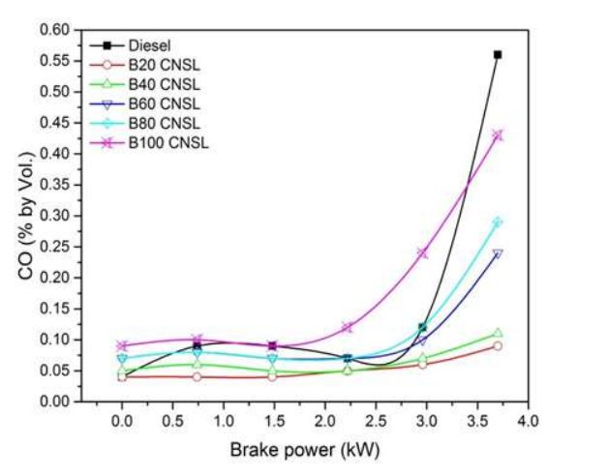
TESTING AND CALCULATION
The BTE differences with brake power in case of various fuel modes such as B20, B20 and 6lpm H2 (B206H2), 10%, 20% and 30% EGR addition.
From the experimental results, it can be inferred that there is an increase in the BTE when hydrogen is added in all the loads.
Further, there is also an indication that the hydrogen got combusted. The reason behind the increase in the efficiency might be due to increased combustion rate, thanks to hydrogen’s high flame velocity.
There was a low combustion efficiency observed in the hydrogen when biodiesel was present in low load range. In high range load, the combustion efficiency of hydrogen, in presence of biodiesel, was high. The BTE got decreased with the addition of EGR in all engine loads.
This might be attributed to the availability of EGR where the oxygen concentration in the intake air is lowered resulting in a notable negative impact on the combustion [34]. There was a decrease observed in the engine BTE when the EGR percentage was increased. The BTE was 32.3% in case of 10% EGR at full load while the BTE got reduced to 30.5%, in case of 30% EGR

Slide 22
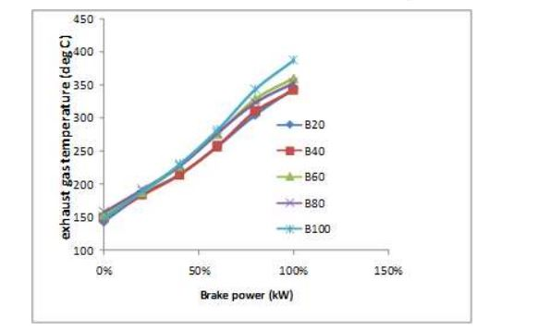
TESTING AND CALCULATION
The BSFC is seen plotted with brake power for B20, B206H2 and different percentages of EGR addition. It can be observed that the BSFC of B206H2 was less than B20 and EGR addition for all engine loads.
This occurred only because of the excellent blend of hydrogen as well as air leading to complete combustion of fuel. In addition to this, a wide flammability range, high flame speed and short quenching distance of hydrogen ensured that the biodiesel is combusted completely resulting in the reduced BSFC .
At the time of applying EGR, there was an increase found in BSFC with the increasing trend in EGR percentage, in all loads. This increment found in the BSFC might be because of the negative impact of EGR upon combustion which in turn results in the incomplete combustion.
The increase in BSFC was more for 30% EGR, when compared to all combinations of fuel used such as B20, B206H2, 10% EGR and20% EGR. Hence the dilution effect of inlet air was high during high quantity of EGR addition. There was less percentage of reduction observed in BSFC at higher load in comparison with lower load. This is the reason for excess amount of air available at full load for complete combustion. The BSFC for B206H2, 10%, 20% and 30% EGR addition were 0.26, 0.28, 0.29 and 0.33 kg/ kW.hr respectively at full load

Slide 23
CONCLUSION
In the present research work, the effects of EGR addition at the intake port of CNSL biodiesel–hydrogen dual fuel mode operated diesel engine upon parameters such as combustion, performance as well as the exhaust emission characteristics of single cylinder, water-cooled CI engine were investigated.
The B20 blends of CNSL-diesel was optimized for maximum BTE and minimum HC and CO emission. The hydrogen gas was introduced via inlet manifold at varied flow rates such as 4 lpm, 6 lpm and 8 lpm with optimized B20 blends.
At the end, different percentages of EGR were added in the inlet manifold with optimized B206H2 fuel. The experimental results were concluded with the following observations.
The following conclusions are drawn based on this experimental investigation on diesel engine when Cashew nut shell oil biodiesel and its blends were used as fuel. An average of 4% BTE decrease was observed in 100% Cashew nut shell oil biodiesel. Viscosity, density, and a certain number of the Cashew nut shell oil biodiesel played vital role in engine performance.
An average of 0.26% CO and 102 ppm HC emission increment were observed in 100% Cashew nut shell oil biodiesel and an average of 0.16% CO and 56 ppm HC emission reductions were observed for 20% blend compared with diesel fuel.

Slide 24
CONCLUSION
The following conclusions are drawn based on this experimental investigation on diesel engine when Cashew nut shell oilbiodiesel and its blends were used as fuel.
An average of 4% BTE decrease was observed in 100% Cashew nut shell oilbiodiesel. Viscosity, density, and a certain number of the Cashew nut shell oil biodiesel played vital role in engine performance.
An average of 0.26% CO and 102 ppm HC emission increment were observed in 100% Cashew nut shell oilbiodiesel and an average of 0.16% CO and 56 ppm HC emission reductions were observed for 20% blend compared with diesel fuel.
The NOx emission is decreased by 3.57% to 18.06% for the addition of 20% to 100% Cashew nut shell oilbiodiesel, respectively. Diesel fuel exhibited a moderate level of NOx emission. It was observed that higher viscosity and density are the most desirable properties of biodiesel for lower NOx emission.
Lower in-cylinder pressure and lower heat release rate was found in all the biodiesel cases.

Slide 25
THANK YOU

