Slide 1

IC Engine Emissions
A Sad Story of Artificial Animal in Natural Environment…..

Slide 2
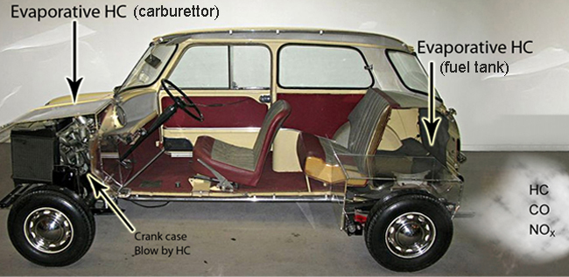
Emission sources in a gasoline fuelled car

Slide 3
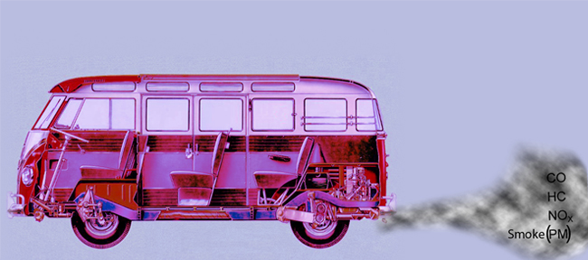
Emission sources in a diesel engine powered Vehicle

Slide 4
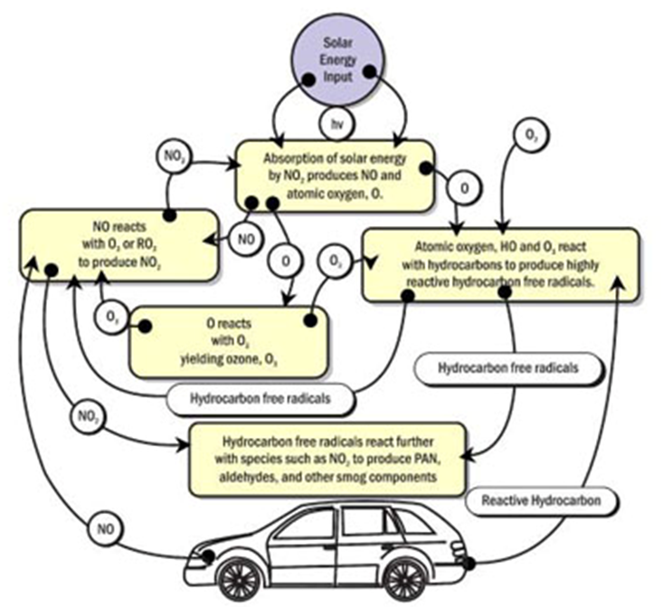
The Unreasonable Interaction with Environment

Slide 5
Engine Development : Pleasure to Pain
During the 1940s air pollution as a problem was first recognized in the Los Angeles basin.
Two causes of this were the large population density and the local weather conditions.
Smoke and other pollutants combined with fog to form smog.
In 1966 HC and CO emission limits were introduced.
By making more fuel efficient engines and with the use of exhaust after treatment, emissions per vehicle of HC, CO, and NOx were reduced by about 95% during the 1970s and 1980s.

Slide 6
Engine Emissions Vs Combustion Strategy
Principal Engine Emissions
SI Engines : CO, HC and NOx
CI Engines : CO, HC, NOx and PM

Slide 7
Emission norms for passenger cars ( Petrol)
Norms | CO( g/km) | HC+ NOx)(g/km)
1991Norms | 14.3-27.1 | 2.0(Only HC)
1996 Norms | 8.68-12.40 | 3.00-4.36
1998Norms | 4.34-6.20 | 1.50-2.18
stage 2000 norms | 2.72 | 0.97
Bharat stage-II | 2.2 | 0.5
Bharat Stage-III | 2.3 | 0.35(combined)
Bharat Stage-IV | 1.0 | 0.18(combined)

Slide 8
Emission Norms for 2/3 Wheelers ( Petrol)
Norms | CO ( g/km) | HC+ NOx (g/km)
1991 norms | 12-30 | 8-12 (only HC)
1996 norms | 4.5 | 3.6
stage 2000 norms | 2.0 | 2.0
Bharat stage-II | 1.6 | 1.5
Bharat Stage-III | 1.0 | 1.0

Slide 9
Emission norms for Heavy diesel vehicles:
Norms | CO (g/kwhr) | HC (g/kwhr) | Nox (g/kwhr) | PM (g/kwhr)
1991 Norms | 14 | 3.5 | 18 | -
1996 Norms | 11.2 | 2.4 | 14.4 | -
stage 2000 Norms | 4.5 | 1.1 | 8.0 | 0.36
Bharat stage-II | 4.0 | 1.1 | 7.0 | 0.15
Bharat Stage-III | 2.1 | 1.6 | 5.0 | 0.10
Bharat Stage-IV | 1.5 | 0.96 | 3.5 | 0.02

Slide 10
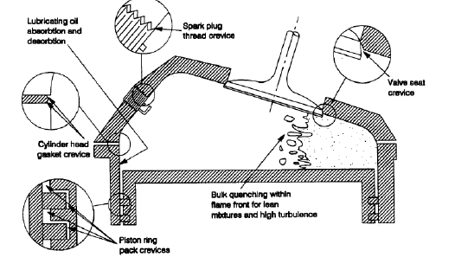
The Cylinder & Hydrocarbon Emission Sources
All these collection centers accumulate air fuel mixture during compression.
They release unburnt HCs during Expansion into Cylinder.

Slide 11
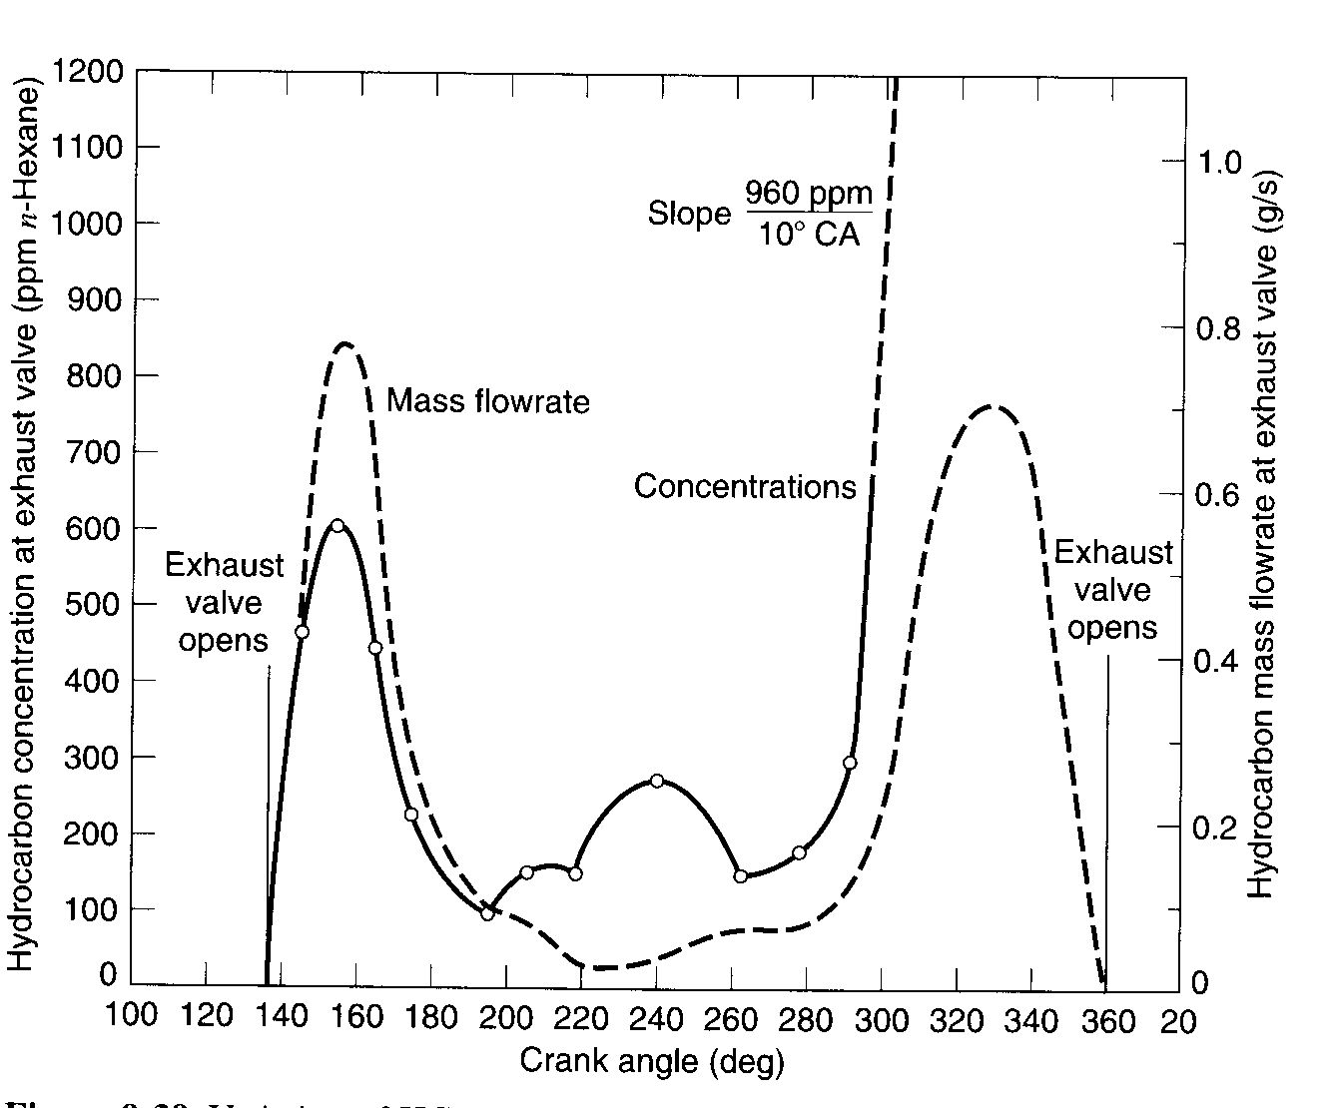
Hydrocarbon Release into Atmosphere Exhaust Process
The first peak is due to blow down and the second peak is due to vortex roll up and exhaust (vortex reaches exhaust valve at roughly 290º)
Exhaust
valve
closes
Exhaust
valve
opens
BC
TC

Slide 12
Hydrocarbon Emission Sources for SI Engines
There are six primary Sources believed to be responsible for
hydrocarbon emissions:
% fuel escaping
Source normal combustion % HC emissions
Crevices 5.2 38
Oil layers 1.0 16
Deposits 1.0 16
Liquid fuel 1.2 20
Flame quench 0.5 5
Exhaust valve leakage 0.1 5
Total 9.0 100

Slide 13
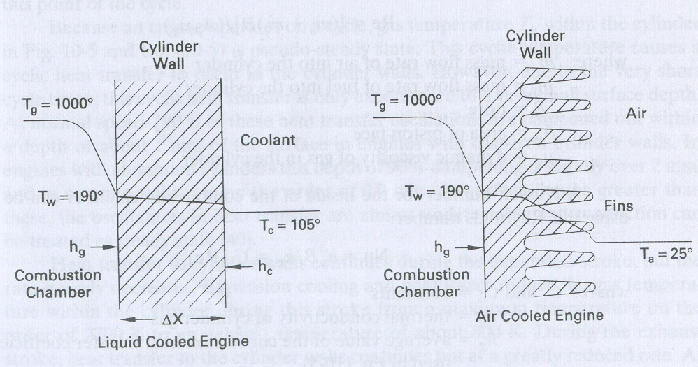
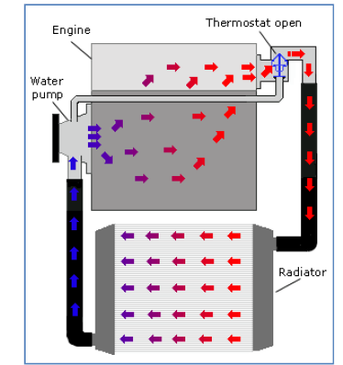
Heat Transfer from Cylinder

Slide 14
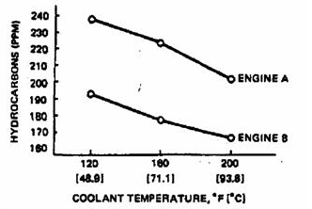
Coolant Temperature Vs HC Emissions

Slide 15
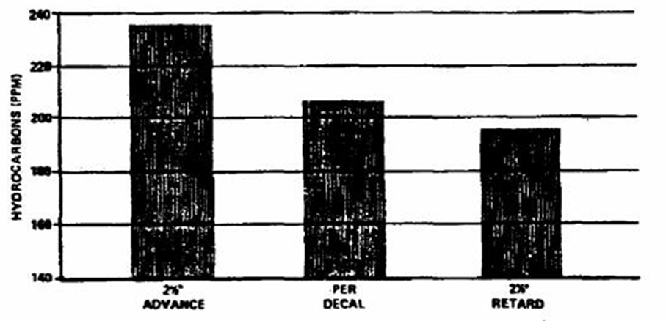
Ignition Timing Vs HC Emissions

Slide 16
Effect of Misfiring on HC Emissions

Slide 17
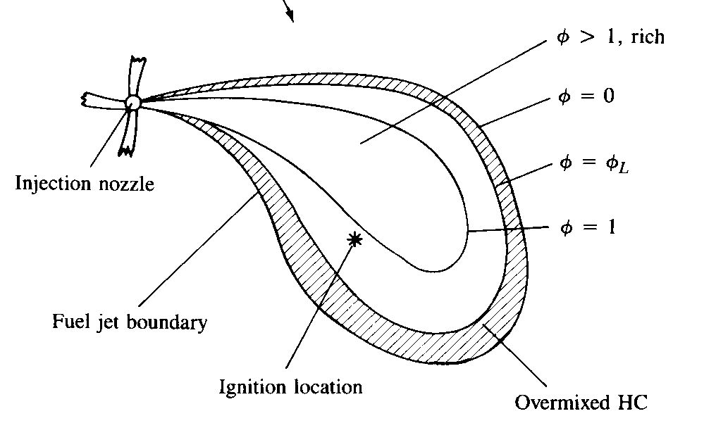

Hydrocarbon Emission Sources for CI Engines
Overmixing of fuel and air - During the ignition delay period evaporated fuel mixes with the air, regions of fuel-air mixture are produced that are too lean to burn.
Some of this fuel makes its way out the exhaust.
Longer ignition delay more fuel becomes overmixed.
Undermixing of fuel and air - Fuel leaving the injector nozzle at low velocity, at the end of the injection process cannot completely mix with air and burn.

Slide 18
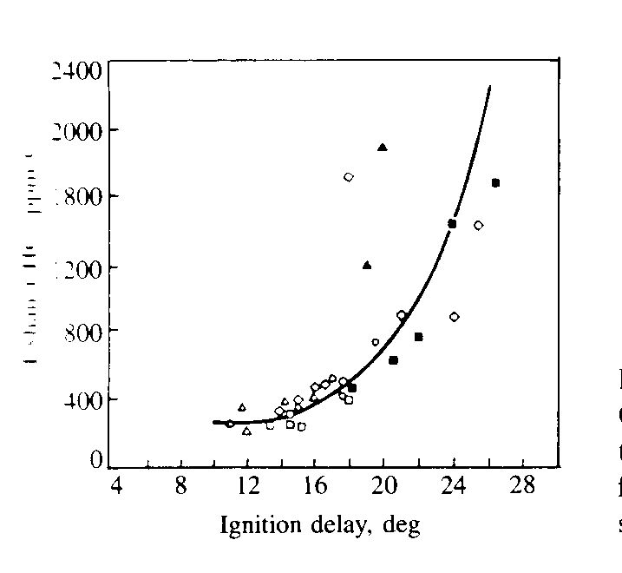
Effect of Ignition Delay on HC Emissions in CI Engine
Exhaust HC, ppm

Slide 19
Formation of CO in IC Engines
Formation of CO is well established.
Locally, there may not be enough O₂ available for complete oxidation and some of the carbon in the fuel ends up as CO.
The amount of CO, for a range of fuel composition and C/H ratios, is a function of the relative air-fuel ratio.
Even at sufficient oxygen level, high peak temperatures can cause dissociation.
Conversion of CO to CO₂ is governed by reaction
Dissociated CO may freeze during the expansion stroke.
The highest CO emission occurs during engine start up (warm up) when the engine is run fuel rich to compensate for poor fuel evaporation.

Slide 20
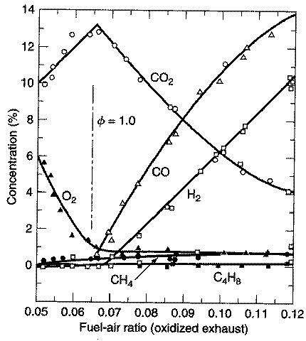
Formation of Carbon Monoxide
C₈H₁₈-air

Slide 21
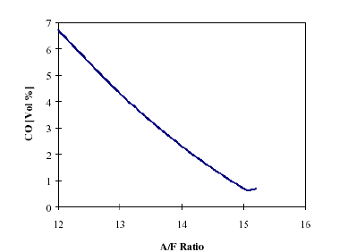
Air/Fuel Ratio Vs Carbon Monoxide Concentration

Slide 22
Formation of CO in CI Engines
The mean air-fuel mixture present in the combustion chamber per cycle is far leaner in the diesel engine than in the SI engine.
Due to a lack of homogeneity of the mixture built up by stratification, however, extremely “rich” local zones are exist.
This produces high CO concentrations that are reduced to a greater or lesser extent by post-oxidation.
When the excess-air ratio increases, dropping temperatures cause the post-oxidation rate to be reduced.
The reactions “freeze up”.
However, the final CO concentrations of diesel engines therefore are far lower than in SI engines.
The basic principles of CO formation, however, are the same as in SI engine.

Slide 23
Particulates
A high concentration of particulate matter (PM) is manifested as visible smoke in the exhaust gases.
Particulates are any substance other than water that can be collected by filtering the exhaust, classified as:
Solid carbon material or soot.
Condensed hydrocarbons and their partial oxidation products.
Diesel particulates consist of solid carbon (soot) at exhaust gas temperatures below 500ºC, HC compounds become absorbed on the surface.
In a properly adjusted SI engines soot is not usually a problem .
Particulate can arise if leaded fuel or overly rich fuel-air mixture are used.
Burning crankcase oil will also produce smoke especially during engine warm up where the HC condense in the exhaust gas.

Slide 24
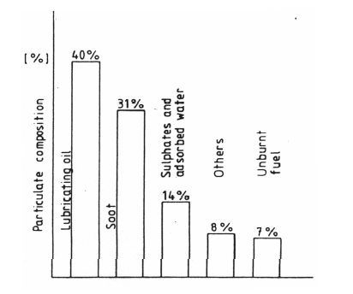
Particulate composition of diesel engine exhaust

Slide 25
Mechanism of Formation of Particulates (soot)
The soot formation process is very fast.
10 – 22 C atoms are converted into 10⁶ C atoms in less than 1 ms.
Based on equilibrium the composition of the fuel-oxidizer mixture soot , formation occurs when x ≥ 2a (or x/2a ≥ 1) in the following reaction:
Experimentally it is found that the critica C/O ratio for onset of soot formation is between 0.5 and 0.8.
The CO, H₂, and C(s) are subsequently oxidized in the diffusion flame to CO₂ and H₂O via the following second stage.
Any carbon not oxidized in the cylinder ends up as soot in the exhaust!

Slide 26
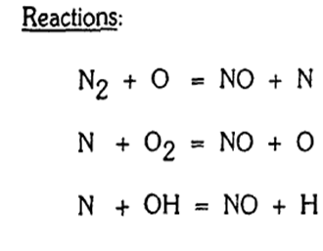
NO_{x} Formation in I.C. Engines
Three chemical reactions form the Zeldovich reaction are:
Forward rate constants:
Zelodvich reaction is the most significant mechanism of NO formation in IC engines.

Slide 27
Global Reaction Rate
Using the chemical reactions given, one can write the following expression for the rate of change of nitric oxide concentration.
Where the brackets denote concentrations in units of molecules/m³.
Approximations to solve above equation:
The C-O-H system is in equilibrium and is not perturbed by N₂ dissociation.
This means that the pressure, temperature, equivalence ratio and residual fraction of fluid element only are required to calculate NO concentration.
N atoms change concentration by a quasi-steady process.
This means that one can solve for the N atom concentration by setting the rate of change of atoms to zero.

Slide 28
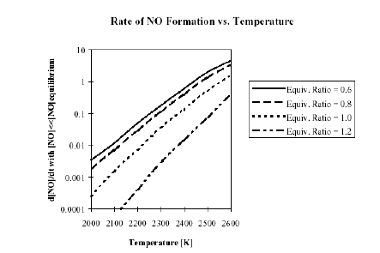

Slide 29
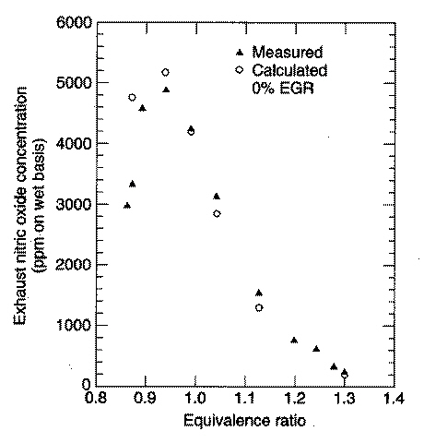

Effect of Equivalence Ratio on NO Concentration

Slide 30
Emissions Control
Three basic methods used to control engine emissions:
1)Engineering of combustion process -advances in fuel injectors, oxygen sensors, and on-board computers.
2) Optimizing the choice of operating parameters -two Nox control measures that have been used in automobile engines are spark retard and EGR.
3) After treatment devices in the exhaust system -catalytic converter.

Slide 31
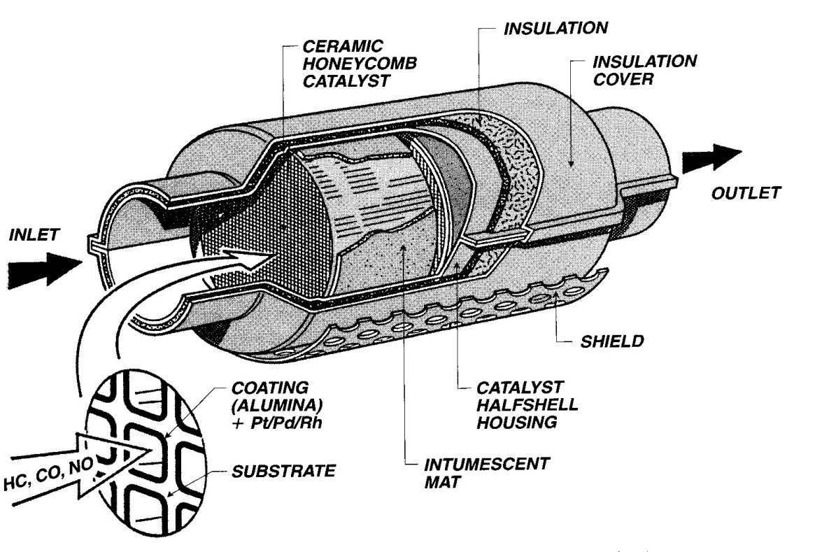
Anatomy of Catalytic Converter for SI Engines
All catalytic converters are built in a honeycomb or pellet geometry to expose the exhaust gases to a large surface made of one or more noble metals: platinum, palladium and rhodium.
Rhodium used to remove NO and platinum used to remove HC and CO.
Lead and sulfur in the exhaust gas severely inhibit the operation of a catalytic converter (poison).

Slide 32
Three-way Catalytic Converter
A catalyst forces a reaction at a temperature lower than normally occurs.
As the exhaust gases flow through the catalyst, the NO reacts with the CO, HC and H₂ via a reduction reaction on the catalyst surface.
NO+CO→½N₂+CO₂ , NO+H₂ → ½N₂+H₂O, and others
The remaining CO and HC are removed through an oxidation reaction forming CO₂ and H₂O products (air added to exhaust after exhaust valve).
A three-way catalysts will function correctly only if the exhaust gas composition corresponds to nearly (±1%) stoichiometric combustion.
If the exhaust is too lean – NO is not destroyed
If the exhaust is too rich – CO and HC are not destroyed
A closed-loop control system with an oxygen sensor in the exhaust is used to A/F ratio and used to adjust the fuel injector so that the A/F ratio is near stoichiometric.

Slide 33
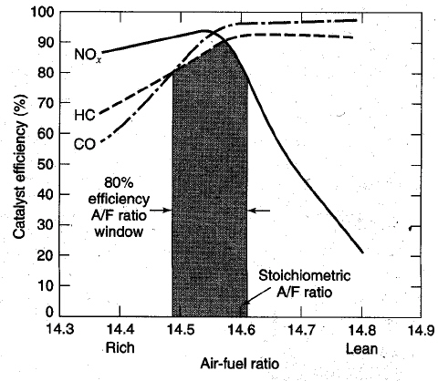
Effect of Mixture Composition

