Slide 1
Design and analysis of pneumatic transmission raised car
Project members,
k.Akash
S.Amjath khan
S.Lawrence
S.Hariharan
Project guided by,
R.Gnana sekaran , M.E…,
Asst-proffesor,
Department of mechanical engineering,
Sir issac newton college of engineering and technology ,
Pappakovil , Nagapattinam.

Slide 2
Abstract
Abstract This paper describes the research, design and construction of a viable experimental pneumatic driven vehicle. The main goal is to find ways to drive efficient by using alternative energy, not necessary cheaper, but more environmental friendly in increasing polluted metropolis. This is done by taking the emission source from the vehicle's tail pipe to the central electrical generating plant. Emission control measures at a central generating plant may be more effective and less costly than treating the emissions of widely dispersed vehicles. Where low emissions sources are available like: aeolian, water, solar, and nitrogen byproducts; net production of pollutants can be reduced. The background results used in this study are obtained by designing, building and testing five experimental configurations of compressed-air/gas vehicles. This study presents the latest one of these vehicles.

Slide 3
INTRODUTION
Pneumatic plays a vital role in modern world.
Our project can replace the conventional engine into compressed cylinder coupled with pump and differential.
It consists of pneumatic and solenoid valve operation.
Example : Trolley movement in industry

Slide 4
Construction
Our construction details of our project is given by,
STAGE 1 ( source to run the vehicle)
Compressor
solenoid valve
Pump coupled with compressor
STAGE 2 (run the vehicle and compressor)
Differential
Pump coupled with differential

Slide 5
Compressor
Compress the air and produce pressurized air
Compressor gets starts by electric motor initially.
In running ,compressor gets run by pump connected with differential at back side of vehicle.

Slide 6
Solenoid valve
To control the pneumatic air with manual operation
It is used to stop and control the vehicle with cut off of air from compressor.
Here 5/3 solenoid valve is used.

Slide 7
Pump
It has run by pneumatic air
It runs by compressed pressure and give output to rear axle through transmission unit.
It is the intermediate working between compressor operation and rear axle working.
In this project we have use two pumps,
One in source with compressor.
Another with differential unit.

Slide 8
Differential unit
It transfer power from propeller shaft to rear axle shaft (power delivered in different axis)
It is covered by differential hub with lubrication
It also run the pump which also run the compressor.so the running operation is quite simple.

Slide 9
electric motor
It produce starting of compressor unit
It also drive the compressor initially with self charging unit.
It is the shunt motor.

Slide 10
Working details
Initially the electric motor start the compressor with limited level.
Then the compressed air flow through solenoid valve to pump.
It is coupled with transmissionn to run the vehicle.
In running the pump connected with differential also run the compressor.

Slide 11
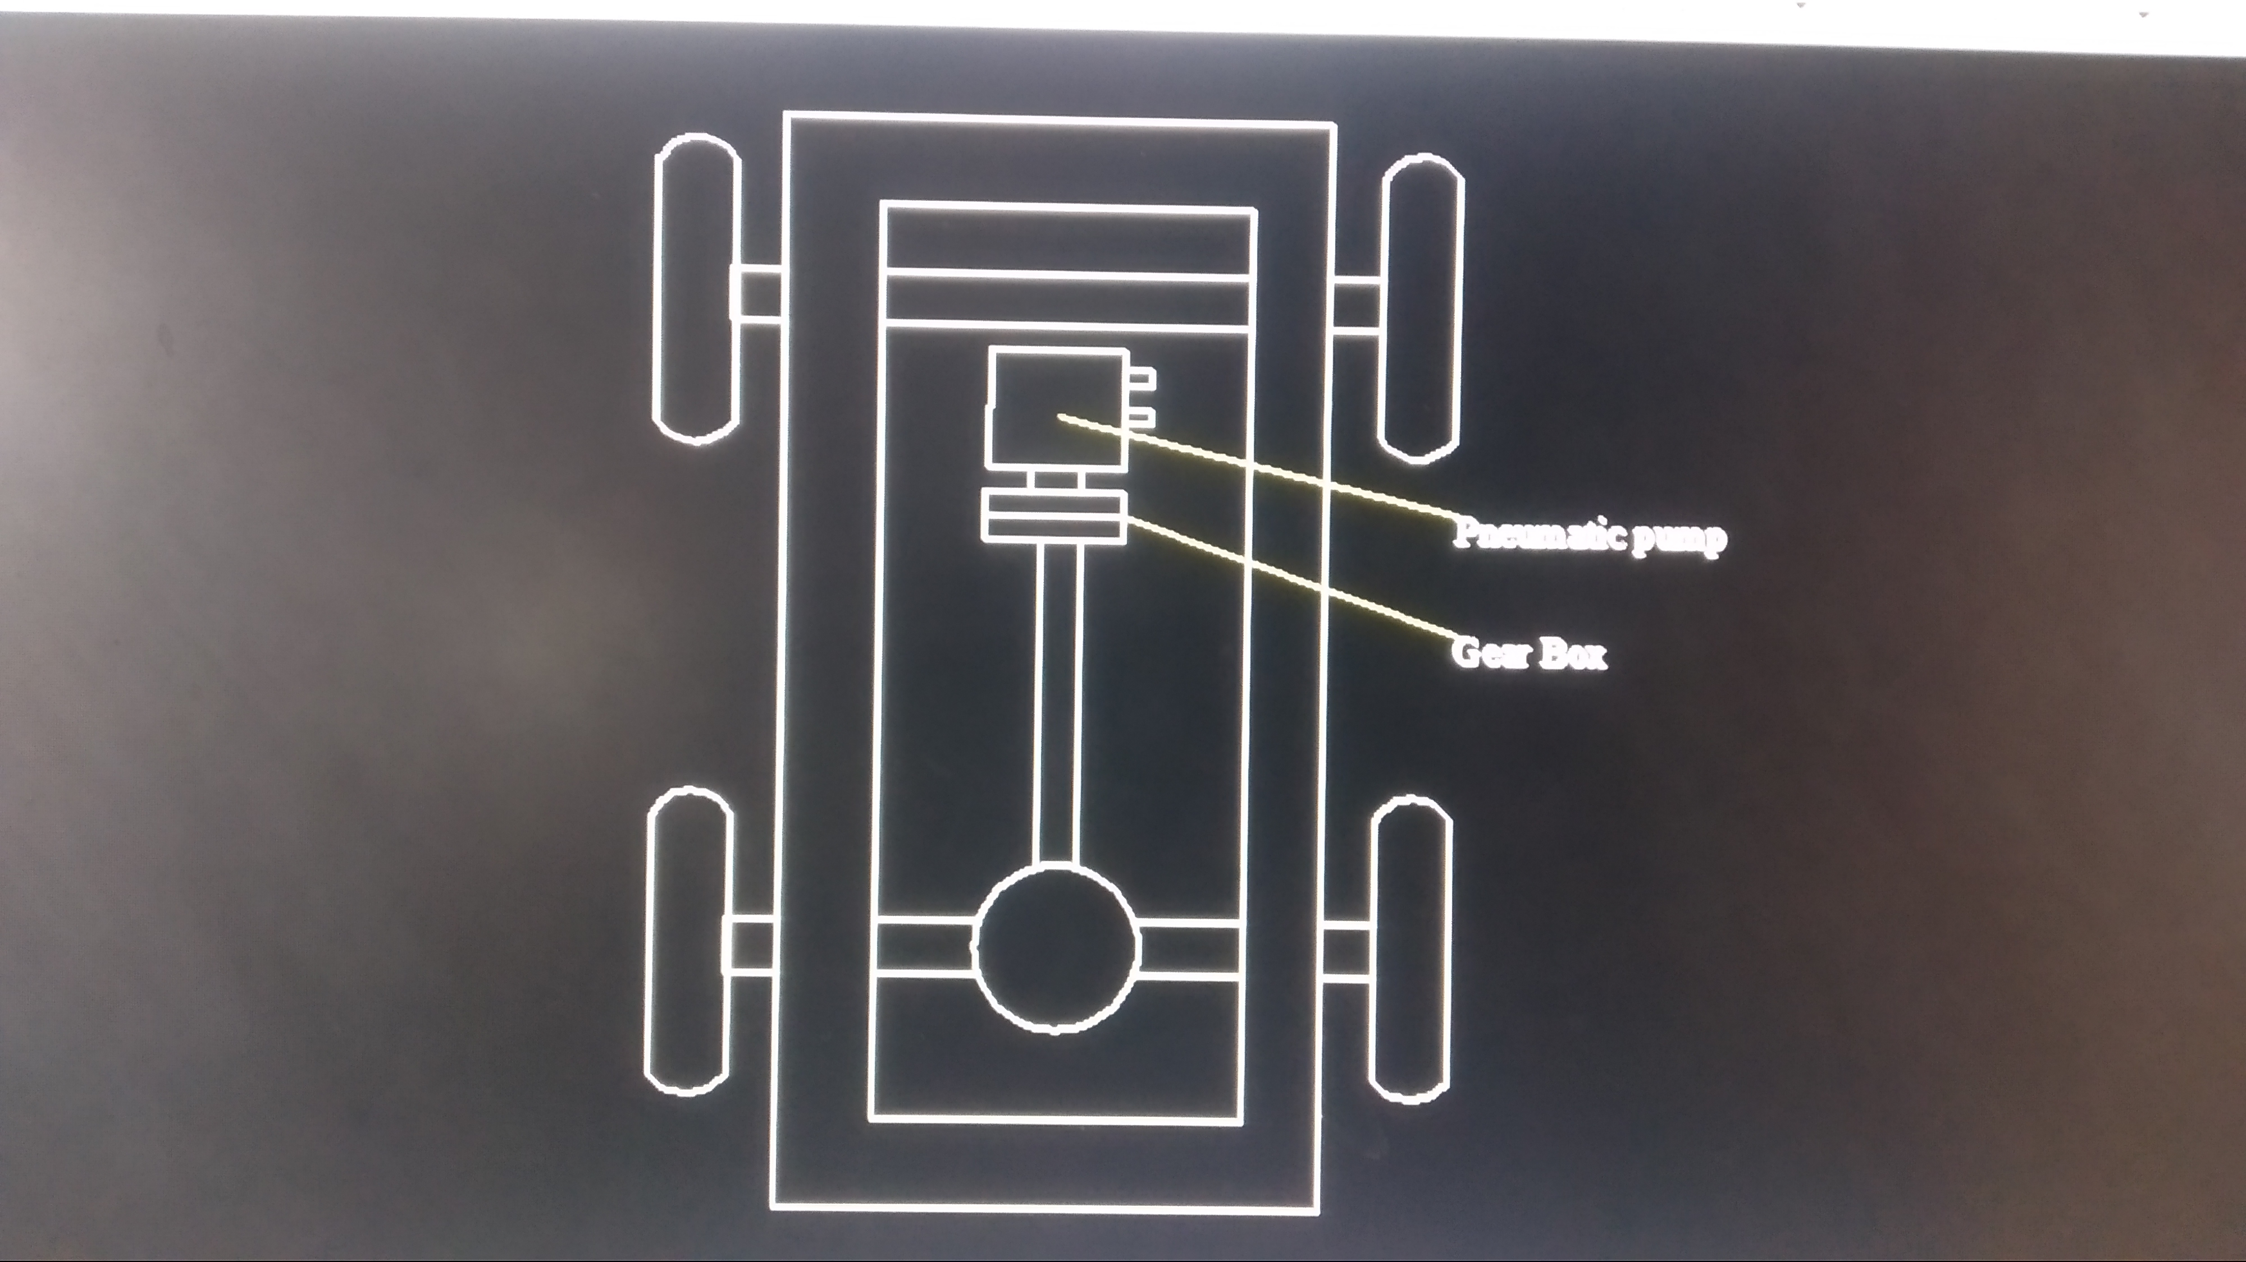

Slide 12
It is the cyclic process
When the vehicle get stop then start to run the vehicle is quite complex. Because it need additional starting power and compressor cylinder.
It can’t need petrol or diesel.
It has additionally need electric power only for starting the compressor.

Slide 13
Advantages
It can’t produce pollution in modern world.
It has less frictional parts compared to conventional engine so less noise.
It can’t need fuel for run the vehicle.
Less cooling purpose needed.
Less number of components and less friction.
Construction cost is very.
Self generating power produced in running.

Slide 14
Disadvantages
It is not suitable for high load.
Air leakage is possible.
Frequently air seals are replaced in pump

