Slide 1
DESIGN AND ANALYSIS OF FAILURE AND IMPROVEMENT OF REAR AXLE SHAFT BY USING COMPOSITE MATERIAL
A PROJECT REPORT
Submitted by
K.GUNAL (821716114012)
D.LOGESH (821716114018)
R.MAHENDHIRAN (821716114019)
B.RANJITH KUMAR (821716114038)
Who carried out the project work my supervision
PROJECT SUPERVISOR
Mr.K.VEERAPANDIAN.,M.E.,
department of mechanical engineering

Slide 2
ABSTRACT Shaft is a very important member in automobile vehicles for power transmition .the shaft in vehicle that transmit power from engine to wheel through transmission unit via a differential unit. Our project to analys the failure and improvement of rear axle shaft by using ANSYS software.the rear axle shaft is located in the differential unit which carry the more load and more vibration due to under a load condition. The main failure of axle shaft at fatigue failure of the shaft due to improper hardening process and reduce of wear resistance of the shaft during a running condition.now we intro the new metal in axle such as a AISI 4140 alloy steel. such take a metal as zirconium and aluminium in the way of properties because of the failure of shaft is done by reduction of fatigue strength and wear resistance of shaft material. so the failure is reduced by improve the fatigue strength of the material.the axle shaft strength improved by composition of new material such zirconium and aluminium which replace of chromium in the axle shaft material that analyzing by ANSYS software.
transmition .the shaft in vehicle that transmit power from engine to wheel through transmission unit via a differential unit. Our project to analys the failure and improvement of rear axle shaft by using ANSYS software.the rear axle shaft is located in the

Slide 3
INTRODUCTION Thus the project is failure analysis and improve the rear axle shaft by using a composite material.The shaft have a more load when its running condition and also more vibration to be developed during a running condition. The failure of shaft due to lot of ways such as a improper heat treatment,different load condition,reduce of fatigue strength, improper hardening process which is lead to reduce of fatigue strength.we are analyzing the different shaft material such we take the AISI 4140 alloy steel which is composition of “chromium-molybdenum alloy steel” the rear axle shaft which is main power transmission in vehicle. when the failure occur in axle shaft which leads to major problem in power transmission.the shaft material is a standard material so we are intro new material in the axle shaft material such as in AISI 4140 alloy steel. the composition of axle shaft material the chromium is replaced by “zirconium and aluminium” the project is carry out by ANSYS software for analyzing the mechanical property of new composite of rear axle shaft and also analyse rear axle shaft in the shaft using analysed ANSYS software

Slide 4
LITERATURE REVIEW 1.J.Sudhakaran, G.Sakthivel ,S.Sheril in the department of mechanical engineering for analysis of “performance and analysis of tractor rear axle shaft using composite material” this is analysis of tractor rear axle shaft that can be solve the problems regarding when it breakdown and failure in field of operation. This project improve the rear axle shaft by using composite material. The rear axle shaft subjected to torsional and bending stress due to varying load condition. This review about the performance and failure of tractor rear axle shaft that the member of power transmission in automobile. This involve the modify the shaft design and material strength that analysed by ANSYS software.this project carry out the material of “ductile cast iron,E-glass and carbon fibre” which increasing material property to achieve the mechanical,suspension arms,long service,effective performance are to be achieved. The aim of this project the present work is to design,analyse on existing model and purpose of change in shape and material

Slide 5
2. Subrata kr mandal,palash kr maji and karmakar, in the CSIR-central mechanical engineering research institute for the “Analysis of an intermediate rear axle shaft failure”. In this project will modify the design of the shaft such as modify the some mechanical property of the shaft are to be done on it. This involve the process to improve the design of the shaft that shaft diameter and length are to be modified such a way. The shaft design generally done based on the application use of the shaft. Hera in this project the design was made of the keeping the fact that it is will be used in a rear axle shaft transmission system. This will also increase the diameter of stepped portion at a ratio increasing the fillet radius the shaft failure at the change of diameter and hence increasing from lowering the stress concentration. The detail design work of the wheel assembly is found wanting the operating under ideal condition the predicted life of relatively short and leaves the no margin for vehicle misuse, a distinct possibility with such an application.

Slide 6
LOADS AND FORCES ON SHAFT The rear axle shaft subjected to point load on acting at both ends of the rear axle shaft. This load depends upon the various factors such as a weight of the of the vehicle, external loads on vehicle and weight of the shaft tends to varying load condition. The shaft has more vibration when more load and power transmitting condition. That the shaft more widely affected by fatigue load on the shaft. Then the shaft is to considered at simply supported beam for assembly and design of shaft which more load acting at both ends of the shaft. There are several loads acting on the shaft as follows: Weight of the vehicle body. Driving thrust. Braking torque. Torque reaction. Side thrust

Slide 7
MATERIAL SELECTION Introduction This material for our project is the application of composite material based that improvement of rear axle shaft such that the selection of material is based on the material properties for our application. So that our selection of rear axle material is AISI 4140 alloy steel we are try to improve the properties of this by intro the new material in composition in AISI 4140 alloy steel. The grade of this alloy is consist of some alloy elements like that chromium,molybdenum and other catbon etc., the grade is “ American Iron And Steel Institute 4140 alloy steel” this is one of the alloy steel material, the selection of new material like the “zirconium and aluminium” it composition in the “ chromium-molybdenum alloy steel” for our application of its properties. The aim of this project is to improve the rear axle shaft. We are selection of materials are follows as a zirconium aluminium

Slide 8
AISI 4140 ALLOY STEEL
Alloy steels are designated by AISI four-digit numbers. They comprise different kinds of steels having composition exceeding the limitations of B, C, Mn, Mo, Ni, Si, Cr, and Va set for carbon steels.
AISI 4140 alloy steel is chromium, molybdenum, manganese containing low alloy steel. It has high fatigue strength, abrasion and impact resistance, toughness, and torsional strength. The following datasheet gives an overview of AISI 4140 alloy steel.
4.2.2Chemical Composition
The following table shows the chemical composition of AISI 4140 alloy steel
Element | Content (%)
Iron, Fe | 96.785-97.77
Chromium, Cr | 0.80-1.10
Manganese, Mn | 0.75-1.0
Carbon, C | 0.380-0.430
Silicon, Si | 0.15-0.30
Molybdenum, Mo | 0.15-0.25
Sulfur, S | 0.040
Phosphorous, P | 0.035

Slide 9
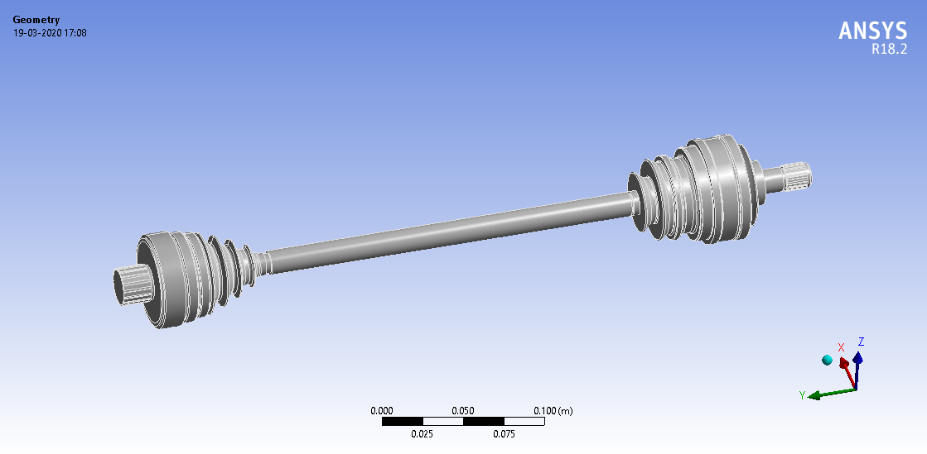
DESIGN OF AISI 4140 ALLOY STEEL

Slide 10
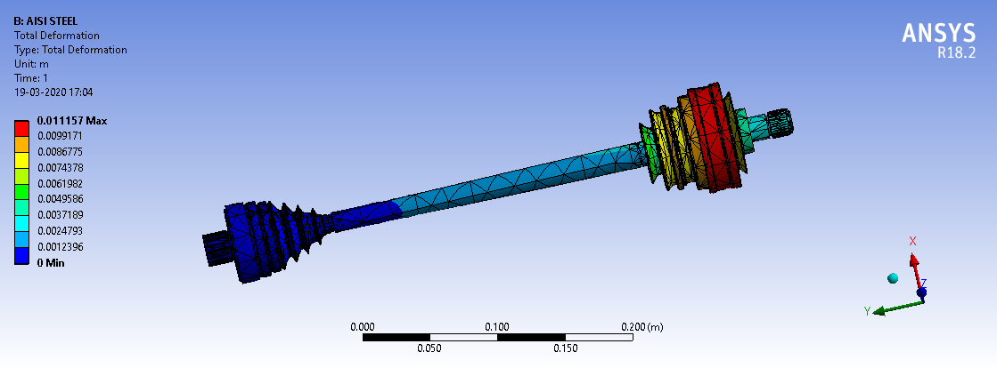
TOTAL DEFORMATION OF AISI 4140 ALLOY STEEL

Slide 11
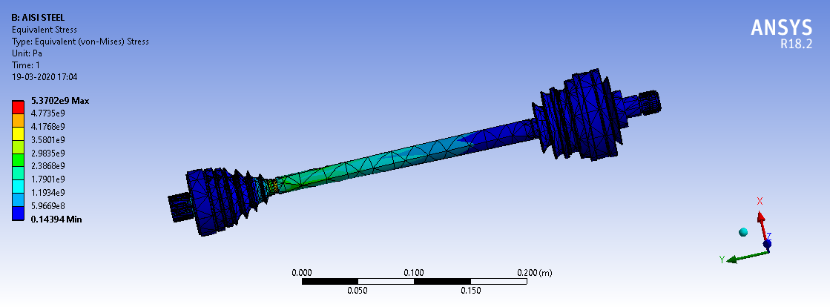
EQUIVELANT ELASTIC STRAIN OF AISI 4140 ALLOY STEEL

Slide 12
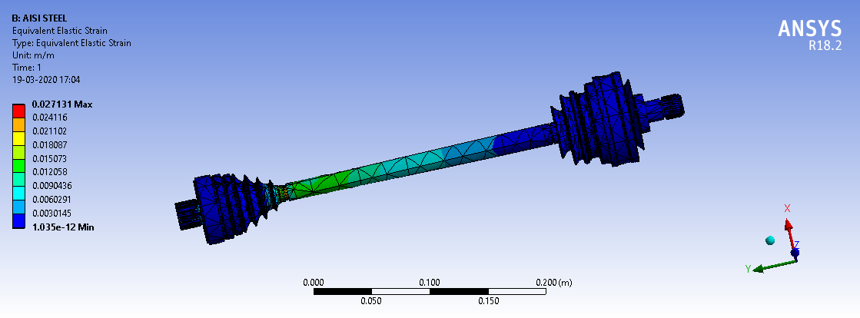
EQUIVELANT ELASTIC STRESS OF AISI 4140 ALLOY STEEL

Slide 13
Mechanical properties of AISI 4140
properties | metric
Tensile strength | 655 MPa
Yield strenghth | 415 MPa
Poisson ratio | 0.27-0.3
Bulk modulus | 140 GPa
Shear modulus | 80 GPa
Elastic modulus | 190-210GPa
Hardness,brinell | 197
Hardness,knoop | 219
Hardness,rockwell B | 92
Density | 7.85 g/cm3
Melting point | 1416°C

Slide 14
CHROMIUM chromium is a lustrous, brittle, hard metal. Its colour is silver-gray and it can be highly polished. It does not tarnish in air, when heated it borns and forms the green chromic oxide. Chromium is unstable in oxygen, it immediately produces a thin oxide layer that is impermeable to oxygen and protects the metal below. 4.3.1 Introduction Chromium is a chemical element with Cr as its symbol. It belongs to group 6, periodic number 4 of the periodic table. Its atomic number is 24.Chromium is a steely-gray lustrous, brittle, hard metal. It is known to have high corrosion resistance. When polished, it gains a very shiny surface, which is used to plate other metals so as to form a protective and attractive covering.Chromium is mined as chromite ore.

Slide 15
Properties of chromium
properties | metric
Density | 7.19g/cm³
Meltimg point | 1907
Boiling point | 2672
Poisson ratio | 0.31
Modulus elasticity | 248 Gpa
Hardness,brinell | 80
Hardness,knoop | 102
Hardness,rockwell B | 48

Slide 16
ALUMINIUM Aluminum is a very light metal with a specific weight of 2.7 g/cm³ Aluminum is ductile and has a low melting point and density . Aluminum naturally generates a protective thin oxide coating which keeps the metal from making further contact with environment Aluminum is a very light metal with a specific weight of 2.7 g/cm³, about a third of that of steel. This cuts the costs of manufacturing with aluminum. Again, its use in vehicles reduces dead-weight and energy consumption while increasing load Aluminum naturally generates a protective thin oxide coating which keeps the metal from making further contact with the environment. It is particularly useful for capacity. This also reduces noise.applications where it is exposed to corroding agents, as in kitchen cabinets and in vehicles. Different types of surface treatment such as anodising, painting or lacquering can further improve this property.

Slide 17
PROPERTIES OF ALUMINIUM
properties | metric
Melting Point (°C) | 660.2
Boiling Point (°C) | 2480
Mean Specific Heat (0-100°C) (cal/g.°C) | 0.219
Thermal Conductivity (0-100°C) (cal/cms. °C) | 0.57
Co-Efficient of Linear Expansion (0-100°C) (x10⁻⁶/°C) | 23.5
Electrical Resistivity at 20°C (Ω.cm) | 2.69
Density (g/cm³) | 2.6898
Modulus of Elasticity (GPa) | 68.3
Poissons Ratio | 0.34

Slide 18
ZIRCONIUM Zirconium (Zr) is a chemical element with atomic number 40 and represented with the chemical symbol ‘Zr’ in the periodic table. It was discovered by Martin Klaproth in the year 1798. This is named after a mineral Zircon as it is the most important source of zirconium. 4.5.1 Physical properties of Zirconium The element is a gray-white, lustrous, strong transition metal that forms a variety of organometallic and inorganic compounds. It is highly resistant to corrosion and heat. The hardness of it is similar to that of copper and it is lighter than steel. Zirconium is available in about 30 mineral species and its major source is Zircon. More than 1.5 million tonnes of Zircon are mined each year, mainly in South Africa and Australia.

Slide 19
ZIRCONIUM PROPERTIES
property | metric
Young modulus | 88 GPa
Shear modulus | 33 GPa
Bulk modulus | 91.1 GPa
Poisson ratio | 0.34
Mohs hardness | 5.0
Vickers hardness | 820–1800 MPa
Brinell hardness | 638–1880 MPa
CAS number | 7440-67-7
Melting point | 2128 K ​(1855 °C, ​3371 °F)
Boiling point | 4650 K ​(4377 °C, ​7911 °F)
density | 6.52 g/cm3

Slide 20
FAILURE ANALYSIS OF REAR AXLE SHAFT Introduction Failure analysis of rear axle shaft that is reduce the function or performance of the shaft during a operating condition the failure of the shaft that cause of lot of way for failure occur in the shaft. The shaft tends ti failure by during a rotation and improper lubrication a nd also a fatigue failure which cause of failure of shaft reasons the cause of failure to followas Fatigue failure Improper heat treatment Improper loading Improper design etc., The failure of shaft mainly discussed fatigue failure of shaft which is main cause for failure and also a various types of failure to be occur during the shaft rotation to main cause produce vibration in the shaft such follow as Transverse Vibrations. Torsional Vibrations. Critical Speed Vibrations. Component Failure.

Slide 21
ANALYSIS OF REAR AXLE SHAFT For design and investigation of engineering difficulties or problem we can solve by using the software is called ANSYS software. The ansys is finite element analysis software for advanced by ansys. It is user friendly graphical user interface package. Many no of CAD programmers have straight interfaces with the ANSYS program through software written by ANSYS or by the CAD venders. Interpreter for the programs like AutoCAD, and pro/engineer are accessible from ANSYS software. There are following tasks which enable the ANSYS finite element analysis software for engineers to execute the performance on the models Construct the computer models or send CAD models of structures,products components or systems Petition the operating loads or other design production state Examine the physical properties such as stress levels, temperature, disseminate etc Optimize a design early in growth action to diminish manufacture piece Do prototype testing in ambient where it otherwise would be undesirable or impossible

Slide 22
COMPOSITE MATERIAL The chemical composition that appear the “chromium-molybdenum alloy steel” the our project is to applied the “zirconium and aluminium” to added instead of chromium. The chromium present in AISI 4140 Steel as 0.80% to 1.10% in exact percentage of chromium present in aisi 4140 steel is 1 % to be presented. That we taken the standard percentage of Cr-1% then we add the Zr and Al in the percentage of 0.70% and 0.30% which it equal to percentage of chromium, that new composite material is sample to be tested as per condition of sample material for its mechanical property to be prepared on the following composition of material

Slide 23
COMPOSITON OF COMPOSITE MATERIAL
Element | Content (%)
Iron, Fe | 96.785-97.77
Zirconium,Zr | 0.60-070
Aluminium,Al | 0.20-0.30
Manganese, Mn | 0.75-1.0
Carbon, C | 0.380-0.430
Silicon, Si | 0.15-0.30
Molybdenum, Mo | 0.15-0.25
Sulphur, S | 0.040
Phosphorous | 0.035

Slide 24
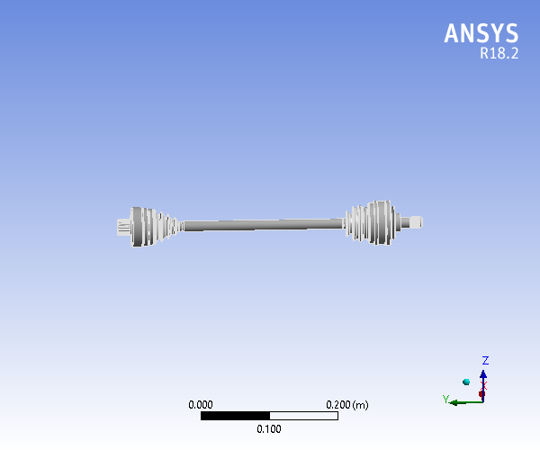
DESIGN OF COMPOSITE SHAFT

Slide 25
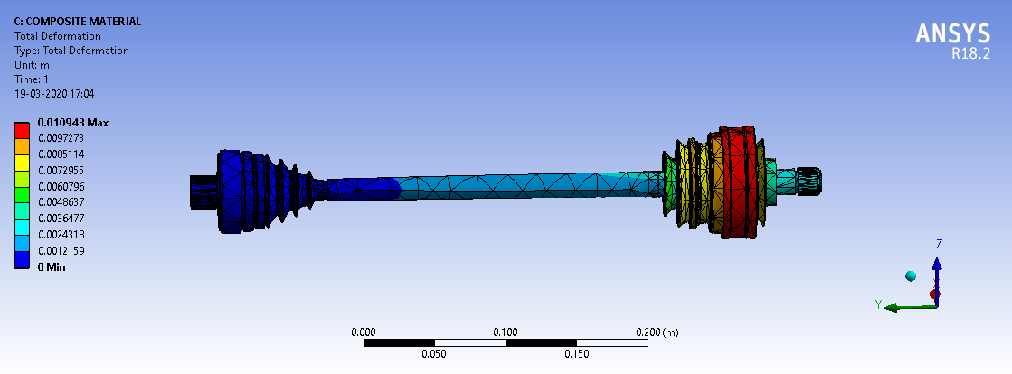
TOTAL DEFORMATION OF COMPOSITE MATERIAL

Slide 26
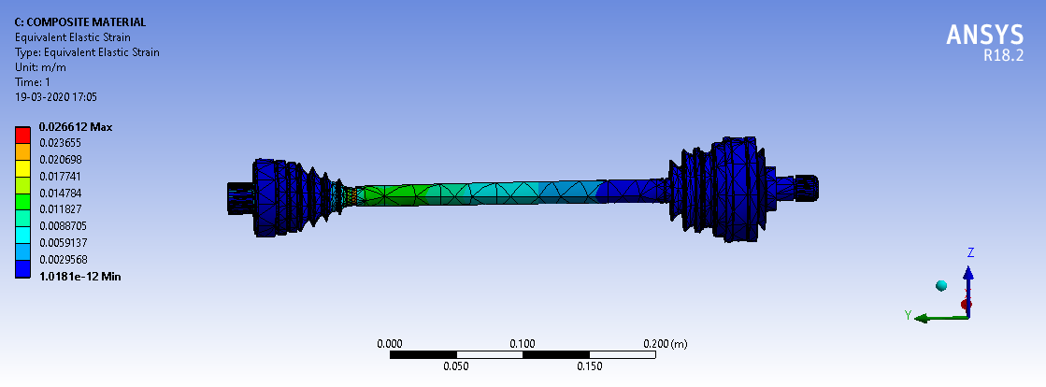
EQUIVELANT ELASTIC STRAIN OF COMPOSITE MATERIAL

Slide 27
PROPERTIES OF COMPOSITE MATERIAL
Property | Metric
Density | 7.6 kg /m³
Modulas of elasticity | 209Gpa
Bulk modulus | 174,4Gpa
Shear modulus | 80.3Gpa
Poisson’s ratio | 0.3
Tensile ultimate strength | 670 Mpa
Tensile yield strength | 450 Mpa

Slide 28
CONCLUSION RESULT AND DISCUSSION
STATIC ANALYSIS | AISI 4140 ALLOY STEEL |  | COMPOSITE MATERIAL
 | minimum | maximum | minimum | Maximum
Total deformation[m] | 0. | 1.1157e-002 | 0. | 1.0943e-002
Equivalent elastic strain[m/m] | 1.035e-012 | 2.7131e-002 | 1.0181e-012 | 2.6612e-002
Equivalent stress[pa] | 0.14394 | 5.3702e+009 | 0.14485 | 5.9702e+009

Slide 29
MODAL ANALYSIS OF MATERIAL
MODAL ANALYSIS
AISI 4140 ALLOY STEEL |  |  | COMPOSITE MATERIAL
Node | Total deform | Frequency | Node | Total deform | Frequency
1 | 34.526 | 957.09 | 1 | 35.49 | 993.34
2 | 34.568 | 992.68 | 2 | 35.39 | 1030.3
3 | 44.284 | 8556.2 | 3 | 45.52 | 8880.3
4 | 54.318 | 12230 | 4 | 55.839 | 12693
5 | 54.244 | 12330 | 5 | 55.757 | 12797
6 | 54.766 | 32258 | 6 | 61.434 | 33480
7 | 59.124 | 32538 | 7 | 62.784 | 33771
8 | 26.789 | 45943 | 8 | 35.259 | 47683
9 | 54.919 | 53190 | 9 | 68.12 | 55204

Slide 30
CONLUSION The analysis of AISI 4140 alloy steel and composite material for analysis of static and modal analysis was done by using ANSYS software R18.2 version The analysis of composite material for static and modal analysis was done using ANSYS software R18.2 version The total deformation, equivalent elastic strain and equivalent stress are analysed for both AISI 4140 alloy steel and composite material are to be analysed. That also show the total deformation, equivalent elastic strain and equivalent stress of composite material is better than AISI 4140 alloy steel The properties of composite material also better than AISI 4140 alloy steel So we are improve the material property that is done by ANSYS software for composite materials that we are suggest the more applications of automobiles for using composite material
CONLUSION
The analysis of AISI 4140 alloy steel and composite material for analysis of static and modal analysis was done by using ANSYS software R18.2 version
The analysis of composite material for static and modal analysis was done using ANSYS software R18.2 version
The total deformation, equivalent elastic strain and equivalent stress are analysed for both AISI 4140 alloy steel and composite material are to be analysed.
That also show the total deformation, equivalent elastic strain and equivalent stress of composite material is better than AISI 4140 alloy steel
The properties of composite material also better than AISI 4140 alloy steel
So we are improve the material property that is done by ANSYS software for composite materials that we are suggest the more applications of automobiles for using composite material

