Slide 1

Design & Analysis of Combustion System for Diesel Engines
Means & Methods to Promote Matured Combustion….

Slide 2
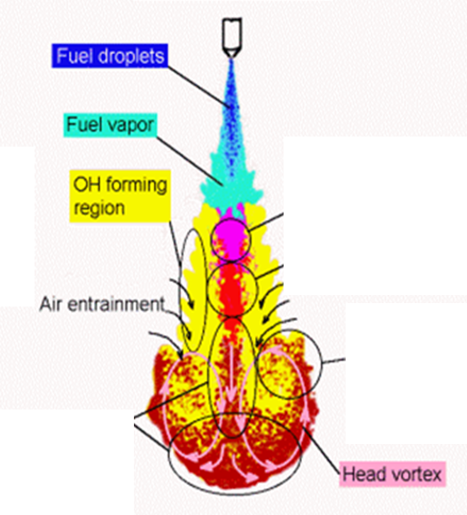
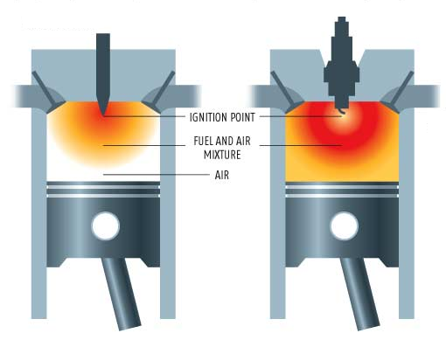
Care for Occurrence of Heat Addition
Occurrence of Heat Addition in SI Engine : A Child Care Event.
Occurrence of Heat Addition in CI Engine: A Teen Care Event.
CI Engine
SI Engine

Slide 3
Type of Fuel Vs Combustion Strategy
Highly volatile with High self Ignition Temperature: Spark Ignition. Ignition after thorough mixing of air and fuel.
Less Volatile with low self Ignition Temperature: Compression Ignition , Almost simultaneous mixing & Ignition.

Slide 4
Compression Ignition Engines
Two basic categories of CI engines:
Indirect-injection Engine – chamber is divided into two regions and the fuel is injected into the “prechamber” which is connected to the main chamber via a nozzle, or one or more orifices.
Direct-injection Engine – have a single open combustion chamber into which fuel is injected directly

Slide 5
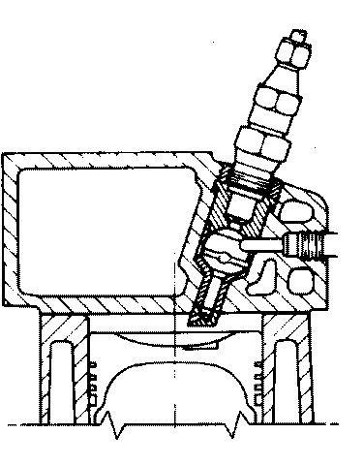
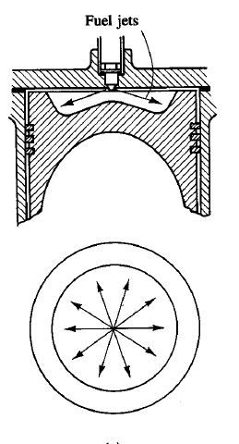
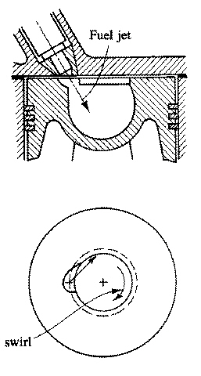
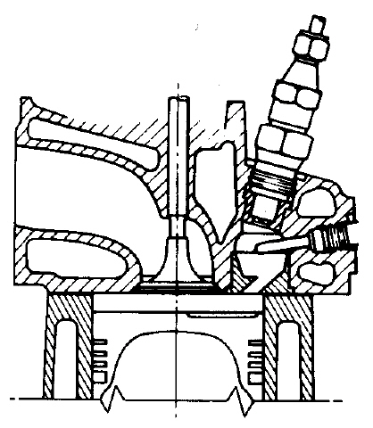
Types of Cylinders for CI Engines
Glow plug
Orifice
-plate
Direct injection:
quiescent chamber
Direct injection:
swirl in chamber
Indirect injection: turbulent
and swirl pre-chamber

Slide 6
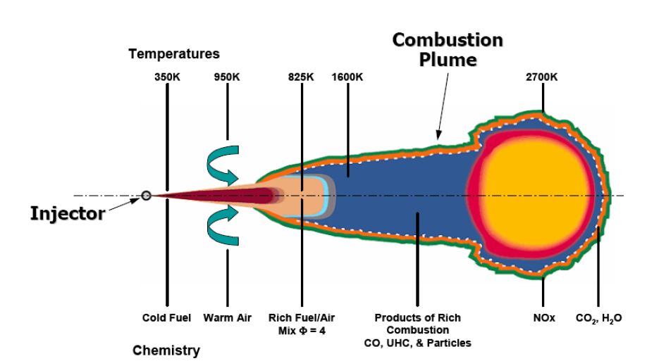
Schematic of a diesel spray & flame with temperatures and chemistry

Slide 7
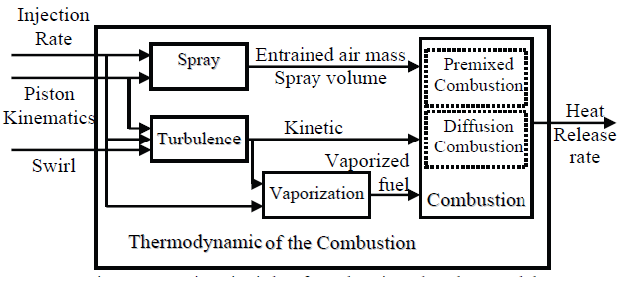
Modeling of Events in CI (Teen) Combustion

Slide 8
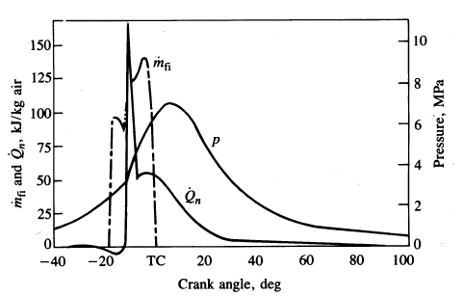
In-Cylinder Processes
This graph shows the fuel injection flow rate, net heat release rate and
cylinder pressure for a direct injection CI engine.
Start of injection
Start of combustion
End of injection

Slide 9
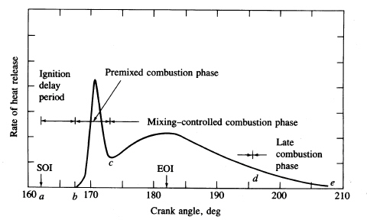
Four Stages of Combustion in CI Engines
Start of
injection
End of
injecction
-20
-10
TC
10
20
30

Slide 10
Combustion in CI Engine
The combustion process proceeds by the following stages:
Ignition delay (ab) - fuel is injected directly into the cylinder towards the end of the compression stroke.
The liquid fuel atomizes into small drops and penetrates into the combustion chamber.
The fuel vaporizes and mixes with the high-temperature high-pressure air.
Start of
injection
End of
injecction
-20
-10
TC
10
20
30

Slide 11
Combustion in CI Engine
Premixed combustion phase (bc) – combustion of the fuel which has mixed with the air to within the flammability limits (air at high-temperature and high-pressure) during the ignition delay period occurs rapidly in a few crank angles.
Start of
injection
End of
injecction
-20
-10
TC
10
20
30

Slide 12
Mixing controlled combustion phase (cd) – after premixed gas consumed, the burning rate is controlled by the rate at which mixture becomes available for burning.
The burning rate is controlled primarily by the fuel-air mixing process.
Start of
injection
End of
injecction
-20
-10
TC
10
20
30

Slide 13
Mixing controlled combustion phase (cd) – after premixed gas consumed, the burning rate is controlled by the rate at which mixture becomes available for burning.
The burning rate is controlled primarily by the fuel-air mixing process.
Late combustion phase (de) – heat release may proceed at a lower rate well into the expansion stroke (no additional fuel injected during this phase).
Combustion of any unburned liquid fuel and soot is responsible for this.
Start of
injection
End of
injecction
-20
-10
TC
10
20
30

Slide 14
Ignition Delay
Ignition delay is defined as the time (or crank angle interval) from when the fuel injection starts to the onset of combustion.
Both physical and chemical processes must take place before a significant fraction of the fuel chemical energy is released.
Physical processes are fuel spray atomization, evaporation and mixing of fuel vapour with cylinder air.
Good atomization requires high fuel pressure, small injector hole diameter, optimum fuel viscosity, high cylinder pressure (large divergence angle).
Rate of vaporization of the fuel droplets depends on droplet diameter, velocity, fuel volatility, pressure and temperature of the air.
Chemical processes: Autoignition phenomenon in premixed fuel-air.
Complex heterogeneous reactions (reactions occurring on the liquid fuel drop surface) also occur.

Slide 15
Ignition Delay
The ignition characteristics of the fuel affect the ignition delay.
The ignition quality of a fuel is defined by its cetane number CN.
For low cetane fuels the ignition delay is long and most of the injected fuel is accumulated in the cylinder before autoignition .
This leads to rapid combustion.
Under extreme cases, this produces an audible knocking sound referred to as “diesel knock”.

Slide 16
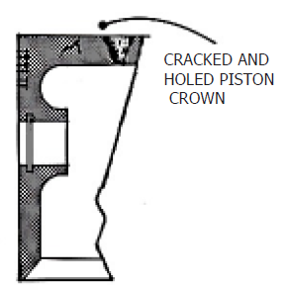
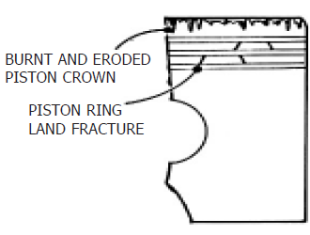
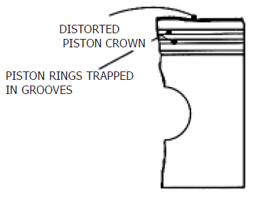
Combustion Problems in Diesel Engine

Slide 17
Cetane Number
The cetane number scale is defined by blends of two pure hydrocarbon reference fuels.
For high cetane fuels the ignition delay is short and very little fuel is injected before autoignition,
The heat release rate is controlled by the rate of fuel injection and fuel-air mixing – smoother engine operation.
By definition, cetane (n-hexadecane, C₁₆H₃₄) has a value of 100.
In the original procedures α-methylnaphtalene (C₁₁H₁₀) with a cetane number of zero represented the bottom of the scale.
This has since been replaced by heptamethylnonane, (HMN) has a cetane number of 15, which is a more stable compound.
The higher the CN the better the ignition quality, i.e., shorter ignition delay.
The cetane number is given by:
CN = (% hexadecane) + 0.15 (% HMN)

Slide 18
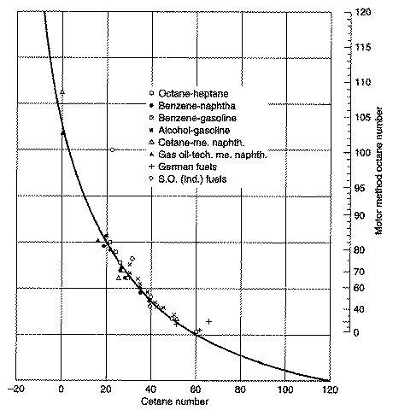
Cetane Number versus Octane Number
The octane number and cetane number of a fuel are inversely correlated.
Octane-heptane
Alcohol-gasoline
Cetane motor method octane number
Cetane number
Gasoline is a poor diesel fuel and vice versa.

Slide 19
Hard Ware Design Factors Affecting Ignition Delay Time
Injection timing – At normal engine conditions the minimum delay occurs with the start of injection at about 10-15 BTC.
Earlier or later injection timing results in a lower air temperature and pressure during the delay period → increase in the ignition delay time.
Injection quantity – For a CI engine the air is not throttled so the load is varied by changing the amount of fuel injected.
Increasing the load (bmep) increases the residual gas and wall temperature which results in a higher charge temperature at injection → decrease in the ignition delay.
Intake air temperature and pressure – an increase in ether will result in a decrease in the ignition delay, an increase in the compression ratio has thesame effect.

Slide 20
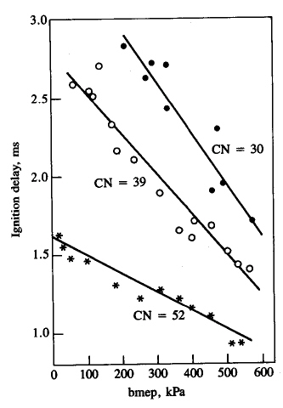
Thermodynamic Factors Affecting Ignition Delay

Slide 21
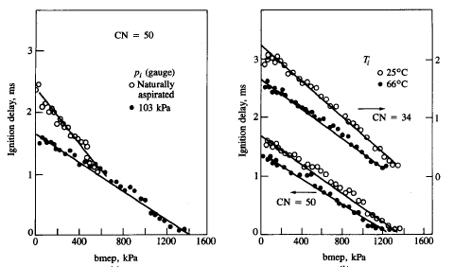
Thermodynamic Factors Affecting Ignition Delay
(gauge)

