Slide 1
WELCOME CFD ANALYSIS OF SHELL AND TUBE HEAT EXCHANGER

Slide 2
ABSTRACT
A heat exchangers of water is proposed with simplified model for the study of thermal analysis of shell and tubes.
Shell and tube heat exchangers are having special significance in boilers, power plants, condensers, turbines.
In this paper, the shell and tube heat exchanger is considered in which hot water is flowing inside one tube and cold water runs over that tube.
For variation we are analyzing with different velocities of inlet for hot fluid.

Slide 3
LITERATURE REVIEW
S. No. | Title | Authot | About
1. | Shell and Tube Heat Exchanger Performance Analysis | Durgesh Bhatt1, Priyanka M Javhar2 | A heat exchanger is a device that is used to transfer thermal energy (enthalpy) between two or more fluids, at different temperatures and in thermal contact. In this problem of heat transfer involved the condition where different constructional parameters are changed for getting the performance review under different conditionIn current paper the baffle spacing and tube metallurgy are the parameters considering change and effect of the same of heat transfer coefficient have been considered.
2. | THERMAL ANALYSIS OF SHELL AND TUBE HEAT EXCHANGER | Mr. M.D.Rajkamal 1,M. Mani Bharathi2, Shams Hari Prasad M3, Santhosh Sivan.M4, Karthikeyan.S5 r.H.Bahruteen Ali Ahamadu6 S.KALIAPPAN 7 Dr.T.Mothilal 8 | A helical coil heat exchanger with a helix angle of 30o using CREO software was designed and fabricated. Nowadays copper is replaced by Carbon steel in industries. Presently the objective is to use ANSYS CFX 15.0 software to infer the replacability of copper with two different inner tube materials such as POCO HTC graphite and ASTM SA 179 carbon steel which also has appreciable heat transfer characteristics and good corrosion resistance than copper. A laminar hot fluid flow is the heat source medium. Also the increase in heat transfer rate with increase in mass flow rate is also observed.

Slide 4
LITERATURE REVIEW
S. No. | Title | Authot | About
1. | Comparative Thermal Analysis of Shell and Tube Heat Exchanger using Bell Coleman Method and CFD | PowarDigvijay D1, Dr. G.Manavendra2 | Design, analysis and optimization of shell and tube heat exchanger using Bell Coleman Method and CFD. Design variables: tube outer diameter, tube pitch, tube length, number of tube passes, no of shell, shell head type, shell layout, baffle spacing and baffle cut are taken for optimization. Bell’s method is used to find the heat transfer area for a given design configuration. The optimal analysis be the one tube, sectional one tube and sectional heat exchanger.
2. | Design and CFD Analysis of Shell and Tube Heat Exchanger | Mohammed Irshad1, Mohammed Kaushar2, G. Rajmohan3 | The objective of this project is to design a shell and tube heat exchanger with segmental baffles and to study the flow and temperatures inside the shell and tubes using ANSYS software tool for the different baffles assemblies and orientation also overall heat transfer is calculated for each design. This project totally contains 5 designs for comparison. The process in solving simulation consists of modelling and meshing the basic geometry of shell and tube heat exchanger using CFD package ANSYS 14.5. The heat exchanger contains 7 tubes and 600mm length and 90mm shell diameter. In simulation we will show how the temperature, pressure, velocity varies in shell due to different baffles orientation.

Slide 5
OBJECTIVE
To analyze the heat transfer rate between counter flow and parallel flow with various inlet velocities
To identify the importance of providing fins instead of plain tube

Slide 6
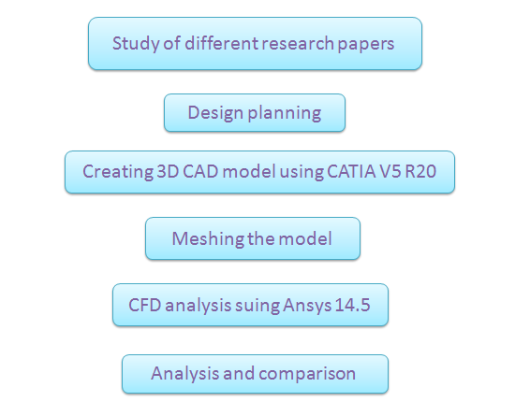
METHODOLOGY

Slide 7
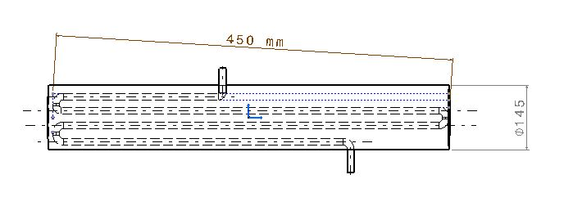
2D DESIGN

Slide 8
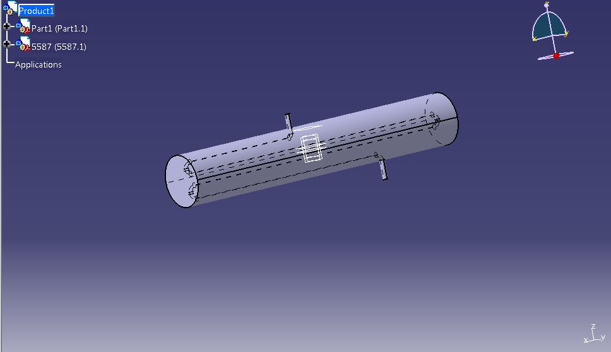
3D DESIGN

Slide 9
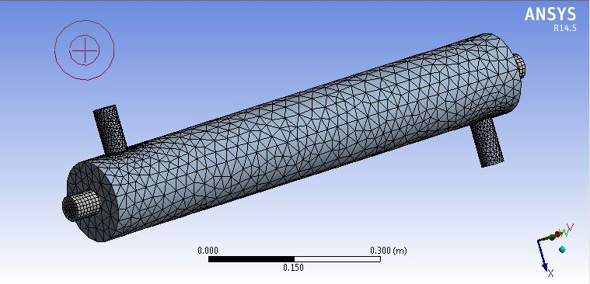
MESHED PART

Slide 10
RESULT
The heat transfer and flow distribution is discussed in detail. From CFD simulation results, for fixed tube wall and shell inlet temperatures, shell side heat transfer coefficient, pressure Baffle inclination angle(degree) Logarithmic Mean Temperature Difference (LMTD) (ΔT)moC 0o inclination 19.31 0o with shell and baffle gap 21.72 20oinclination 17.27 30o inclination 15.24 40o inclination 10.02 Baffle inclination angle(degree) Max pressure Pa Min pressure Pa Pressure Difference Pa 0o without leakage 20.83 -2.313 23.143 0o with leakage 11.29 -2.28 13.57 20o inclination 19.03 -2.558 21.588 30o inclination 17.84 -2.63 20.47 40o inclination 16.96 -1.653 18.613 International Journal of Engineering Science and Computing, April 2017 6457 http://ijesc.org/ drop and heat transfer rate values are obtained. From the CFD result it is observed that the heat exchanger without any short- circuited flow has the higher heat transfer coefficient than the heat exchanger with leakage.

Slide 11
REFERENCE
Jian-Fei Zhang, Experimental performance comparison of shell-side heat transfer for shell-and-tube heat exchangers with middle-overlapped helical baffles and segmental baffles, Chemical Engineering Science 64 (2009) 1643 – 1653.
Pooja J. Pawar, Experimental investigation of shell-and-tube heat exchanger with different type of baffles, International Journal of Current Engineering and Technology Accepted 15 June 2016, Available
Ender Ozden-Shell side CFD analysis of a small shell-and-tube heat exchanger, Energy Conversion and Management 51 (2010) 1004–1014
Simin Wang, An experimental investigation of heat transfer enhancement for a shell-and-tube heat exchanger, Applied Thermal Engineering 29 (2009) 2433–2438
Andre´ L.H. Costa, Design optimization of shell-and-tube heat exchangers, Applied Thermal Engineering 28 (2008) 1798–1805.
B.Jayachandriah, Thermal Analysis of Tubular Heat Exchangers Using ANSYS, International Journal of Engineering Research Volume No.3 Issue No: Special 1, pp.: 21-25 22nd March 2014
Karno, A., and Ajib, S., 2006, “Effect of tube pitch on heat transfer in shell-and- tube heat exchangers—new simulation software Heat Mass Transfer 42, pp. 263–272.

